Slide 1
TARs with Uniquely mapped reads
Whole cell polyA+ RNA-seq
Human:
90% exon disc. rate: 375,156,282 (13%)
95% exon disc. rate: 642,840,821 (22%)
98% exon disc. rate: 926,657,303 (32%)
All compartments total RNA-seq
Human
98% exon disc. rate: 1,302,489,521 (45%)
Expressed RPKM set to 0.01.

Slide 2
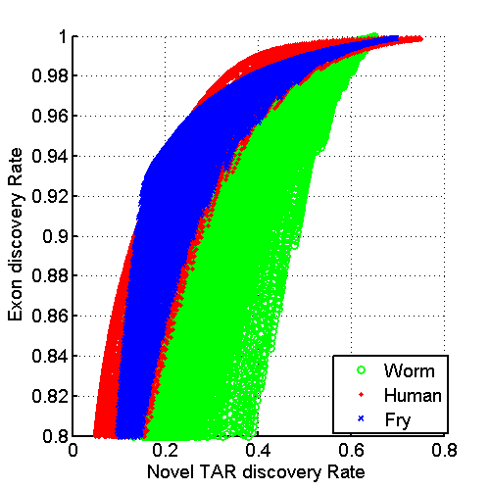
ROC

