Slide 1
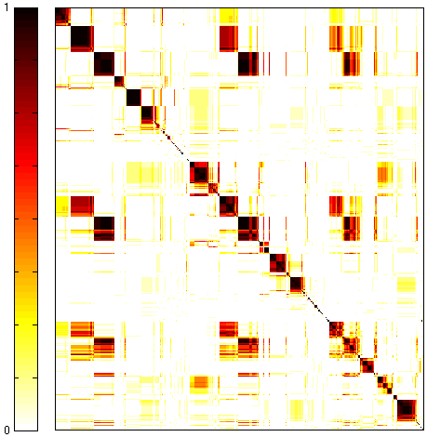
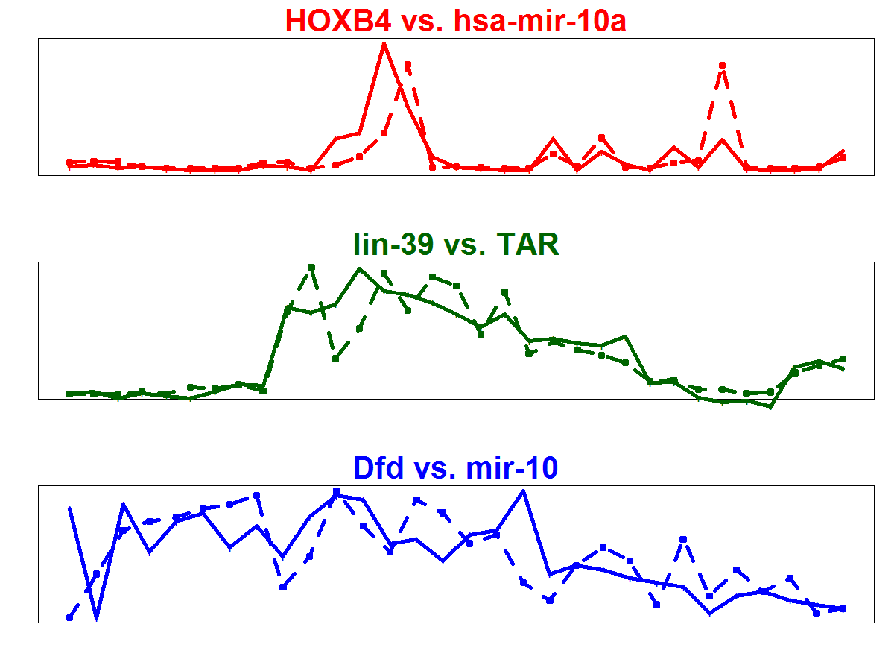
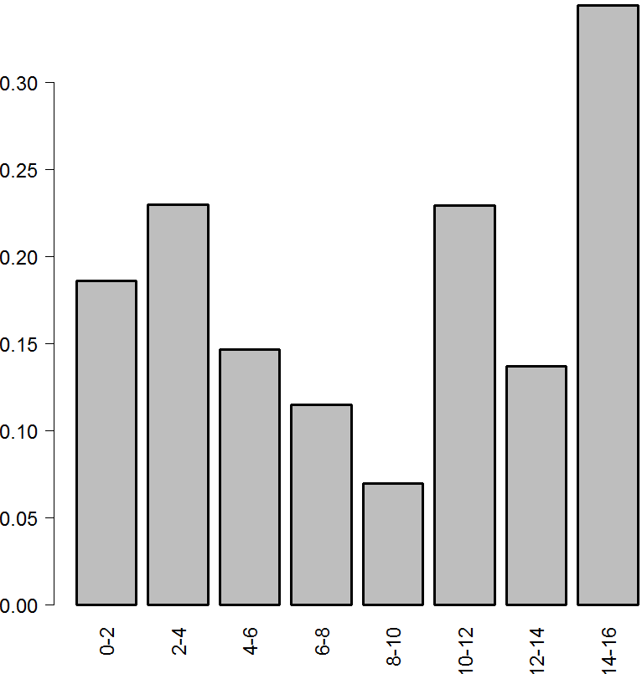
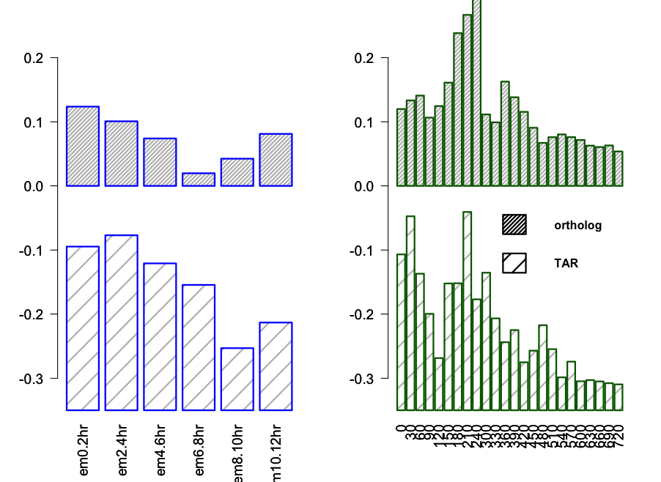
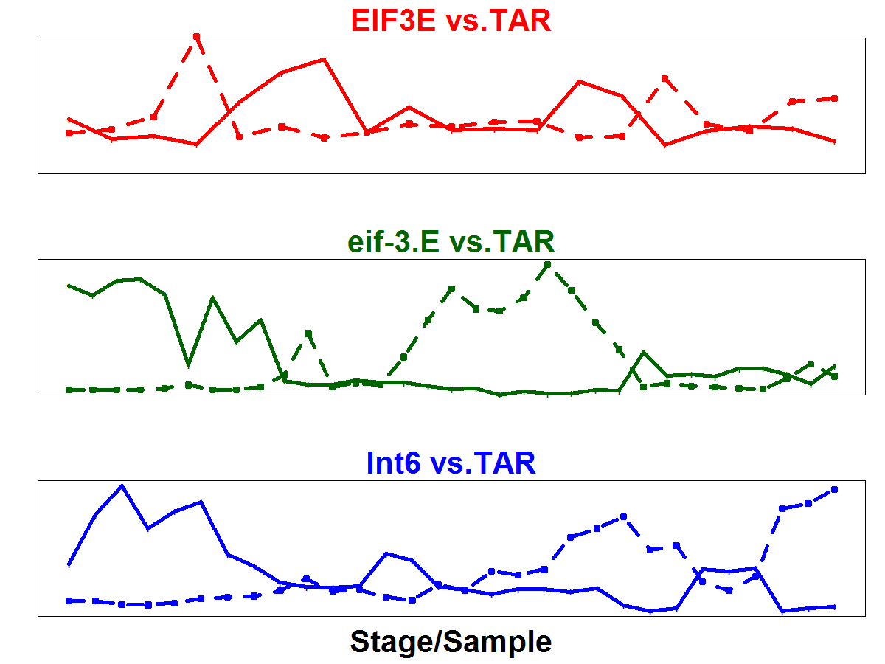
A
Human
Worm
Fly
1
highly conserved module O
99
144
99
58
49
22
51
1059
orthologs
Co-expressed TARs
B
Conservation in # of species
co-appearance frequency (normalized)
worm-specific module
2 ncRNAs + TAR
Zero orthologs
0
Expression
Ortholog
ncRNA/TAR
C
IQR of gene expressions across fly species
IQR of gene expressions across modules
3 TARs
D
Notes:
|cor| ncrna tar
H >0.65 >0.9
W >0.65 >0.9
F >0.65 >0.9

Slide 2
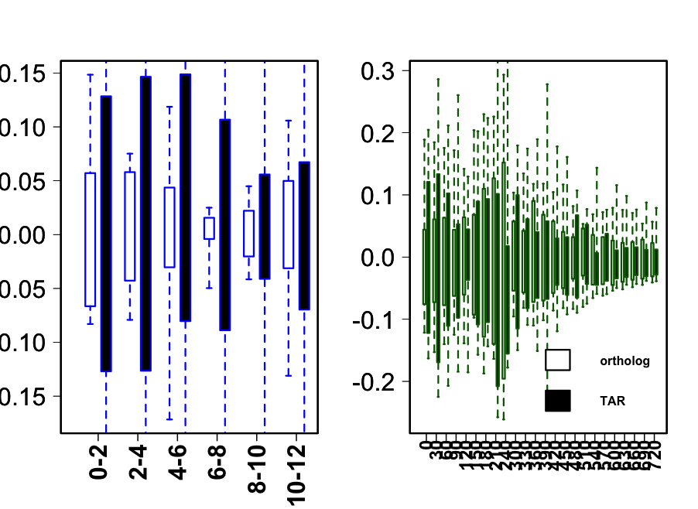
A
1
highly conserved module
worm-specific module
B
58
99
144
99
49
22
51
1059
0
Co-expressed
TARs
Co-appearance frequency (normalized)
2 ncRNAs + TAR
0
C
Ortholog
ncRNA/TAR
IQR of gene expressions across fly species
gene expressions across modules
3 TARs
3 TARs
D

Slide 3
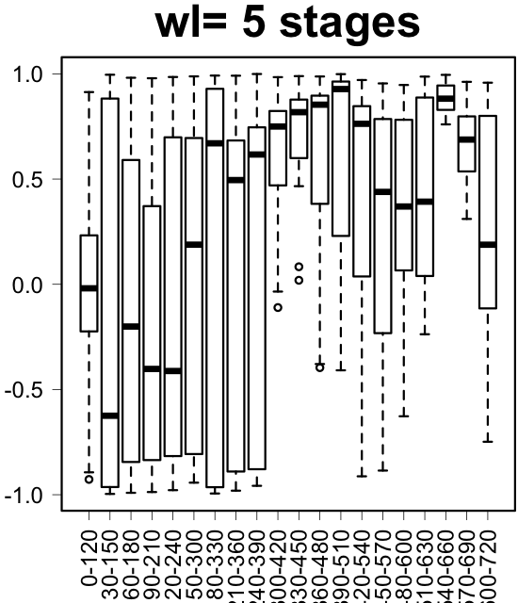
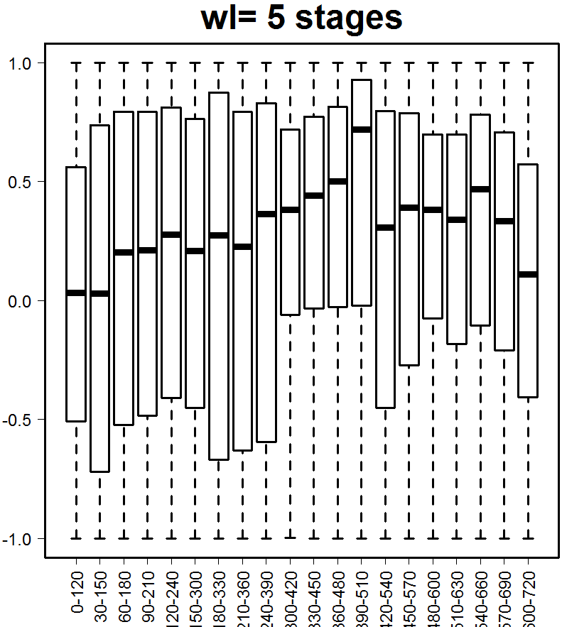
Correlations among from cons. modules per 2 hours (5 stages)
1175 genes (deg. > 30)
eigengenes of
7 cons. modules

Slide 4
Worm eigengenes of 7 cons. modules

Slide 5
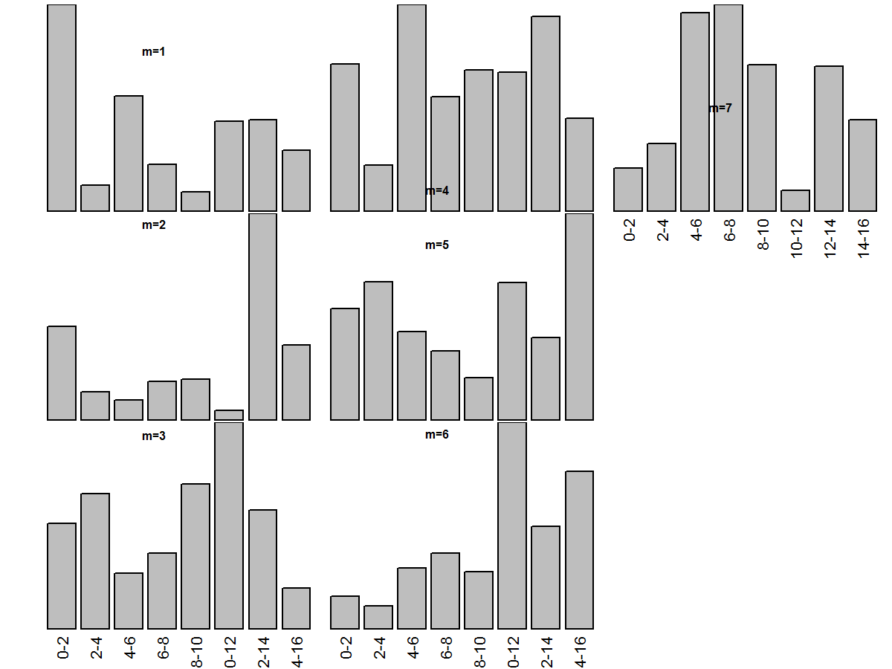
IQR of gene expressions across fly species

Slide 6
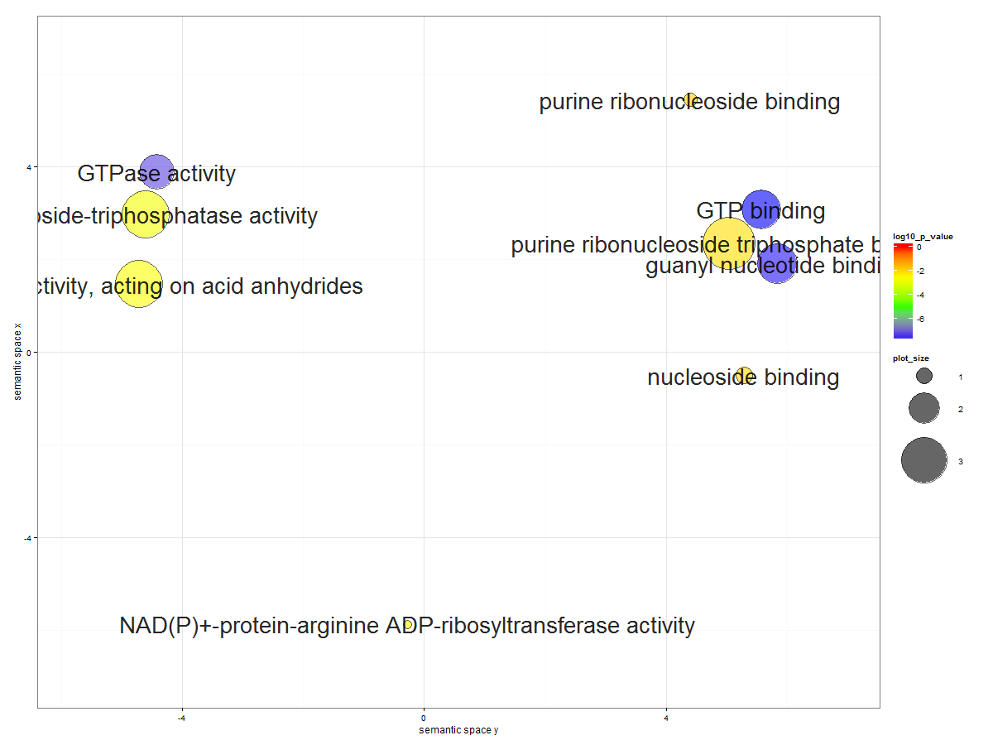
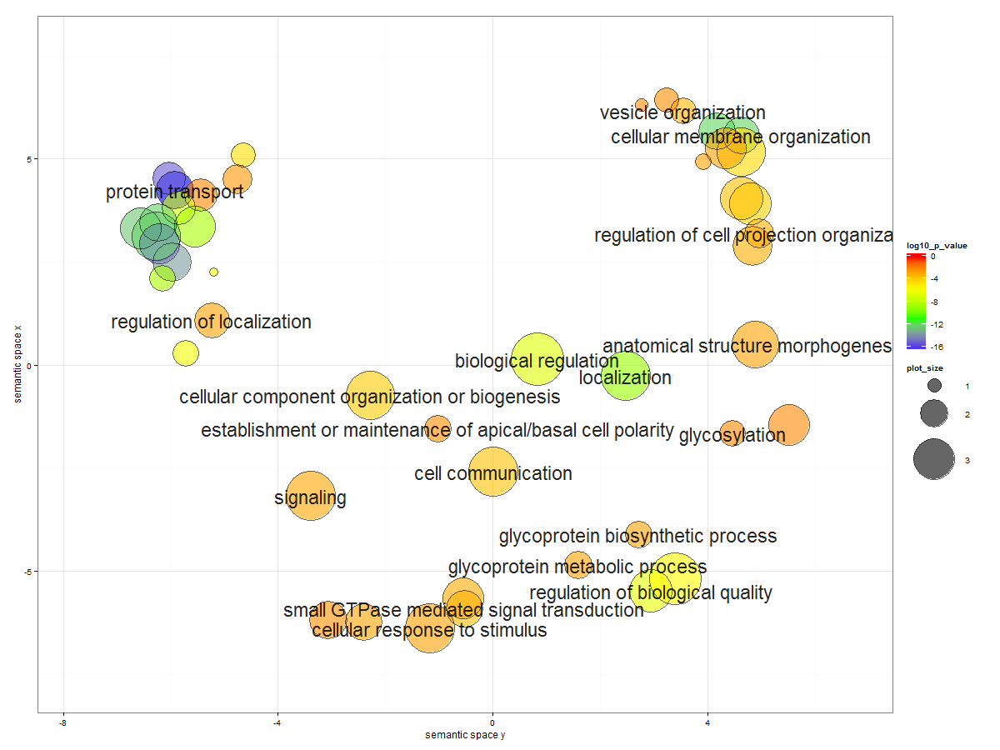
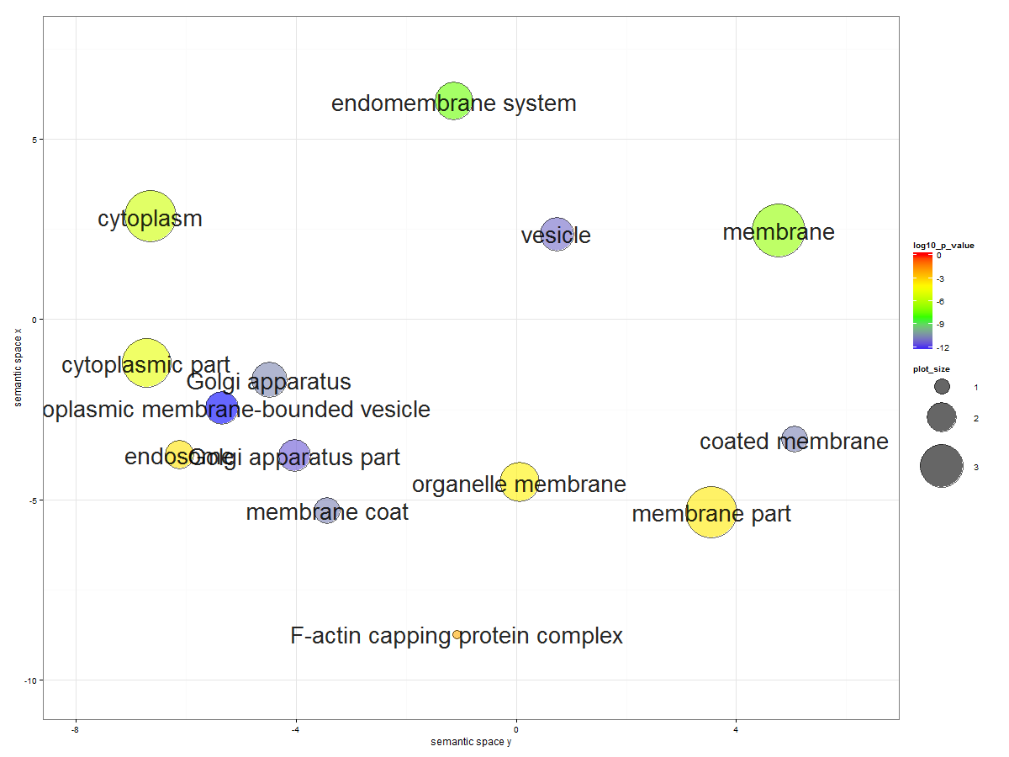
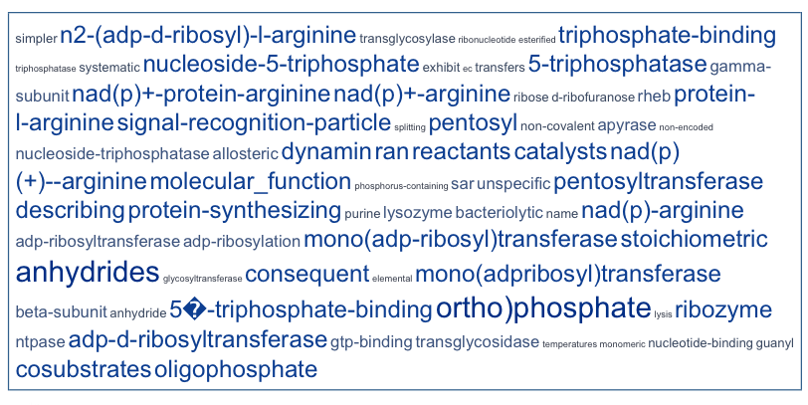
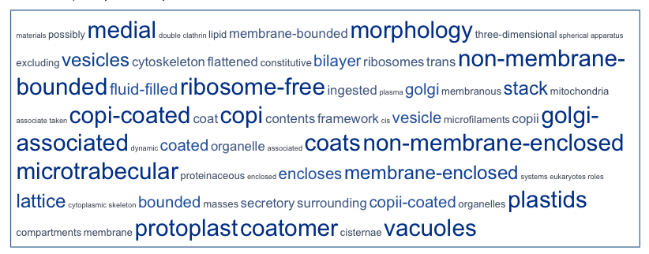
Module 1 (119 fly genes*)
Function
Process
Component
* deg. of conservation > 50

Slide 7
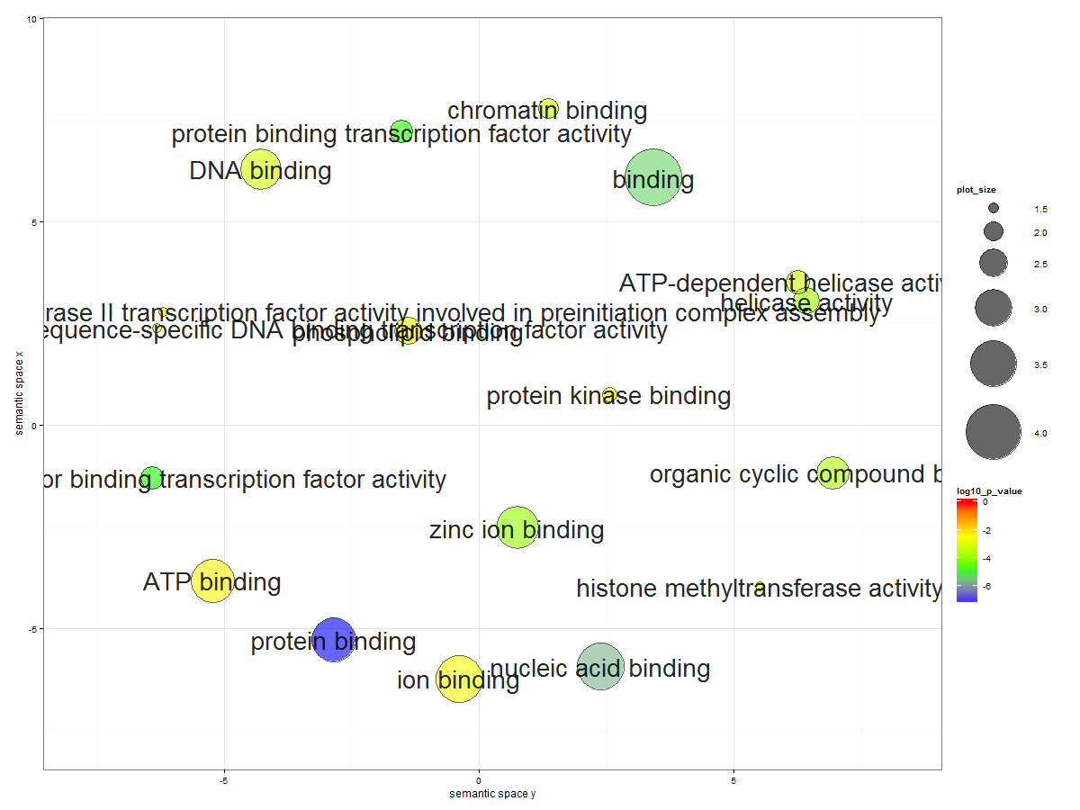
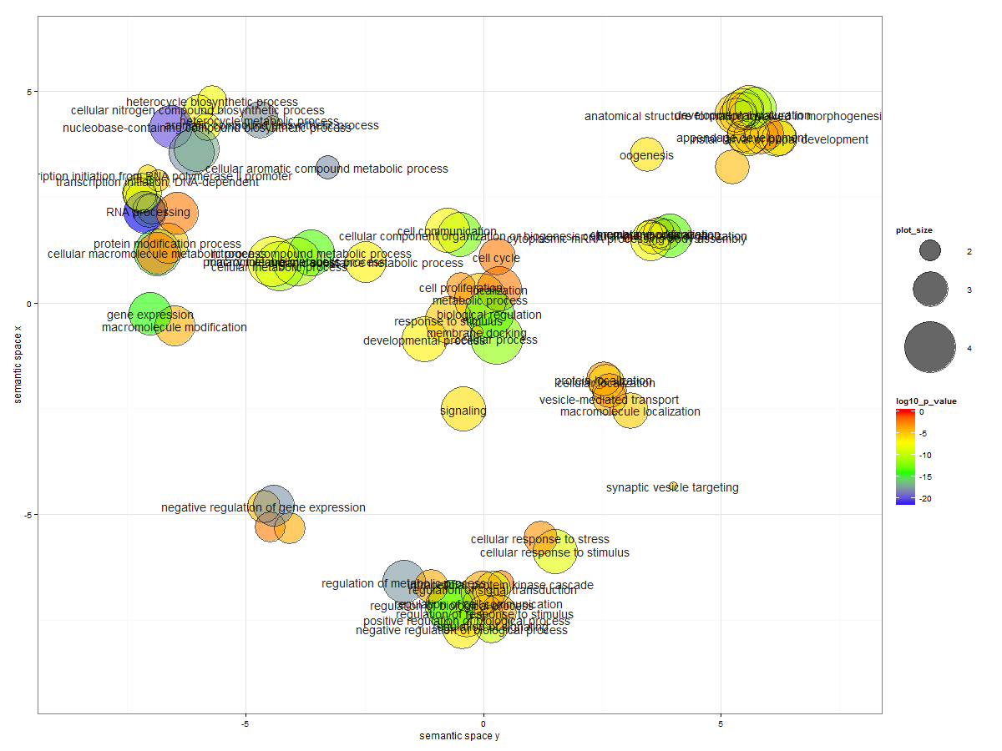
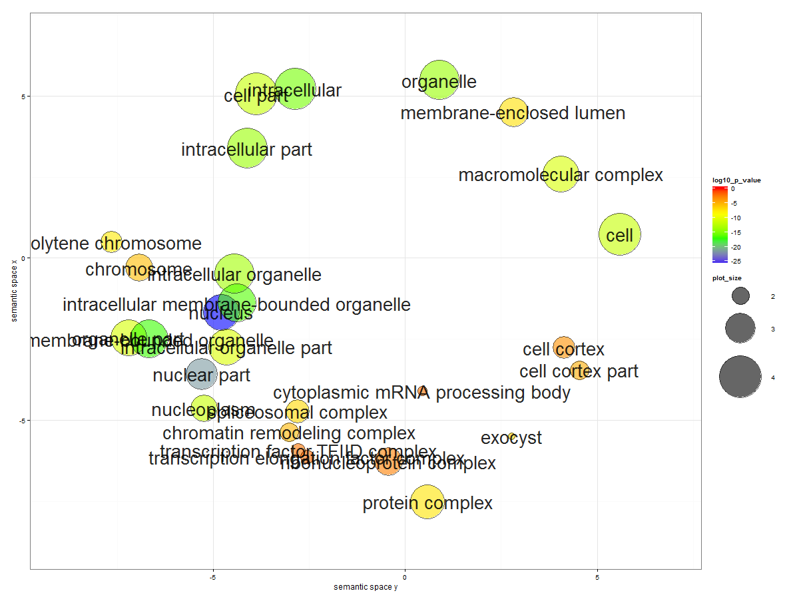
Module 2 (243 fly genes*)

Slide 8
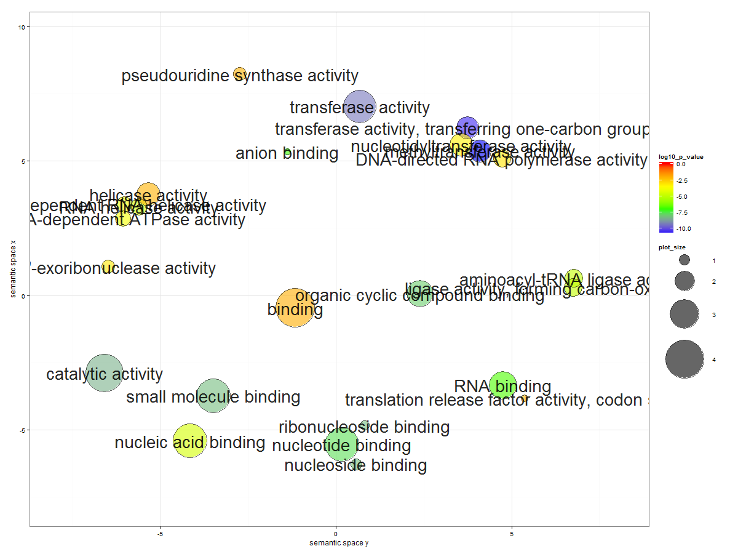
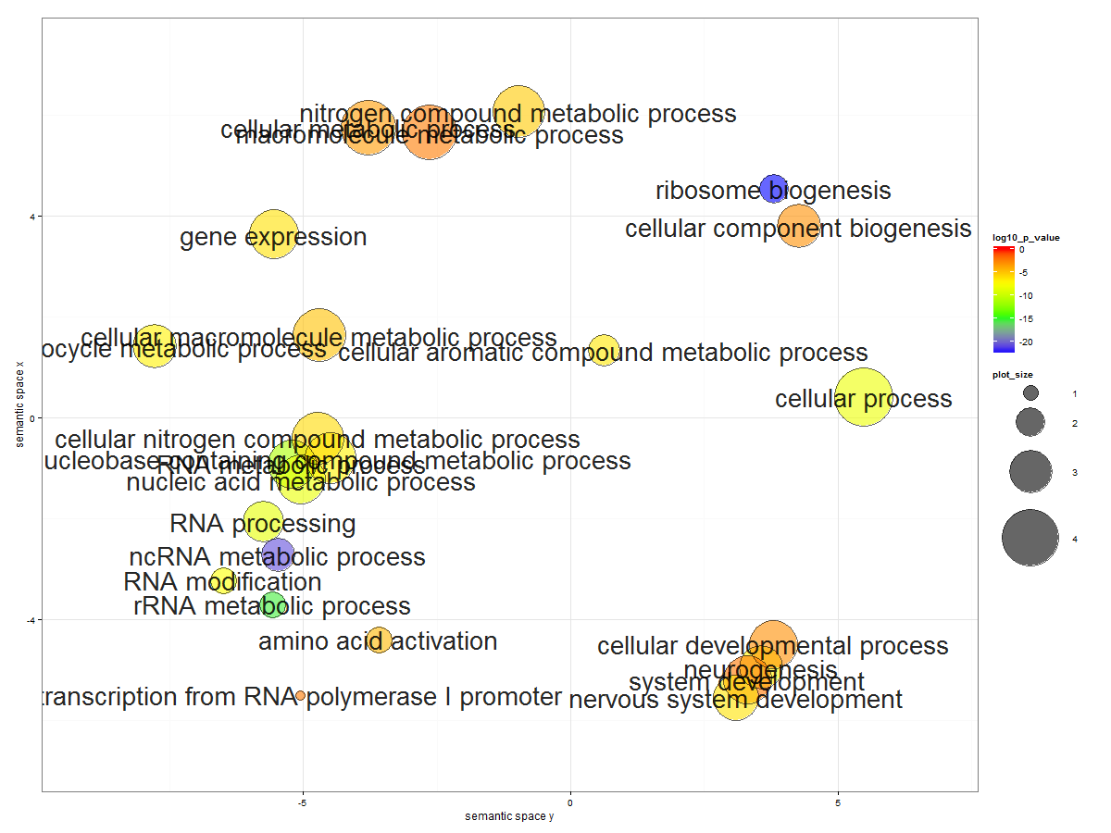
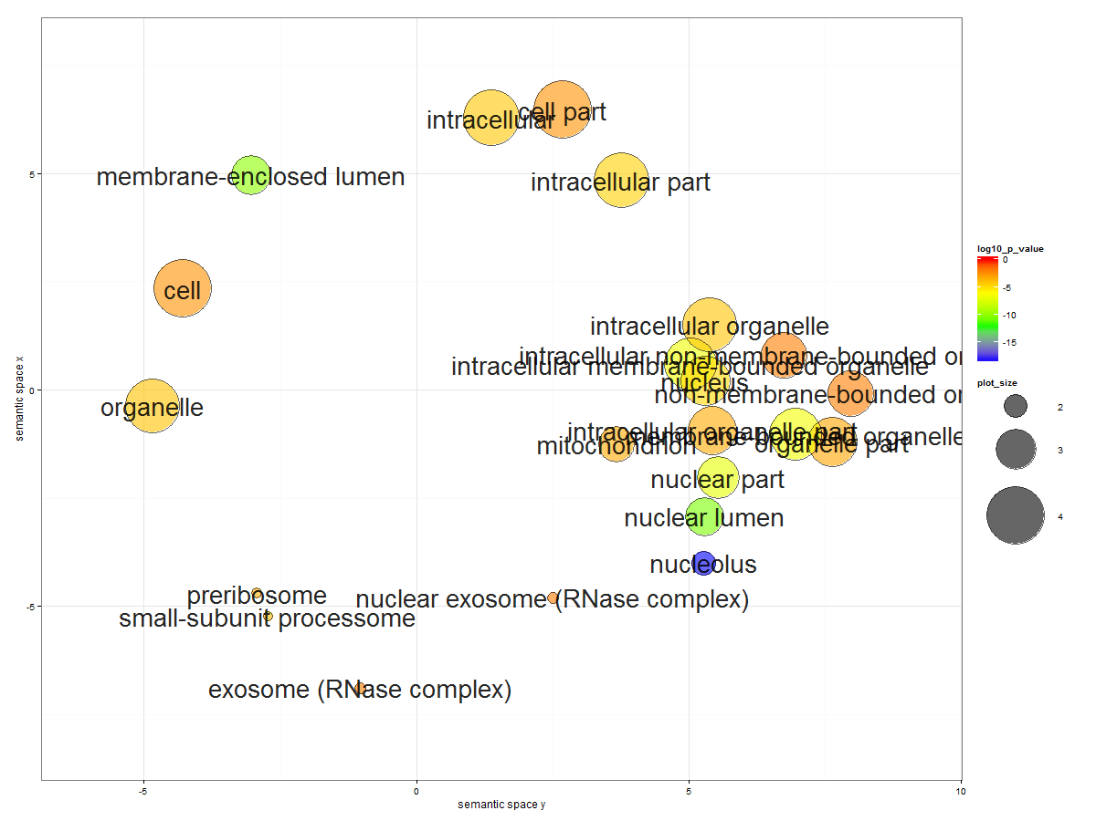
Module 3 (137 fly genes*)

Slide 9
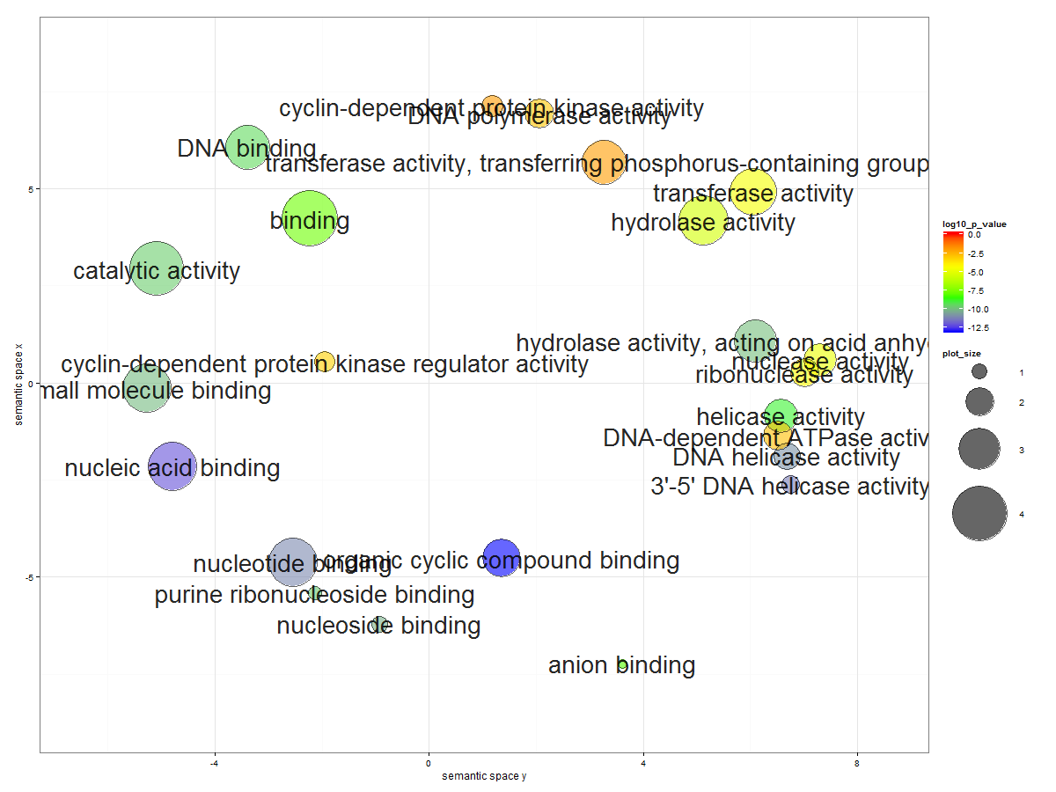
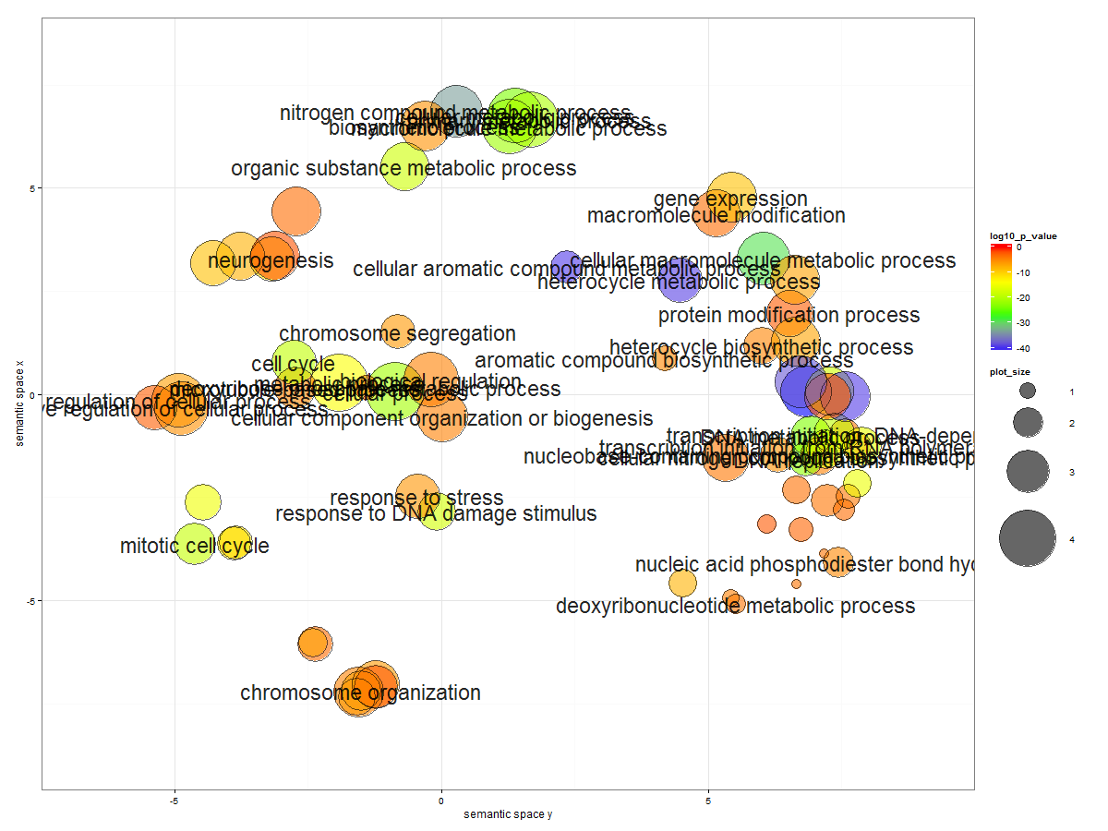
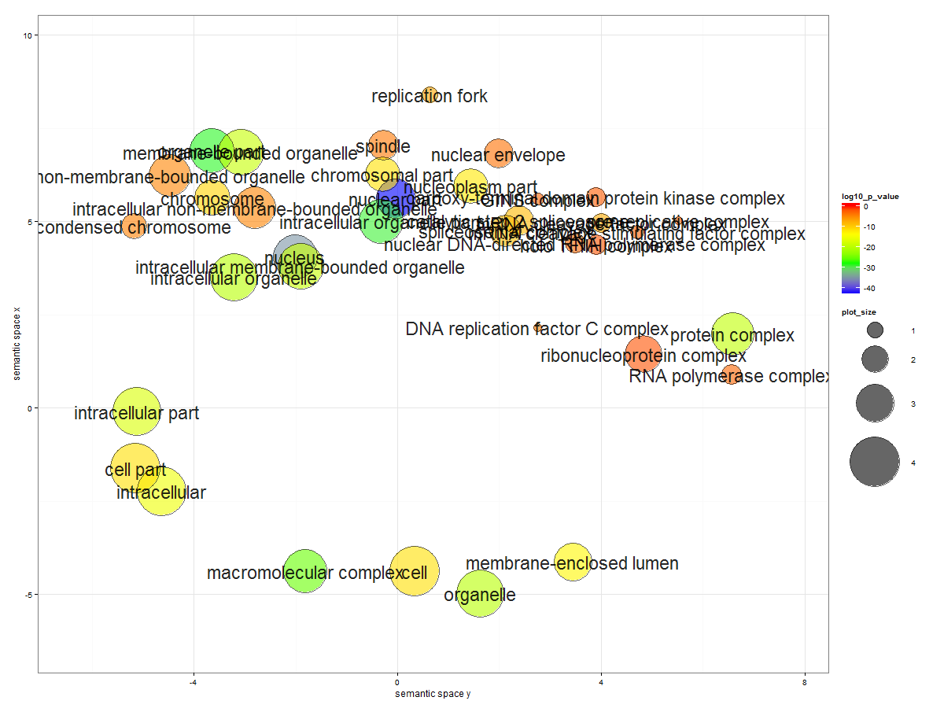
Module 4 (169 fly genes*)

Slide 10
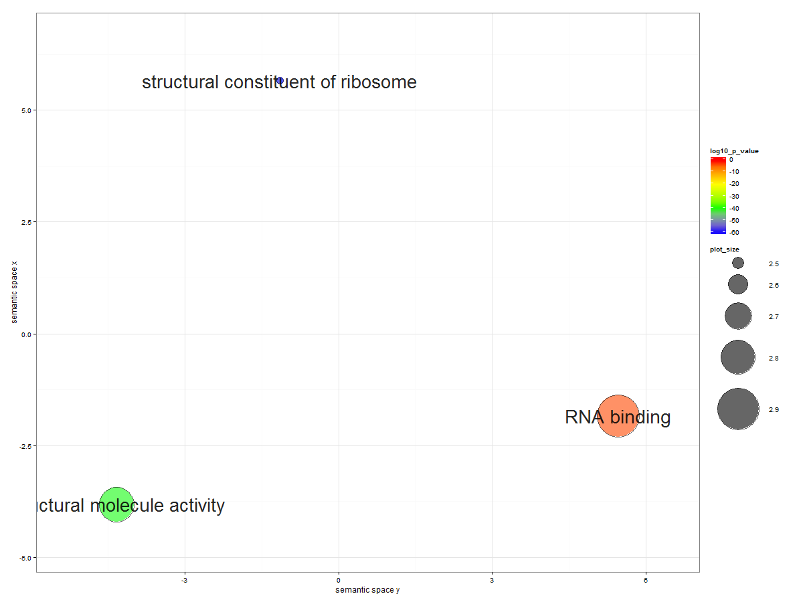
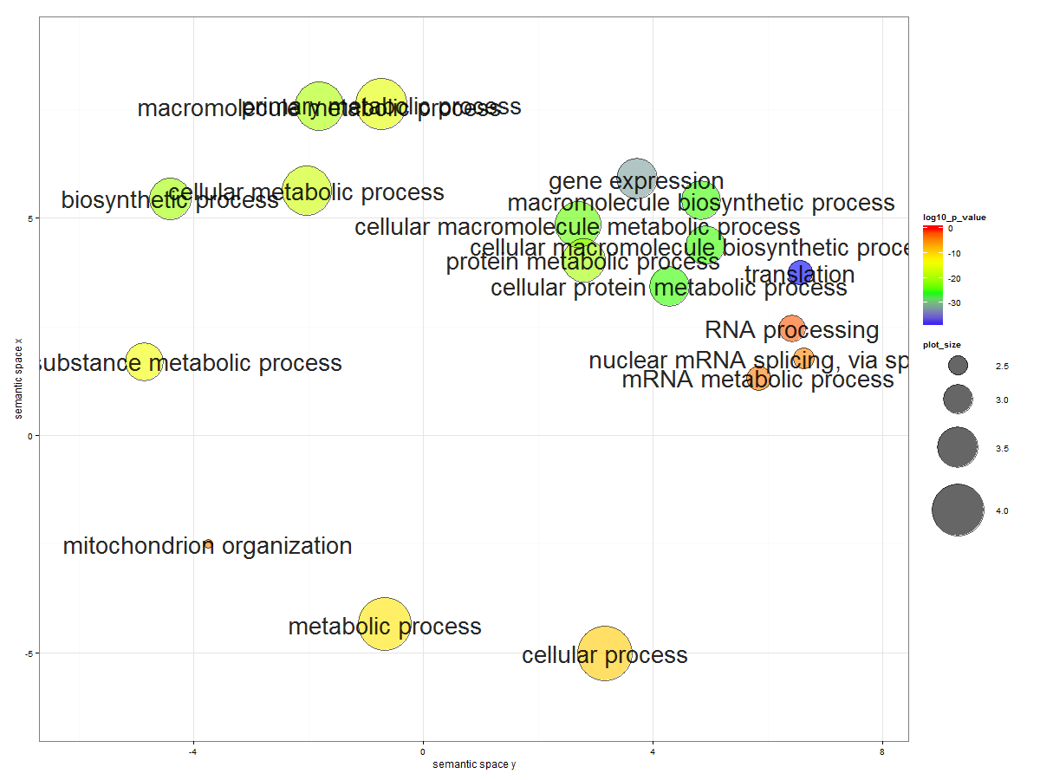
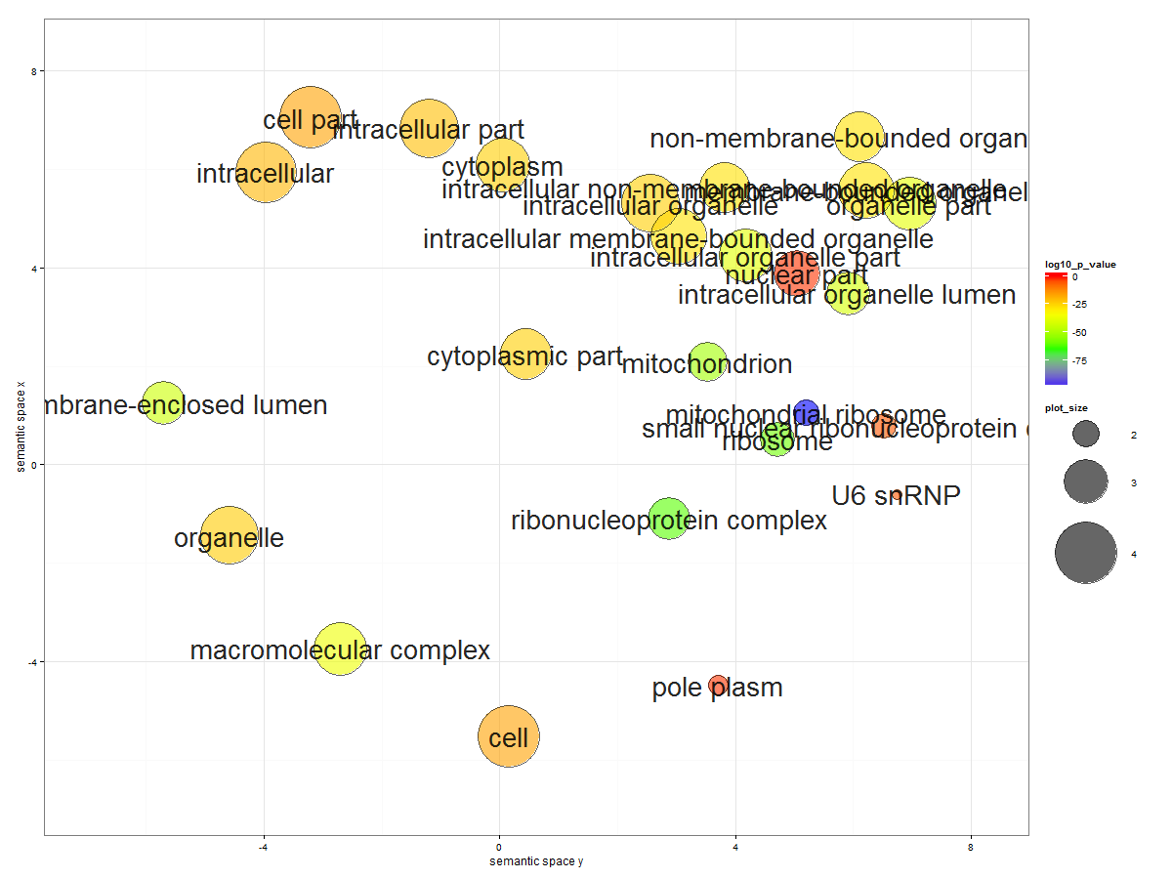
Module 5 (58 fly genes*)

Slide 11
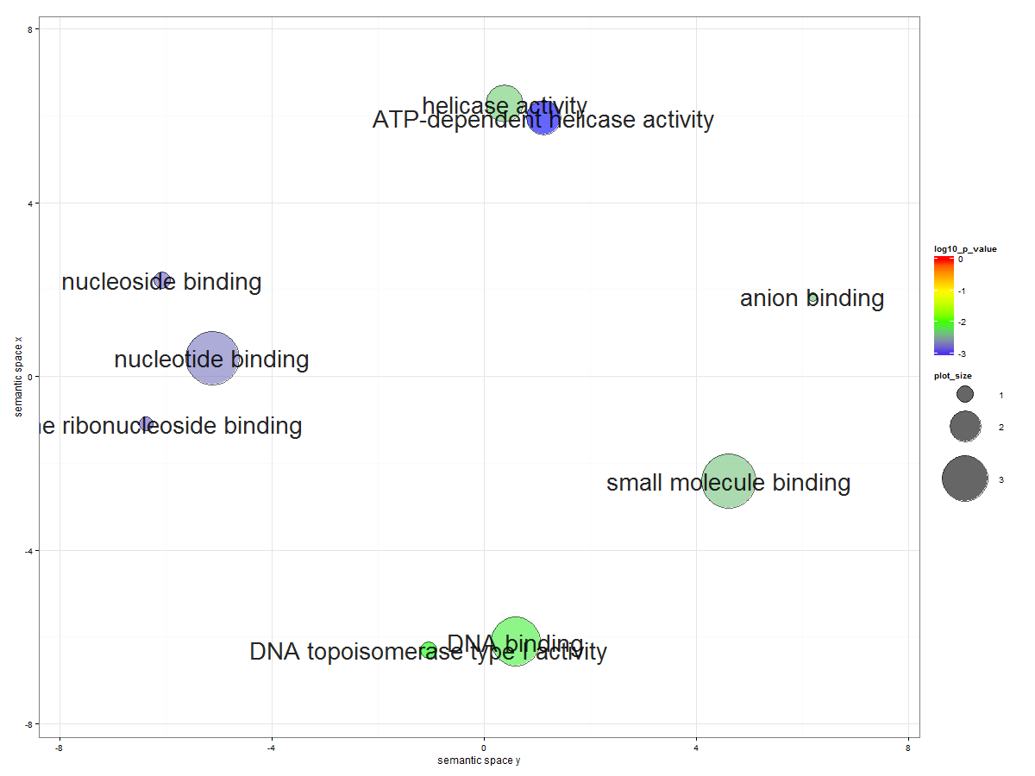
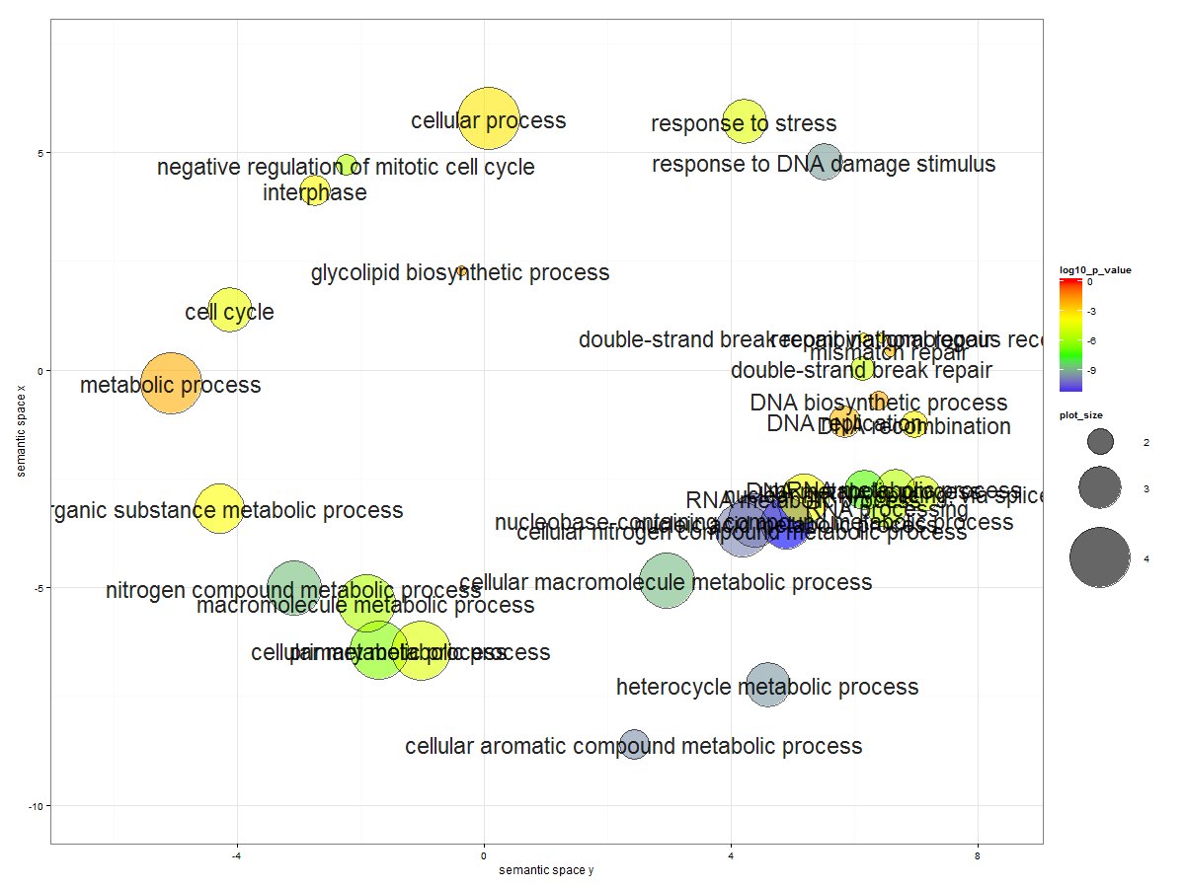
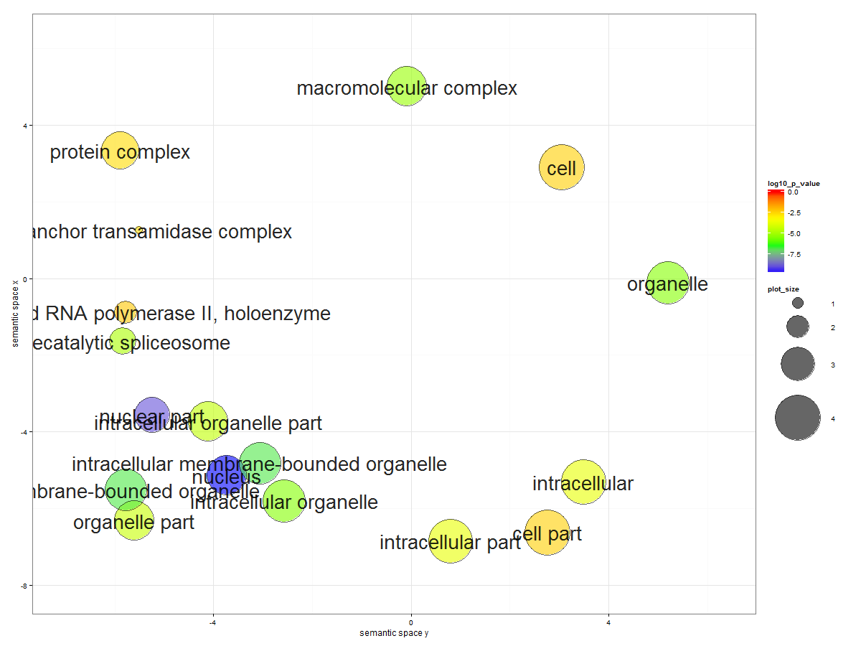
Module 6 (66 fly genes*)

Slide 12
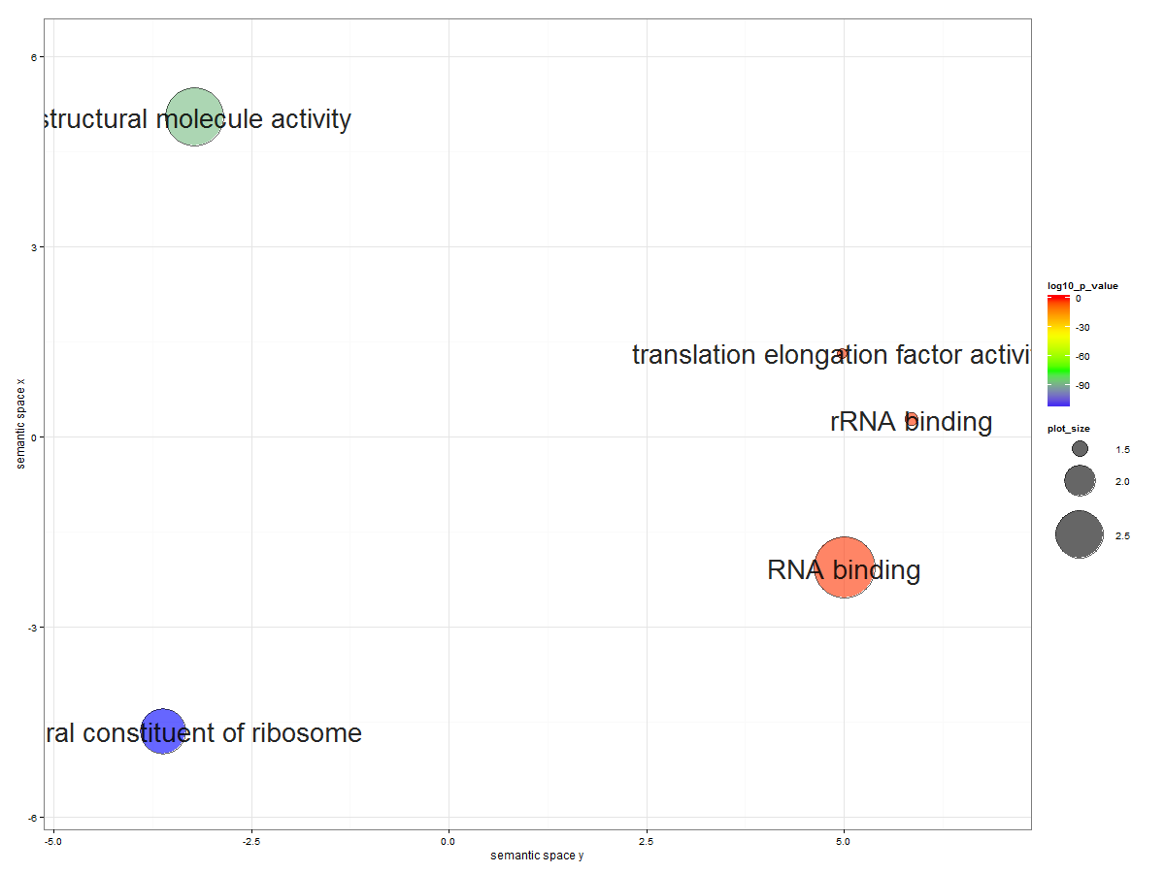
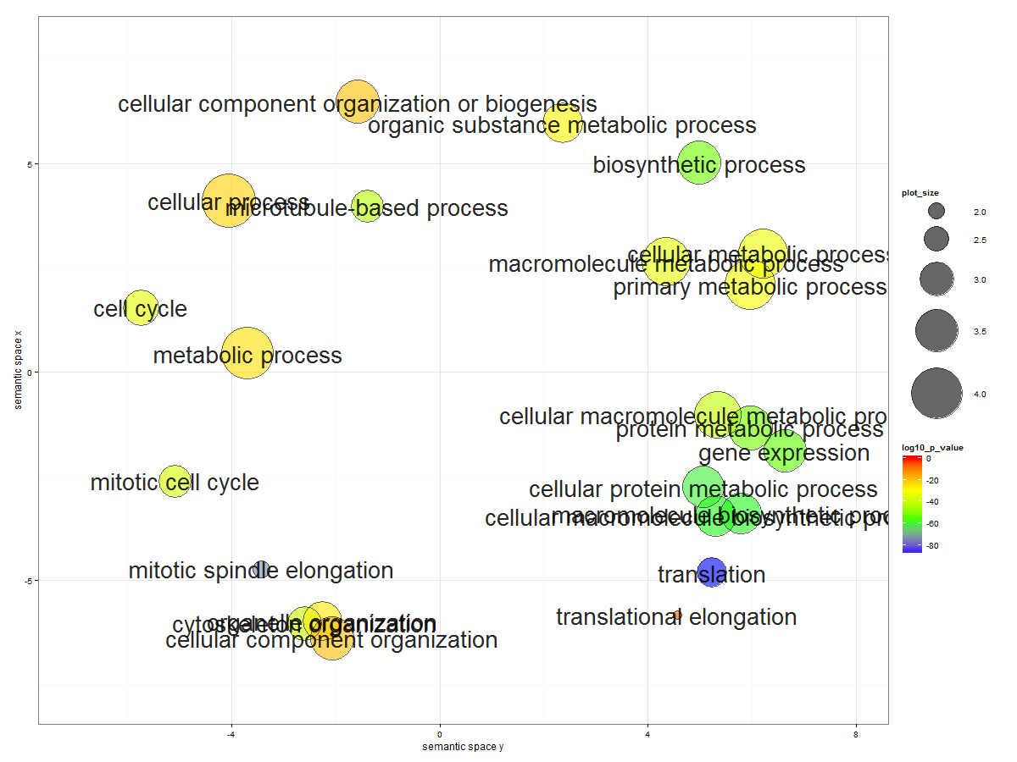
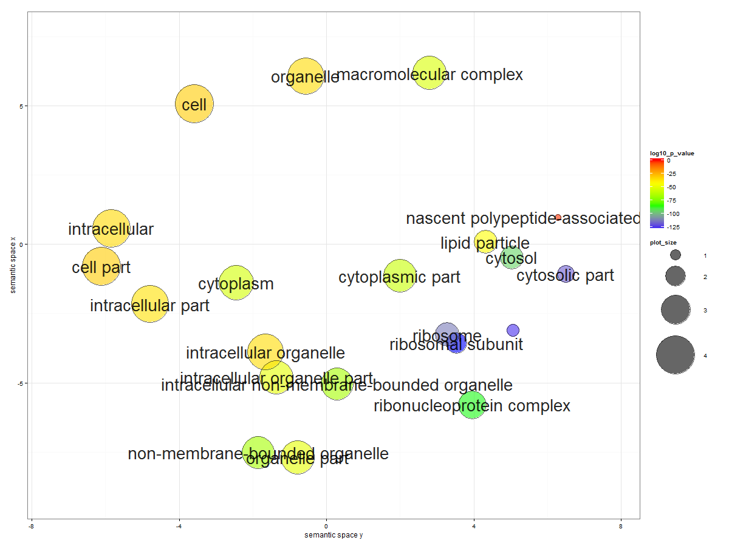
Module 7 (46 fly genes*)

Slide 13
backup

Slide 14
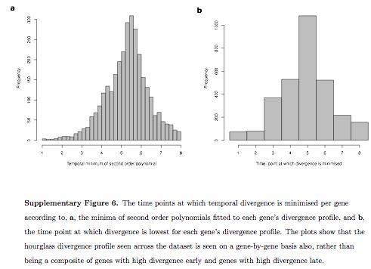
http://www.nature.com/nature/journal/v468/n7325/full/nature09634.html

