Slide 1
Pseudogene Transcription
PseudoSeq: too stringent
Overlap with TAR: too liberal
RPKM method
  Calculate RPKM for each pseudogene using the uniquely mapped reads from RNA-Seq experiments
  Set a RPKM cut-off, say at 0.1
  Calculate FDR by randomly generating 5 million reads from protein coding genes with random errors, repeat the above two steps and then find the false discoveries.

Slide 2
Pseudogene Annotation
Human:
  HAVANA level 1 and level 2 pseudogenes from GENCODE 7. Totally 11,216.
Worm:
  Intersection of PseudoPipe and WormBase pseudogenes. Totally 911.
Fly:
  Intersection of PseudoPipe and FlyBase pseudogenes. Totally 108.

Slide 3
RNA-Seq Data
Human:
  HumanBodyMap 2.0: 75-bp single reads from polyA+ RNA of 16 tissues
  Gm12878 and K562: 76-bp single reads from total long RNA
Worm:
Fly:
  Developmental stages from embryo to adult: 36-bp single reads
  Embryo 0 – 4 h L1
  Embryo 4 – 8 h L2
  Embryo 8 – 12 h L3
  Embryo 12 – 16 h Pupae
  Embryo 16 – 20 h Adult male
  Embryo 20 – 24 h Adule female

Slide 4
RPKM Calculation
Alignment: Bowtie
  Use Bowtie to map RNA-Seq reads to the whole genome and splice junctions;
  0 mis-matches allowed, only uniquely mapped reads are kept
RPKM: RSEQTools

Slide 5
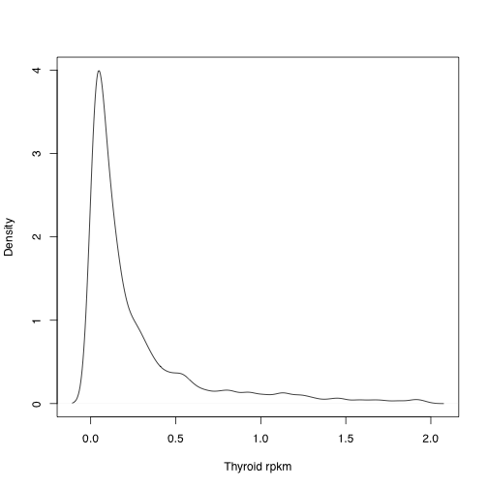
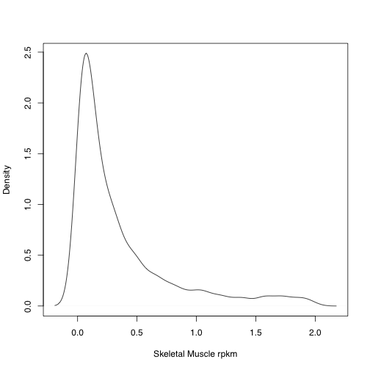


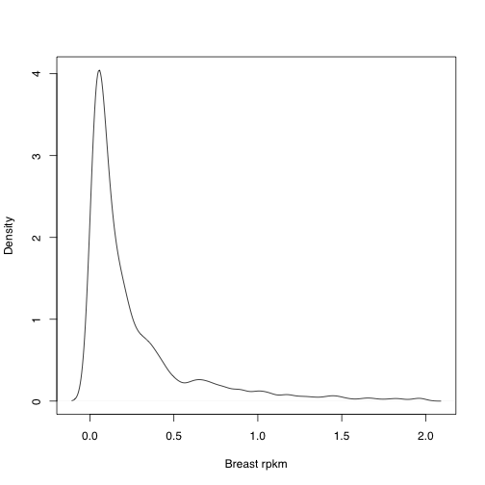

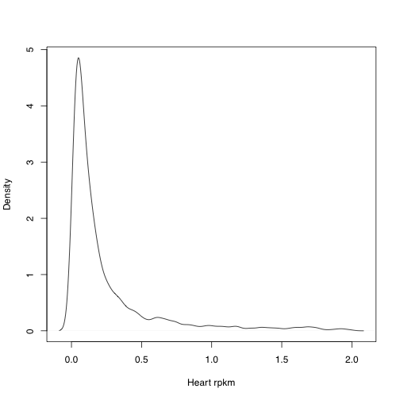
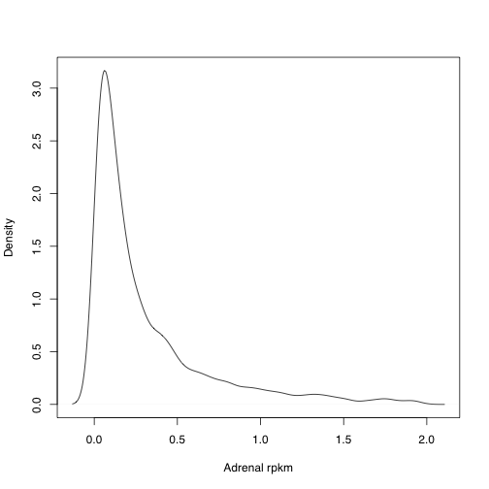
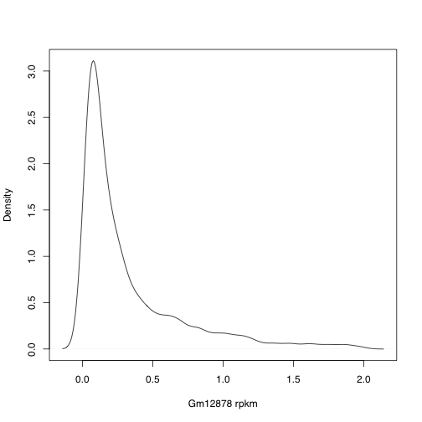
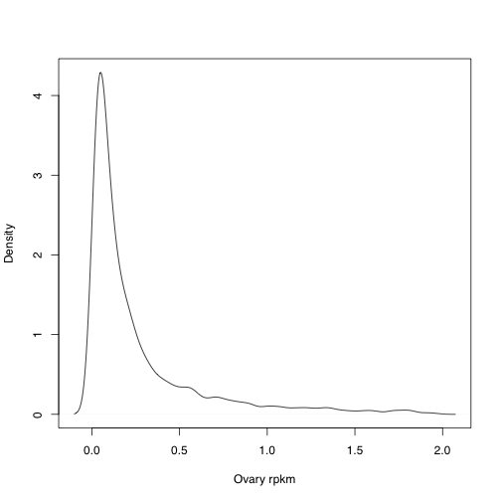


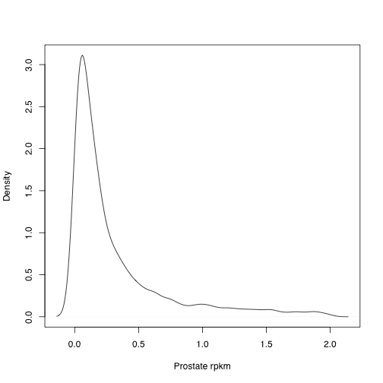



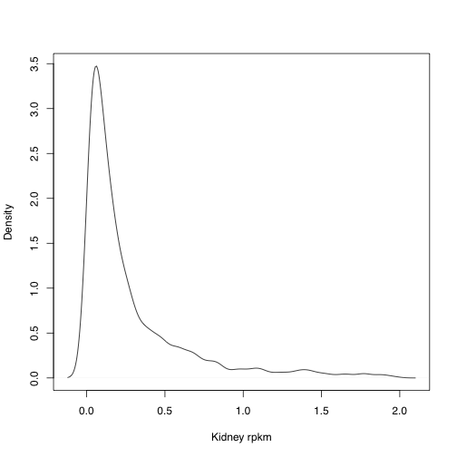
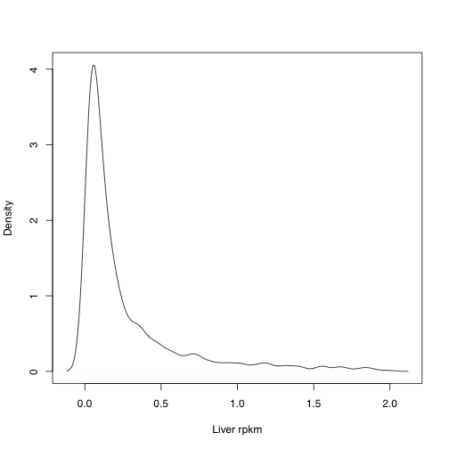
Pseudogene RPKM Distribution

Slide 6
Human Results
Number of Pgenes
Tissue specificity
Number of Pgenes
Number of Tissues
RPKM threshold: 1
Union: 1,411
False positive from simulation: 121
Notes:
PseudoSeq:876
TAR: 6468

Slide 7
Human Results
Tissue specificity of pgenes with parents
Number of Pgenes
Associated parent genes
All parents
Broadly expressed parents
Number of Pgenes
Number of Tissues
RPKM threshold: 1
Notes:
PseudoSeq:876
TAR: 6468

Slide 8
Human Results
Number of Pgenes
Tissue specificity
Number of Pgenes
Number of Tissues
RPKM threshold: 0.1
Union: 5,714
False positive from simulation: 121
Notes:
PseudoSeq:876
TAR: 6468

Slide 9
Human Results
Tissue specificity of pgenes with parents
Number of Pgenes
Associated parent genes
All parents
Broadly expressed parents
Number of Parents
Number of Tissues
RPKM threshold: 0.1
Notes:
PseudoSeq:876
TAR: 6468

Slide 10
Fly Results
Number of Pgenes
Developmental stage distribution
Number of Pgenes
Number of Tissues
RPKM threshold: 1
Union: 40
False positive from simulation: 3
Notes:
PseudoSeq: 9
TAR: 60

Slide 11
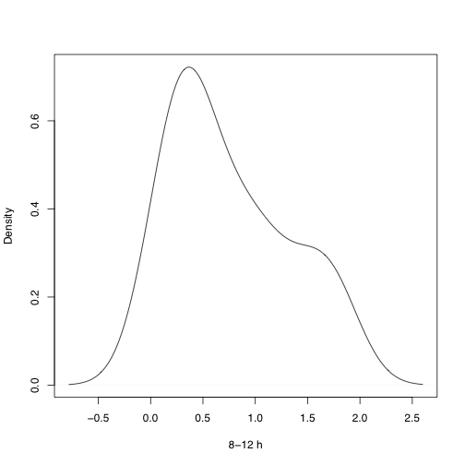


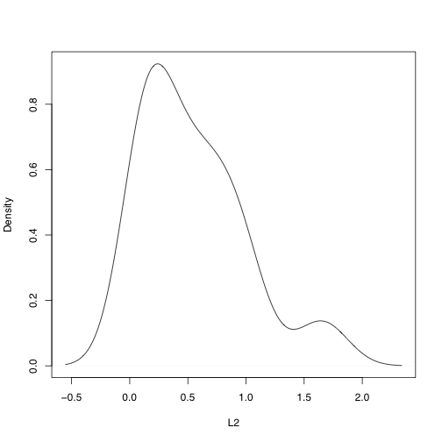
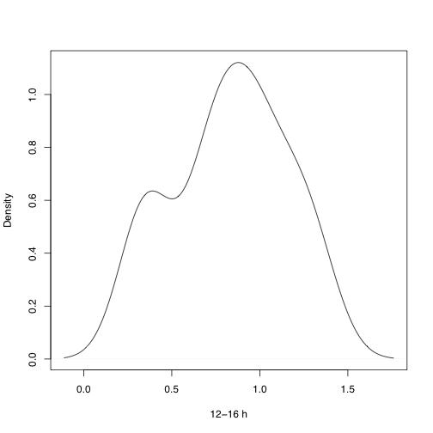

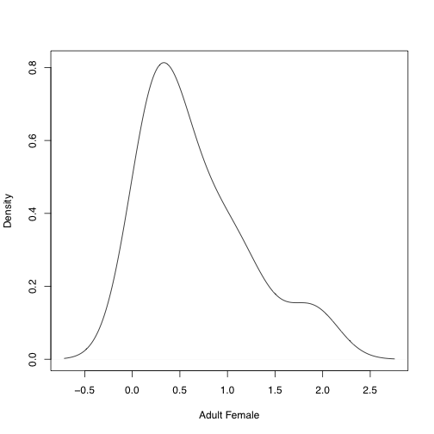
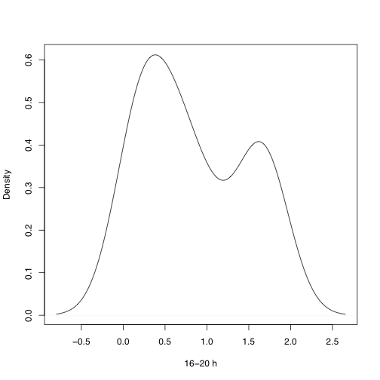




Fly Pseudogenes RPKM

Slide 12
Fly Results
Number of Pgenes
Developmental stage distribution
Number of Pgenes
Number of Tissues
RPKM threshold: 0.1
Union: 62
False positive from simulation: 3

Slide 13
Fly Results
RPKM > 1
Developmental
stages
1 | 2 | 3 | 4 | 5 | 6 | 7 | 8 | 9 | 10 | 11 | 12
8 | 8 | 3 | 5 | 3 | 2 | 1 | 1 | 1 | 1 | 2 | 5
1 | 0 | 2 | 0 | 0 | 0 | 0 | 0 | 0 | 0 | 0 | 0
Parents
Broadly exp.
parents
RPKM > 0.1
Developmental
stages
1 | 2 | 3 | 4 | 5 | 6 | 7 | 8 | 9 | 10 | 11 | 12
11 | 5 | 6 | 9 | 5 | 5 | 3 | 1 | 1 | 3 | 5 | 8
1 | 1 | 2 | 1 | 1 | 0 | 0 | 0 | 0 | 0 | 0 | 0
Parents
Broadly exp.
parents

