Slide 1
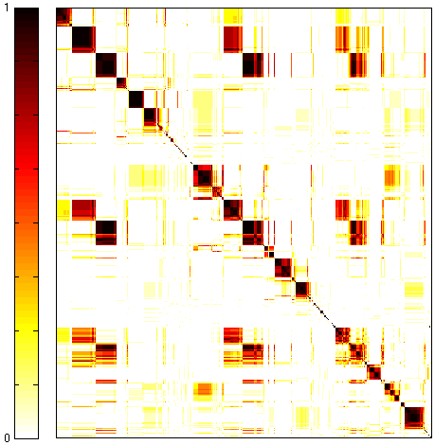
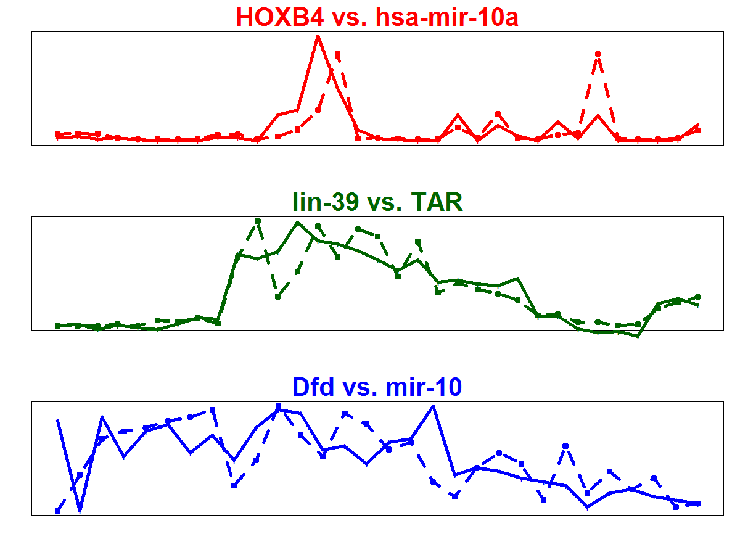
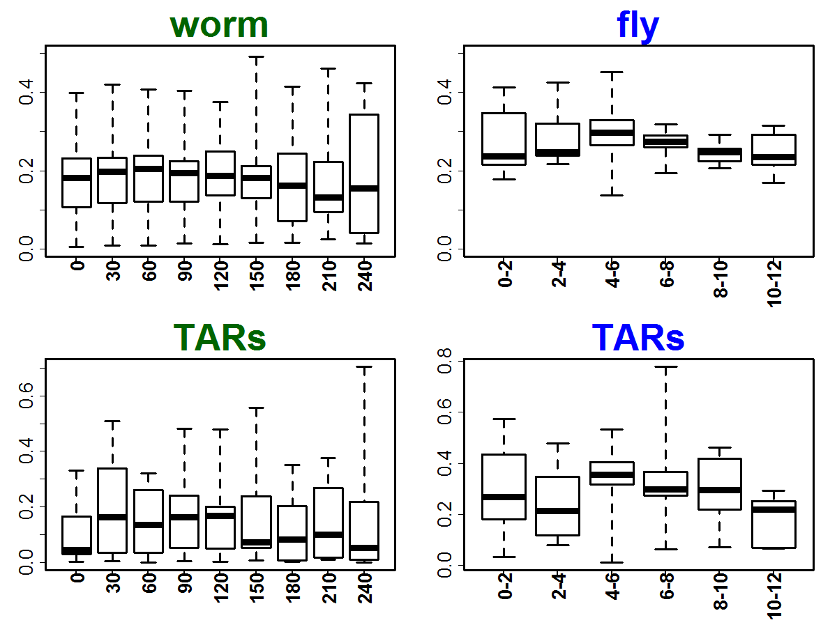
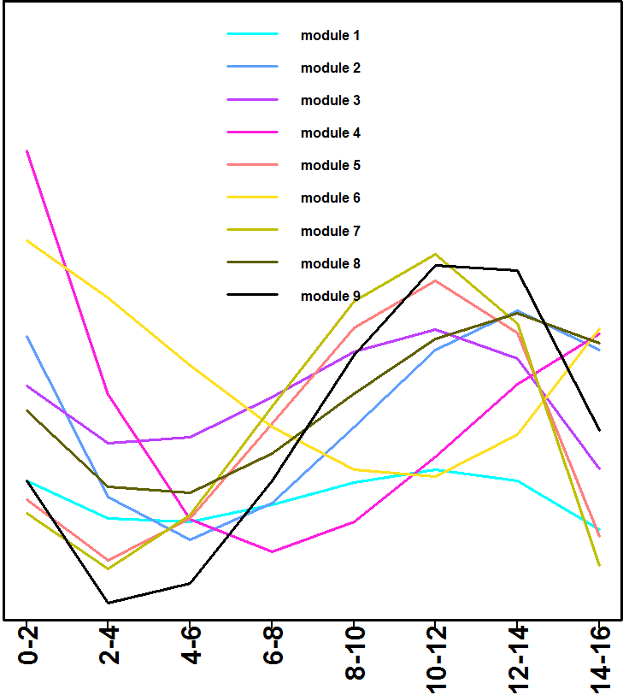
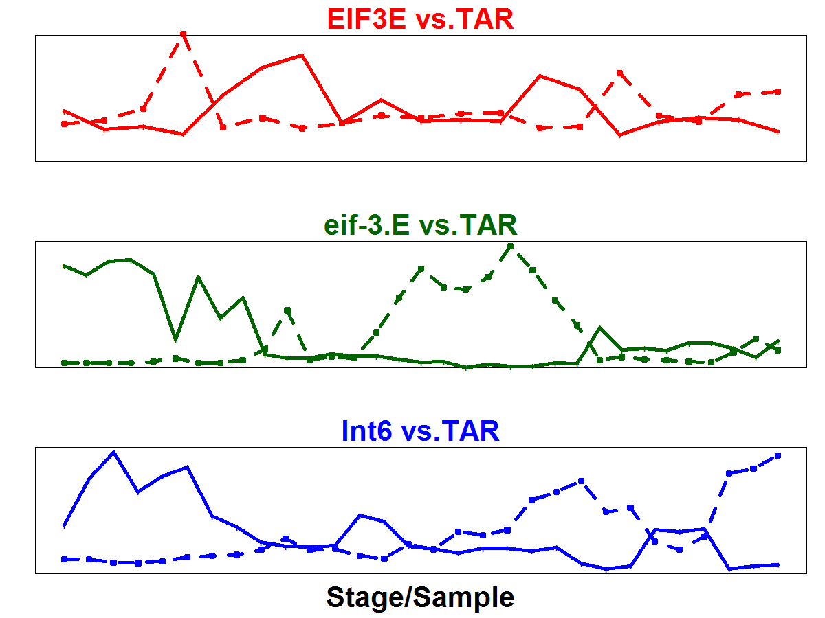
A
Human
Worm
Fly
1
highly conserved module O
Human
Fly
1059 orthologs
Co-expressed TARs
Worm
B
Conservation in # of species
co-appearance frequency (normalized)
worm-specific module
Human
Fly
2 ncRNAs + TAR
Zero orthologs
Worm
0
Expression
Ortholog
ncRNA/TAR
C
Temporal expression divergence across modules
Temporal expression divergence across fly species
3 TARs
D
Notes:
|cor| ncrna tar
H >0.65 >0.9
W >0.65 >0.9
F >0.65 >0.9

Slide 2
Std. dev. & fitted curve
1
2
3
Temporal expression divergence across fly species
4
5
6
7
8
9

Slide 3
boxplot
1
2
3
Temporal expression divergence across fly species
4
5
6
7
8
9

Slide 4
backup

Slide 5
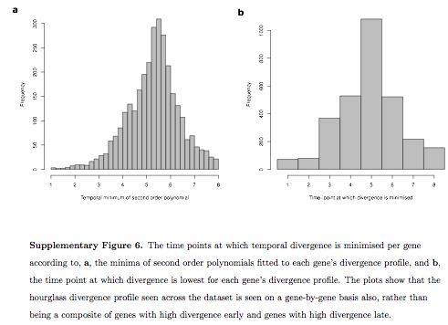
http://www.nature.com/nature/journal/v468/n7325/full/nature09634.html

