Slide 1
Finding New Non-coding RNAs Among Hox Clusters
He Zhu
Gerstein Lab
First Round Rotation Talk
12-11-2012
Notes:
I am doing my lab rotation in Professor Mark Gerstein’s lab

Slide 2
Start from
model organism ENCyclopedia Of DNA Elements:
gene structure
mRNA and ncRNA expression profiling
transcriptional factor binding sites
histone modifications and replacement
chromatin structure
DNA replication initiation and timing
Notes:
The goal of the modENCODE project is to provide a comprehensive encyclopedia of genome functional elements in the model organisms C. elegans and D. Melanogaster. It is run as a research network and the consortium is formed by 11 primary projects, like…

Slide 3
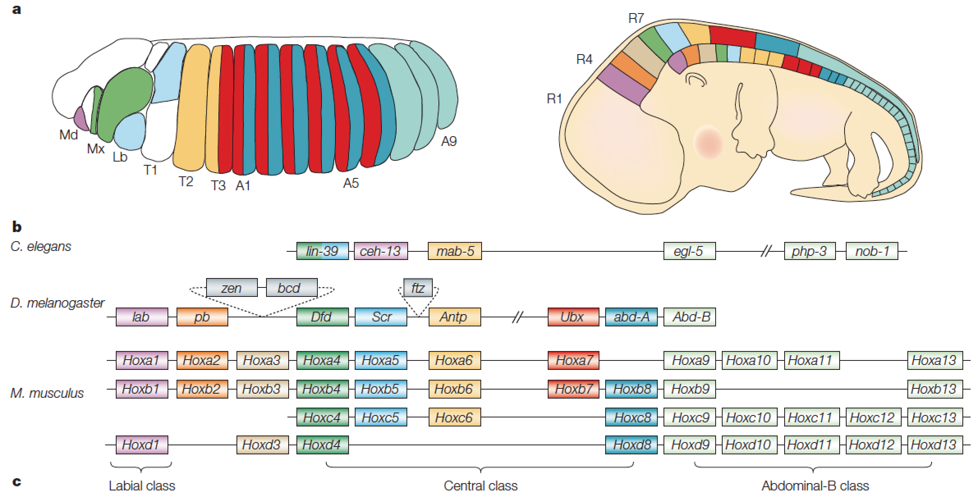
Why Hox genes: Hox genes in different species
Pearson, Lemons et al. 2005
Notes:
They play a central role in axial patterning during animal development. They are clustered in the genome and specify cell fate in sequential domains along the anteriorposterior body axis in an order that is co-linear with their relative genomic position. So the body parts are regulated by the hox genes of the same colors. And the genes are quite conserved across different species. The hox genes of same colors in mouse worm and fly are homologues.

Slide 4
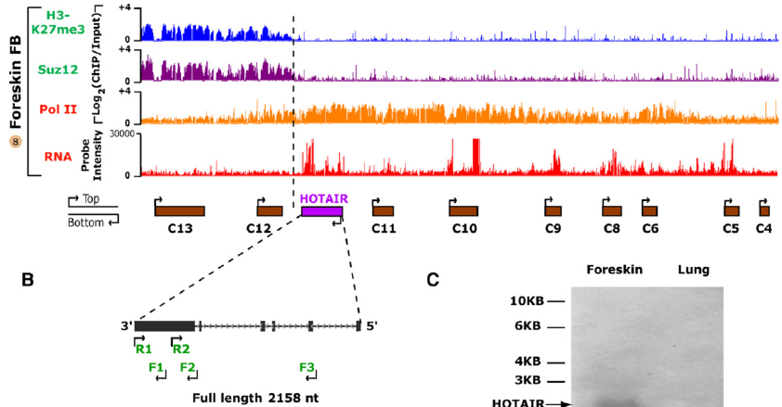
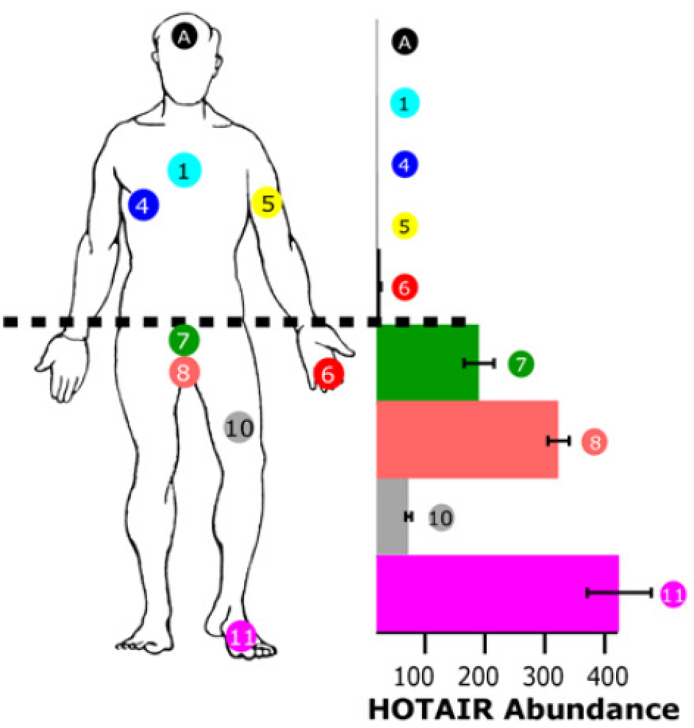
Why noncoding-RNA: HOTAIR in Homo sapiens
Rinn, Kertesz et al. 2007
Notes:
Then why non-coding RNAs? In 2007, using high-resolution tiling array data, a group found that a long intergenic non-coding RNA called HOTAIR among human clusters could regulate the activities of hox genes. However, there are no similar findings in other species. So it is interesting if we could find some non-coding RNAs in the conserved regions across different species

Slide 5
Uniform Processing Pipeline
1) TAR Calling
Retrieve RNA-seq data of Three Species
Visualize the RNA-seq Data (IGV 2.1)
Look for Transcriptionally Active Regions(TARs)
2) Mappability
Chop the Whole Genome of Three Species at Different Levels
Map the Chopped Pieces Back to the Genome (BOWTIE)
Visualize the Mappability Data (IGV 2.1)
Filter the Bowhit Data and Make it Applicable to IGV Tools
3) Synteny mapping with Circos
Reorganize the Mappability Data Applicable to Circos Tool
Visualize the Synteny across Species (Circos)
Notes:
So let us come to the first part. I achieved the raw RNA-seq data from the modENCODE project and visualized the data using a software called IGV, integrative genomics viewer. And then I focused on hox clusters and looked for TARs with interesting expression patterns.

Slide 6
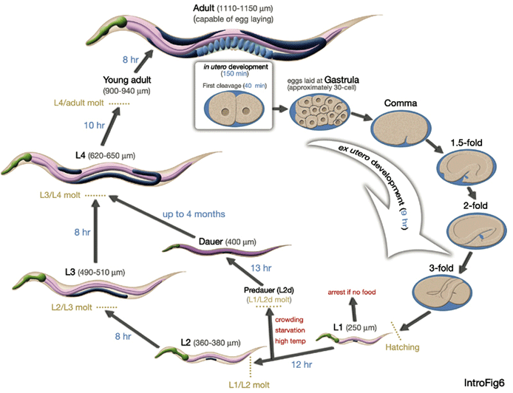
Life Cycle of Roundworm C. elegans
Image from Worm Atlas
Notes:
Here is a cartoon showing the life cycle of worm. So far we are focusing on the early embryogenesis period.

Slide 7
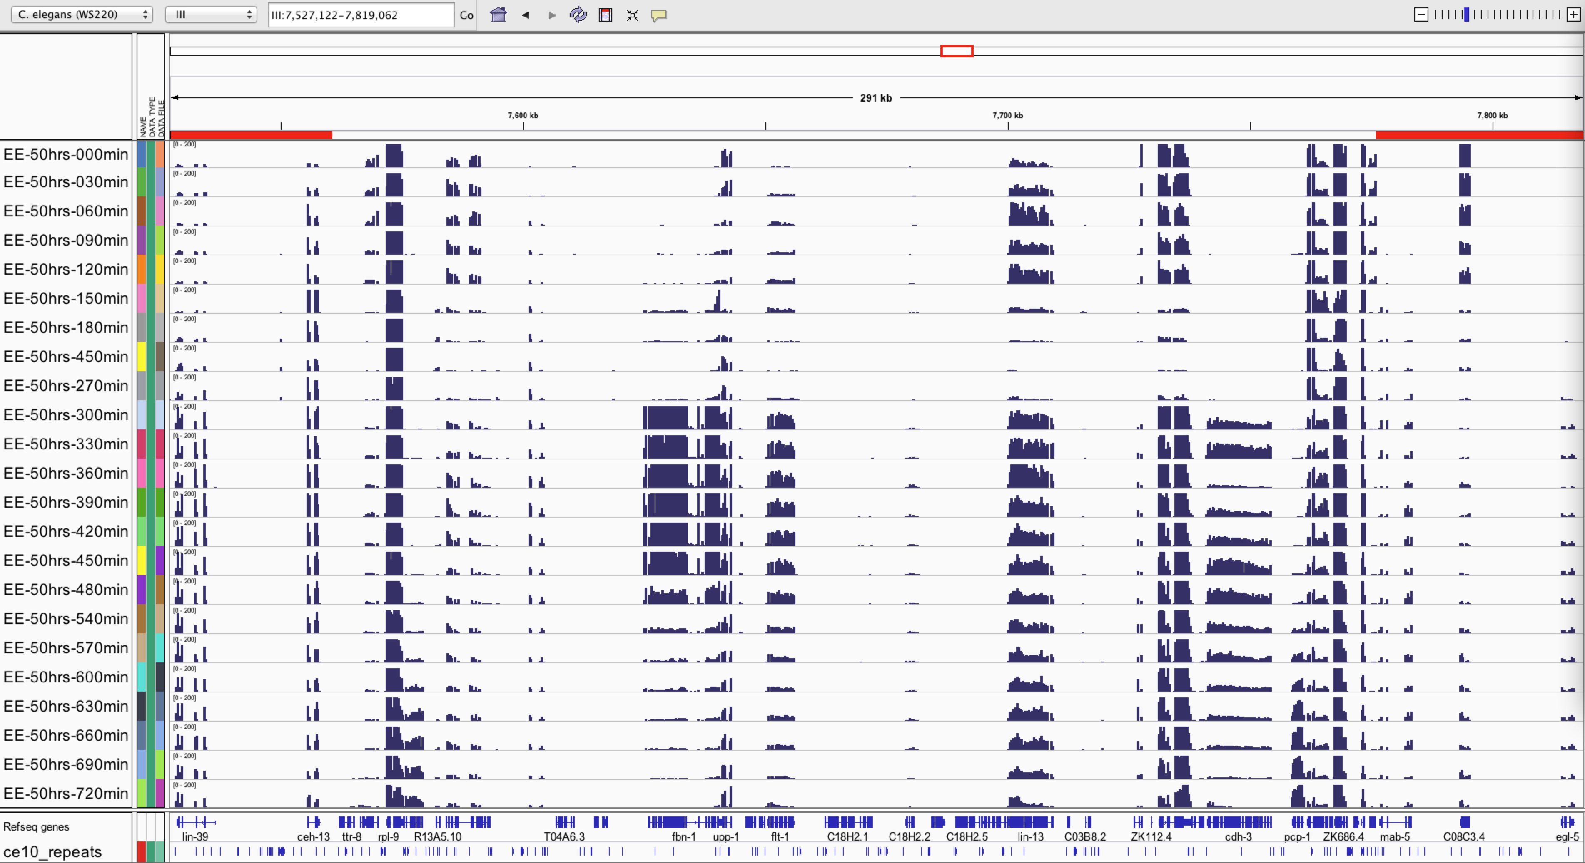
RNA-seq Visualization for C. elegans (Hox Clusters)
Notes:
Here is the general view of RNA-seq data visualization for worm in a successive developmental time course starting from early embryo. On the very left column, EE is short for early embryo, the worms were synchronized and the time-point 0 is 50 hours after their synchronization, the min means different time points. So basically, the name means researchers grew worms and harvested embryos at the right time, 50 hours after one specific stage, and did RNA-seq for successive time points during embryogenesis. The line below shows the name of different genes or regions on the genome.

Slide 8
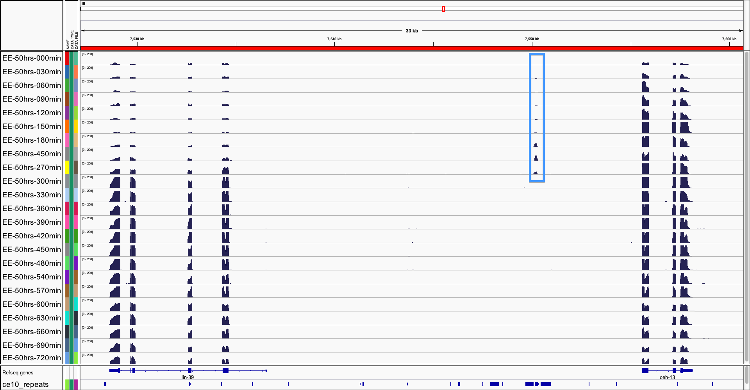
Interesting TAR between lin-39 and ceh-13
Notes:
When we zoom in the visualization output, we can find some interesting regions among hox clusters. It is between lin-39 and ceh-13. The region showed increasing expression from time-point 0min to 300min during early embryogenesis, and showed no expression thereafter. This pattern is quite anti-correlated with lin-39, which decreases its expression from 0min to 300min and then increases the expression.

Slide 9
Interpretation for potential TARs (between lin-39/ceh-13)
A new linc-RNA (long intergenic non-coding RNA)?
- Over 200nt, transcribed between two protein-coding genes
Regulates lin-39?
-share anti-correlated expression patterns during early embryogenesis
Need to exclude the possibility that it is a repetitive region…

Slide 10
Uniform Processing Pipeline
1) TAR Calling
Achieve RNA-seq data of Three Species
Visualize the RNA-seq Data (IGV 2.1)
Look for Transcriptionally Active Regions(TARs)
2) Mappability
Chop the Whole Genome of Three Species at Different Levels
Map the Chopped Pieces Back to the Genome (BOWTIE)
Visualize the Mappability Data (IGV 2.1)
Filter the Bowhit Data and Make it Accessible to IGV Tools
3) Synteny mapping with Circos
Reorganize the Mappability Data Accessible to Circos Tool
Visualize the Synteny across Species (Circos)

Slide 11
“Chop” the genome at six levels
…
…
ATGCATAAACGTTCTACTTTTGGG…TTCTACTTTTGAAATCGTCAGTTCG…
“Chopped” pieces
…
Length of the chopped pieces: 22nt, 36nt, 50nt, 75nt, 100nt and 200nt.
Notes:
Mention read length of DNA sequencers

Slide 12
Mapping tool: Bowtie
Bowtie is an ultrafast, memory-efficient short read aligner geared toward quickly aligning large sets of short DNA sequences (reads) to large genomes.
Locus
Matching loci
Sequence of locus
Number of other matches
Langmead B, Trapnell C, Pop M, Salzberg SL. 2009

Slide 13
“Mappability” definition:
Bowhit value: The number of other sites in the entire genome where a given sequence matches.
Bowhit value = n
Mappability value = 1/(n + 1)
Number of other matches

Slide 14
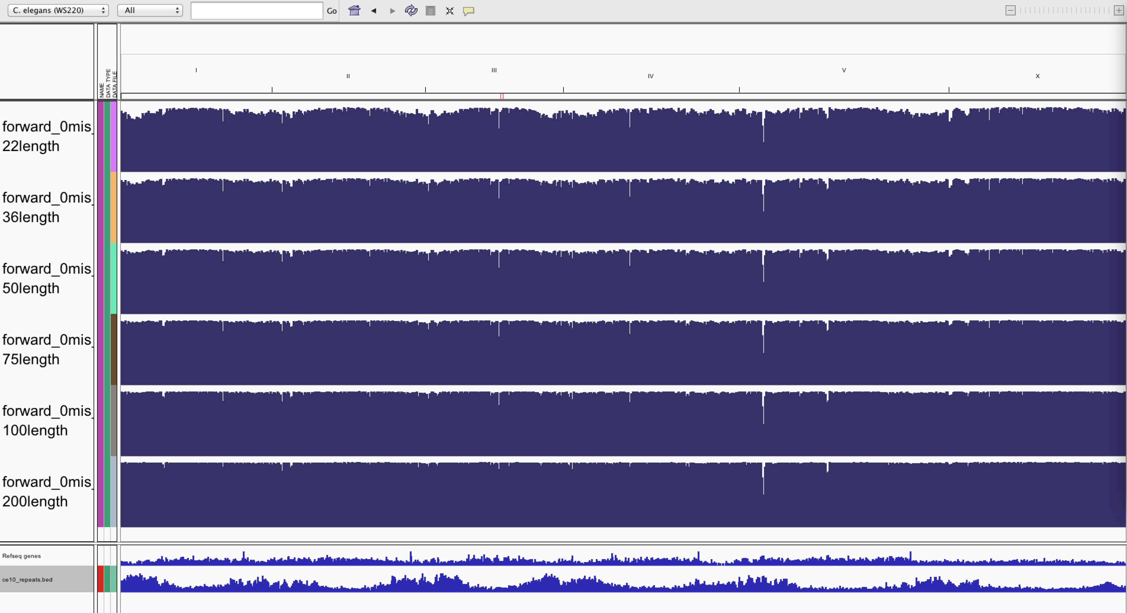
Mappability visualization for C. elegans
(whole genome)
Notes:
Here is the general view of mappability visualization for worm genome. On the very left column, the forward means I aligned all the forward strand of the genome. 0mis means that the alignment allows no mismatches. 22length means that the length of the chopped genome is 22nt. We could see most of the genome regions are unique.

Slide 15
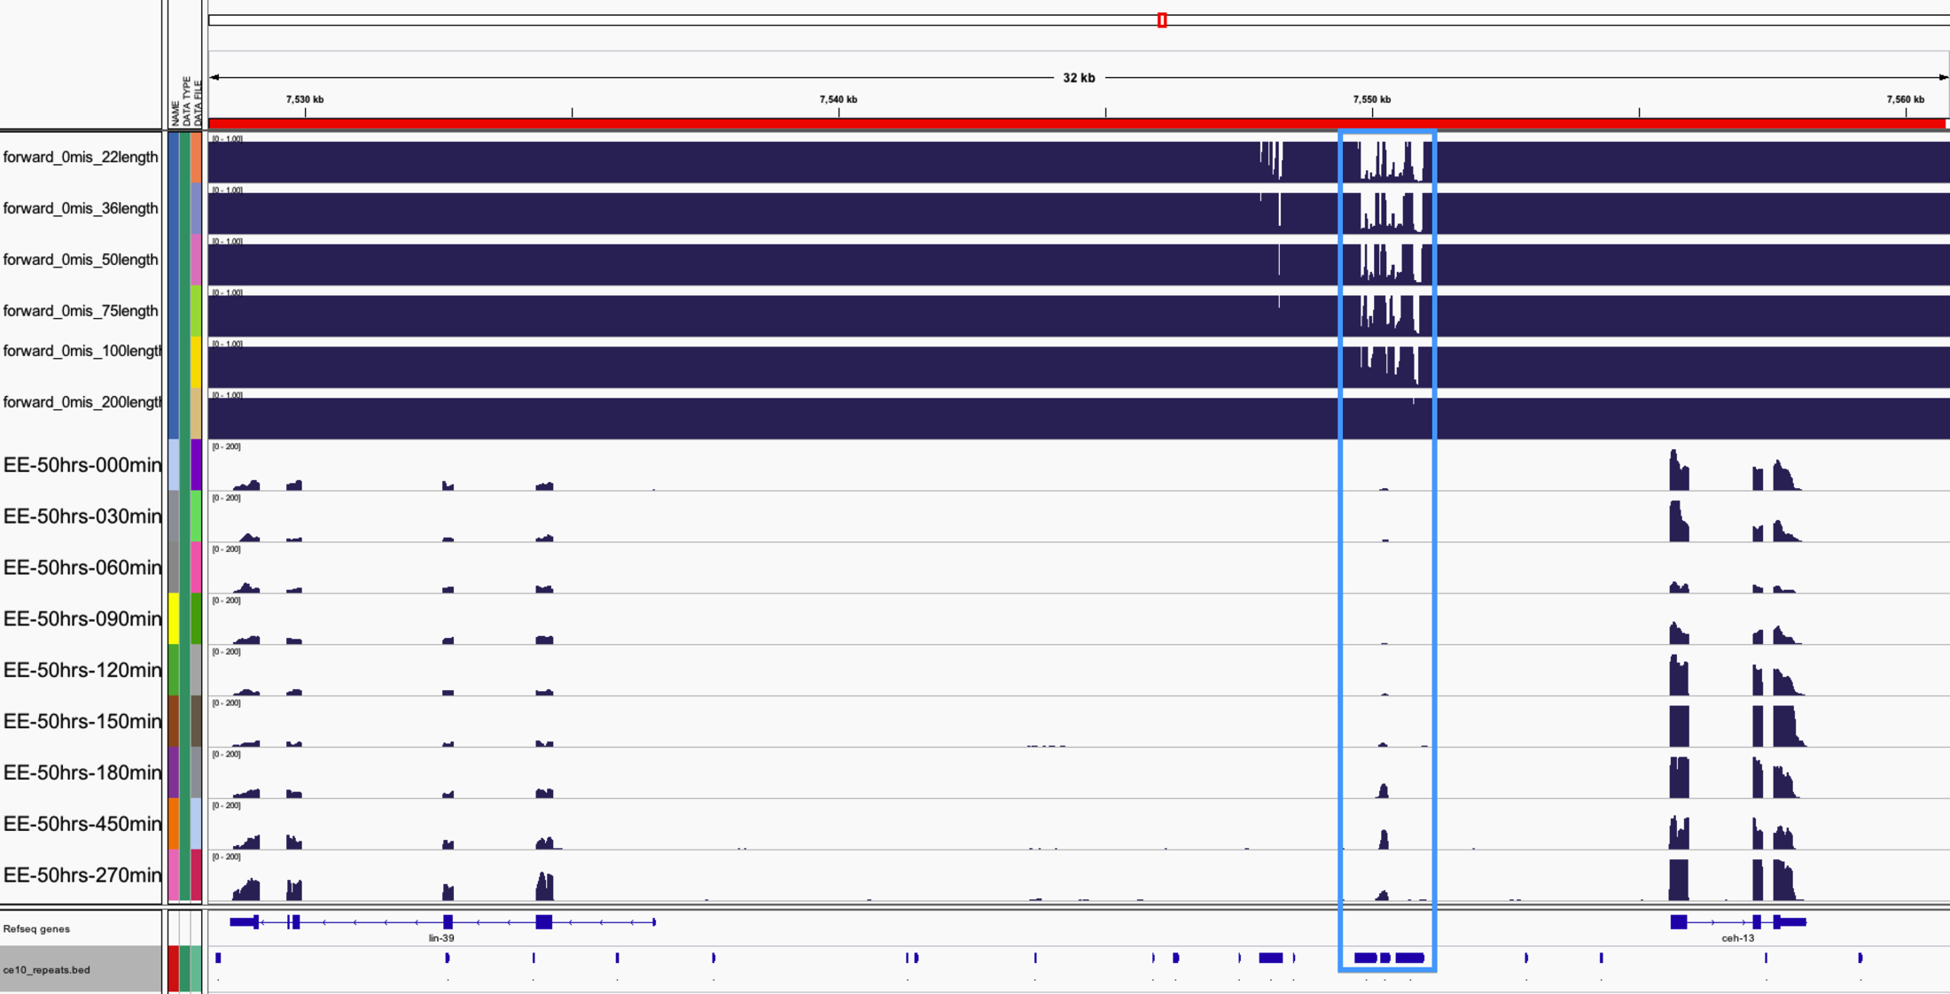
Mappability visualization for C. elegans
(TAR between lin-39 and ceh-13)

Slide 16
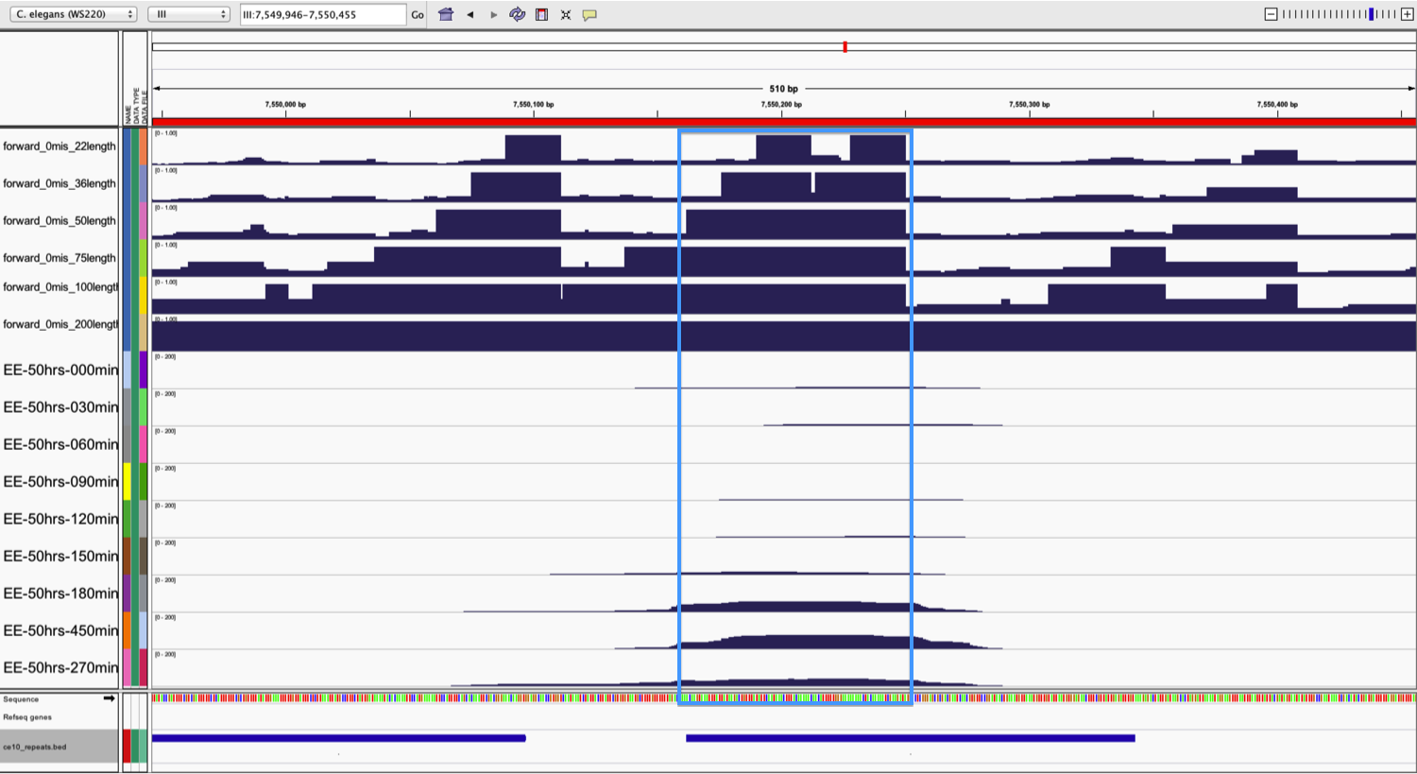
Mappability visualization for C. elegans
(TAR between lin-39 and ceh-13:Zoom in)
Notes:
When we zoom in again, we could find that most of the TAR regions are in fact unique, with the mappability value equal to 1.

Slide 17
Mappability visualization for C. elegans
(TAR between lin-39 and ceh-13)
RepeatMasker track in UCSC Genome Browser: DNA repeat PALTTTAAA3

Slide 18
Interpretation for Mappability visualization for C. elegans
(TAR between lin-39 and ceh-13)
TAR between lin-39 and ceh-13 is a member of the PALTTTAA3 DNA repeat family.
It is old enough that part of its sequence has mutated away from its parent sequence, and is uniquely identifiable in RNAseq data.
The TAR RNA is expressed in a way anti-correlated with the adjacent lin-39 gene, so it may be functional.
To find out, we need more information on its secondary structure, evolutionary conservation, chromatin state, functional tests, etc.

Slide 19
Uniform Processing Pipeline
1) TAR Calling
Achieve RNA-seq data of Three Species
Visualize the RNA-seq Data (IGV 2.1)
Look for Transcriptionally Active Regions(TARs)
2) Mappability
Chop the Whole Genome of Three Species at Different Levels
Map the Chopped Pieces Back to the Genome (BOWTIE)
Visualize the Mappability Data (IGV 2.1)
Filter the Bowhit Data and Make it Accessible to IGV Tools
3) Synteny mapping with Circos
Reorganize the Mappability Data Accessible to Circos Tool
Visualize the Synteny across Species (Circos)

Slide 20
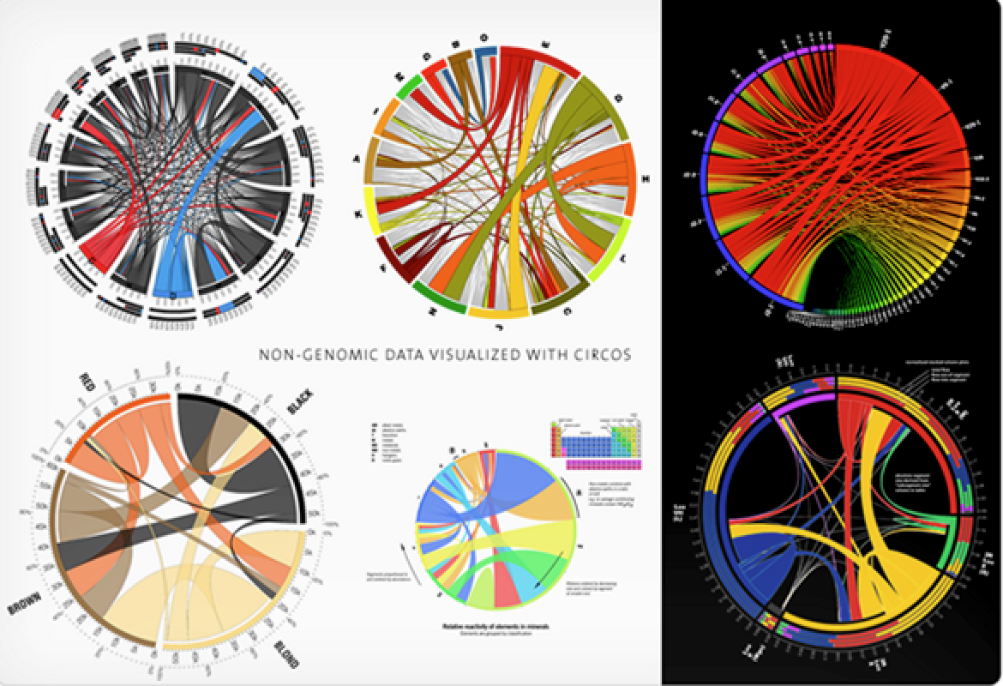
Another tool: Circos
Circos visualizes data in a circular layout —exploring relationships between objects or positions.
Ideal for creating publication-quality infographics and illustrations with a high data-to-ink ratio, richly layered data and pleasant symmetries.
Krzywinski, M. et al. 2009

Slide 21
Conclusion
Found an interesting transcriptionally active region (TAR) among worm Hox clusters
The TAR might regulate lin-39 activity during early embryogenesis
Built whole genome mappability dataset for human worm and fly, which is helpful for finding repetitive regions

Slide 22
Future work
Integrate more evaluations to test the TAR found in worm
Use Circos to visualize mappability and synteny data in a circular layout
Visualize the RNA-seq data for human and fly
Find TARs in human and fly Hox clusters

Slide 23
Acknowledgements
Special thanks to Dr. Roger Alexander
Dr. Mark Gerstein (rotation advisor)
Dr. Arif Harmanci
Dr. Daifeng Wang
Declan Clarke
All the Gerstein Lab members
The MCGD DGSs
1st year MCGD classmates
Shirlene Scott

Slide 24
Thank you!

