Slide 1
Transcription Supp. Figures
Version 20121211

Slide 2
List of supplementary materials
Supp. Figure 1. modENCODE transcription clustering.
Supp. Figure 2. Relationship between TF number in a model with predictive accuracy.
Supp. Figure 3. Relationship between Pol II binding and expression.
Supp. Figure 4 – (a package from John Lu.)

Slide 3
20k genes
33 samples
20k genes
33 stages
30 stages
Human
Worm
14k genes
Fly
33 samples
33 stages
30 stages
20k ncRNAs
4k ncRNAs
2k ncRNAs
Human
Worm
Fly
6353 h-w-f orthologs
5083 h-w-f orthologs
4839 h-w-f orthologs
…
Human
XXXX
Fly
XXXX
species-specific modules
H-W-F
XX
Potts clustering
…
ncRNA/TAR
mapping
WormXXXX
highly conserved modules
Supp. Figure 1. modENCODE transcription clustering.

Slide 4
Supp. Figure 2. Relationship between TF number in a model with predictive accuracy.
We started from the full model, and iteratively remove the worst TF (with lowest relative importance) from the model until only two TFs are left. To fit the 3 organisms in a plot, I cut the curve as that they all started from a model with 28 TFs.

Slide 5
A
B
(rank-rank plot)
C
Supp. Figure 3. Relationship between Pol II binding and expression.
Example: worm. A – log scale scatterplot. B – Q-Q plot. C – Rank-rank plot.

Slide 6
incRNA for modENCODE/ENCODE
Following figures…

Slide 7
RT-PCR Validation in Different Human Tissues
38 were selected from incRNA V1
In incRNA V2
The candidates were validated by Cédric Howald (Gencode)

Slide 8
Human ncRNA validations(Cedric’s) in V2
(38 were selected from V1)
 |  | 95% sensitivity |  |  | 99% sensitivity
 | Cedric_ validations | In ncRNA1 prediction | In ncRNA2 prediction | In all prediction | In ncRNA1 prediction | In ncRNA2 prediction | In all prediction
ncRNAI | 11 | 0 | 0 | 0 | 2 | 0 | 2
ncRNAII | 27 | 8 | 0 | 8 | 13 | 3 | 14

Slide 9
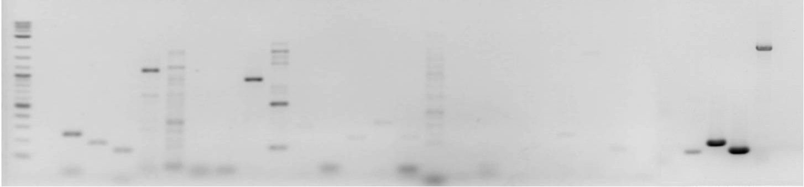
RT-PCR Validation in Fly embryo
Total RNA from fly 12 h embryo, radom primer
for cDNA, specific primer for lincRNA
Positive control
Rassf8
Rpl32
7SL
25 26 27 28 29 30 31 32 33 34 35 36 37 38 39 40 41 42 43 44 45 46 47 48 49 50
10 kb
3 kb
1.5 kb
1 kb
500 bp
300 bp
200 bp
100 bp
Based on previous prediction, doing new validations to replace it!

Slide 10
incRNA_v1 and incRNA_v2 comparison in C. elegans
 |  | Overlap with 95% sensitivity predictions |  |  | Overlap with 99% sensitivity predictions |  |  | Overlap with max ncRNA score bins(no cutoff) |  |  | Pearson Correlation coefficient
 | incRNA_v1 frags | In ncRNA1 | In ncRNA2 | In ncRNA1 or ncRNA2 | In ncRNA1 | In ncRNA2 | In ncRNA1 or ncRNA2 | In ncRNA1 | In ncRNA2 | In ncRNA1 or ncRNA2 | ncRNA1 _score | ncRNA2 _score
All | 7237 | 22% | 1% | 23% | 43% | 10% | 49% | 80% | 78% | 94% | 0.21 | -0.06
All high confident | 704 | 51% | 0% | 51% | 65% | 7% | 68% | 86% | 74% | 95% | 0.32 | -0.10
All medium confident | 6533 | 19% | 1% | 20% | 40% | 11% | 47% | 79% | 78% | 94% | 0.31 | -0.05
Intergenic | 2262 | 22% | 1% | 23% | 46% | 12% | 54% | 85% | 82% | 97% | 0.07 | -0.07
All high confident | 143 | 23% | 1% | 24% | 49% | 12% | 56% | 82% | 80% | 97% | 0.02 | -0.04
All medium confident | 2119 | 21% | 1% | 23% | 46% | 12% | 53% | 85% | 82% | 97% | 0.09 | -0.08

Slide 11
Annotations
 | Human | Fly | Worm
Gold-standard (Coding sequence, UTR, etc) | Gencode V10 (level 1 and 2) | FlyBase R5.45 (confirmed) | WormBase WS220 (confirmed)
Gold-standard (ncRNA) | Gencode V10 (level 1 and 2) | FlyBase R5.45 (with support of ETC, expression, etc) | WormBase WS220 (noncoding transcripts)
Extended annotation | Gencode V10 (all levels) | modENCODE freeze | modENCODE freeze

Slide 12
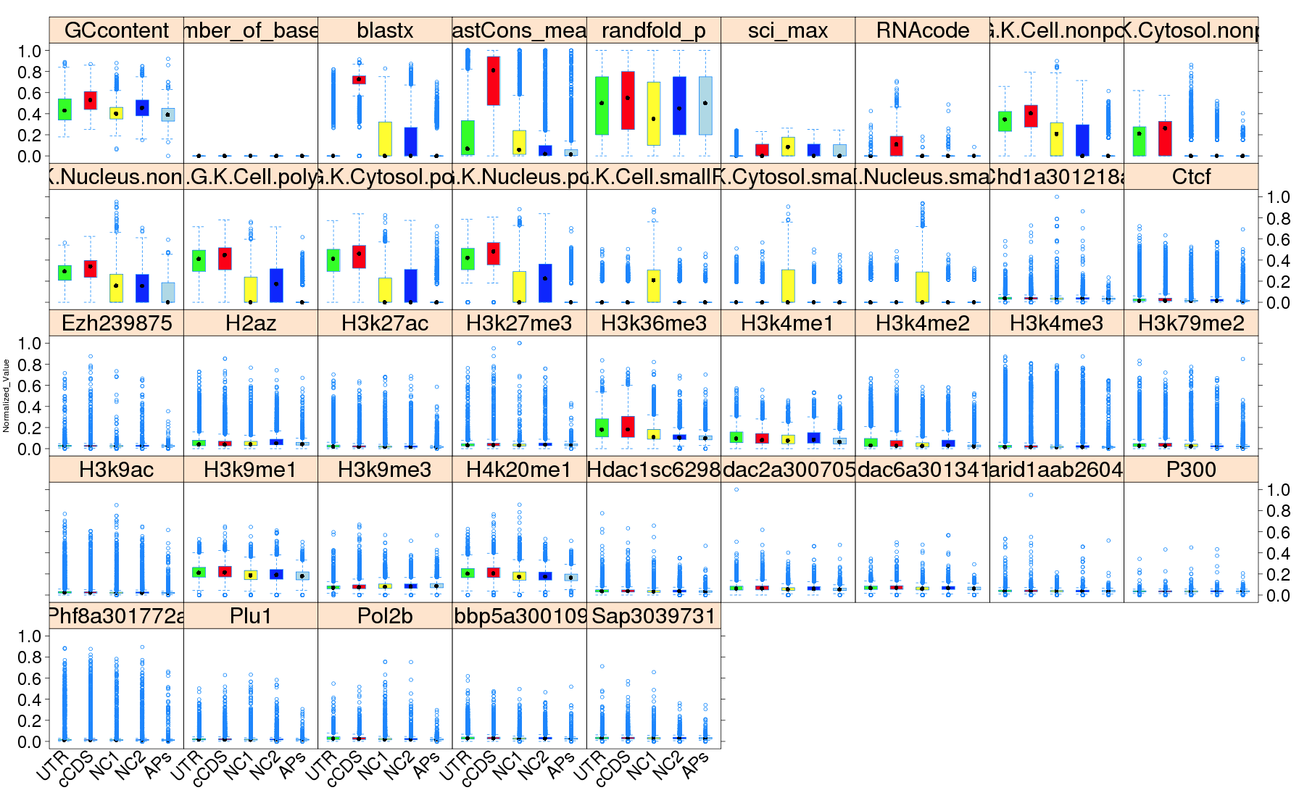
Human feature distribution (H1hesc+GSM12878+K562 and fold enrichment)

Slide 13
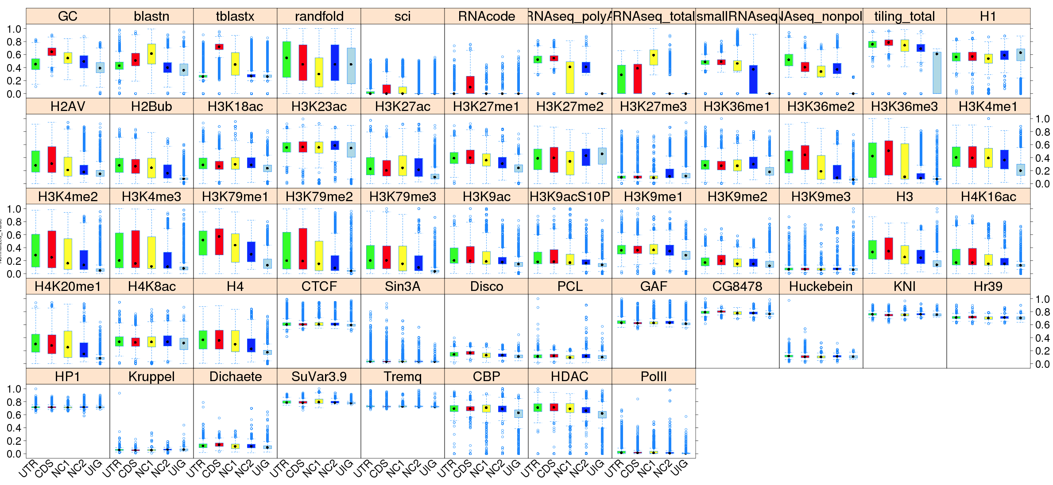
Fly feature distribution (all stage and fold enrichment)

Slide 14
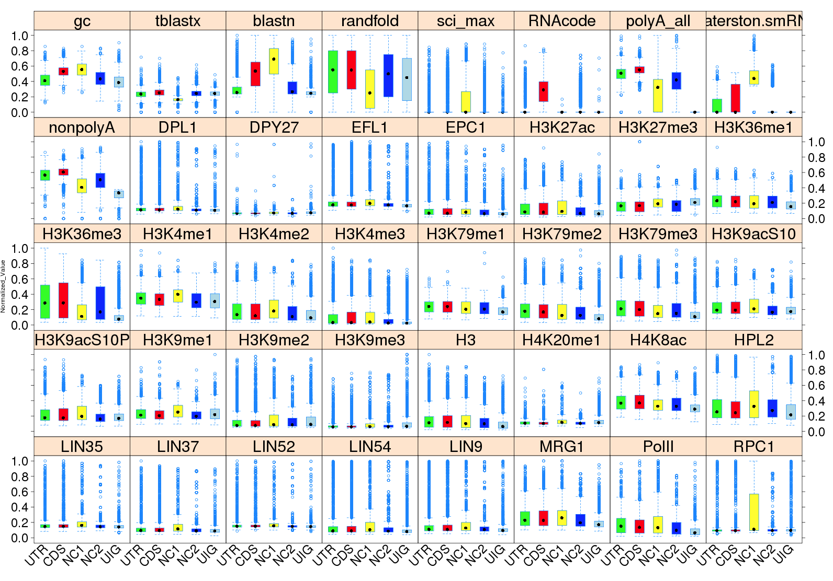
Worm feature distribution (all stage and fold enrichment)

Slide 15
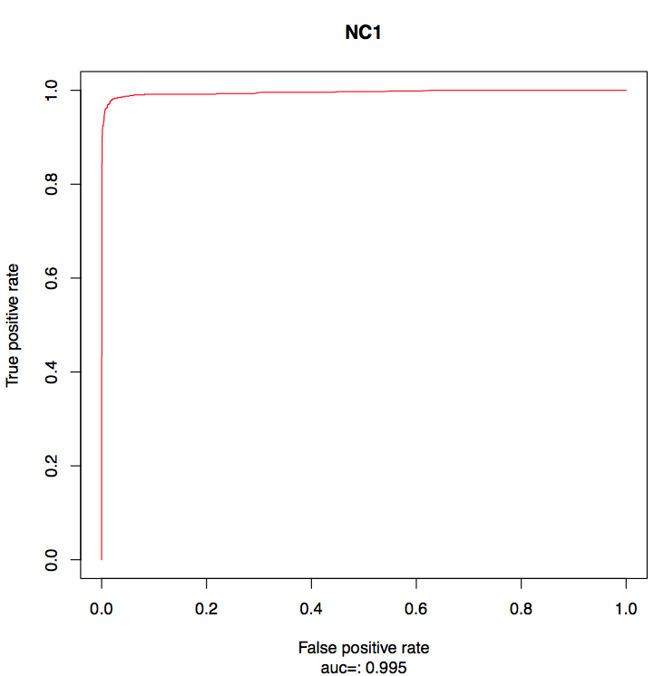
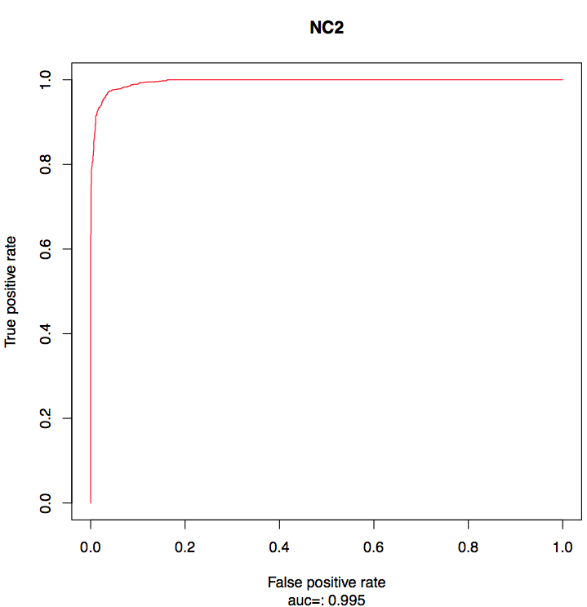
Worm
ROC curve

Slide 16
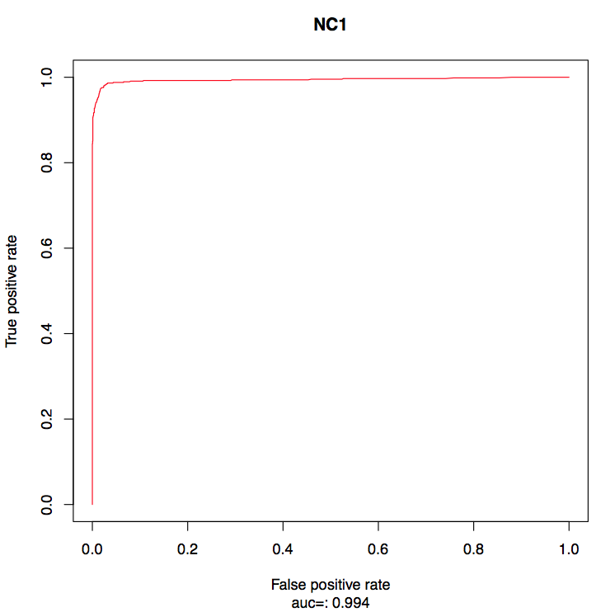
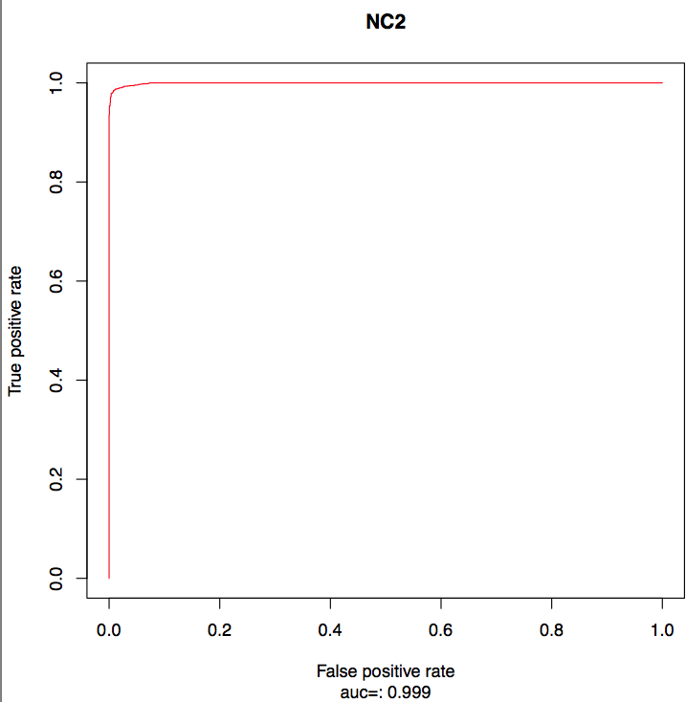
Fly
ROC curve

Slide 17
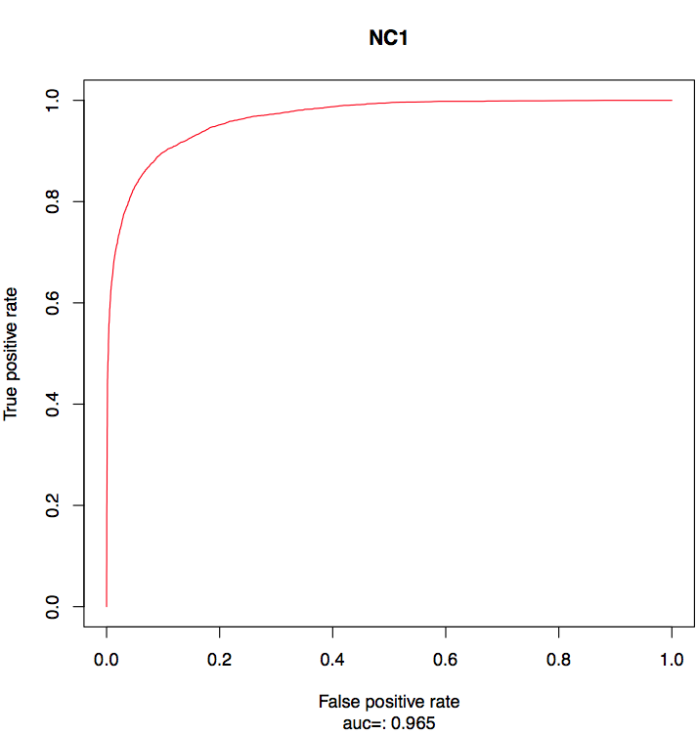
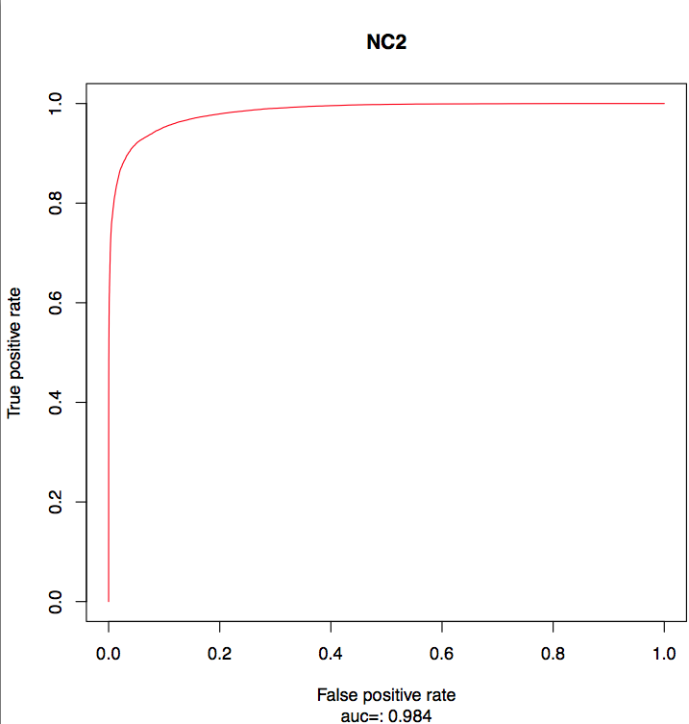
Model performance of incRNA V2
Human
ROC curve

Slide 18
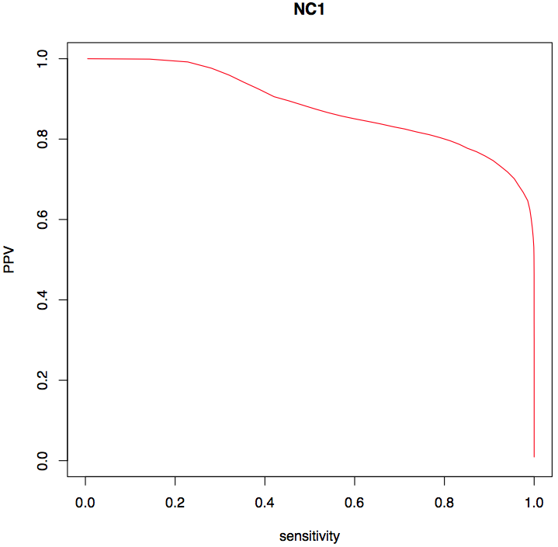
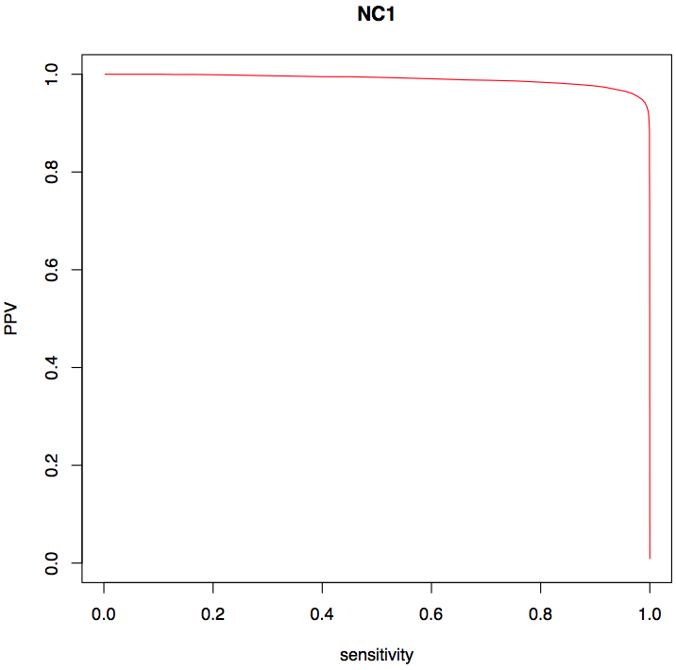
original features
Feature Selection and Performance Improvement in Human
GCcontent
blastx
phastCons_mean0
randfold_p
sci_max
RNAcode
H.G.K.nonpolyA.Cytosol.max
H.G.K.nonpolyA.Nucleus.max
H.G.K.nonpolyA.whole.cell.max
H.G.K.polyA.Cytosol.max
H.G.K.polyA.Nucleus.max
H.G.K.polyA.whole.cell.max
H.G.K.smallRNAseq.Cytosol.max
H.G.K.smallRNAseq.Nucleus.max
H.G.K.smallRNAseq.whole.cell.max
Chd1a301218a
Ctcf
Ezh239875
H2az
H3k27ac
H3k27me3
H3k36me3
H3k4me1
H3k4me2
H3k4me3
H3k79me2
H3k9ac
H3k9me1
H3k9me3
H4k20me1
Hdac1sc6298
Hdac2a300705a
Hdac6a301341a
Jarid1aab26049
P300
Phf8a301772a
Plu1
Pol2b
Rbbp5a300109a
Sap3039731
selected features
GCcontent
phastCons_mean0
randfold_p
Chd1a301218a
Ctcf
Ezh239875
H2az
H3k27ac
H3k27me3
H3k36me3
H3k4me1
H3k4me2
H3k4me3
H3k79me2
H3k9ac
H3k9me3
H4k20me1
Jarid1aab26049
Rbbp5a300109a
NC1 without feature selection:
PPV : 0.655
SEN : 0.956
NC1 with feature selection:
PPV : 0.965
SEN : 0.955
Notes:
3 cell lines
use emb selected features

