Slide 1
Somatic copy-number mosaicism in human skin revealed by induced pluripotent stem cells
Alexej Abyzov, Jessica Mariani, Dean Palejev, Ying Zhang, Michael Seamus Haney, Livia Tomasini, Anthony Ferrandino, Lior Rosenberg Belmaker, Anna Szekely, Michael Wilson, Arif Kocabas, Nathaniel E. Calixto, Elena L. Grigorenko, Anita Huttner, Katarzyna Chawarska, Sherman Weissman, Alexander Eckehart Urban, Mark Gerstein, Flora M. Vaccarino
Yale University
for CSHL Meeting on Personal Genomes & Medical Genomics
November 15, 2012

Slide 2
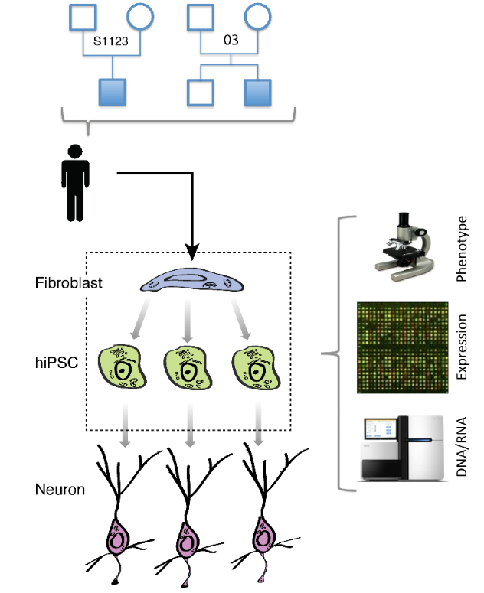
Does reprogramming into hiPSC cause de novo CNVs?
- autism
7 individuals, 21 hiPSC lines
Few previous studies reported de novo CNVs in hiPSC
Is the hiPSC genome stable during reprogramming?
What is the cause/origin of hiPSC line-manifested CNVs (LM-CNVs)?
Data (one HiSeq lane per hiPSC):
Whole genome RNAseq
Whole genome DNAseq
Abyzov et al., Nature, Nov 18 (online)
Notes:
This can be used to study somatic CNVs.

Slide 3
hiPSC characterization

Slide 4
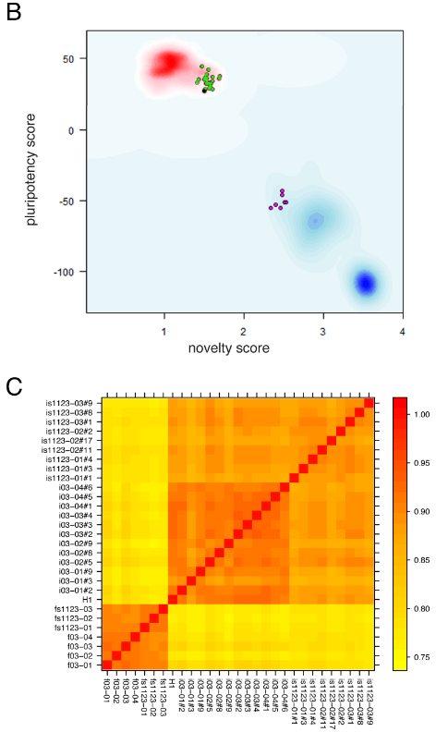
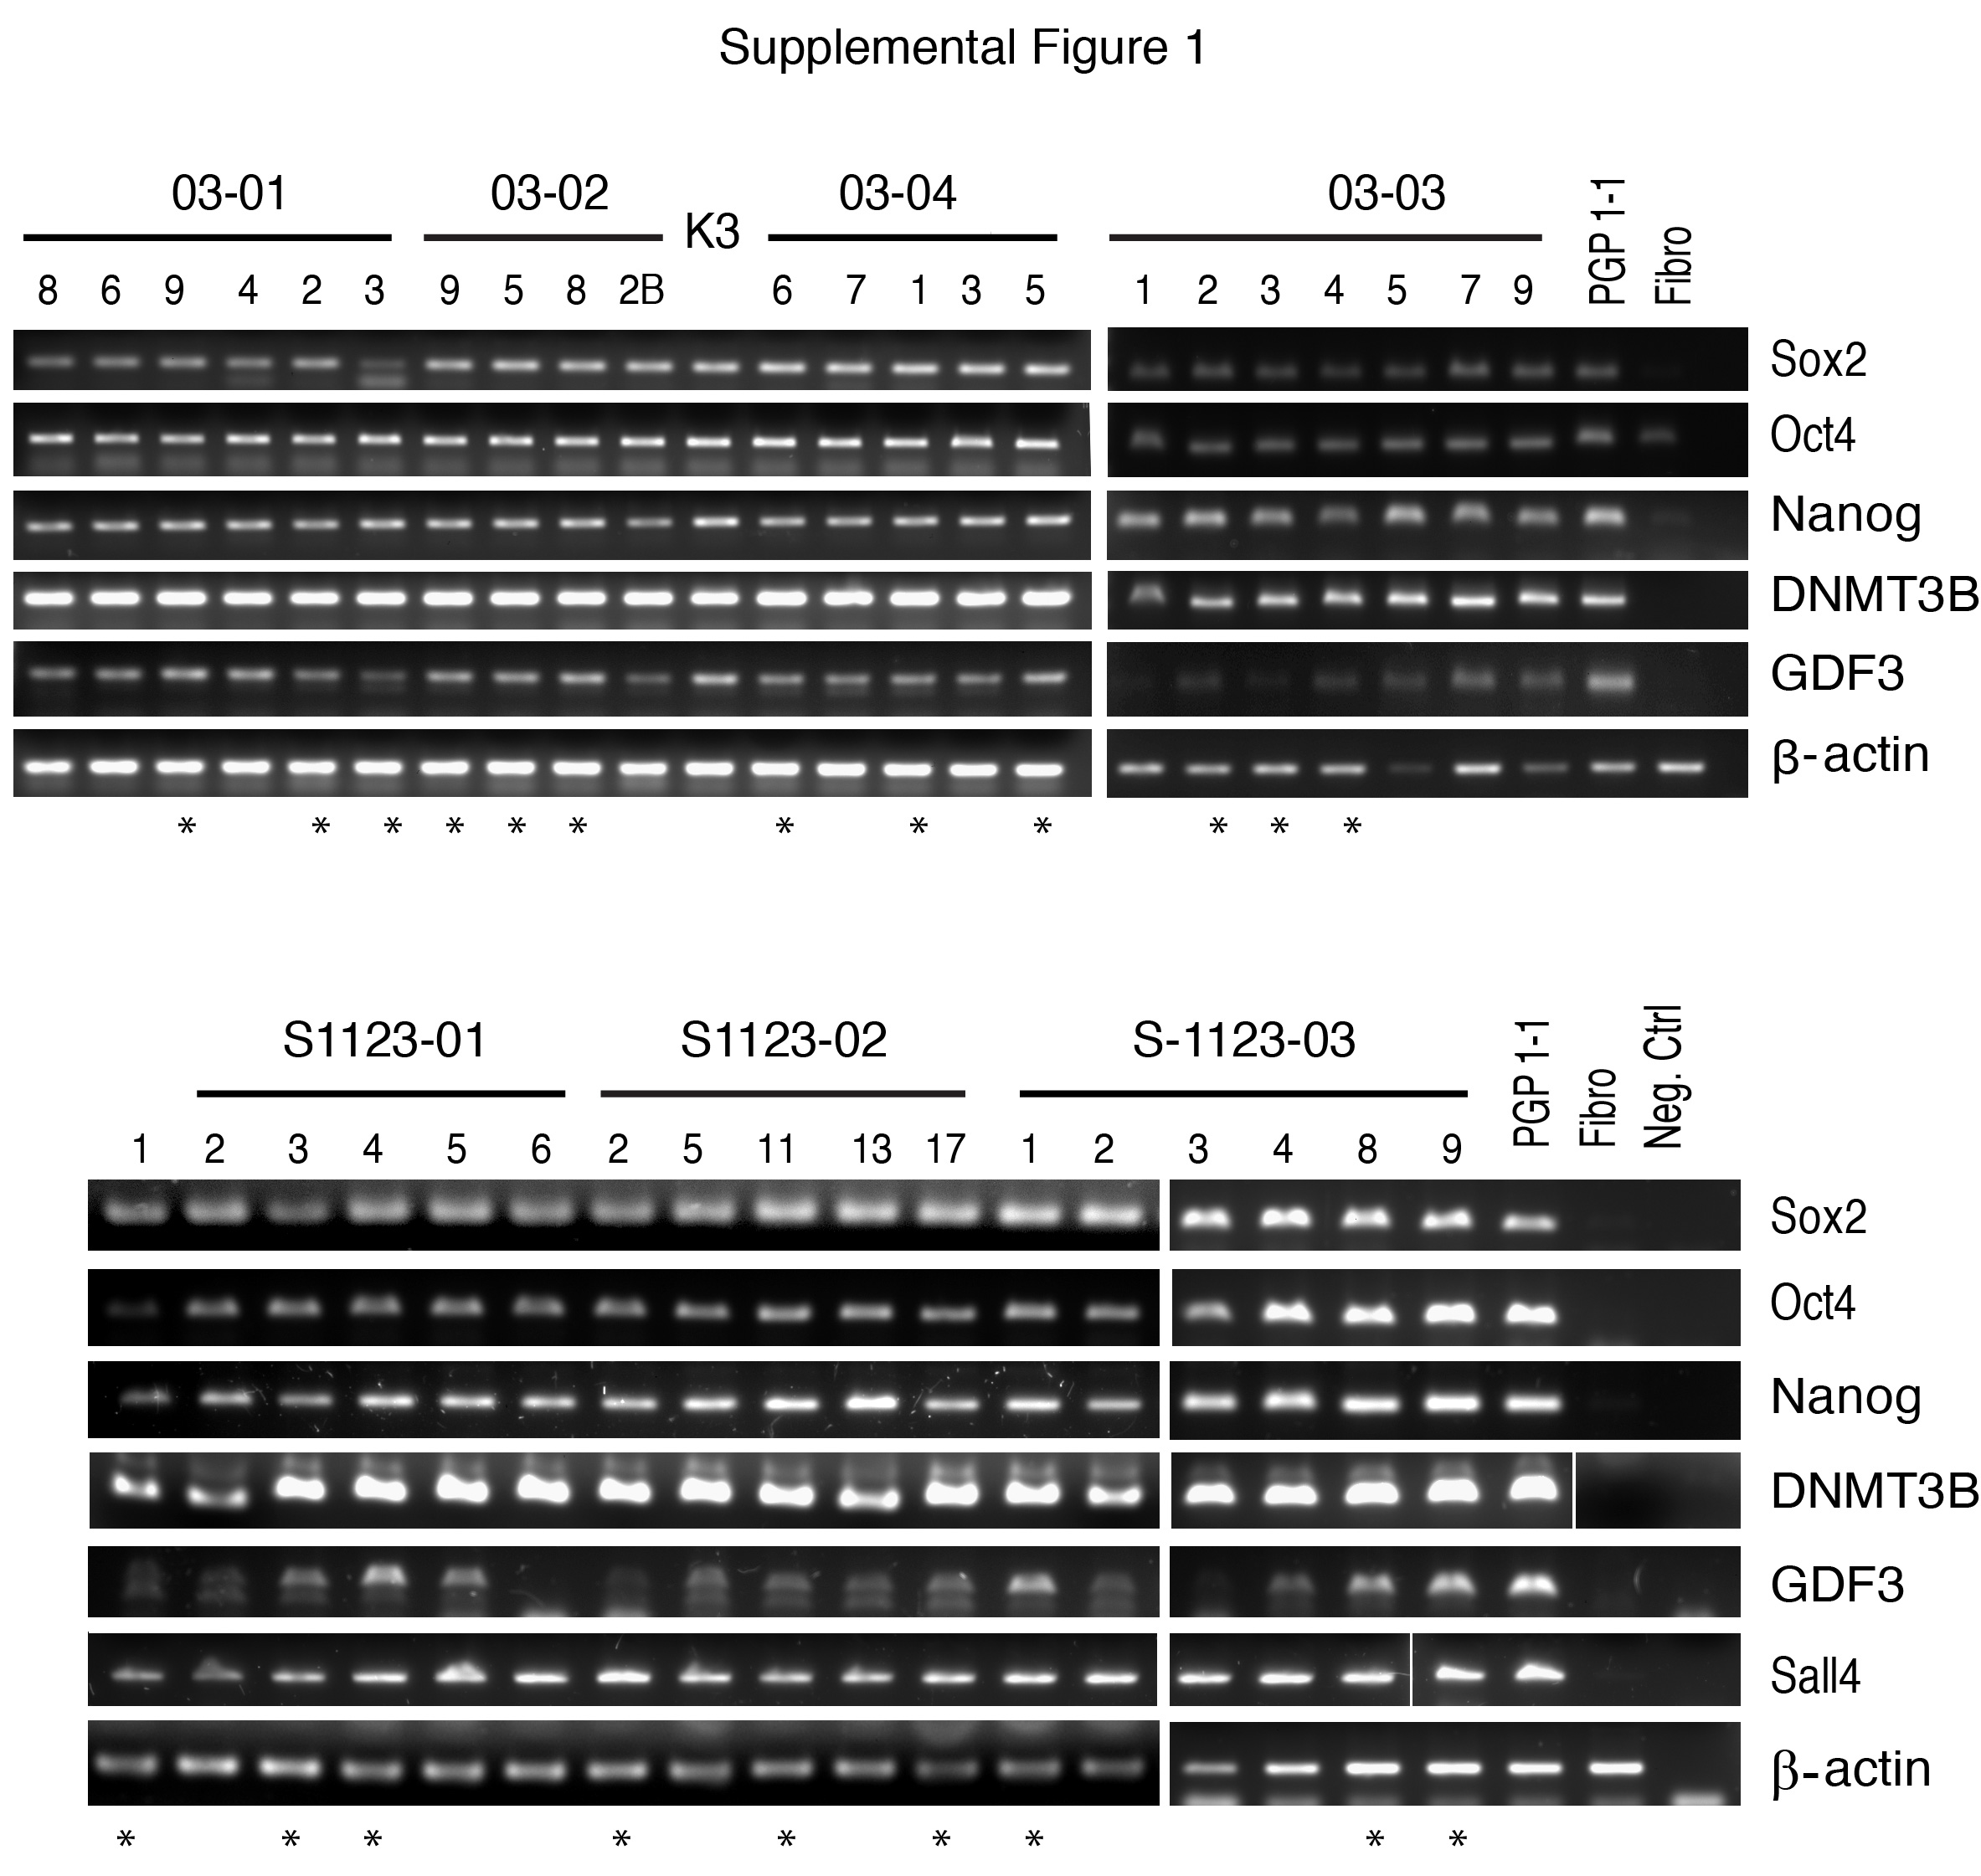
hiPSC characterization
hiPSC
Neurons
Abyzov et al., Nature, Nov 18 (online)

Slide 5
hiPSC genome characterization

Slide 6
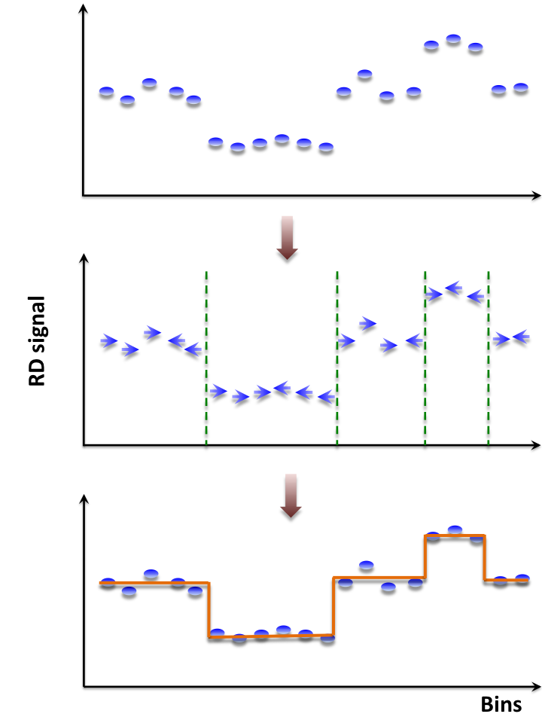
CNVnator: mean-shift approach
For each bin, attraction (mean-shift) vector points the direction of bins with most similar RD signal
No prior assumptions about number, sizes, haplotype, frequency and density of CNV regions
Not model-based (e.g. like HMM) with global optimization, distribution assumption & parameters (e.g. number of segments)
Achieves discontinuity-preserving smoothing
Derived from image-processing applications
Highest sensitivity to find CNVs detected by aCGH and fosmid end sequencing
1000 Genomes Consortium, Nature 467, 1061-1073 (2010)
Mills et al., Nature 470, 59-65 (2011) – companion article
Abyzov et al., Genome Res. 21, 974-84 (2011) – companion article

Slide 7
Example of lineage manifested CNV (LM-CNV)
One lane of genomic DNA sequencing reads by Illumina HiSeq
(2 x 100 nt) at ~10x coverage
Abyzov et al., Nature, Nov 18 (online)
Gene in duplication has increased expression

Slide 8
Stability of hiPSC genome with passages

Slide 9
LM-CNVs are not burden
High
coverage
Abyzov et al., Nature, Nov 18 (online)

Slide 10
Validation and origin of LM-CNVs by qPCR

Slide 11
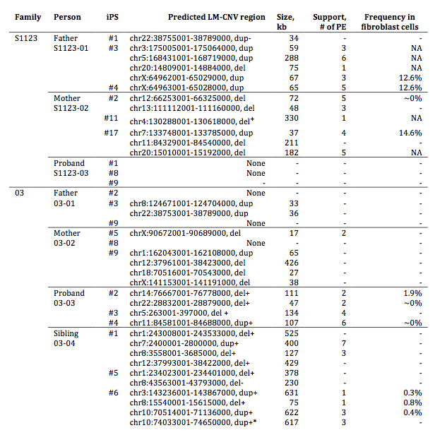
33 qPCR/aCGH validated LM-CNVs in 15 hiPSC
+Validated in
late passage
-Invalidated in
late passage
Abyzov et al., Nature, Nov 18 (online)

Slide 12
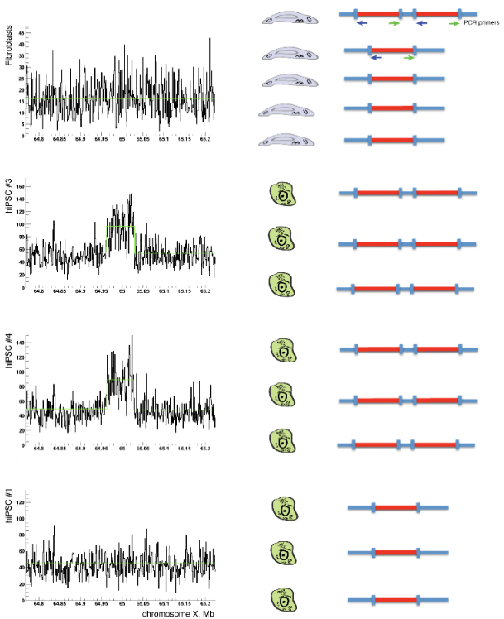
Hypothesis about somatic CNVs
1) Somatic CNVs present in few fibroblast cells (i.e., at low allele frequency) give rise to hiPSC
2) hiPSC colonies are derived from a single (or just a few) fibroblast cell
Equal DNA input
hiPSC #3 hiPSC #4 Fibroblast Control
Excess of DNA input from fibroblast
hiPSC #3 hiPSC #4 Fibroblast Control
10 (50%) out of 20 CNVs tested are present in fibroblast
Abyzov et al., Nature, Nov 18 (online)

Slide 13
QuantaLife
Abyzov et al., Nature, Nov 18 (online)

Slide 14
Abyzov et al., Nature, Nov 18 (online)

Slide 15
Abyzov et al., Nature, Nov 18 (online)

Slide 16
Conclusion
Reprogramming to hiPSC does not necessarily introduces de novo CNVs
LM-CNVs represent a small increment to existing natural CNV variation between individuals
>50% of LM-CNVs pre-existed in fibroblast as somatic CNVs
Possibly 30% of fibroblast cells carry somatic CNVs
(6 out of 20 hiPSC lines have somatic fibroblast CNVs)
Frequency of somatic CNVs varies from 0.3% to 15%
Expression of overlapping genes is affected (generally in the direction of copy number change), but no effects on neuronal differentiation potential or genome-wide expression changes
Abyzov et al., Nature, Nov 18 (online)
Notes:
It is non-cancer but it is obvious it can be applied to cancer.

Slide 17
Acknowledgements
Yale university
Stanford university
Jessica Mariani
Dean Palejev
Ying Zhang
Livia Tomasini
Anthony Ferrandino
Lior Rosenberg Belmaker
Anna Szekely
Michael Wilson
Arif Kocabas
Nathaniel E. Calixto
Elena L. Grigorenko
Anita Huttner
Katarzyna Chawarska
Sherman Weissman
Mark Gerstein
Flora M. Vaccarino
Alexander Eckehart Urban
Michael Seamus Haney
Also people in
Snyder lab
Gerstein lab

