Slide 1
SV discovery and analysis (phase II&III)
Gerstein lab
November 5, 2012

Slide 2
Analyses
Deletion & duplication calls (CNVnator)
Per population
Per individual (including CG data?)
Breakpoint selection and analysis
Retroduplication calls
Per population
Per individual

Slide 3
Deletion & duplication calls
Using CNVnator with minor improvements and additional stringency from finding PE support

Slide 4
Breakpoint selection (summary of current analysis)

Slide 5
Gold set of 12,774 breakpoints (update numbers)
11%-19% of SVs are also found by Mills-Devine set
Comparison is inexact for cases with micro-homology and micro-insertion due to different conventions
24% are on OMNI 2.5s array
First round of PCR validation of 60 random events
48 tested
18 (38%) perfectly validated
2 (4%) validated with different breakpoints
2 (4%) invalidated
1 (2%) unclear – no match in the reference genome
25 (52%) unclear PCR status

Slide 6
Genotypes for breakpoints on OMNI 2.5s (update)
Total of 4,385 breakpoints genotypes on XXX samples
3,084 (70.3%) are part of gold set
XXX IRS FDR
More comprehensive but very concordant with genotypes assigned by read mapping to junction sequence

Slide 7
Retroduplications (future analysis)

Slide 8
What is retroduplication?
Gene
Distant locus
Genome
mRNA
Genome
Gene
Retroduplication
Notes:
Most of Ψgenes are processed

Slide 9
Approaches
Gene
Novel retroduplication
Person
( )
( )
( )
Splice junction
library
Unique sequences
Bowtie mapping
Unmapped genomic reads
Gene
Novel retroduplication
Read sequencing
…
Person
Reference
…
Read mapping
Cluster
Notes:
Split-read and paired-end approaches

Slide 10
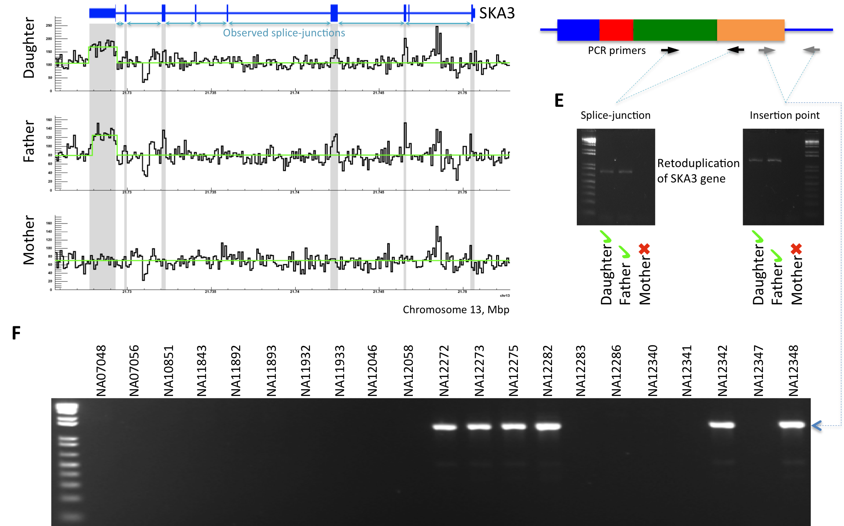
In phase I
Discovered 147 retroduplications in Phase I data
Notes:
Split-read and paired-end approaches

