Slide 1
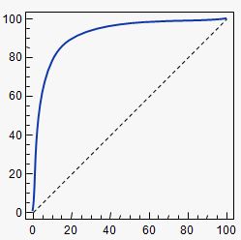
1
Sequencing Data
>seq19834
aattggcatgatagcctcgatsgctaaaaaa...
>seq873
gatcttctgataggtcactctcgatsgctggccaaaaa...
Non human matches
Filter
Microbial genomes annotation
library
AlignmentBlocks ID
Chr1:+:201:205:1:50 1
Chr5:-:561:510:1:50 2
Chr3:+:724:773:1:50 3
ID Sequences
1 gtcgtctgatt……………..
2 atgctcgctactac..
3 ctctcgcctctgrgac…
2
Splicing
Dynamics
IQSeq
RSEQtools
De novo splice discovery tools
Trans Splicing
FusionSeq
3
RNA
Databases:
miRBase
Ensembl
….
Gene
Annotation
GENCODE
Pseudogene
Annotation
psiDR
4
exRNA transcription
New
Statistics
Tools
True Positive Rate
ROC
5
False Positive Rate
>Seq1
atgctgatcccttctcgtagtaatctcctaatatattgtagtgcagcagtgctg……….
>pepSeq1
MLICRPTSSAAGVILMGFHISPLTCADAAGGRL…
Protein Databases
Peptide matches
6
RNA
editing
sites
Allele Specific
Expression
AlleleSeq

