Slide 1
mod/ENCODE Transcription Comparison Paper
10/19/2012

Slide 2
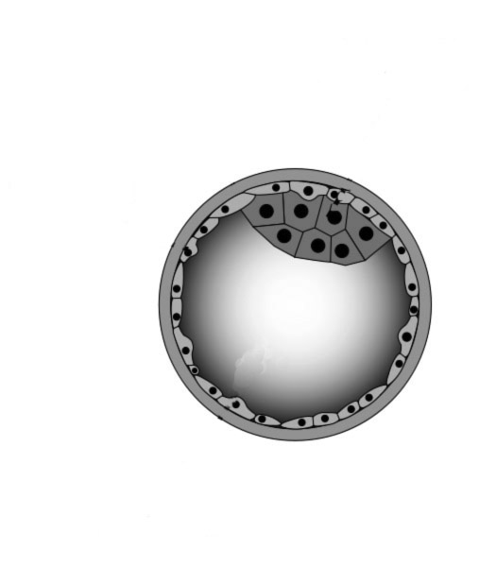
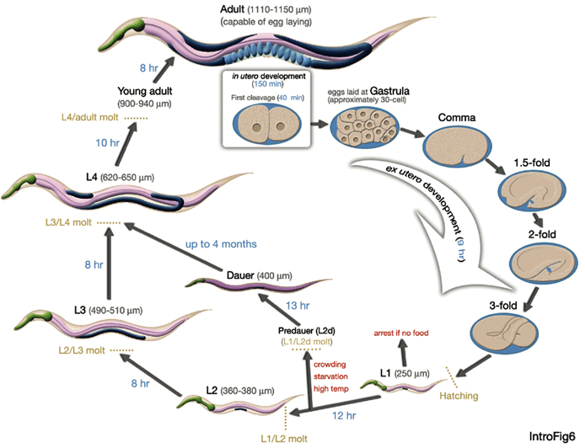
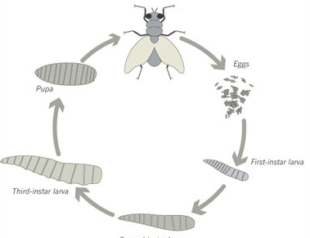
Figure 1: Data Sets
Gm12878
K562
HepG2
HeLa-S3
Chromatin structure
HUVEC
DNA methylation
MCF7
Open Chromatin
… …
RNA profiling
TFBS & Histone
H1-hESC
Other chromatin binding sites
Adult
H1-neurons
Adult
Early embryo
Yong adult
Embryo
Pupa
L4
Late embryo
L1
L3
L3
L1
L2
L2

Slide 3
Table 1: Summary Statistics for Protein Coding Genes
Table 1a

Slide 4
Figure 2: Splicing Figure
Significant amount of protein-coding gene splicing complexity
There is a consistent pattern of splicing events in all three organisms
with more retained introns in fly and worm
more on / off events in fly casette exons
more lowly expressed minor isoforms in human

Slide 6
Figure 3: Orthologs
Orthologous genes do not have orthologous splice isoforms.
More fly genes with no alternative splicing
More human genes with alternative splicing in domains

Slide 7
A
C
Example
B
D

Slide 8
Figure 4: Comparison of ncRNAs
Using our uniform processing procedure compared, we identified more pervasive transcription in human compared to worm and fly.
We clustered the TARs wrt histone modification signals, conservation, CSF: Enriched in non-coding elements and compared the clusters: Human show the most amount of non-coding pervasive transcription

Slide 9
 |  |  | Human (GENCODE v10) hg19: 3,095,677,412 bps | Worm (WS220) ce10: 100,286,070 bps | Fly ( FlyBase R5.45) dm3: 168,736,537 bps
Annotations | Micro RNAs (miRNAs) |  | 160,476 bps (1,771) | 4,074 bps (203) | 22,103 bps (239)
 | Transfer RNAs (tRNAs) |  | 45,468 bps (625) | 45,553 bps (651) | 22,998 bps (314)
 | Ribosomal RNAs (rRNAs) |  | 96,155 bps (712) | 22,740 bps (44) | 79,813 bps (160)
 | Small nucleolar RNAs (snoRNAs) |  | 170,710 bps (1,594) | 15,028 bps (139) | 33,522 bps (287)
 | Small nuclear RNAs (snRNAs) |  | 214,453 bps (2,017) | 14,099 bps (114) | 7,136 bps (47)
 | Miscellaneous RNAs |  | 180,973 bps (1,190) | 3,219,259 bps (49,305) | 1,719,130 bps (604)
 | Long non-coding RNAs (lncRNAs) |  | 316,105,197(11,790) | TBD from Nam, Bartell 2012 | TBD (CR fly r5.45)
 | Repeats |  | 1,457,724,597 bps (3,986,522) | 13,248,996 bps (89,336) | 44,701,713 bps (135,355)
In silico Predictions | incRNA predictions | Type 1
 |  | Type 2
 | Transcriptionally Active Unannotated Regions* | 80% Exon Discovery | xxx,xxx,xxx bps (xx,xxx) | 5,034,040 bps (64,304) | 3,517,469 bps (27,098)
 |  | 90% Exon Discovery | xxx,xxx,xxx bps (xx,xxx) | 15,323,269 bps (256,509) | 7,531,278 bps (128,815)
* Transcriptionally active regions as identified by the uniform processing for Worm, Fly, and Human RNA-seq data

Slide 10
Figure 5: Pseudogenes
Pseudogene distribution shows an enrichment of processed pseudogenes in Human, a relative ratio of 3:1 of duplicated to processed pseudogenes in Worm and an equal distribution in Fly.
On average 1 in 10 pseudogenes is transcribed.
Sequence similarity to parent genes reveals marking points in the organism evolution – burst of retrotransposition events in humans & large scale gene duplication in worm.
Pseudogenes are classified into 3 classes: - active, partially active and inactive based on transcription & upstream elements features.
Case study of ribosomal protein S6 gene orthologs:
The human gene gave rise to 24 pseudogene transcripts of which 1 is transcribed, the fly orthologue has only 1 related pseudogenes, and there are no known related pseudogene in worm.
Relative distribution of pseudogenes in the orthologs trio can be indicative of gene access & importance.

Slide 12
Figure 6: Histone and TF Models for Gene Expression
Can build models to predict gene expression using either histone modification or TF binding in all three organisms
Similar model (similar feature weights) in all three organisms (transferable?)
Model works for both predicting coding gene and ncRNA expression
Comparing embryo in worm and fly with human stem cells we see very few genes that are show stalled or burst behavior (comparing Pol II binding with expression) in more than one organism

Slide 15
Figure 7: Expression Clustering of Coding Genes and ncRNAs
Identify all possible worm-fly-human orthologous triplets from merged list of MIT+Ensembl
Calculate expression correlations and genomic distances between ncRNAs and those orthologs in three species
Find potential orthologous w-f-h ncRNAs that are nearby to and also highly correlate with corresponding w-f-h orthologs, and show a good example
Cluster orthologs and ncRNAs into co-expression modules using hierarchical clustering or Potts model, and find potential functional orthologous w-f-h ncRNAs clustered in w-f-h modules enriched with orthologs
Identify highly conserved genes and species-specific genes in all three species by looking at their persistent indices.
Worm-Fly development stage mapping
Worm LE stage maps to both fly LE and prepupa stages

