Slide 1
Update on Detecting network modules across species
KKY
Sept 28, 2012

Slide 2
Detecting modules is an optimization problem
Reward non-links between modules
Punish links between modules
Potts model
Reward links within a module
Punish non-links within a module

Slide 3
Sign of interactions matter for co-expression network
positive
negative
Reward NEG links between modules
Punish NEG non-links between modules
Reward non-links between modules
Punish links between modules
Reward NEG non-links within a modules
Punish NEG links within a module
Reward links within a module
Punish non-links within a module

Slide 4
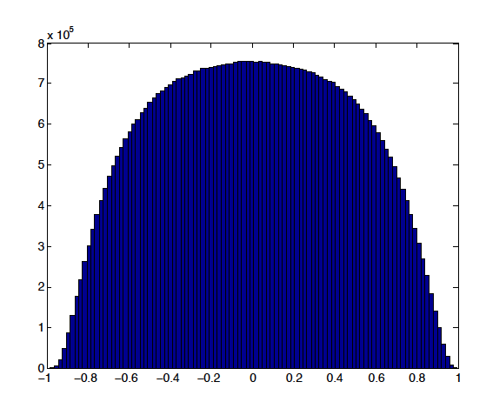
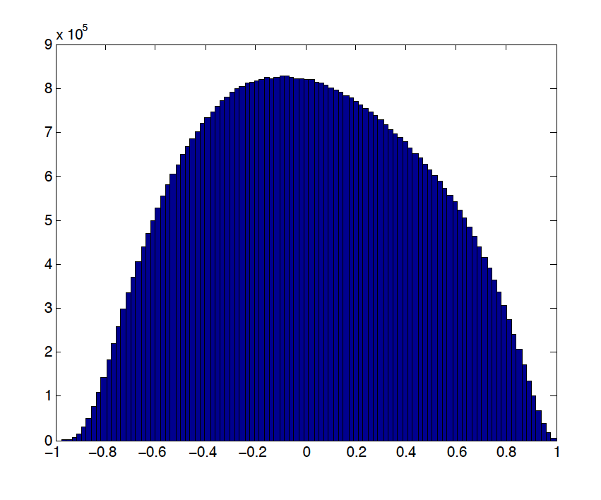
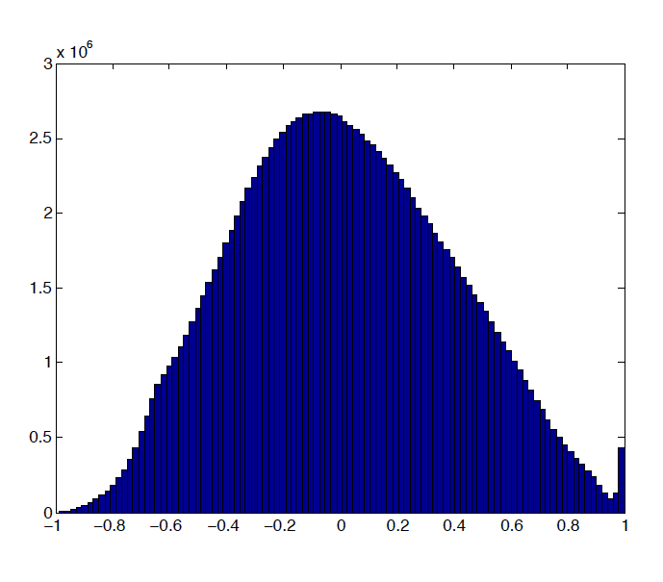
Co-expression networks for worm, fly, human
 | Worm | Fly | human
Number of Genes (stages/cell types) | 10450 (33) | 10377 (30) | 16572 (21)
Ap: 1438000
An: 1342000
Ap: 1693000
An: 635000
Ap: 3276000
An: 500000

Slide 5
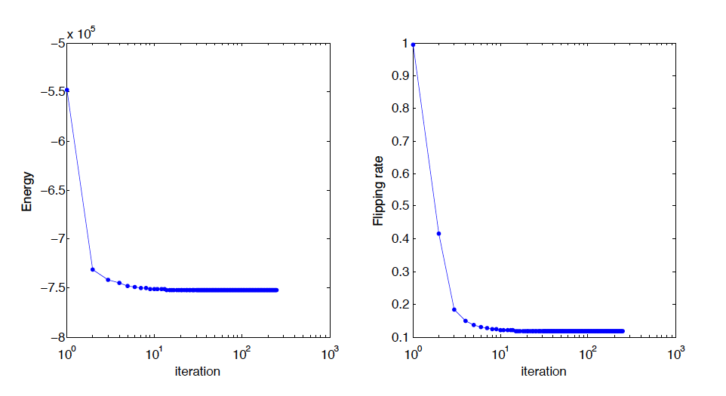
A trial on worm network
q=250, gamma=1;
Start with a random spin assignment, set T=1
Notes:
Forgot the initial

Slide 6
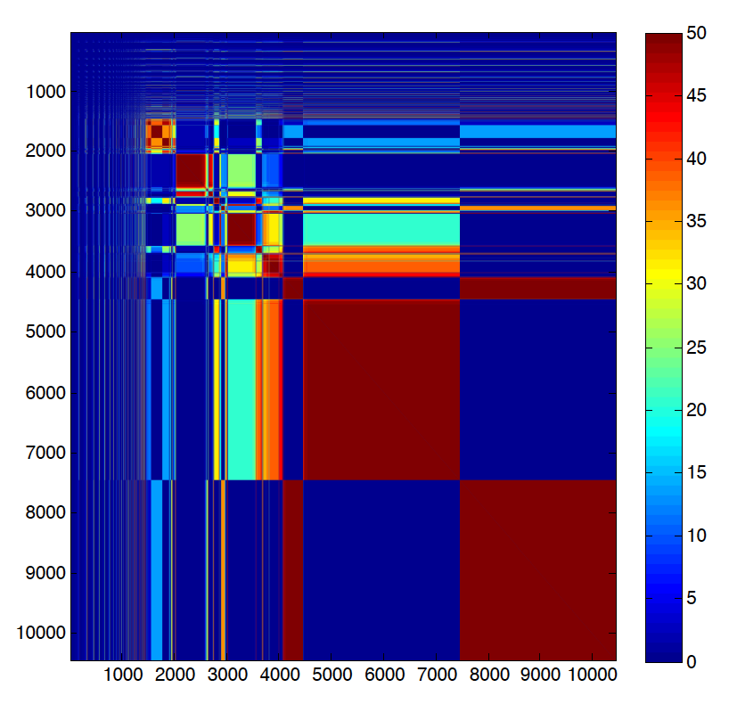
Co-appearance matrix for worm

Slide 7
Detecting modules across species
positive
negative
ortholog
Module: 2 sets from genes from 2 species, which presumably corresponding to the same biological function.
not really, weighted

Slide 8
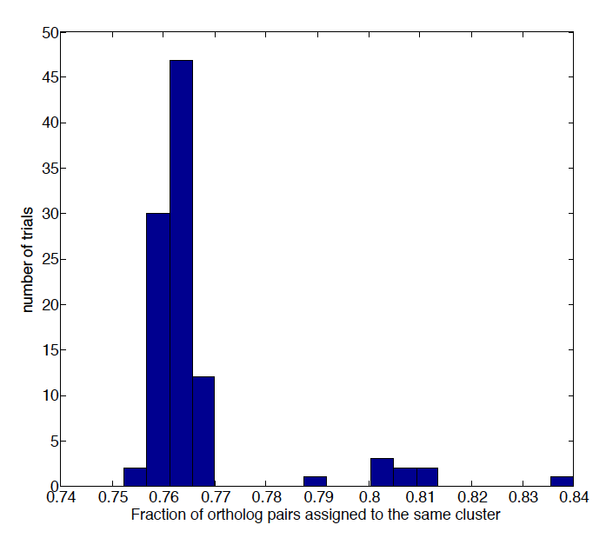
A trial on worm-fly network
Start with a random spin assignment, set T=1
q=250;gamma=1;kappa=100;
worm
fly
orthologs

Slide 9
Generalization to worm, fly, human
Straight-forward
The 3 co-expression networks are not very consistent…

