Slide 1
Pseudogene Distribution
Sequence Analysis
Human
Human
Worm
Fly
Partial Activity
Human
Worm
Fly
Worm
T
Tr
TF
P
C
11216
946
113
876
10340
146
800
11
102
394
482
3422
6918
53
93
549
251
7
4
26
76
36
358
19
463
102
3220
327
6791
10
43
21
73
74
3220
74
165
3
4
2
2
24
2
37
39
T – Total Tr – Transcription TF – Transcription Factor P – Pol2 C – Open Chromatin
xx – YES xx – NO
Orthology
Human
555 (2145)
Fly
Pgene Gene | Human 2145 | Worm 8 | Fly 15
Human 555 | 2113 550 | 4 2 | 28 3
Worm 8 | 2 2 | 6 6 | -
Fly 8 | 6 3 | - | 9 5
2
3
0
Worm 8 (8)
0
Fly 8 (15)

Slide 2
Sequence Similarity Human
Similarity % | Duplicated | Processed
47.5 | 1 | 8
52.5 | 37 | 189
57.5 | 126 | 514
62.5 | 96 | 504
67.5 | 166 | 561
72.5 | 115 | 704
77.5 | 92 | 462
82.5 | 102 | 687
87.5 | 119 | 1023
92.5 | 114 | 1659
97.5 | 150 | 723
Total | 1118 | 7034

Slide 3
Sequence Similarity Worm
Similarity % | Duplicated | Processed
42.5 | 34 | 16
47.5 | 41 | 27
52.5 | 56 | 22
57.5 | 48 | 12
62.5 | 46 | 13
67.5 | 38 | 14
72.5 | 35 | 9
77.5 | 44 | 12
82.5 | 34 | 10
87.5 | 23 | 11
92.5 | 28 | 3
97.5 | 11 | 5
Total | 438 | 154

Slide 4
Sequence Similarity Fly
Similarity % | Duplicated | Processed
45 | 2 | 4
55 | 5 | 7
65 | 4 | 6
75 | 2 | 2
85 | 10 | 3
95 | 11 | 9
Total | 34 | 31

Slide 5
Orthologs
1935 gene orthologs 1-1-1 for human, worm, and fly
There are no 1-1-1 ortholog genes with pseudogenes in all three organisms
Pgene Gene | Human 2145 | Worm 8 | Fly 15
Human 555 | 2113 550 | 4 2 | 28 3
Worm 8 | 2 2 | 6 6 | -
Fly 8 | 6 3 | - | 9 5

Slide 6
Case Study I – Ribosomal Protein S6 Human ENSG00000137154 – Worm Y71A12B.1 – Fly RpS6
Essential gene
Human – 5 transcripts
Worm – 2 transcripts
Fly – 2 transcripts
Pseudogenization occurs in human & fly only
Human – 25 processed pseudogenes (3 gene transcripts) -> 1 transcribed
Fly – 3 processed pseudogenes
Sequence similarity
Human : Parent – Pgene : 78..93 %
Human : Parent – Fly Parent : 71 %
Human : Parent – Worm Parent : 72 %
Fly: Parent – Pgene : 84..85%
Worm – Fly : Parent genes: 72 %

Slide 7
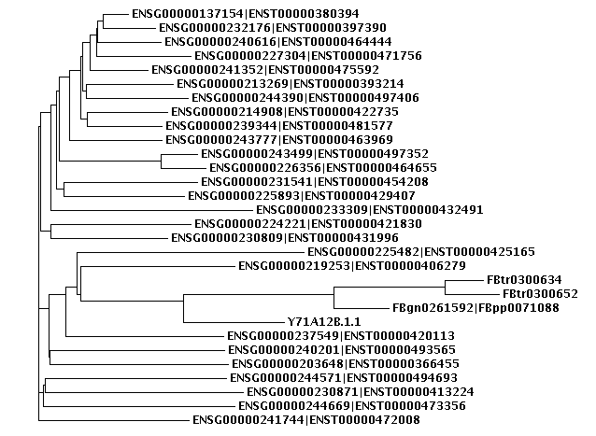
Human Pseudogenes
Fly
Worm
Human Pseudogenes

