Slide 1
Group meeting
Alexej Abyzov
September 19, 2012

Slide 2
Outline
Human iPSC and somatic variations
Variability in retroduplications

Slide 3
Outline
Human iPSC and somatic variations
Variability in retroduplications

Slide 4
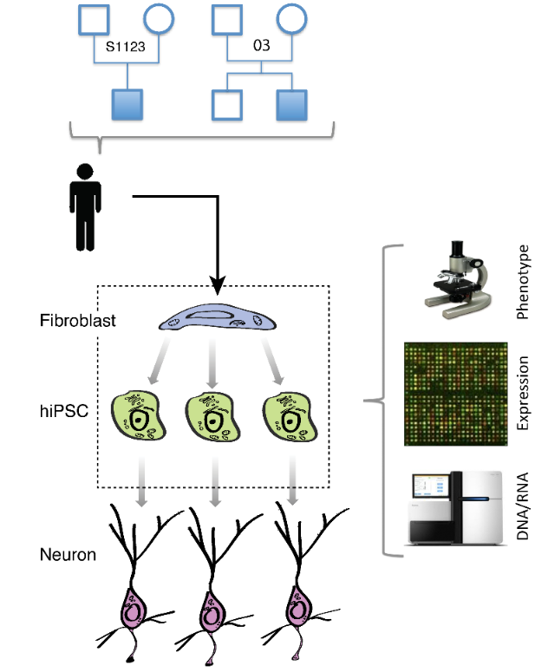
Experimental design and goal
7 individuals, 21 hiPSC lines
Few previous studies reported large numbers of de novo CNVs in hiPSC
Is the hiPSC genome stable during reprogramming?
What is the cause/origin of hiPSC line-manifested CNVs (LM-CNVs)?
Abyzov et al. (in revision)
Notes:
This can be used to study somatic CNVs.

Slide 5
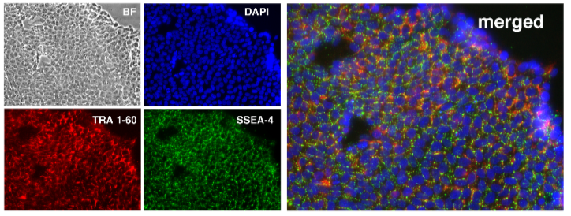
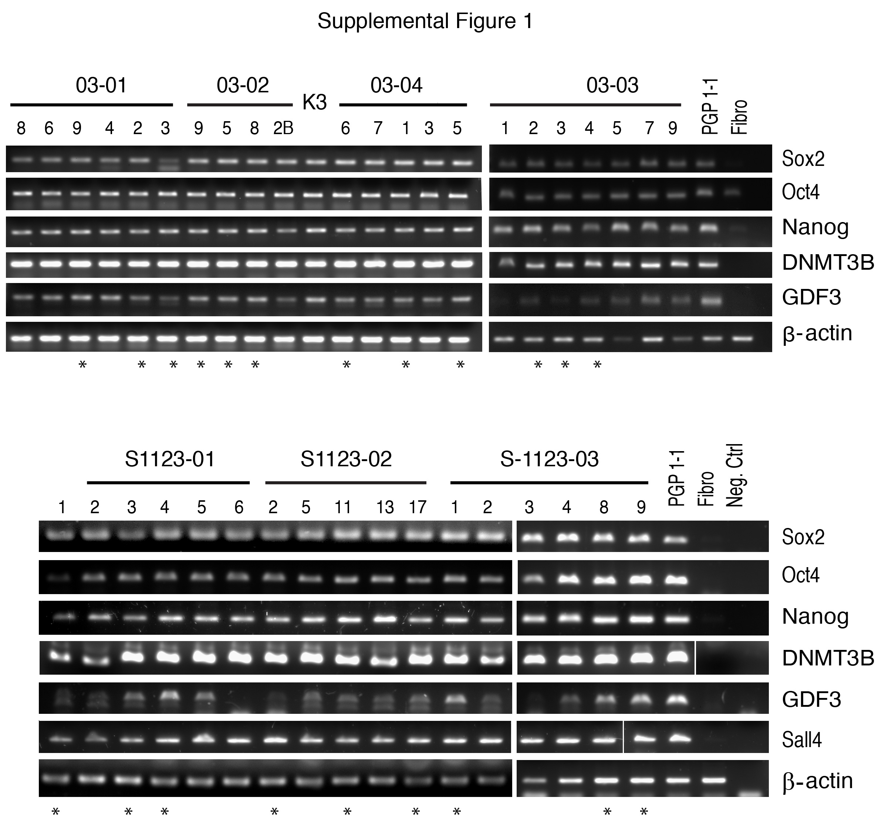
hiPSC characterization
Abyzov et al. (in revision)

Slide 6
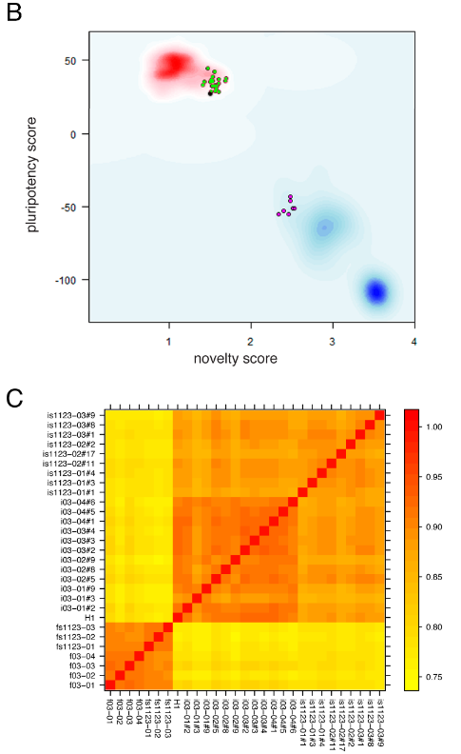
hiPSC characterization
hiPSC
Neurons
Abyzov et al. (in revision)

Slide 7
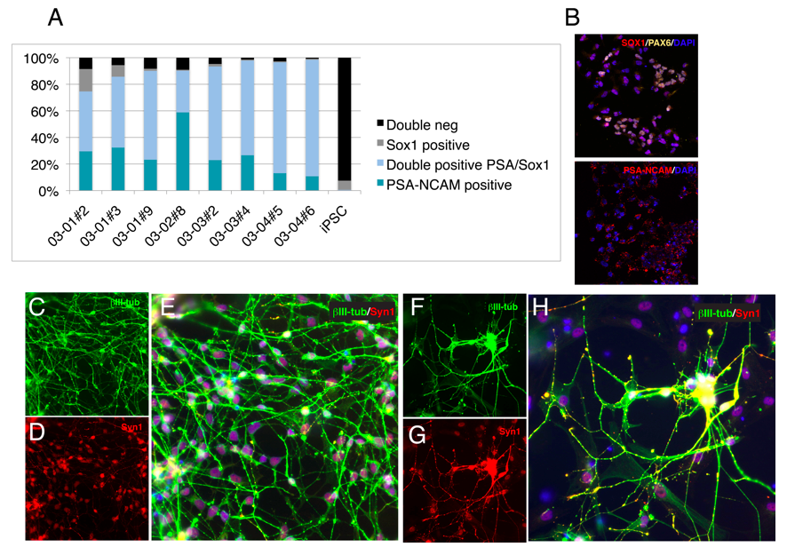
Neurons from hiPSC
Abyzov et al. (in revision)

Slide 8
Characterizing hiPSC genomes

Slide 9
Example of LM-CNV
Gene in duplication has increased expression
Abyzov et al. (in revision)

Slide 10
LM-CNVs are not burden
Abyzov et al. (in revision)

Slide 11
Validation of LM-CNVs by qPCR

Slide 12
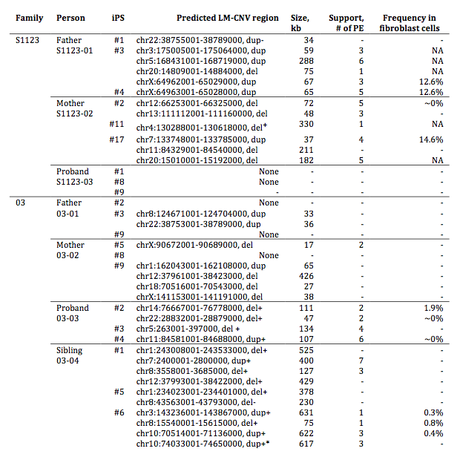
33 qPCR
validated LM-CNVs
in 15 hiPSC
+Validated in
late passage
-Invalidated in
late passage
Abyzov et al. (in revision)

Slide 13
What is the origin of LM-CNVs?

Slide 14
+Validated in
late passage
-Invalidated in
late passage
Abyzov et al. (in revision)

Slide 15
Read Depth and qPCR results
Pearson correlation 0.96
Validated
Invalidated
Negative control
Expected outcome for
homogeneous cell populations in
fibroblast and hiPSC
Abyzov et al. (in revision)

Slide 16
LM-CNV preexisted in fibroblast populations

Slide 17
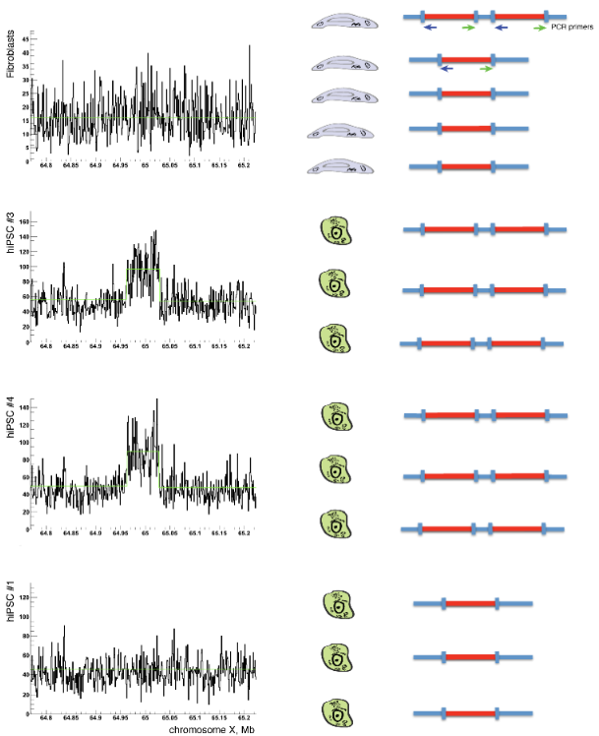


Hypothesis about somatic CNVs
1) Somatic CNVs present in few fibroblast cells (i.e., at low allele frequency) give rise to hiPSC
2) hiPSC colonies are derived from a single (or just a few) fibroblast cell
Excess of DNA input from fibroblast
hiPSC #3 hiPSC #4 Fibroblast Control
Equal DNA input
hiPSC #3 hiPSC #4 Fibroblast Control
10 (50%) out of 20 CNVs tested are present in fibroblast
Abyzov et al. (in revision)

Slide 18
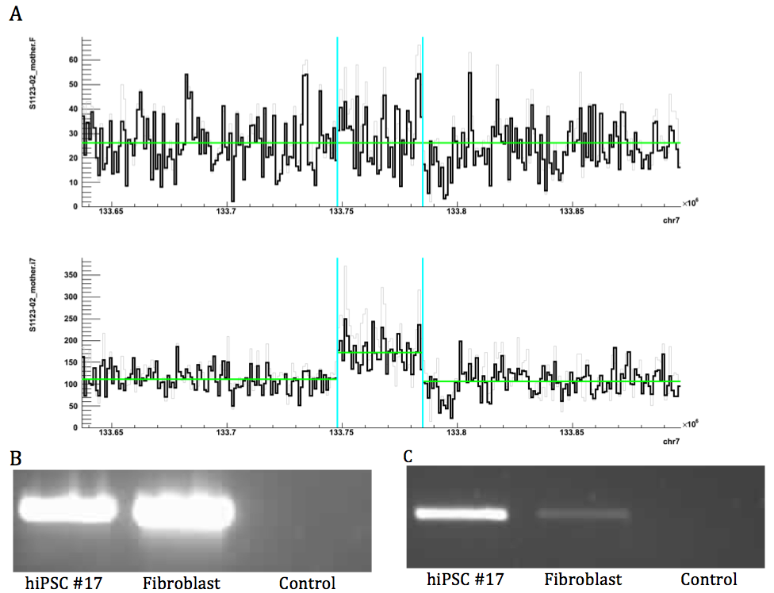
Example (S1123-03 #17)
Abyzov et al. (in revision)

Slide 19
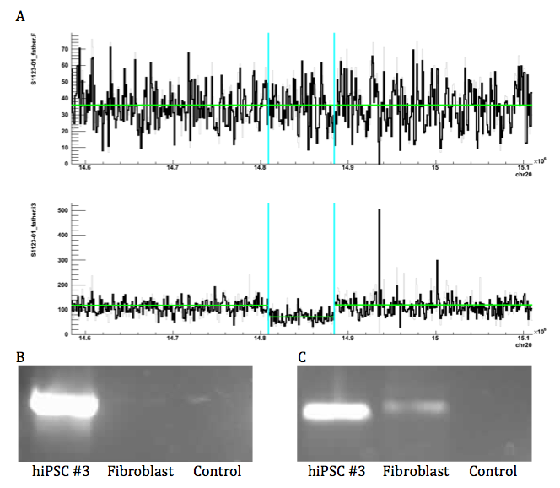
Two cycles of amplification
(S1123-01 #3)
Abyzov et al. (in revision)

Slide 20
Using digital droplet PCR (ddPCR) for estimating cell frequency of somatic CNV

Slide 21
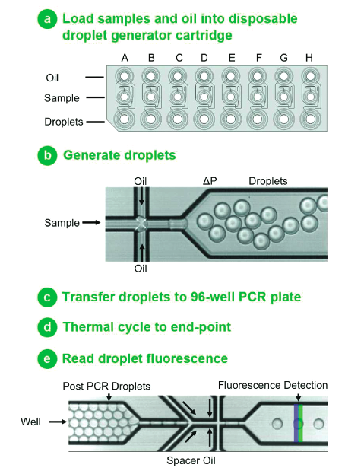
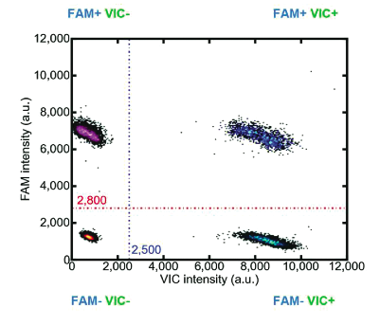
ddPCR by QuantaLife

Slide 24
+Validated in
late passage
-Invalidated in
late passage
Abyzov et al. (in revision)

Slide 25
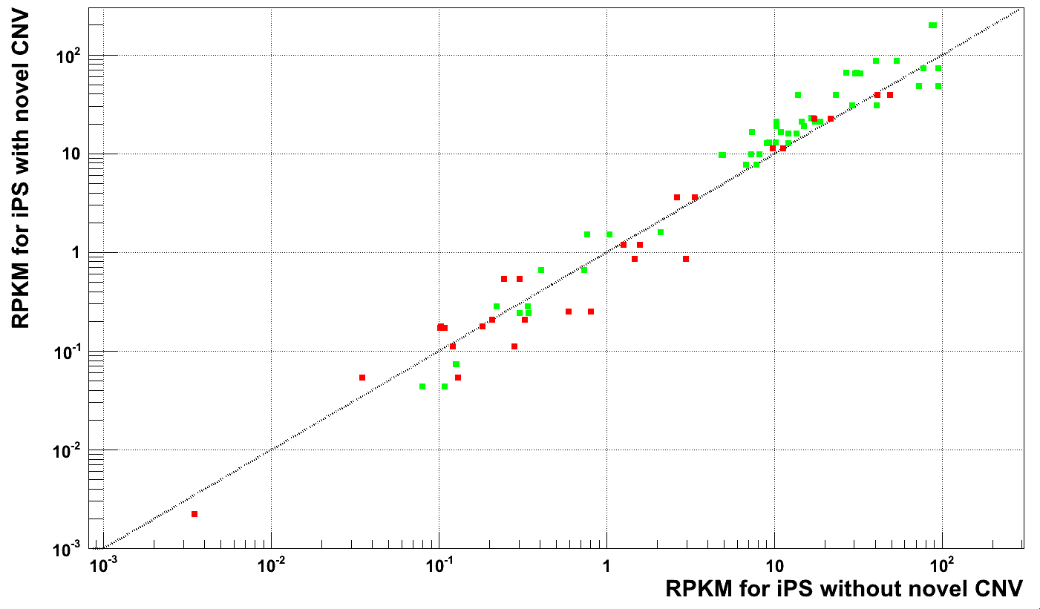
LM-CNVs affect gene expression
Genes in duplications
Genes in deletions
Fischer’s exact test
p-value = 0.01
RPKM for hiPSC with LM-CNV
RPKM in hiPSC without LM-CNV

Slide 26
Conclusion
Reprogramming to hiPSC does not necessarily introduces de novo CNVs
LM-CNVs represent a small increment to existing natural CNV variation between individuals
>50% of LM-CNVs were somatic CNVs in fibroblast
30% of fibroblast cells carry somatic CNVs
(6 out of 20 hiPSC lines have somatic fibroblast CNVs)
Cell frequency of somatic CNVs ranges from a fraction to a dozen of percent
Abyzov et al. (in revision)
Notes:
It is non-cancer but it is obvious it can be applied to cancer.

Slide 27
Outline
Human iPSC and somatic variations
Variability in retroduplications

Slide 28

Paired-ends
Read sequencing
Studied genome
Deletion
Insertion
Tandem
duplication
Inversion
MEI
Reference genome
Read mapping
Mobile
element
sequence
library
Split-read
…
Read sequencing
Studied genome
Deletion
Insertion
Tandem
duplication
Inversion
MEI
Retroduplications
Reference genome
Read mapping
Read-depth
Genotyping
Read sequencing
Studied genome
Deletion
Duplication
Deletion
Insertion
Reference genome
Mapped read count
Breakpoint
sequence
library
…
Notes:
Insertions/deletion are extreme reference bias.

Slide 29
What is retroduplication?
Gene
Distant locus
mRNA
Parent gene
Retroduplication
Disabling mutation
Retrogene
Processed pseudogene
Retrogene with new function
Expressed processed pseudogene
Notes:
Most of Ψgenes are processed

Slide 30
Variability in retroduplications
Gene
Retroduplications
Reference
Person 1
Known retroduplication
Person 2
Person 3
. . .
Reference
Person 1
Person 2
Novel retroduplication
Person 3
. . .

Slide 31
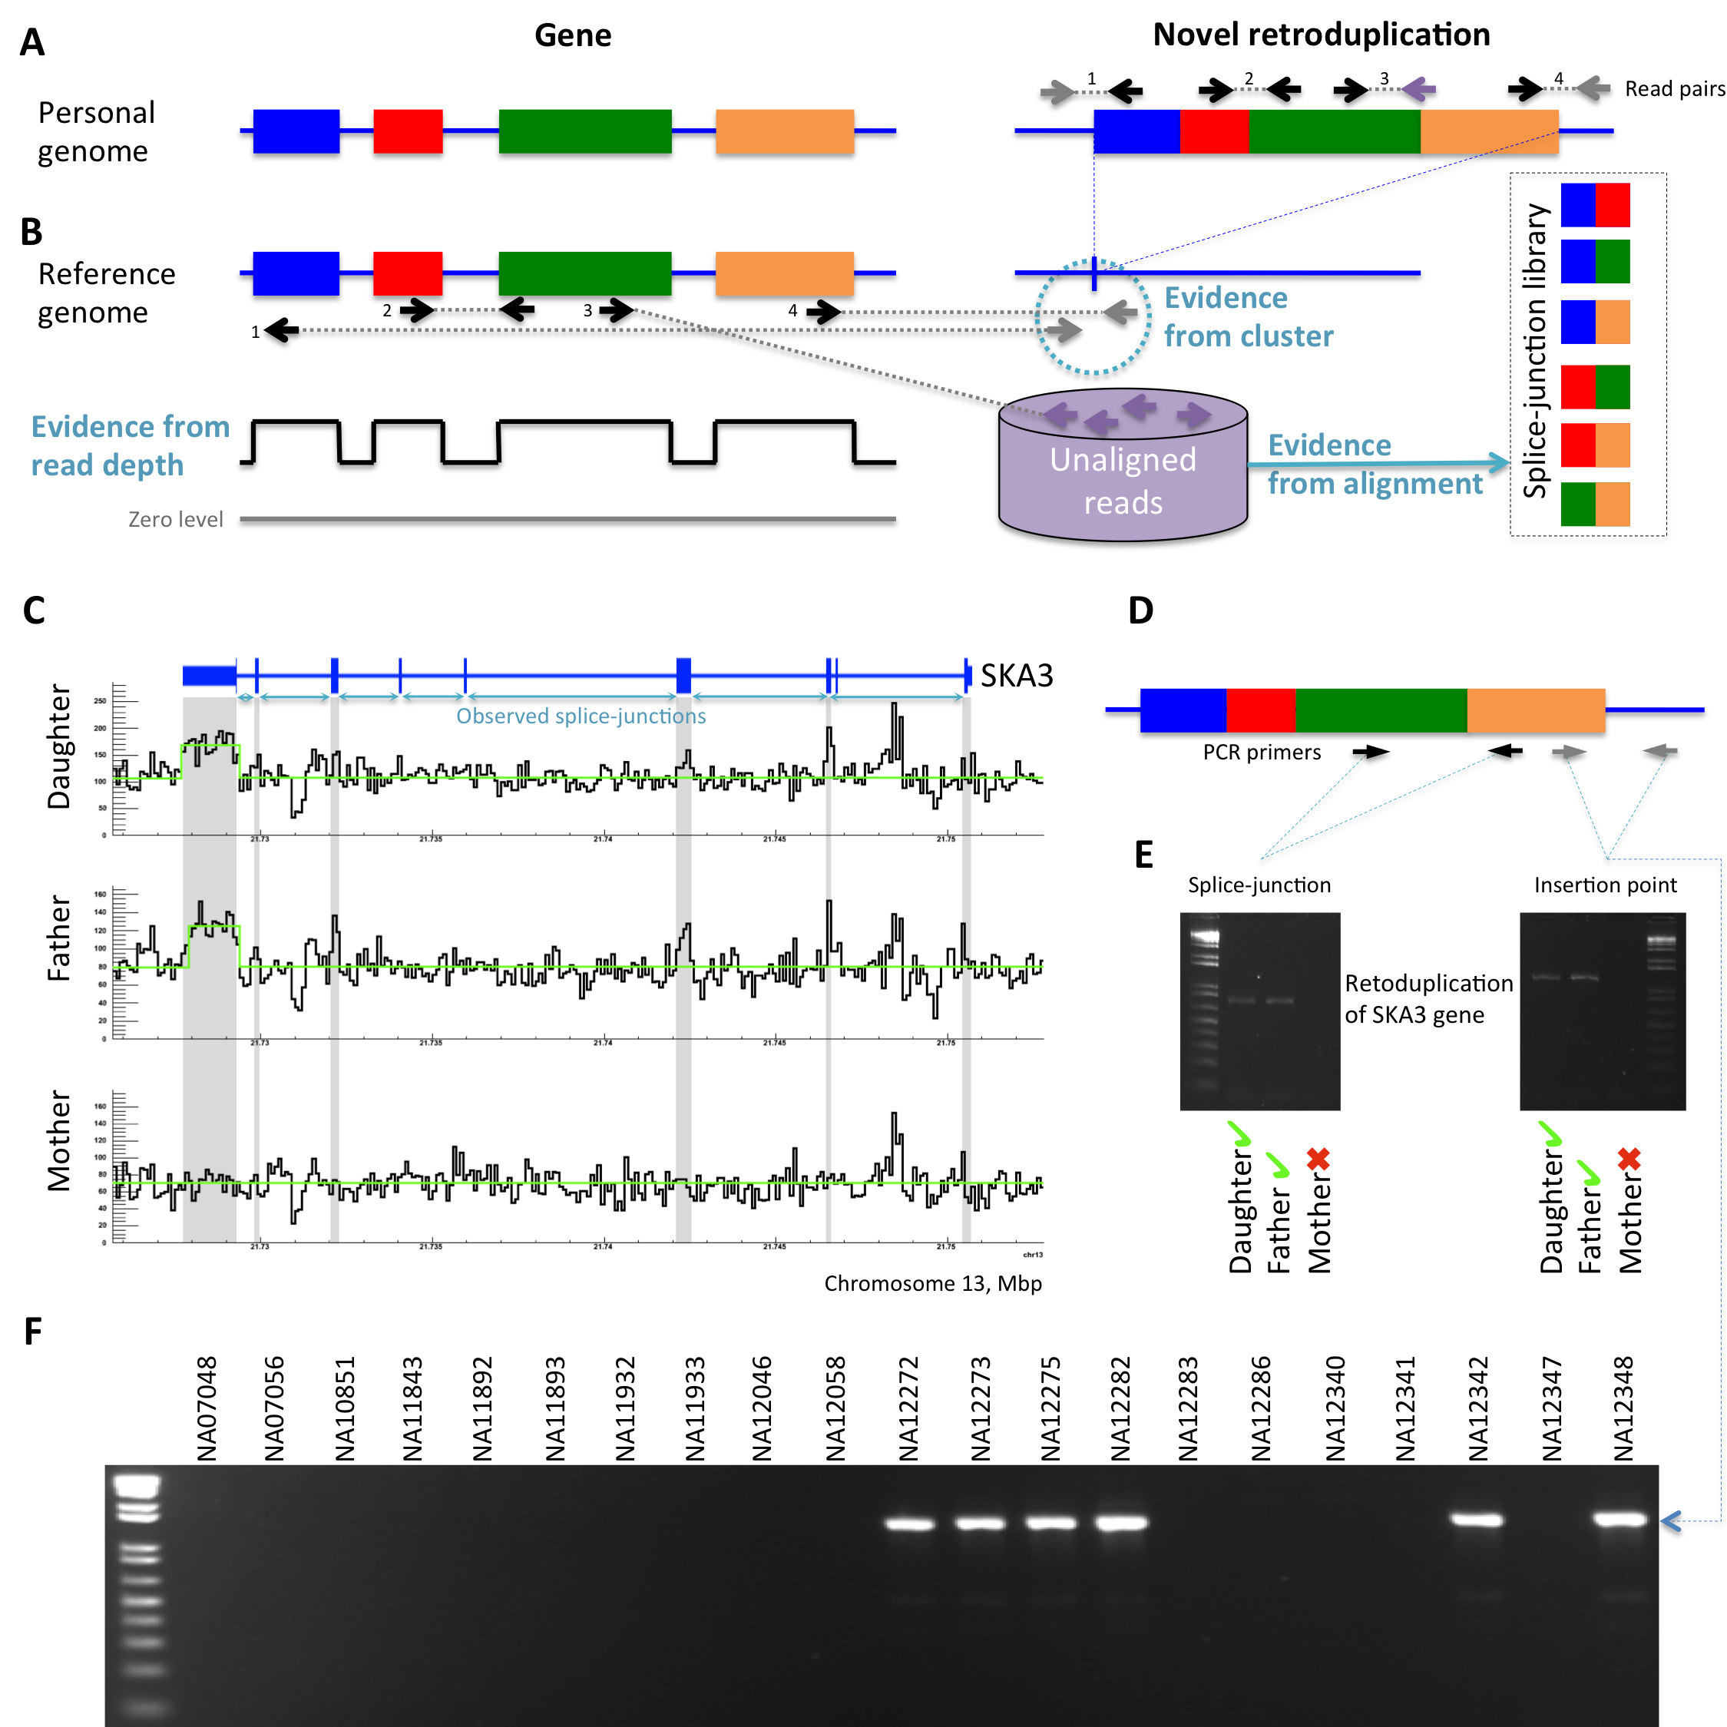
Approaches
Notes:
Split-read and paired-end approaches

Slide 32
Empirical null model
Gene model
Shift
Null model
Normal
splice-junction
library
Null
splice-junction
library
Bowtie mapping
Bowtie mapping
Unmapped reads
Unmapped reads
Gene structure is preserved but coordinates are shifted
Aim at < 5% of false discovery rate

Slide 33
Locating insertion point
Gene
Retroduplication
Read sequencing
Studied genome
…
Reference genome
…
Read mapping
Cluster
Gene
Retroduplication
Read sequencing
Studied genome
…
Reference genome
…
Read mapping
Cluster

Slide 34
Retroduplication for SKA3 gene
Notes:
Split-read and paired-end approaches

Slide 35
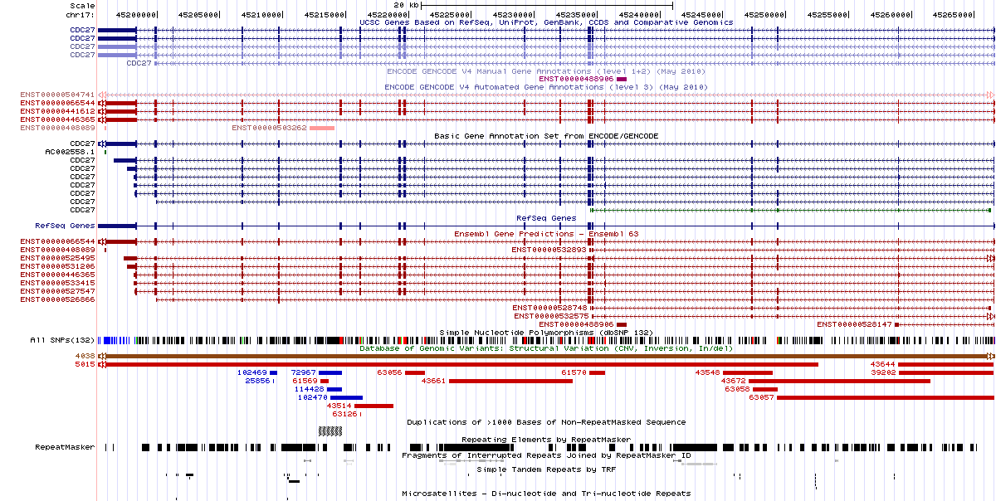
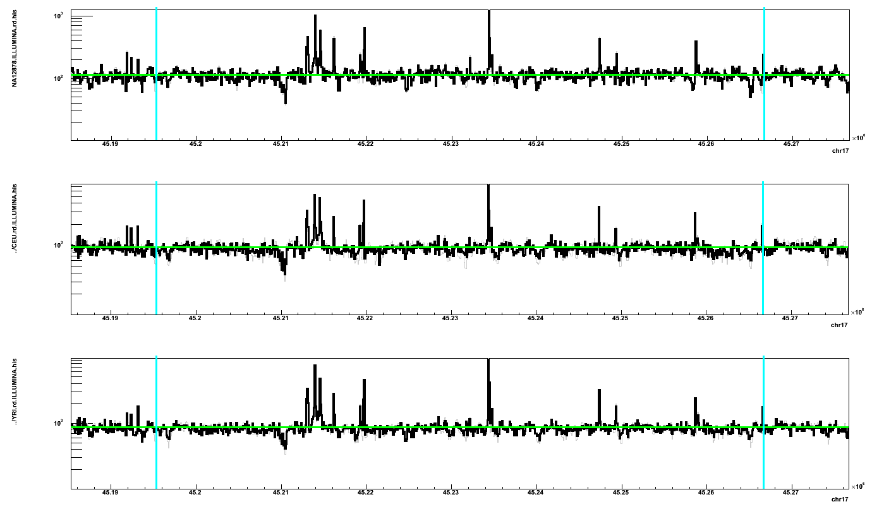
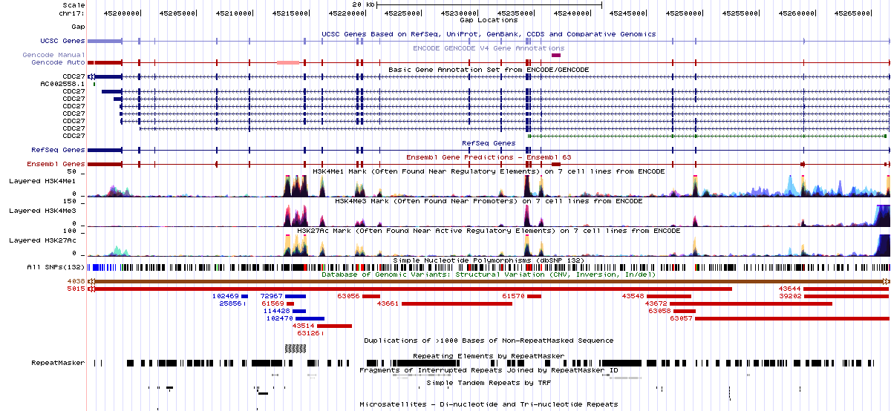
Supported slice-junctions
CDC27 gene
Known exons
Possible unknown exons
88 YRI samples 80 CEU sample NA12878 (CEU)
Chromosome 17, Mb
Histone marks
by ENCODE

Slide 36
Discovery in NA12878 (CEU)
Parent gene with predicted novel retroduplication | Additional support |  |  | PCR validation
 | Read depth support | Insertion point support | Found in Venter genome
CDC27 | Yes |  | Yes | UN
BCLAF1 | Yes |  | Yes | UN
LAPTM4B | Yes | Yes |  | Yes
MTCH2 |  |  |  | Yes
CBX3 | Yes | Yes | Yes | Yes
TMEM66 | Yes | Yes |  | Yes
TDG | Yes | Yes | Yes | Yes
BOD1 |  |  |  | Yes
CACNA1B |  | Yes |  | Yes
SKA3 | Yes | Yes |  | Yes
AP3S1 | Yes |  | Yes | Yes
AC131157.1 |  |  |  | N/A
AL590623.1 | Centromere

Slide 37
Retroduplications by population
Notes:
Needle in haystack.

Slide 38
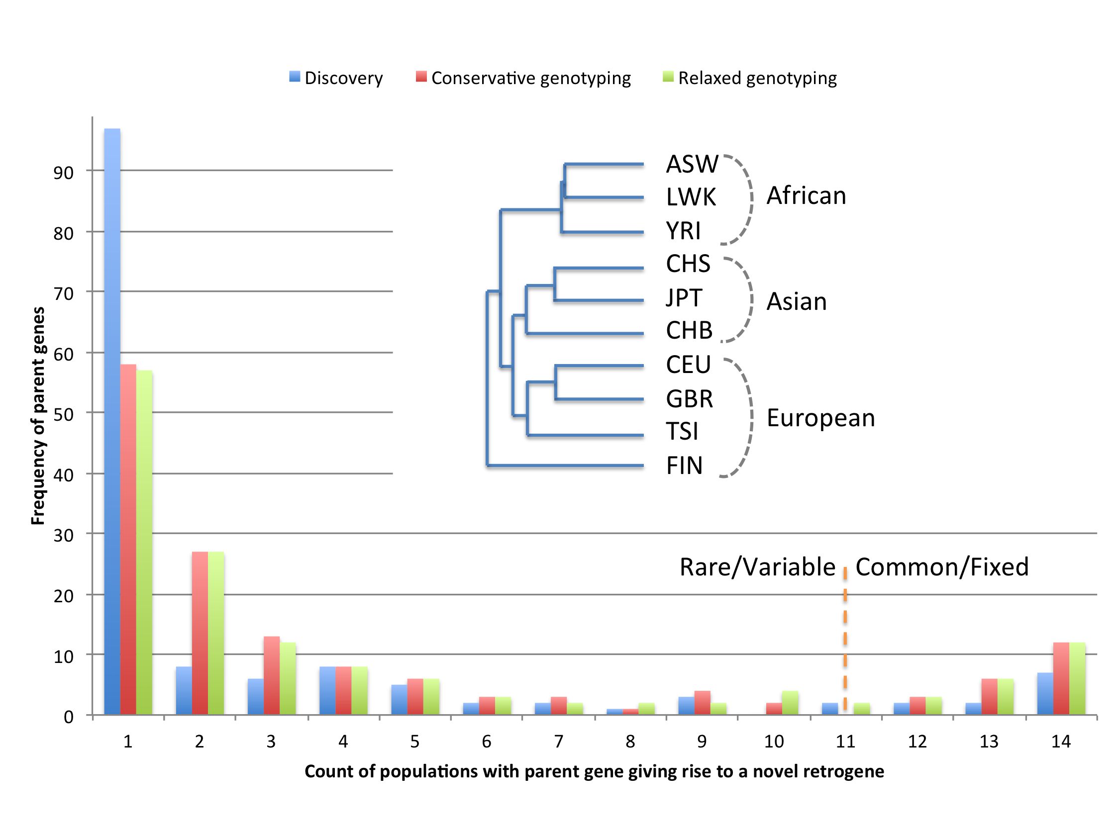
Total of 145 of parent genes
are predicted to have
novel retroduplication

Slide 39
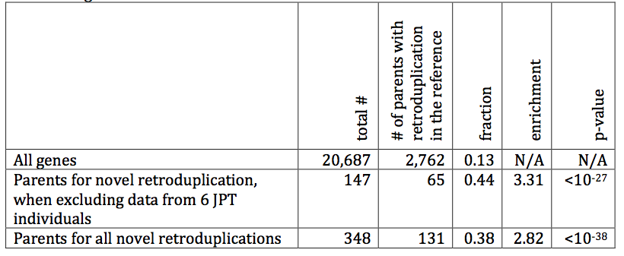
Buy one get one free!

Slide 40
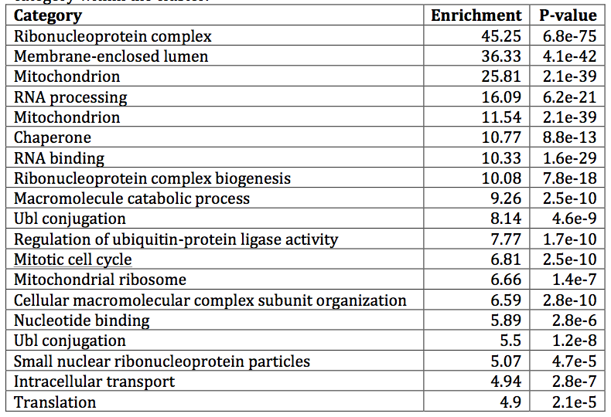
GO enrichment for parents

Slide 41
Hypothesis
Retrotransposition is coupled to cell division

Slide 42
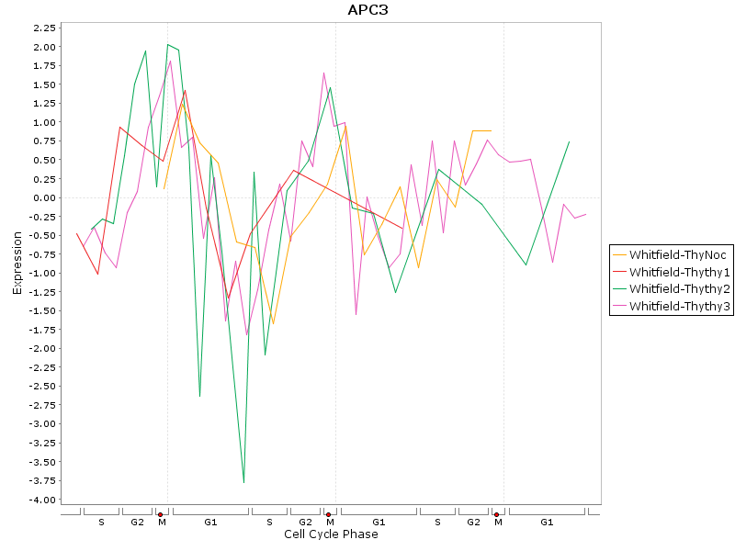
Periodic expression of CDC27 gene

Slide 43
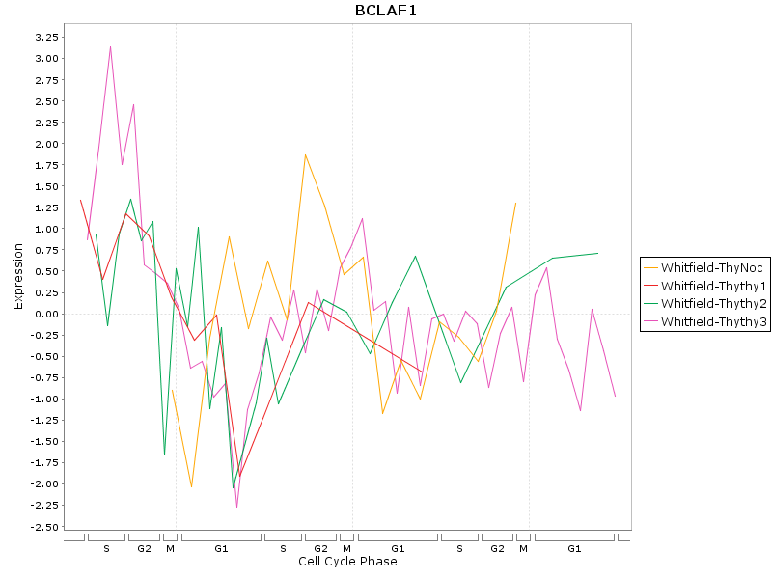
Periodic expression of BCLAF1 gene

Slide 44
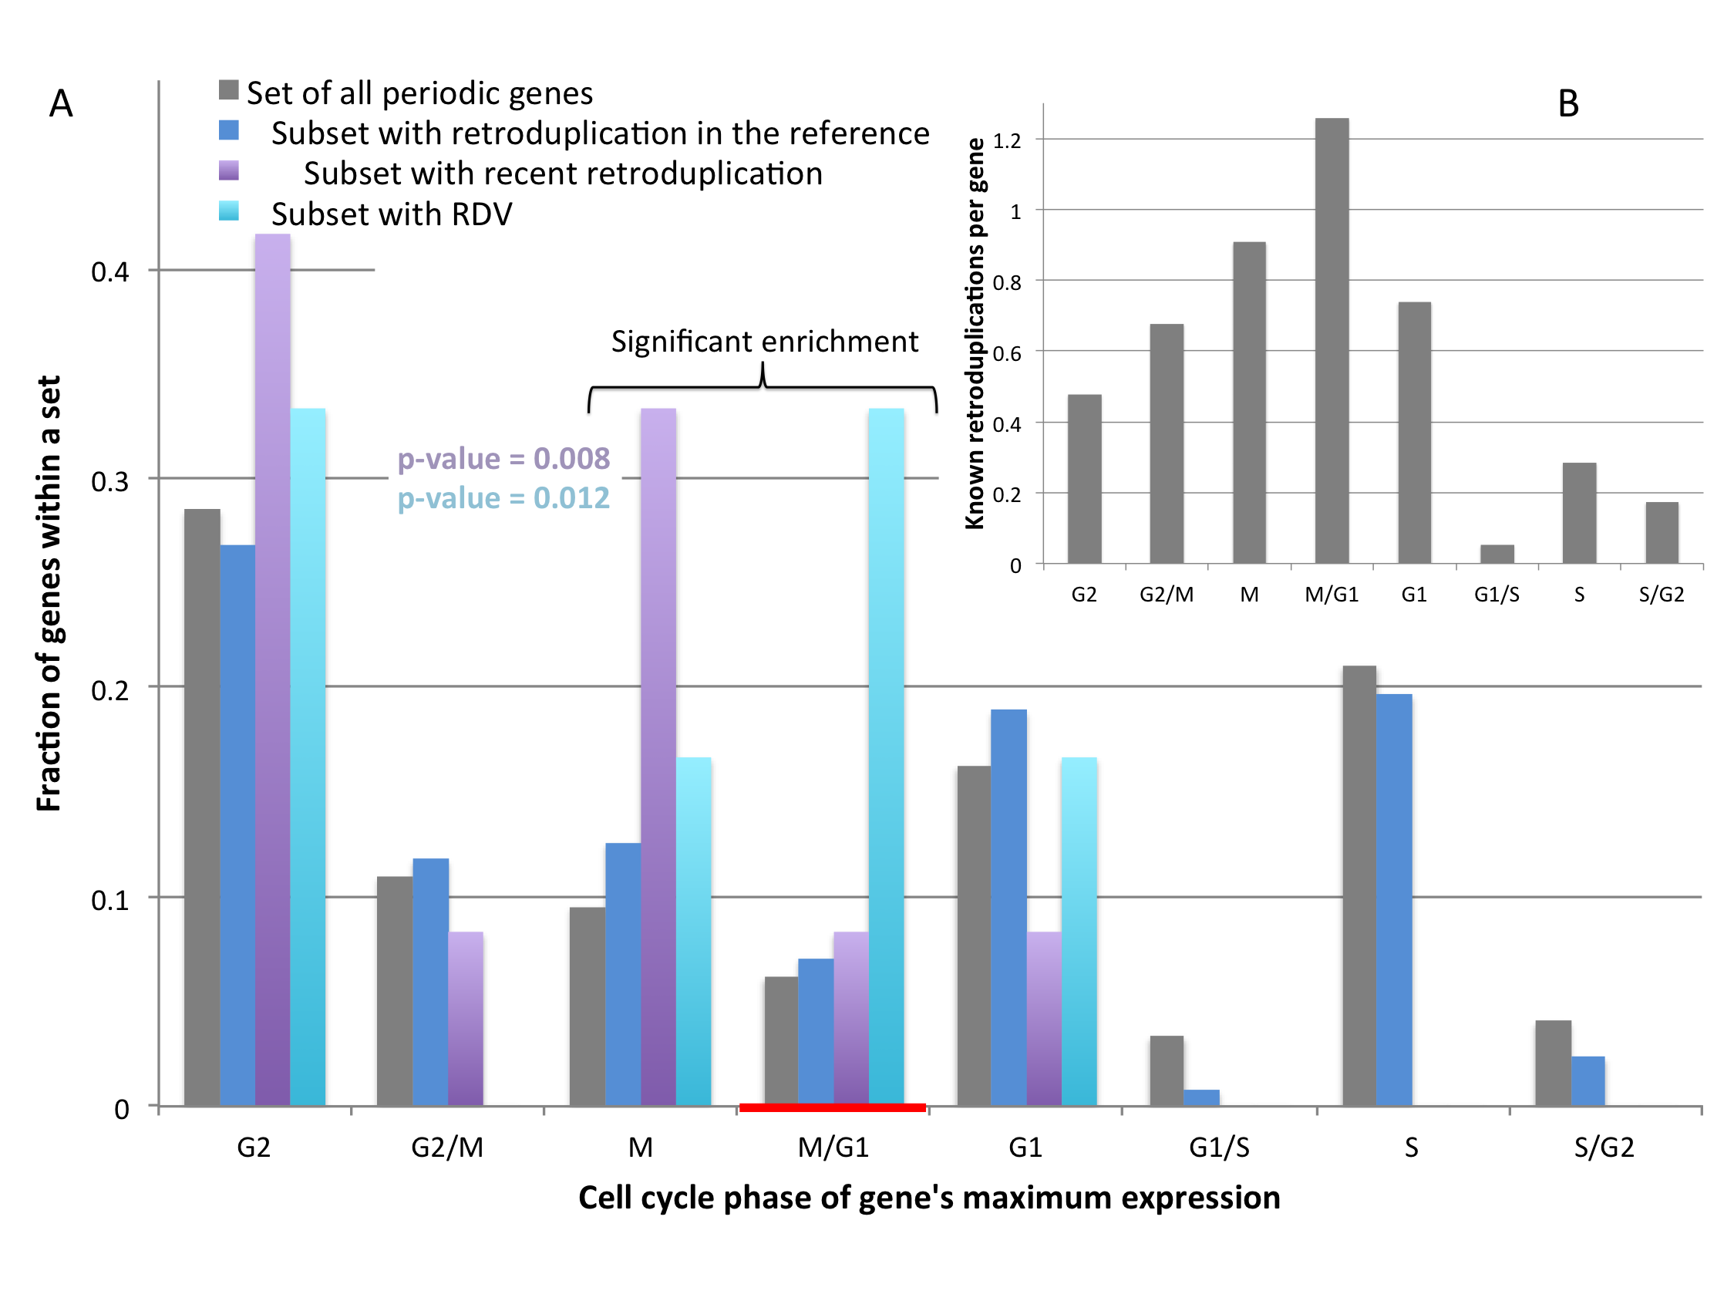
Cell cycle and retroduplications

Slide 45
Conclusion
Created a catalog of 174 retroduplications variations (RDV)
Data suggest that retrotransposition is coupled to cell division
RDVs are found for every 120 genes while LOF variants for every 60 genes – comparable gene birth and death processes

Slide 46
Acknowledgements
1000 Genomes Project
Stanford university:
Michael Snyder
Alexander Eckehart Urban
Michael Seamus Haney
Harvard Medical School:
Rebecca Iskow-Torene
Omer Gokcumen
Charles Lee
Yale university:
Dean Palejev
Lior Rosenberg Belmaker
Ying Zhang
Jessica Mariani
Livia Tomasini
Anthony Ferrandino
Anna Szekely
Elena L. Grigorenko
Anita Huttner
Sherman Weissman
Flora M. Vaccarino
All in Gerstein lab

