Slide 1
eQTL II
Jieming
Annotation
9/19/12

Slide 2
Definition
“The term ‘cis-eQTL’ has been used to describe associations between genes and nearby polymorphisms”
→ Pickrell et. al. 2010

Slide 3
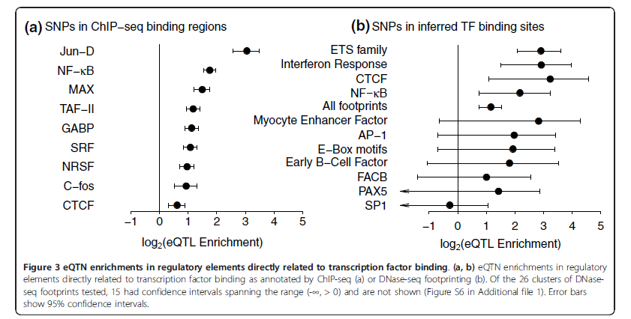
Enrichment of eQTL in non-coding regions
Gaffney et. al. 2012

Slide 4
eQTL
Enrichment/depletion of A | In B | OR | p-value
eQTL | ASB (hetero NA12878 MAF>0.05) | 3.8 | < 2.2e-16
 | ASE (hetero NA12878) | 5.0 | < 2.2e-16
 | General TFs (phase 1 MAF > 0.05) | 1.4 | 0.22
 | TFSS | 1.0 | 1
 | Chromatin | 0.9 | 0.87
 | AP2 | 1.3 | 0.54
 | bZIP | 0.6 | 0.21
 | CBF-NFY | 4.1 | 0.22
 | ETS | 0.2 | 0.21
 | Forkhead | 0.7 | 0.81
 | HLH | 1.0 | 0.85
 | Homeodomain | 0.9 | 1
 | IPT/TIG | 0 | 1
 | MADS-box | 0.7 | 1
 | NR | 1.4 | 0.46
 | P53 | 1.6 | 0.35
 | STAT | 1.1 | 0.81
 | wHTH | 1.1 | 0.79
 | ZNF | 1.3 | 0.15

Slide 5
