Slide 1
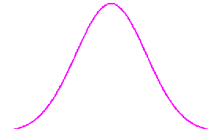
ChIP/RNAseq peak
Allele-specific
Non-AS non-peak
Non-AS peak
1
2
3
4
NA12878 GW
5
NA12878 Pseudogenes

Slide 2
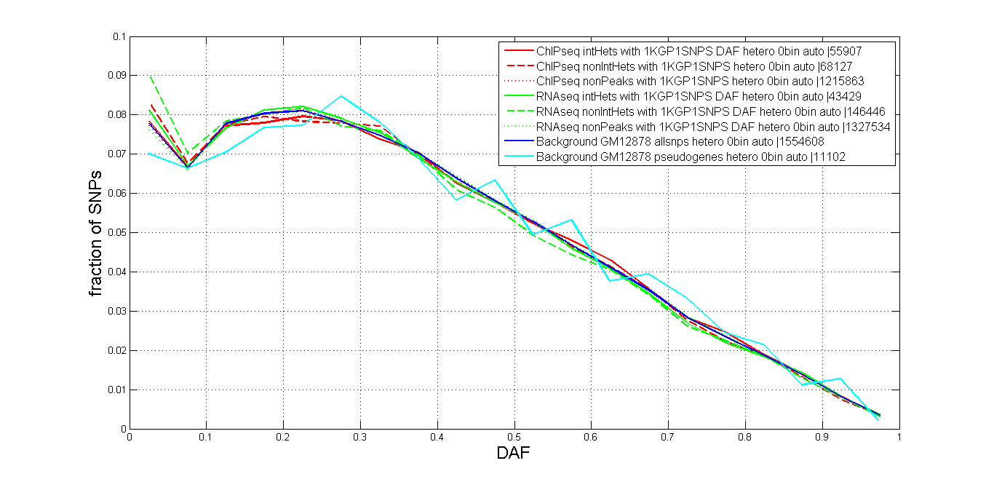
No0bin

Slide 3
eQTL
Jieming
11th Sept 2012
Annotation

Slide 4
Datasets
Pritchard eQTL → RNA-seq (Pickrell et. al. 2010)
Pritchard dsQTL → DNase-seq (Degner et. al. 2012)
Pritchard meQTL → Illumina27K methylation data (Bell et. al. 2011)
Tuuli eQTL → RNA-seq and gene expression arrays (Montgomery et. al. 2011)

Slide 5
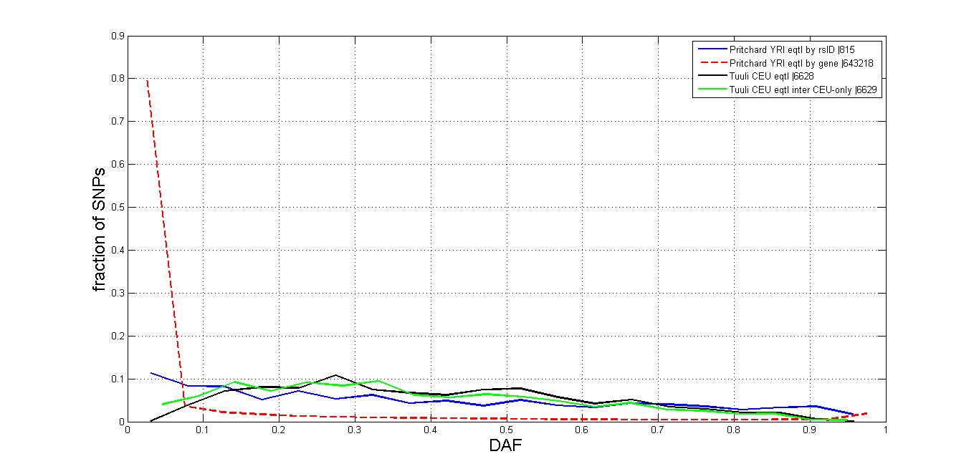

Slide 6
Pritchard eQTL
69 LCLs YRI (HapMap) → unrelated → many are part of trios
Hg18 lifted over to hg19
929 genes with 871 unique ‘representative’ SNPs → SNPs with lowest p-value for association with eQTL gene → SNPs ± 200kb are scanned for association with eQTL gene
SNP source → 3.8 million SNPs from phases II and III

Slide 7
Tuuli eQTL
60 LCLs CEU (HapMap)
14812 cis-eQTL SNPs → SNPs associated with eQTL genes; ± 1Mb scan → 1KG pilot 1 and 2 common variants (MAF>0.05)
Tuuli’s caveats: → “the vast majority of these sites themselves are not causal variants” → “this analysis has power to find only strong effects driven by common variants”

Slide 8
 | Pritchard eQTL
Total # genes with associated SNPs | 929
# unique SNPs | 891
# with DAF | 815
 | Tuuli eQTL
Total # SNPs | 14812
# with DAF, unique | 6629

Slide 9
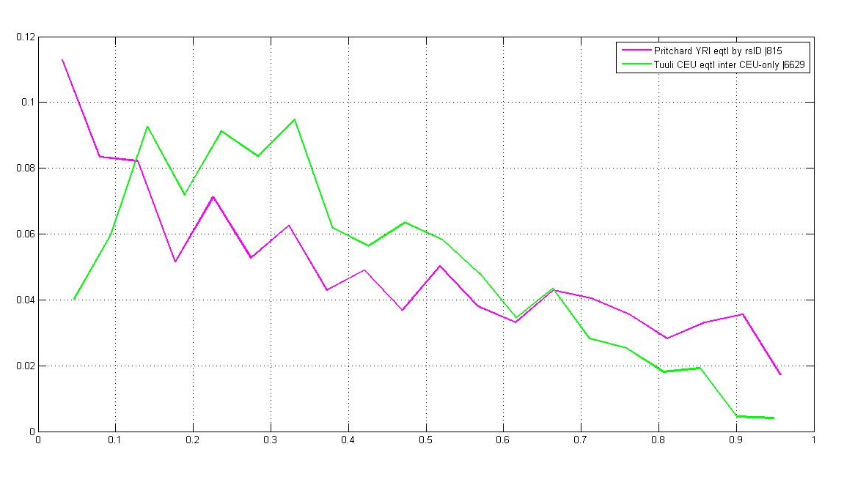

Slide 10
