Slide 1

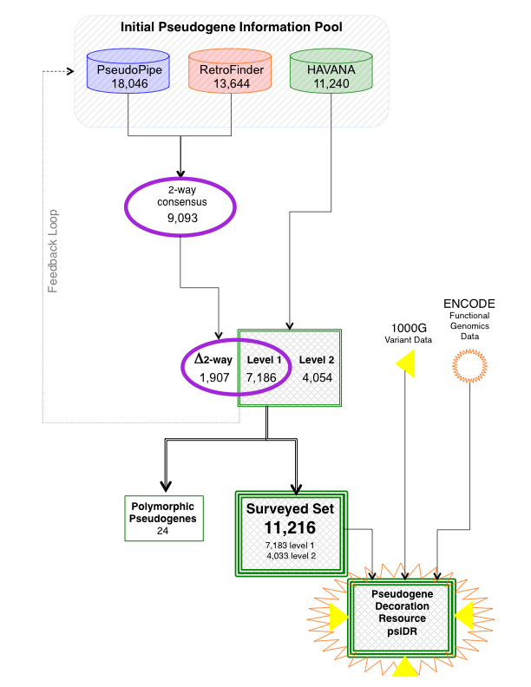
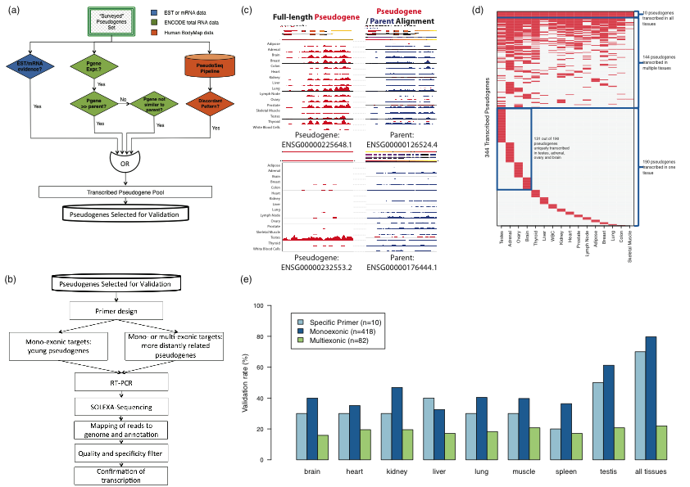
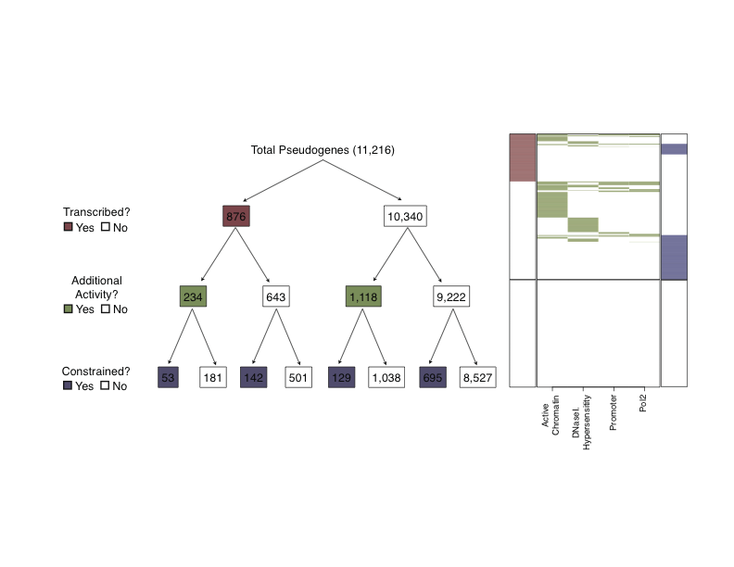
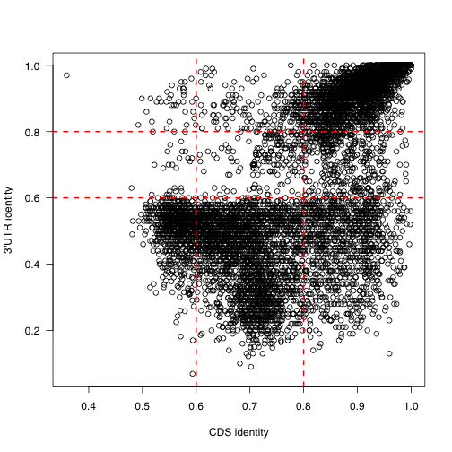
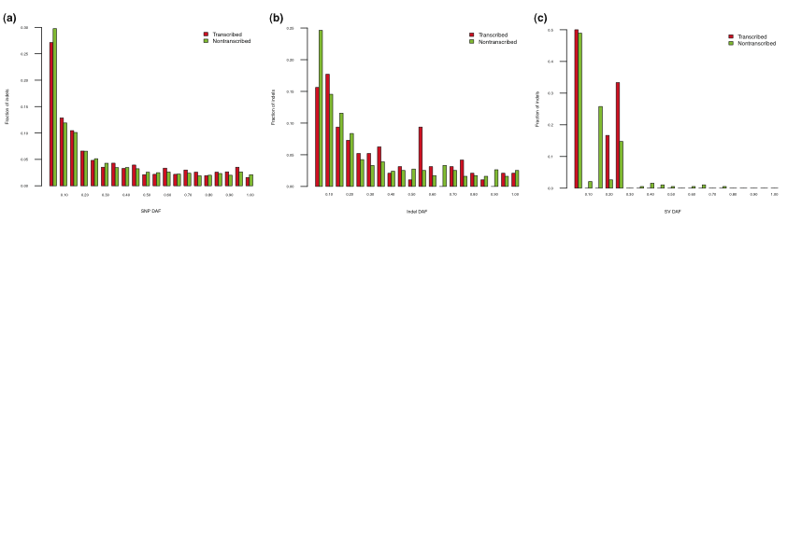
Integration of functional genomics evidence allows comprehensive annotation
of partial activity of pseudogenes
B. Pei¹, C. Sisu¹, A. Frankish², C. Howald³, L. Habegger¹, X. J. Mu¹, R. Harte⁴, S. Balasubramanian¹, A. Tanzer⁵, M. Diekhans⁴, A. Reymond³, T. J. Hubbard², J. Harrow² and M. B. Gerstein¹
¹Yale University, ²Wellcome Trust Sanger Institute, ³University of Lausanne, ⁴University of California Santa Cruz, ⁵Centre for Genome Regulation
Abstract
As part of the GENCODE annotation of the human genome, we present the first genome-wide pseudogene assignment for protein-coding genes, based on both large-scale manual annotation and in silico pipelines. We integrate the pseudogene annotations with the extensive ENCODE functional genomics information. In particular, we determine the expression, transcription-factor and RNA polymerase II binding, and chromatin marks associated with each pseudogene. We also compare our pseudogenes with conservation and variation data from primate alignments and the 1000 Genomes project, producing lists of pseudogenes potentially under selection. At one extreme, some pseudogenes possess conventional characteristics of functionality; these may represent genes that have recently died. On the other hand, we find interesting patterns of partial activity, which may suggest that dead genes are being resurrected as functioning non-coding RNAs. The activity data of each pseudogene are stored in an associated resource, psiDR.
We have identified 876 transcribed pseudogenes on a genome-wide scale by examining locus specific transcription evidence and RNA-Seq data from BodyMap 2.0 and ENCODE cell lines GM12878 and K562. Pseudogenes with discordant expression patterns from those of the parent genes were considered as transcribed. The potential of a mapping artifact was ruled out by the difference in their expression patterns. 469 transcribed pseudogenes were evaluated experimentally via RT-PCR-Seq techniques, where 354 were validated (Figure 3).
Beyond transcription, we studied the evolutionary selection on human pseudogenes by integrating the annotation with the variation data from the 1000 Genomes pilot project [47]. No significant differences were found in the derived allele frequency (DAF) spectra of SNPs, indels and structure variations (Figure 4). We also analyzed the divergence of pseudogenes to orthologs in the chimp and the mouse genome under the assumption that the conserved pseudogenes will show significantly lower divergence than neutral background. There are 1,019 conserved pseudogenes identified in the human genome. The conserved group is enriched with transcribed pseudogenes (195 conserved pseudogenes are transcribed, P-value = 1.19 × 10⁻³⁵).
We associated each pseudogene annotation with chromatin state, chromatin accessibility, active promoters and upstream Pol2 binding sites derived from ENCODE functional genomics information (Figure 5). It can be seen that pseudogenes showing various range of partial activity. We believe that the partial activity patterns are reflective of the pseudogene evolutionary process, where a transcribed pseudogene with active upstream regulatory regions may be in the process of resurrection as a ncRNA, and a non-transcribed pseudogene with active promoters may be in the process of gradually losing its functionality.
Figure 1. Pseudogene annotation flowchart.
Figure 2. Pseudogenes sequence identity to parents.
Background
Pseudogenes have long been considered as nonfunctional genomic sequences. However, evidence of transcription and conservation of some pseudogenes led to the speculation that they might be functional [1]. More recently, studies have shown that, in some cases, expressed pseudogenes can perform crucial regulatory roles through their RNA products [2,3].
While there are examples clearly illustrate that some pseudogenes indeed have a functional role, the extent of this phenomenon is not clear. The large corpus of functional data from the ENCODE consortium provides us with an opportunity to study pseudogene transcription and activity in a systematic and comprehensive manner. It is of interest to study whether these examples are just sporadic exceptions, or indeed represent a generic mechanism for gene regulation.
Conclusion
As a part of the GENCODE project, we carried out a comprehensive and accurate pseudogene annotation for the entire human genome. We combined automated pipelines and manual curation into a production annotation workflow. This allowed us to precisely annotate pseudogene loci and create a consensus set of pseudogenes.
We have integrated a large amount of genome-wide functional genomics data, together with expression and conservation data, to create a pseudogene annotation resource, psiDR. We found a group of pseudogenes exhibiting various ranges of partial activity. Understanding why pseudogenes show partial activity may shed light on pseudogene evolution and function.
Results
The annotation of all pseudogenes in the human reference genome is part of the wider effort by the GENCODE consortium that also aims to identify all protein-coding, long non-coding RNA (lncRNA) and short RNA genes [4]. Similar to the annotation of other functional classes, the annotation of pseudogenes contains models that have been created by the Human and Vertebrate Analysis and Annotation (HAVANA) team. This is informed by, and checked against, computational pseudogene predictions by the PseudoPipe [5] and RetroFinder [6] pipelines (Figure 1). In this study, we focused on the 11,216 manually annotated pseudogenes, where 7,186 have also been identified by both computational pipelines.
We refer to the functional paralog with the greatest sequence similarity to a pseudogene as its parent gene. Currently, we have successfully identified parents for 9,368 pseudogenes, whereas the parents for the remaining 1,848 pseudogenes are still ambiguous and may require further manual annotation. We compared the CDS and 3’ UTR sequence identity of each pseudogene to its parent. While most pseudogenes have comparable sequence identities to the two genomic regions, there are pseudogenes that exhibit high sequence identity to the 3’ UTR but poor identity to CDS, or vice versa (Figure 2). This inconsistency implies that mutations were rejected by natural selection non-randomly. Certain regions in the sequence may be under higher evolutionary constraint than the others.
Figure 3. Pseudogene transcription.
References
Harrison et al. Nucleic Acids Res 2005, 33:2374-2383.
Poliseno et al. Nature 2010, 465:1033-1038.
Tam et al. Nature 2008, 453:534-538.
Harrow et al. Genome Res 2012. doi: 10.1101/gr.135350.111.
Zhang et al. Bioinformatics 2006, 22:1437-1439.
Baertsch et al. BMC Genomics 2008, 9:466.
Figure 4. SNP, indel and SV derived allele frequency spectra.
Acknowlegements
This work was funded by National Human Genome Research Institute (NHGRI)/National Institutes of Health (NIH) grants to the GENCODE (U54 HG004555) subgroup of the ENCODE project. We acknowledge grants from the Swiss National Science Foundation to AR and from the Wellcome Trust (WT077198/Z/05/Z) to JH, AF and TH.
Figure 5. Summary of pseudogene activity.

