Slide 1
TARs: Small and Long
Classify TARs into two
Long
From PolyA+
Small
From Small RNA-seq samples

Slide 2
TARs: Small and Long
Call TARs in all the samples separately
26 worm samples
78 fly samples
Set RD threshold at 70% of expressed miRNAs
Merge TARs in all the samples
Extend each TAR +/- 100 bps
Search for stable hairpins
Filter repeats/known ncRNAs
~300 novel stable short-TARs for fly and worm

Slide 3
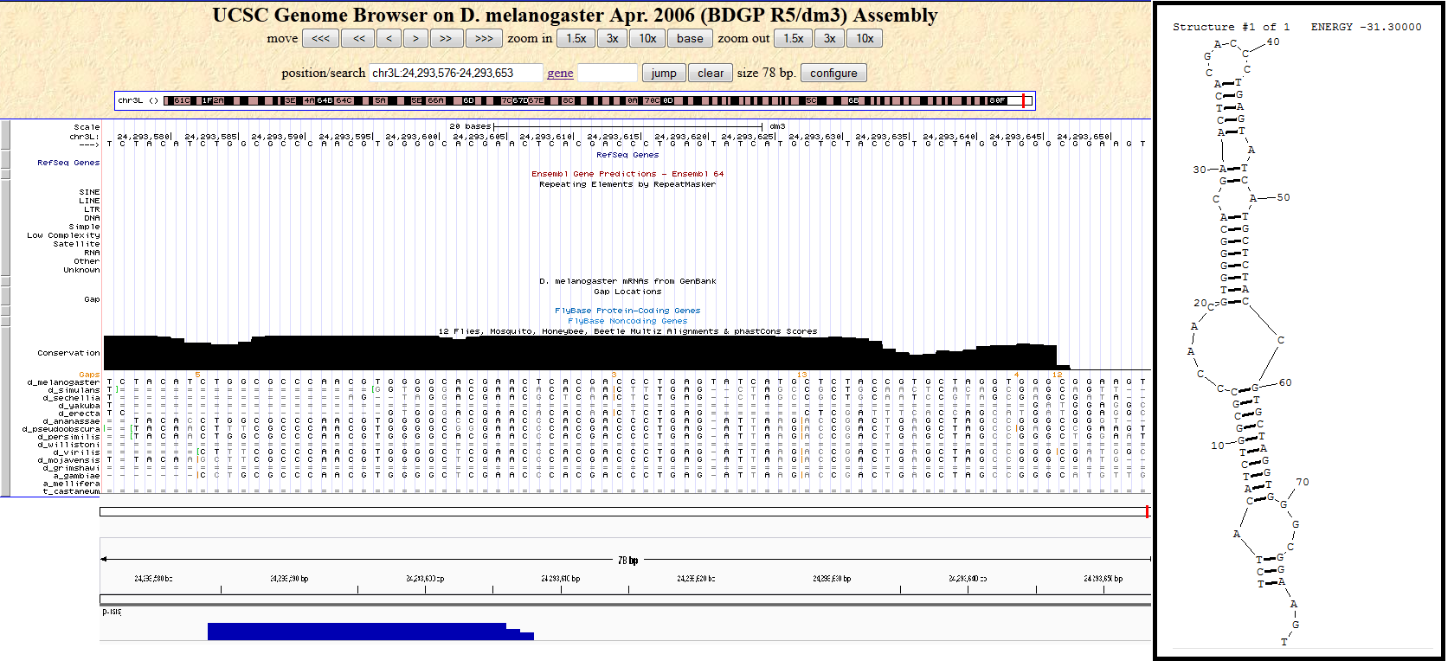
Example

