Slide 1
miRNA and its effect on variability of mRNA expression
YF
July 23, 2012

Slide 2
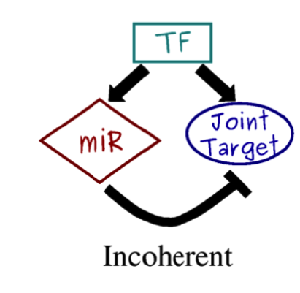
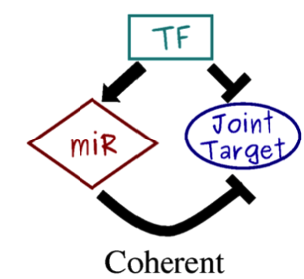
Introduction
The canonical miRNA regulation postulates that miRNAs repress expression of target genes.
Feed-forward loops are hypothesized to reduce stochastic noise in expression and translation of targeted genes.

Slide 3
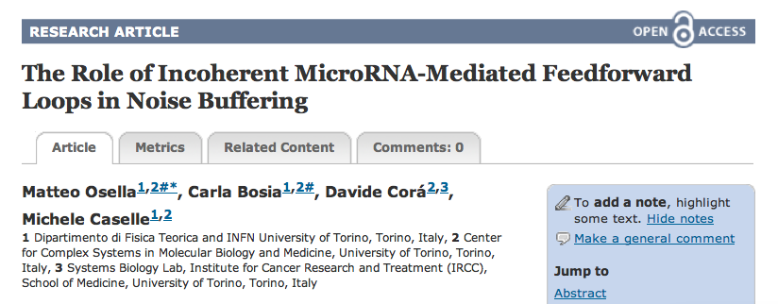
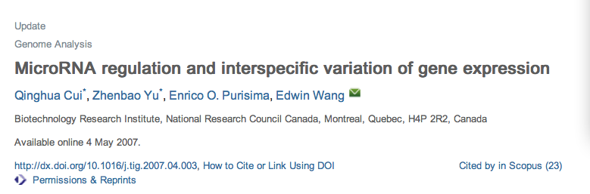
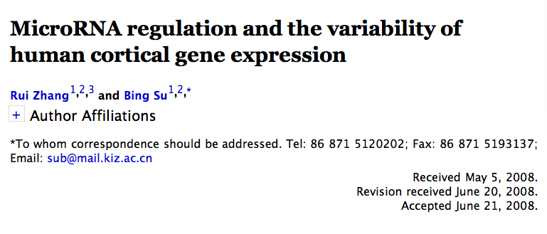

Slide 4
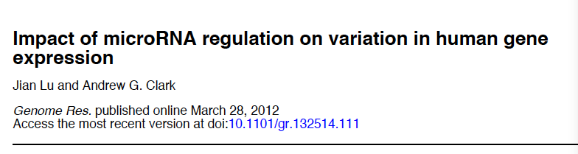
Summary
General comparison of variability of targeted genes Vs. non-targeted genes.
Effect of trans- and cis- mutations on gene expression.
miRNA regulation on human evolution

Slide 5
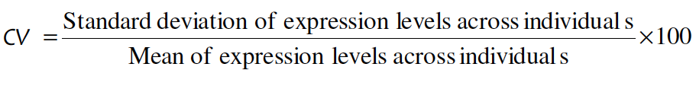
miRNA target genes show higher expression variation
CV (coefficient of variation in expression )
90 European-American males

Slide 6
90 European-American males
194 healthy Arab and Amazigh
HapMap ( 30 YRI)
HapMap (30 CEU)
HapMap (45 CHB)
HapMap (45 JPT)

Slide 7
Synergistic effects of miRNA regulation
Strong miRNA regulation is associated with greater inter-individual variation in gene expression

Slide 8
Variations in miRNAs

Slide 9
Mutation Data
HapMap3 : 21 SNPs inside miRNA precursors
1000 Genome Phase 1: 54 in seed region; 115 in mature miRNA outside seed; 425 in precursors.
Expression Data
HapMap3: 196 (43 CHB, 42 JPT, 56 CEU, 55YRI)
1000 Genome: 149 (32 CEU,41 CHB, 39 JPT,37YRI)

Slide 10
Genome wide association studies
6 SNPs and indels are significantly associated with one of target genes in 1000 genome project

Slide 11
associated variants are outside of “seed” region. These mutations might affect target genes through changing abundance of mature miRNAs.

Slide 12
Variations in mRNAs

Slide 13
HapMap3: 8,413 SNPs in 3’ UTRs and 187,222 SNPs in introns.
GWAS : 467 in 3’UTR and 3,874 in introns.
more associated SNPs in 3’ UTRs than introns.

Slide 14
1000 Phase 1
For SNPs, Indels, and SVs, associated variants are enriched in 3’UTR compared to introns.

Slide 15
miRNA and population differentiation
HapMap3 : for CEU and Asians, ~ 4,700 transcripts are differentially expressed.

Slide 16
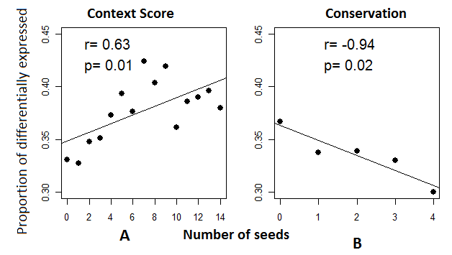

Slide 17
Dual roles of miRNA on target genes during primate evolution
RNA-seq data : 6,030 differentially expressed genes between human and chimp.
1,391 genes under stabilizing selection during primate evolution
887 genes were under directional selection in human.

Slide 18
Differentially expressed genes
Stabilizing selected genes

Slide 19
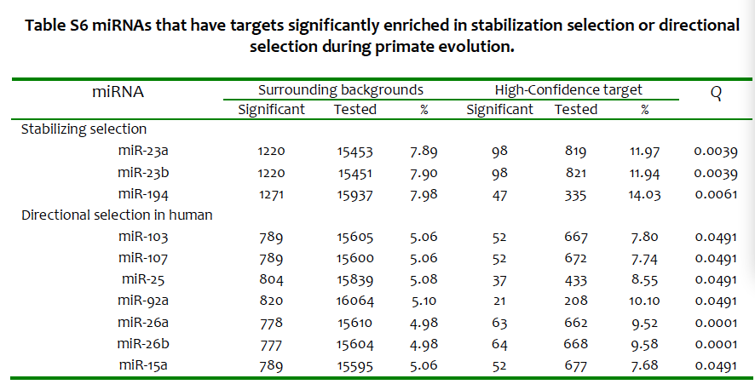

Slide 20
Summary
During primate evolution, miRNA buffers expression of a few genes.
But, within human populations and human and other primates, miRNAs targeted genes show more variability.

Slide 21
Hypothesis 1
miRNA targeted genes are intrinsically more variable, miRNA has the effect to reduce inter-individual stochastic variability.
--- could not be tested.

Slide 22
Hypothesis 2
Variation in miRNA regulation network promoters variation of target genes.
Variable miRNA expression
Multiple targets of miRNA
mRNA could have multiple miRNA binding

Slide 23
~ 8,000 positively selected SNPs, 46 in 3’UTR, 16 in pairing regions of miRNAs. Thus, some genetic variation in miRNA target recognitions may be favored by natural selection.

Slide 24
Thank you

