Slide 1
Cell type specificity
FIG
July 2012

Slide 2
Cell type specific TF-binding motifs
GM12878
H1-hESC
HeLa-S3
HepG2
K562
TF-binding motif
cell-type nonspecific
(in 2-5 cell types)
cell-type
specific
(in 1 cell type)

Slide 3
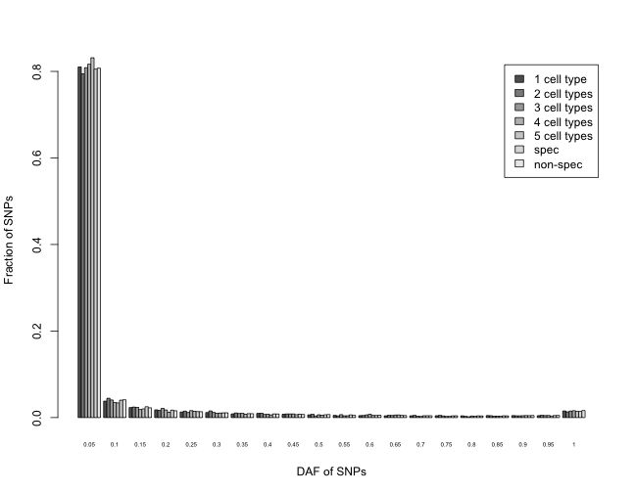
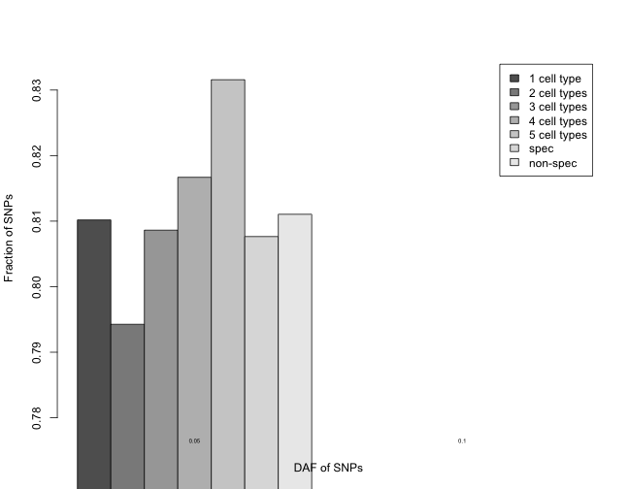
SNP DAF spectra for TF-binding motifs (lowest bin: DAF<5%)

Slide 4
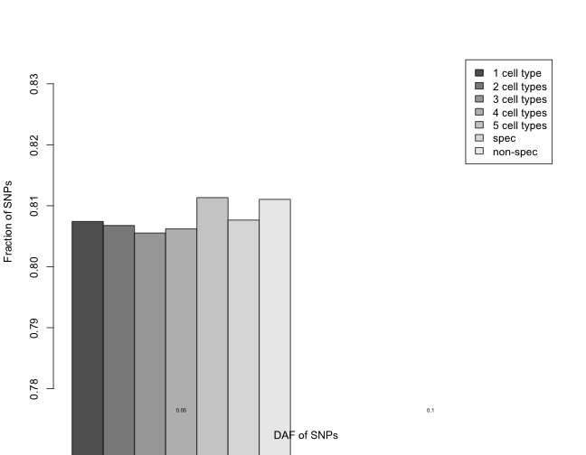
SNP DAF spectra for TF-binding motifs (lowest bin: DAF<5%)
peaks

Slide 5
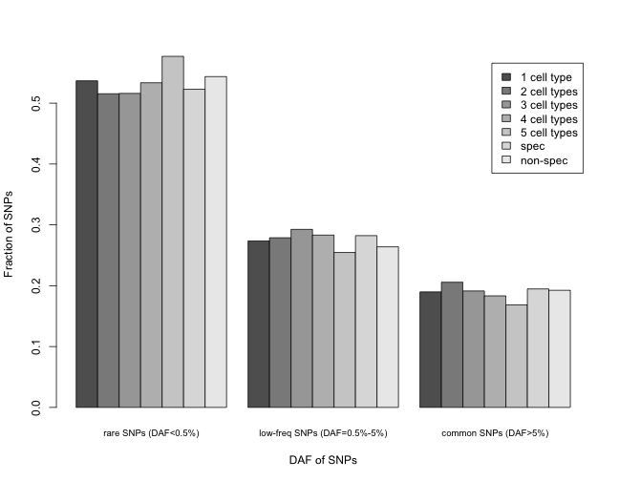
SNP DAF spectra for TF-binding motifs (lowest bin: DAF<0.5%)

Slide 6
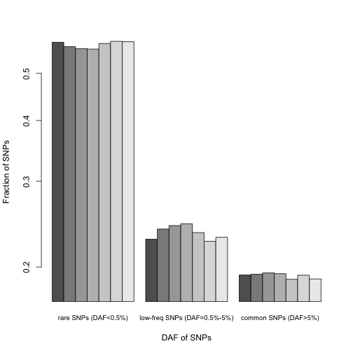
SNP DAF spectra for TF-binding motifs (lowest bin: DAF<0.5%)
DAF<0.5%
peak

Slide 7
GERP scores for different cell types – TF-binding motifs
Cell Type | Total bp | # GERP Sites | Fraction of GERP sites | Average GERP | Fraction of Conserved Sites (GERP>2)
1 cell type | 1387567 | 114391 | 0.082 | -0.035 | 0.242
2 cell types | 454408 | 38585 | 0.085 | 0.116 | 0.270
3 cell types | 323490 | 27177 | 0.084 | 0.323 | 0.306
4 cell types | 334492 | 28190 | 0.084 | 0.511 | 0.347
5 cell types | 715762 | 65588 | 0.092 | 0.757 | 0.402
spec | 4553866 | 393707 | 0.086 | 0.055 | 0.263
non-spec | 2230478 | 192816 | 0.086 | 0.295 | 0.304
increasing

Slide 8
GERP scores for different cell types – TF-binding motifs
Cell Type | TF-binding motifs |  |  |  | TF-binding peaks
 | Total bp | # GERP Sites | Average GERP | Frac. of conserved Sites (GERP>2) | Total bp | # GERP Sites | Average GERP | Frac. of conserved Sites (GERP>2)
1 cell type | 1387567 | 114391 | -0.035 | 0.242 | 110736491 | 9264821 | -0.253 | 0.171
2 cell types | 454408 | 38585 | 0.116 | 0.270 | 45487895 | 3932120 | -0.249 | 0.184
3 cell types | 323490 | 27177 | 0.323 | 0.306 | 30542641 | 2746570 | -0.260 | 0.183
4 cell types | 334492 | 28190 | 0.511 | 0.347 | 30491600 | 2764610 | -0.256 | 0.193
5 cell types | 715762 | 65588 | 0.757 | 0.402 | 52244235 | 5008160 | -0.274 | 0.179
spec | 4553866 | 393707 | 0.055 | 0.263 | 202800563 | 17274864 | -0.248 | 0.161
non-spec | 2230478 | 192816 | 0.295 | 0.304 | 135778938 | 12546610 | -0.256 | 0.172

Slide 9
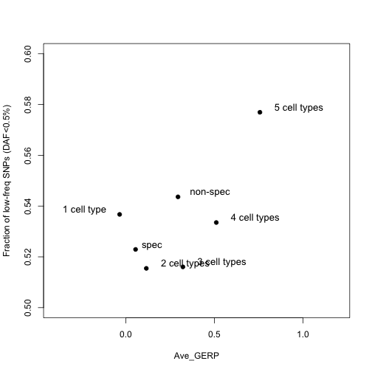
TF-binding motifs

Slide 10
Proximal motifs: TF-binding motifs that are within 2.5kb of the TSS of genes
Distal motifs: TF-binding motifs that are more than 2.5kb away from the TSS of genes

Slide 11
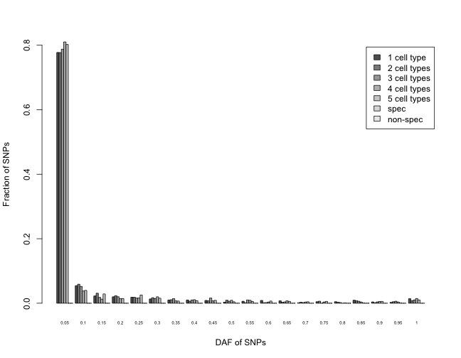
SNP DAF spectra for proximal motifs (lowest bin: DAF<5%)

Slide 12
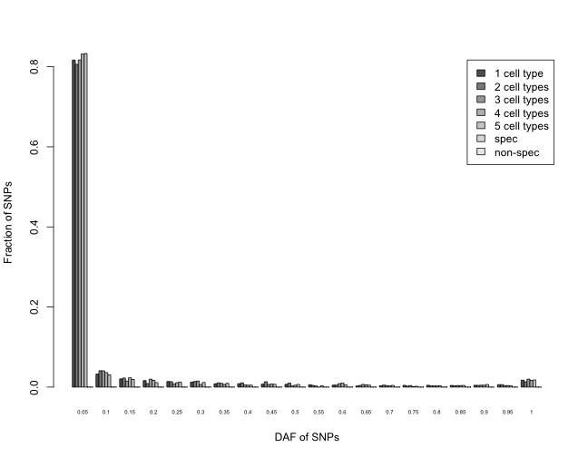
SNP DAF spectra for distal motifs (lowest bin: DAF<5%)

Slide 13
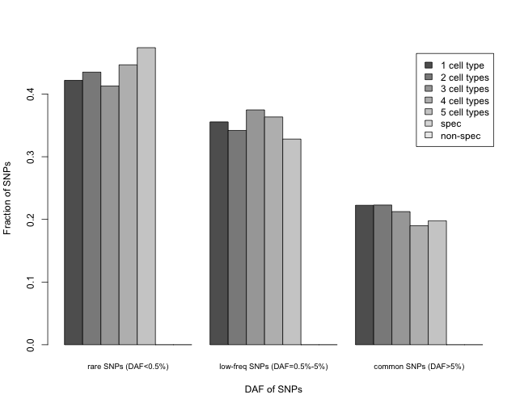
SNP DAF spectra for proximal motifs (lowest bin: DAF<0.5%)

Slide 14
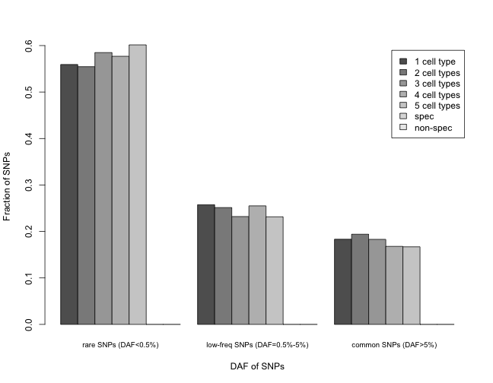
SNP DAF spectra for distal motifs (lowest bin: DAF<0.5%)

Slide 15
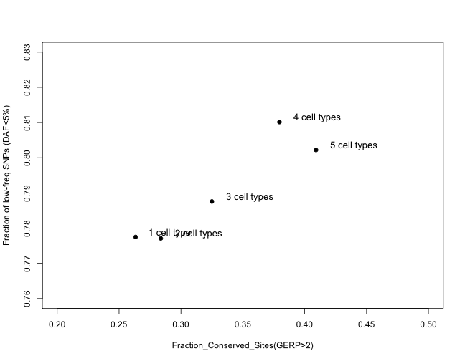
Proximal motifs

Slide 16
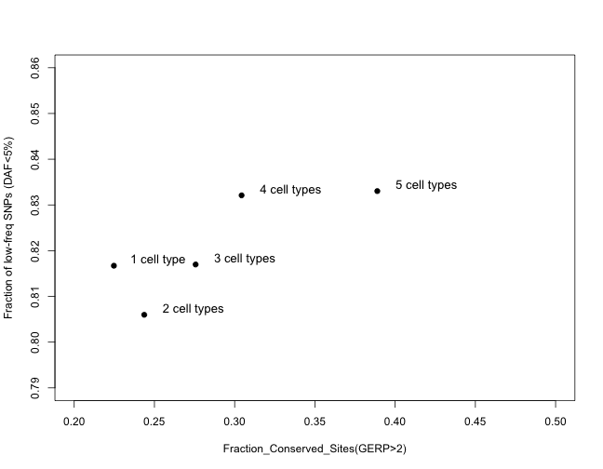
Distal motifs

Slide 17
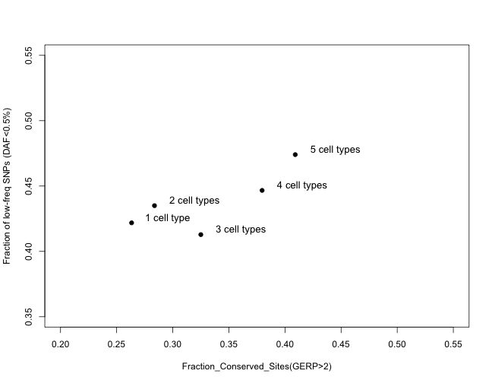
Proximal motifs

Slide 18
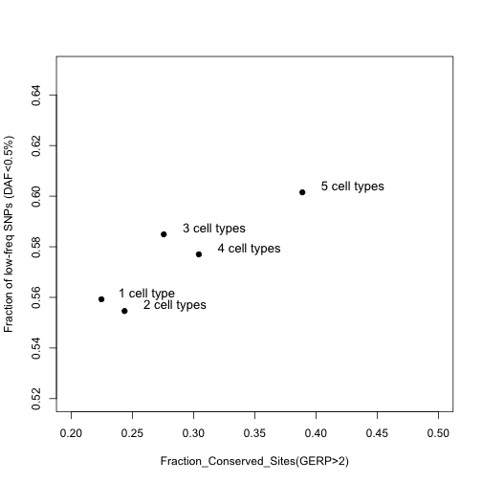
Distal motifs

Slide 19
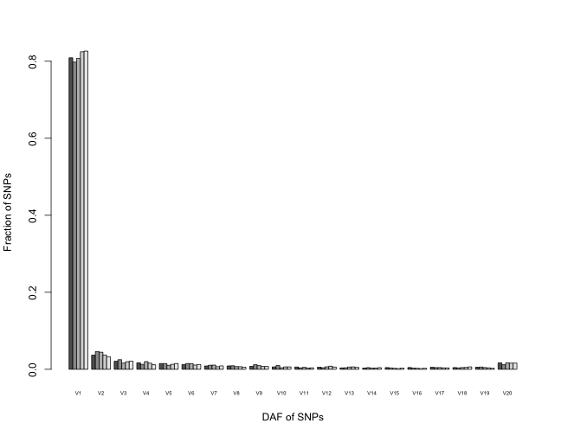
Distal+proximal

Slide 20
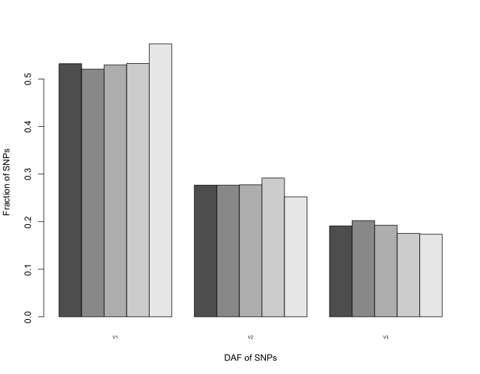
Distal+proximal

