Slide 1
1KG Phase 1 SNPs & NA12878 Allelic SNPs
Jieming
Annotation-FIG
24th July 2012

Slide 2
1KG Phase 1 - Some numbers -
NA12878 is not in the Phase 1 CEU.
 | Population | Full name | # individuals | Broadpop
1 | LWK | Luhya in Webuye, Kenya | 97 | AFR
2 | YRI | Yoruba in Ibadan, Nigeria | 88 | AFR
3 | ASW | African Ancestry in Southwest US | 61 | AMR
4 | CLM | Colombian in Medellin, Colombia | 60 | AMR
5 | MXL | Mexican Ancestry in Los Angeles, California | 66 | AMR
6 | PUR | Puerto Rican in Puerto Rico | 55 | AMR
7 | CHB | Han Chinese South | 97 | ASN
8 | CHS | Southern Han Chinese | 100 | ASN
9 | JPT | Japanese in Tokyo, Japan | 89 | ASN
10 | CEU | Utah residents (CEPH) with NW European ancestry | 85 | EUR
11 | FIN | Finnish in Finland | 93 | EUR
12 | GBR | British in England and Scotland | 88 | EUR
13 | IBS | Iberian populations in Spain | 14 | EUR
14 | TSI | Toscani in Italia | 98 | EUR
 |  |  | 1092

Slide 3
1KG Phase 1 (hg19) - Some numbers -
Phase 1 SNP data
“1KG SNPs” refer to auto.nonMono.lowCov.wDAF SNPs
Category | # of SNPs
All SNPs | 38,248,779
Autosomal SNPs | 36,820,992
Non-mono (ALL) | 36,648,992
Low Coverage (ALL) | 36,395,771
With DAF (ALL) | 34,986,616

Slide 4
NA12878/AlleleSeq (hg19) - Some numbers -
Category | # SNPs | # SNPs in 1KG | %
all.heterozygous.autosomal | 1,654,514 | 1,554,608 | 94.0
pseudogenes | 14,203 | 11,102 | 78.2
found in TF peaks (AS+nonAS) found in TF peaks (mt6) | 370,455 136,936 | 351,783 129,767 | 91.4 90.1
found in RNAseq peaks found in RNAseq peaks (mt6) | 244,099 204,060 | 227,074 189,874 | 93.0 93.0
ChIPseq/ASB
AllelicSNPs (intHets, mt6) | 61,217 | 55,907 | 91.3
nonAllelicSNPs.inPeaks (nonIntHets, mt6) | 73,317 | 68,129 | 93.0
nonAllelicSNPs.notInPeaks | 1,291,694 | 1,215,864 | 94.1
RNAseq/ASE
AllelicSNPs (intHets, mt6) | 47,176 | 43,429 | 92.1
nonAllelicSNPs.inPeaks (nonIntHets, mt6) | 153,696 | 146,446 | 92.7
nonAllelicSNPs.notInPeaks | 1,414,319 | 1,327,534 | 90.8
Notes:
Note that #SNPs in 1KG can include those not found in the uniq file because they can be in 1KG just not having an AA!! So we need to remove these

Slide 5
ChIP/RNAseq peak
NonIntHets
NonPeaks
IntHets
1
2
3
4
NA12878 GW
5
NA12878 Pseudogenes

Slide 6
0bin

Slide 7
0bin

Slide 8
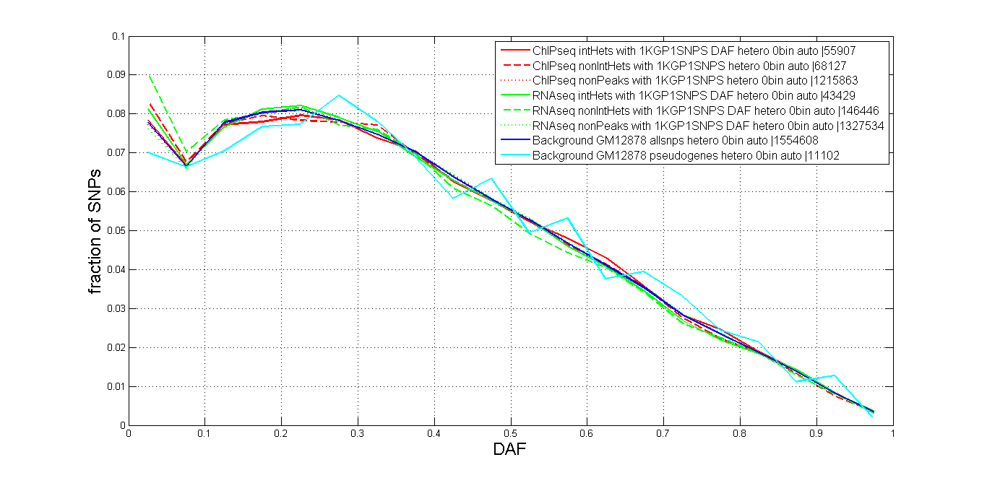
No0bin

Slide 9
No0bin

