Slide 1
Human, Worm, and Fly Pseudogens
Cristina Sisu
17th July 2012

Slide 2
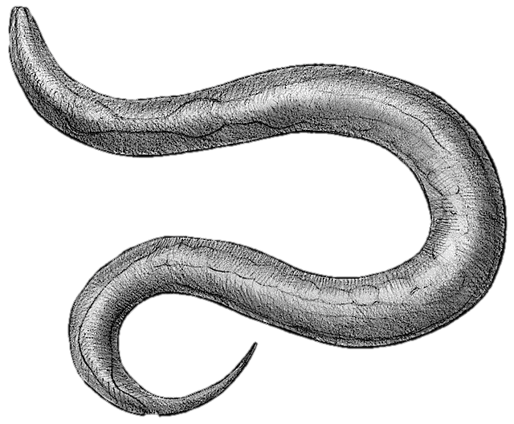
PseudoPipe
 | Total | Processed | Duplicated | Ambiguous
Build 54 WS201 | 1198 | 253 | 538 | 508(153)
Build 66 WS220 | 2267 | 313 | 719 | 1235
Build 67 WS230 | 2290 | 320 | 722 | 1248
WormBase 220 | 1441
Intersection 80% | 1014 | 164 | 445 | 405
 | Total | Processed | Duplicated | Ambiguous
Build 61 FlyBase 5.25 | 529 | 119 | 95 | 315
Build 67 FlyBase 5.39 | 312 | 46 | 75 | 191
FlyBase 5.39 | 170
Intersection 80% | 114 | 33 | 32 | 49

Slide 3
per Chromosome
Worm:
- uniform distribution of pseudogene types among the chromosomes
FLY:
- all pseudogenes in known chromosomes

Slide 4
Transcription Factor – Fly
36 Transcription factor in 2kb upstream of pseudogene start site
TFBS selected compatible with Flybase release 5:32
Source: Chip-Chip & Chip-Seq
Duplicated
Processed
Ambiguous

Slide 5
Transcription Factor – Worm
47 (/91) Transcription factor in 2kb upstream of pseudogene start site
TFBS from WS220
Source: Chip-seq

Slide 6
Transcription Factor – Human
Use Gm12878 and H1hesc to mimic the evolutionary stages from Worm and Fly
Three way comparison

Slide 7
Embryo vs Adult
Comparison Early Stage vs Adult for worm and fly with H1hesc vs GM12878 for Human for processed, duplicated and ambiguous pseudogenes

