Slide 1
Genes: “Since the beginning of time, we are team players.”
Gang Fang
Group Meeting July 17, 2022

Slide 2
Outline
To study gene biological interactions from an evolutionary point of view:
Biological interactions
Co-expressed genes, gene regulation and protein-protein interaction network, metabolite profiles etc.
within a model organism.
Data: Caulobacter crescentus life cycle transcriptome, and worm and fly (modEncode ) embryonic development time course transcriptomes
Evolution
Gene evolutionary profile, phylogenetic tree, sequence conservation etc.
across many species.
Data: all fully sequenced bacterial genomes, and animal genomes in Ensemble Compara.
Notes:
Co-expression network

Slide 3
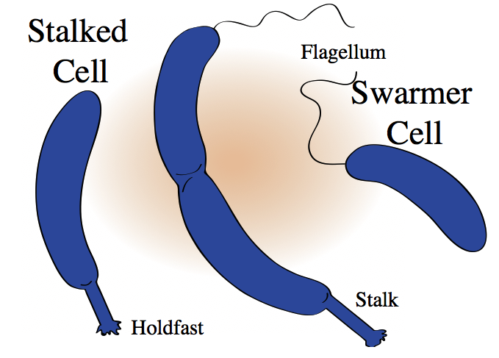
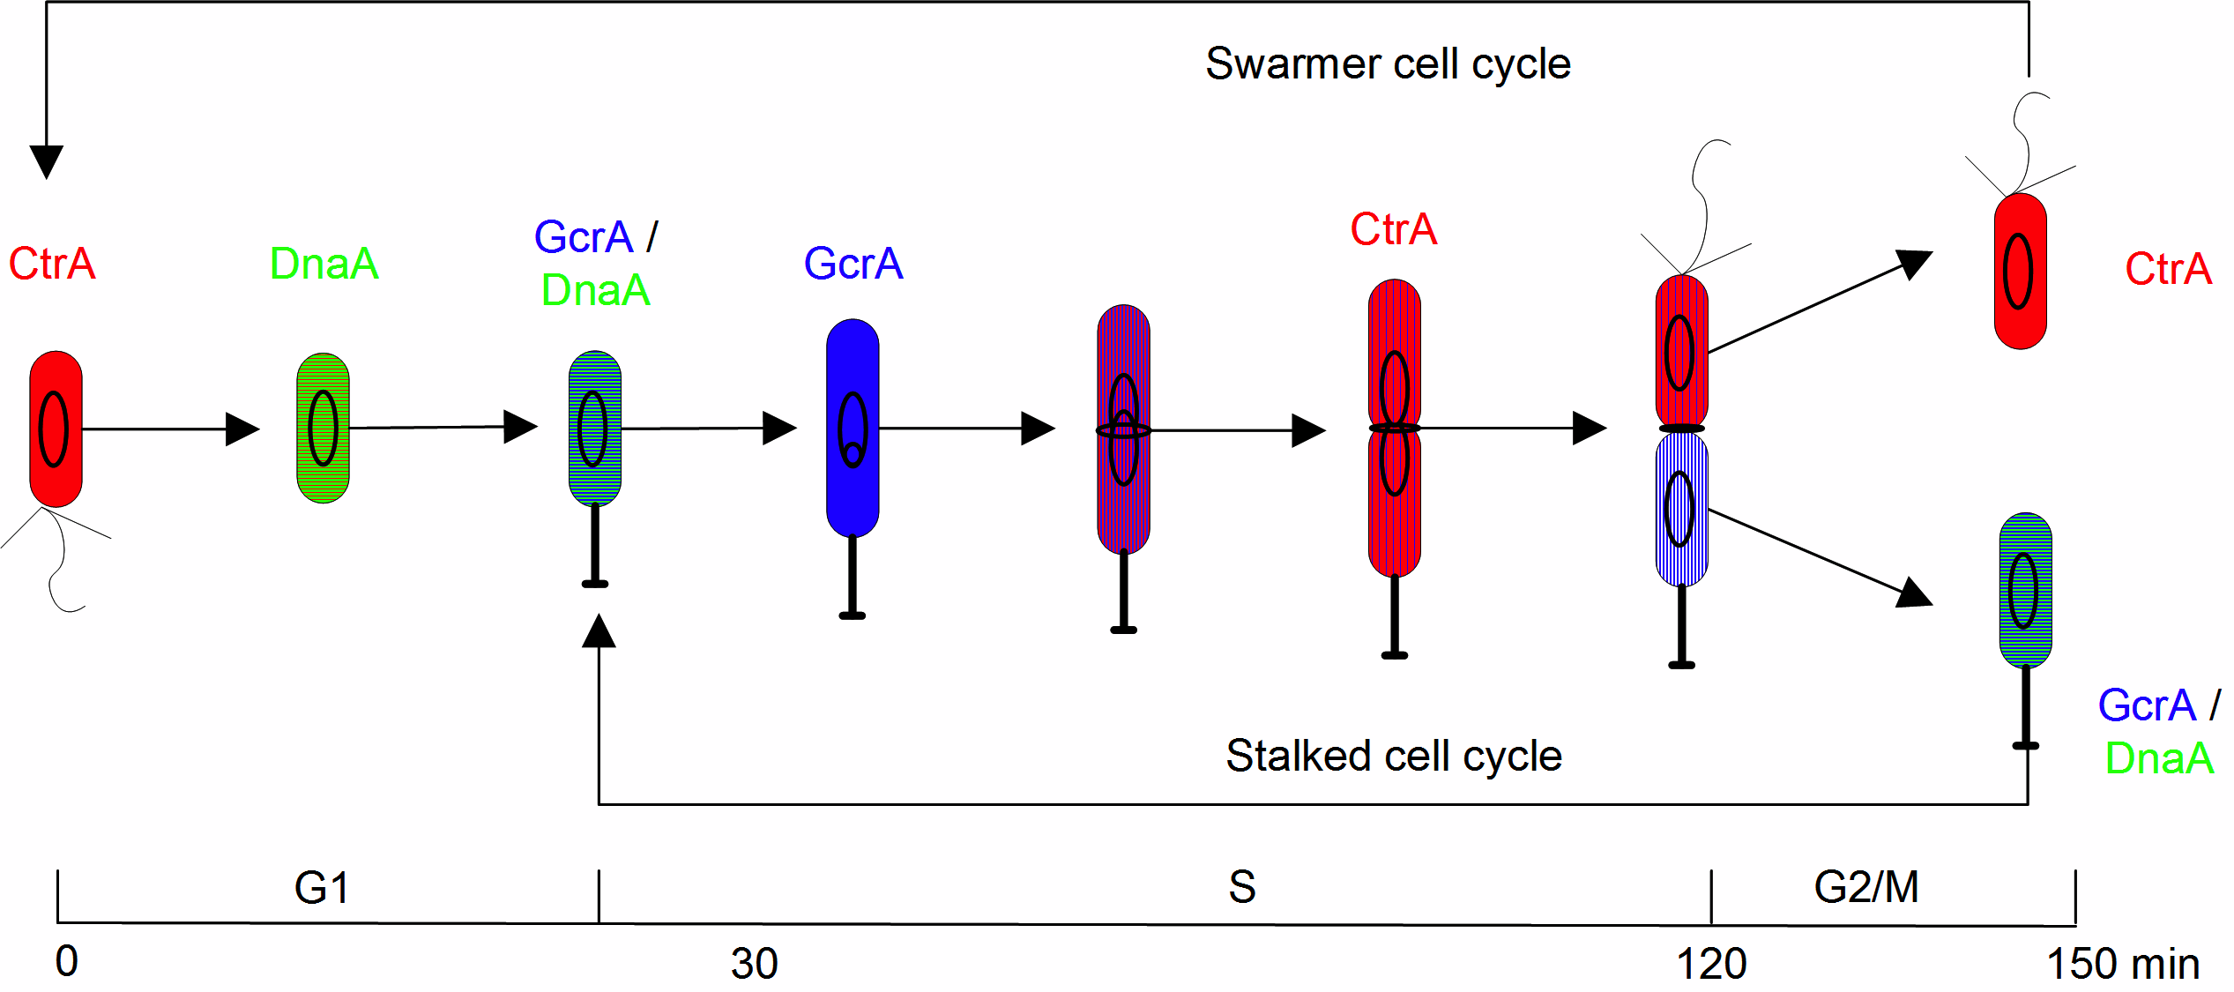
C. crescentus life cycle
Notes:
High coverage, 5 cell types. Swarmer (with a flagellum), stalked (with a stalk), early pre-division, pre-division, and late pre-division. Each cell types with 3 biological replicates

Slide 4
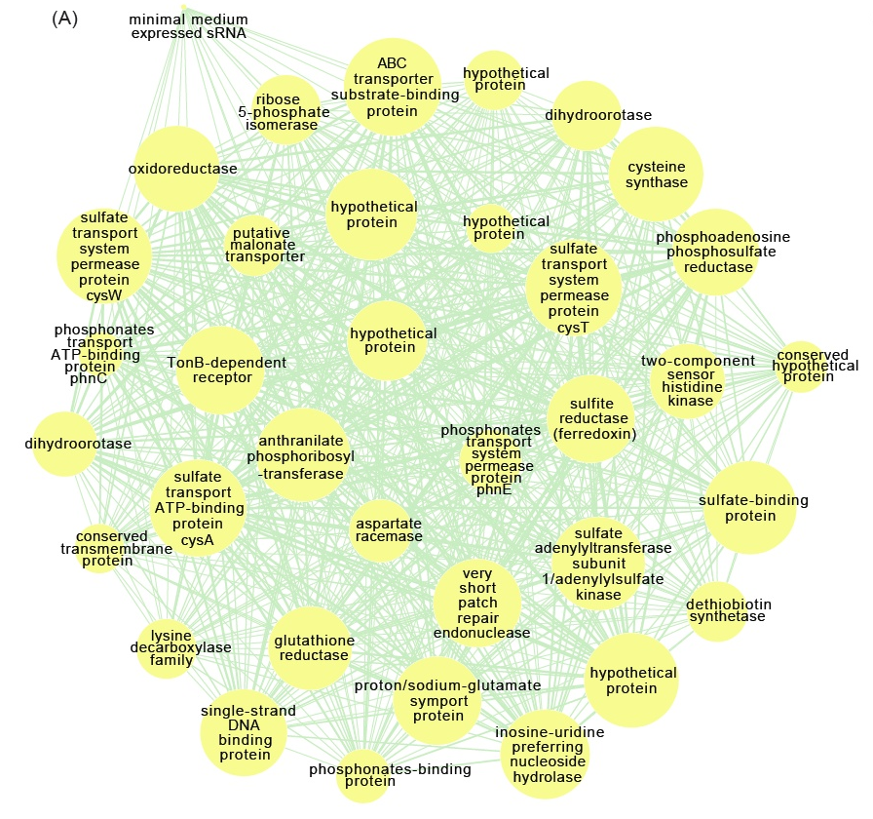
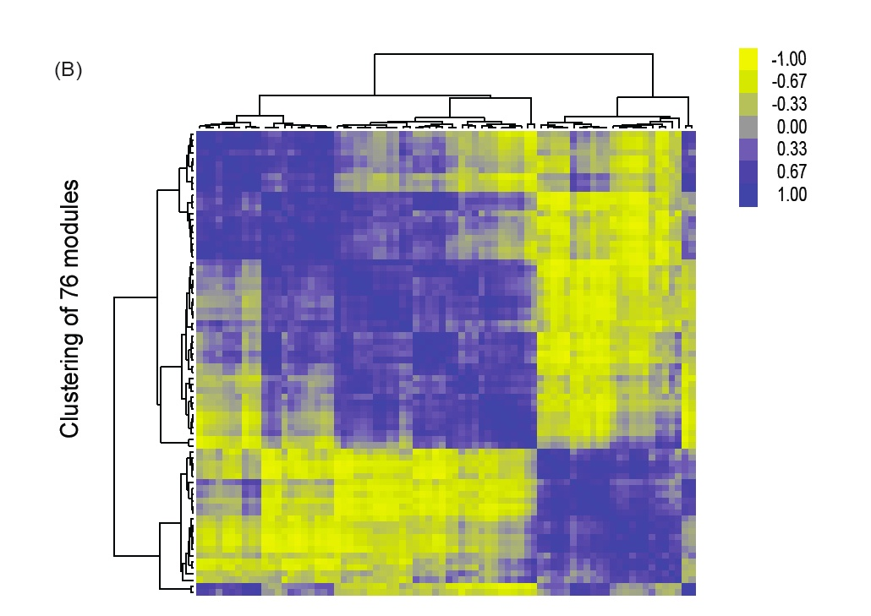
WGCNA modules
~1600 Cell cycle regulated genes (baySeq) and 76 functional modules
1st eigenvector of each module was used to represent the module’s expression profile
Notes:
Sulfate metabolism genes.

Slide 5
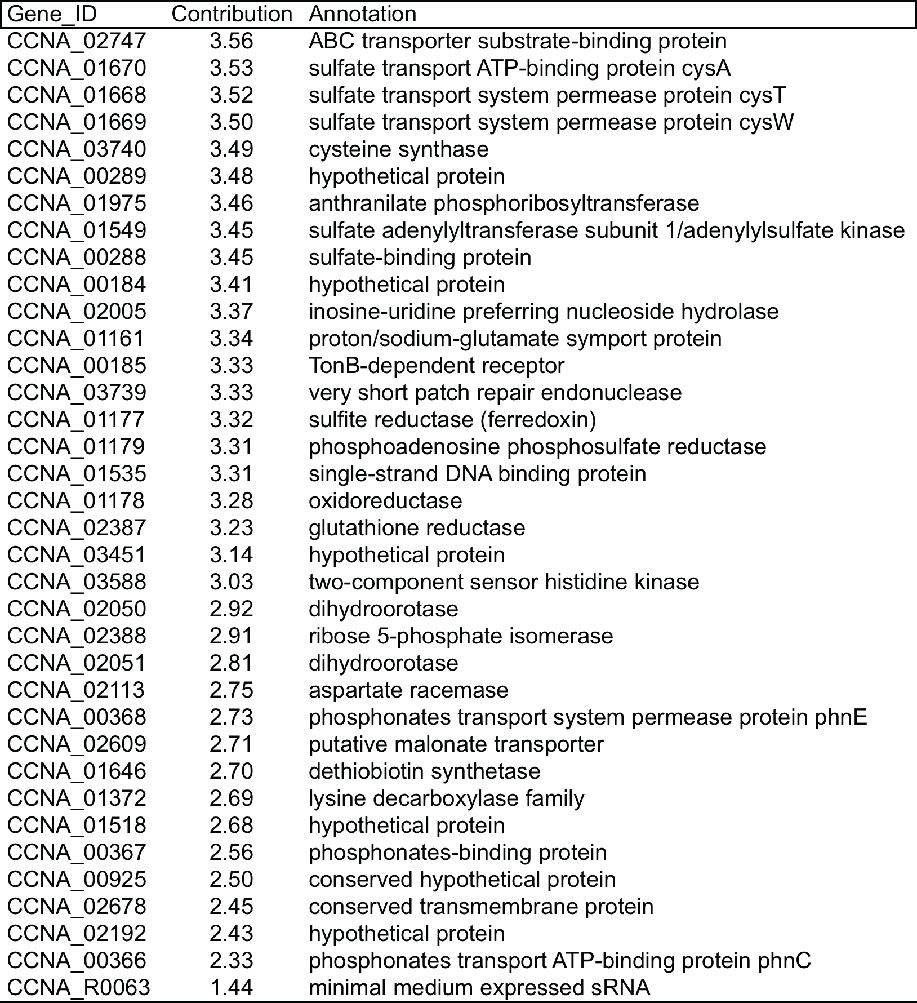
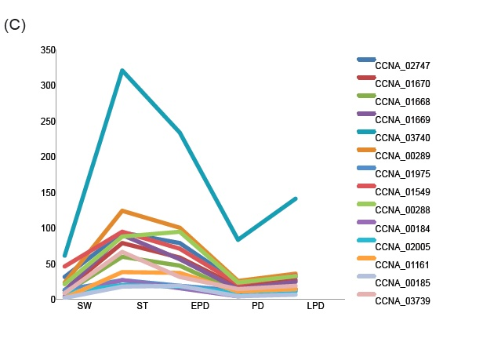
Genes were assigned functional features
Expression values
5 cell types during life cycle
Gene feature: Membership (expression profile projected to 1st eigenvector) or contribution to the module.
Notes:
Sulfate metabolism genes.

Slide 6
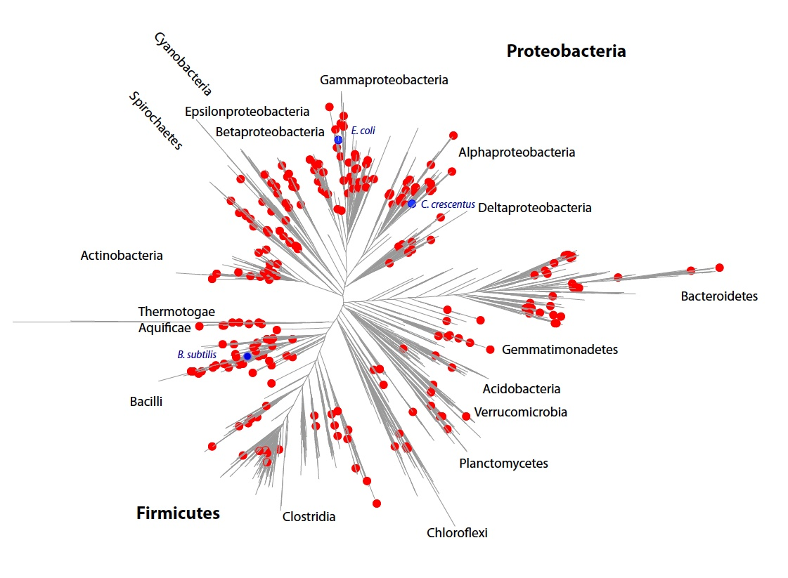
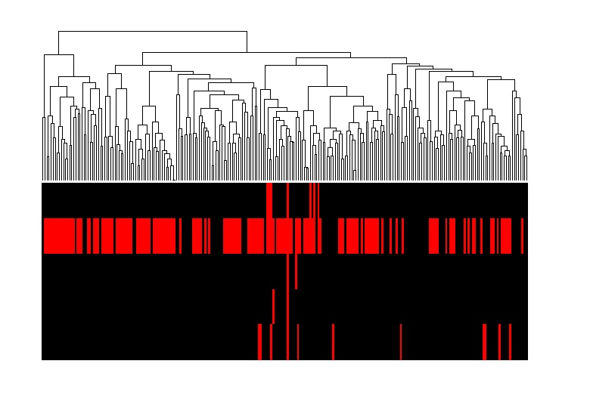
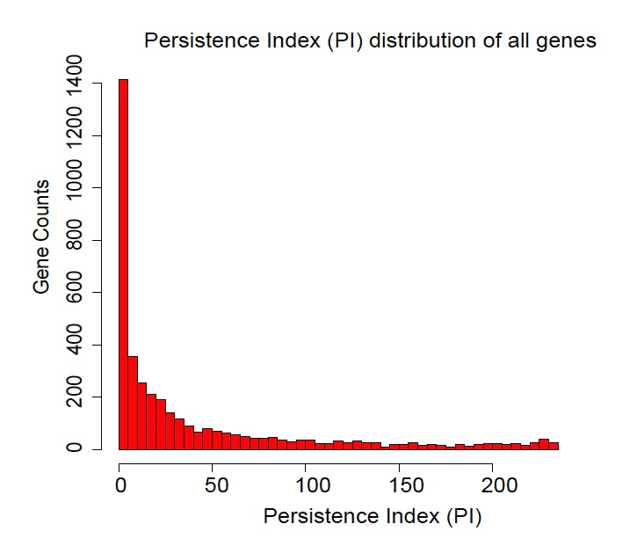
Gene evolutionary profile
Gene evolutionary profiles
g1
g2
g3
g4
g5
~300 clades clustered from the huge (1M) Greengenes 16s rRNA phylogenetic tree (matrix), K-means.
Map the ~1000 fully sequenced bacterial genomes into the 300 clades, and select one from each clade as representative.
236 evenly selected species.
Notes:
Gene has one quantitative feature, how many orthlogs identified from the evenly selected species.

Slide 7
Cross comparisons between gene functional features and evolutionary feature
Biology functional features
Cell cycle regulated genes: True or False
Expression value
Essentiality
Module membership
Evolutionary feature
Persistent index

Slide 8
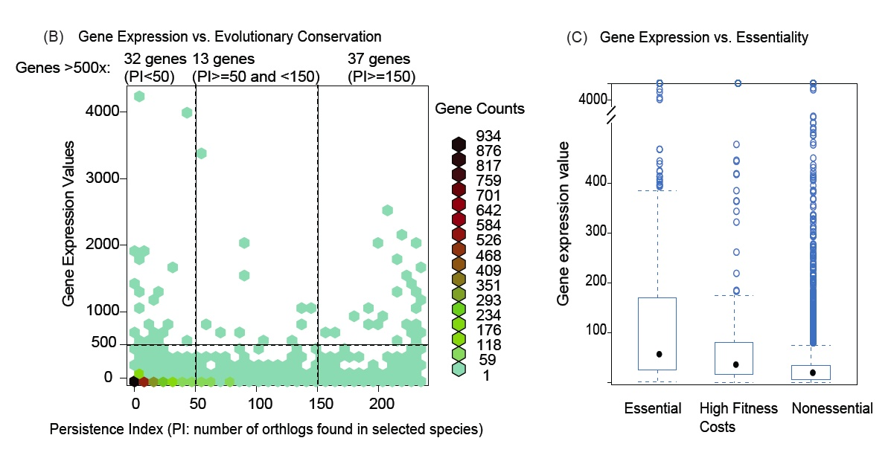
Highly expressed genes found in both species-specific and persistent genes
Fisher’s test: persistent genes have more highly expressed genes
ANOVA test: essential genes have the highest expression values, and high fitness cost genes are higher expressed than nonessential genes.
Notes:
we observed ss genes also have highly expressed genes. Of course, statistic test will say persistent genes have have more highly expressed genes

Slide 9
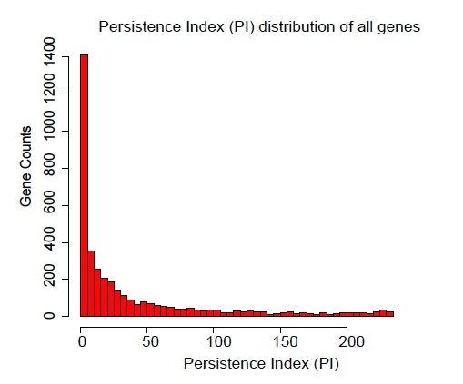
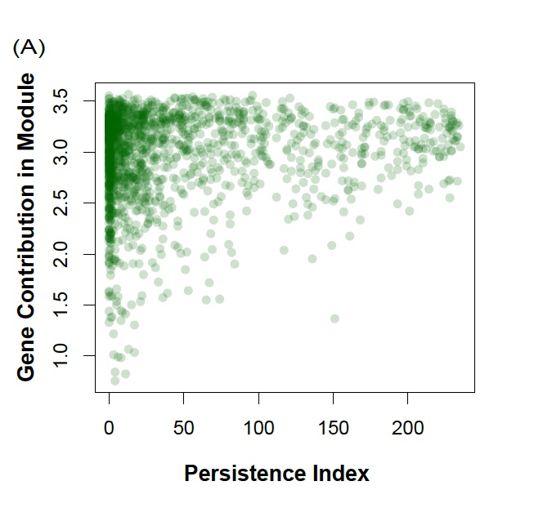
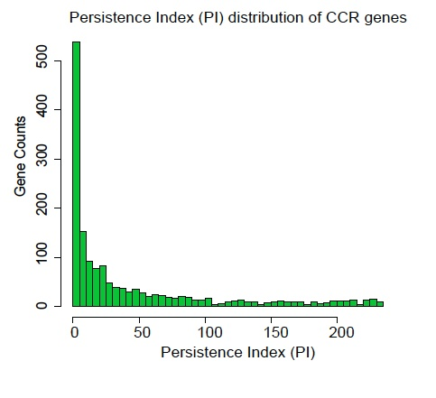
Cell cycle regulated genes vs. PI
When considering all CCR genes, their PI have no difference with the other genes (ks.test)
However, when taking CCR genes’ membership into account, persistent genes have no low membership values.
Notes:
This is a pool of all modules.
What does the fact persistent genes have high mm value mean? That means persistent genes are more likely to have similar expression profiles. And they are widely conserved in most species. So the modules containing such persistent genes are likely to be ancestral modules. that is, the genes functions are coupled in the early stages during evolution.
Also point out SS genes have high membership genes as well.

Slide 10
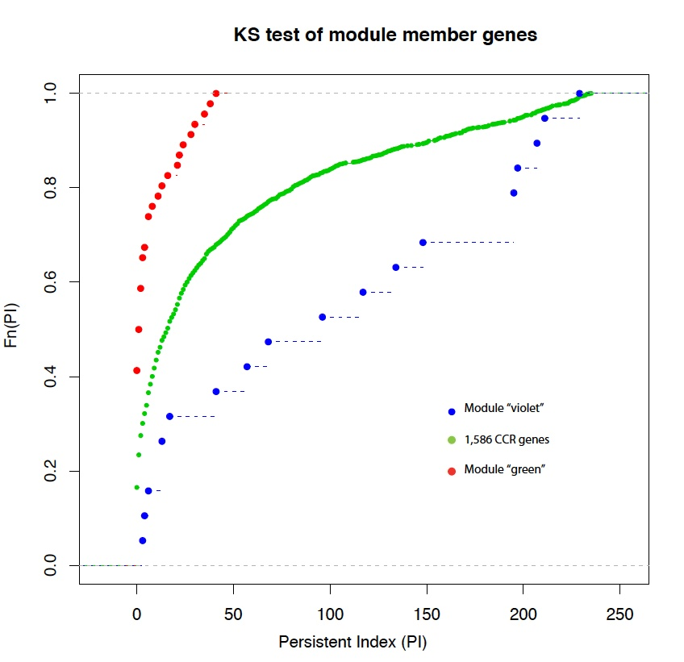
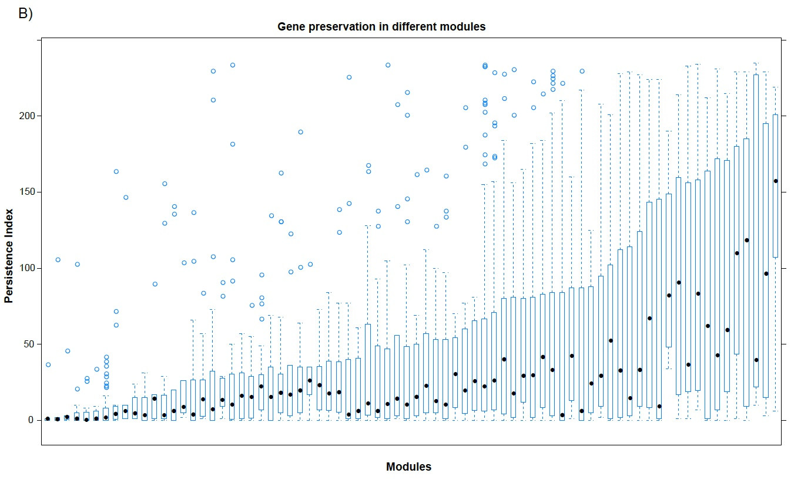
Persistence is not randomly distributed among the 76 modules
KS test: 19 out of 76 modules have p-value <0.05

Slide 11
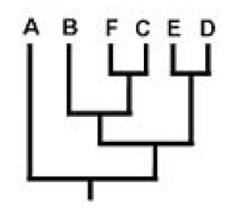
Phylogenetic signal (K value) is a better statics for randomness of evolutionary profile
G1 0 1 0 0 0 0
G2 0 0 1 1 0 0
G3 0 1 1 1 0 0
G4 0 1 1 1 1 1
Picante’s K statistic reported: 67 (88% out of 76) modules had their genes not randomly distributed with respect to phylogeny (p<0.001).
Blomberg, S. P., T. Garland, Jr., and A. R. Ives. 2003. Testing for phylogenetic signal in comparative data: behavioral traits are more labile. Evolution 57:717-745.
Orthologs’s position on tree is also important in testing randomness.

Slide 12
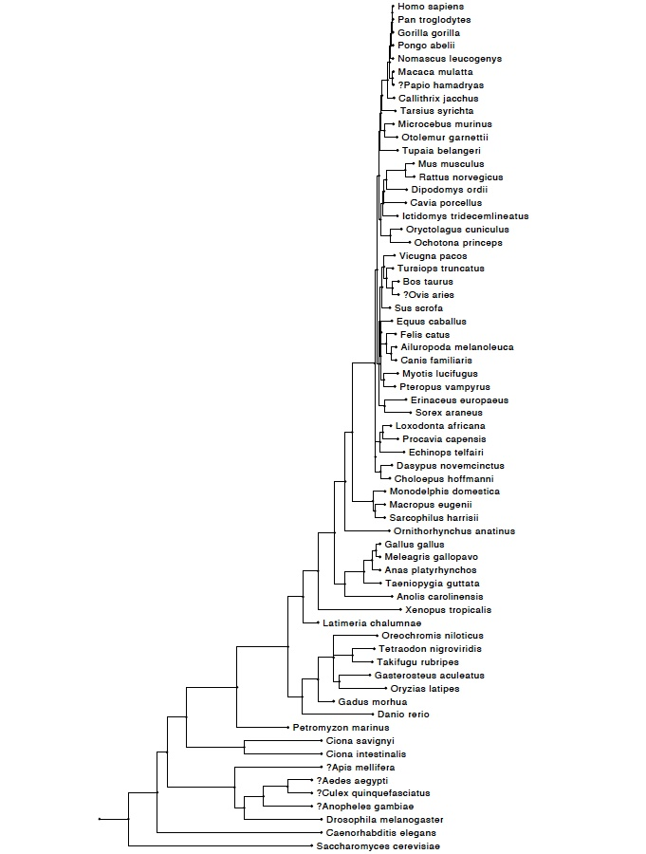
Mean pairwise distance (MPD) and mean nearest taxon distance (MNTD)
MPD significant
MNTD significant
Notes:
Mean pairwise distance: 'how closely related are the average pair of orthologs on the tree?” and relate the patterns we observe to what we'd expect under random/even distribution.
MNTD the mean distance separating each orthologs on the tree from its closest relative.
MPD is able to capture the tree level clustering. It’s not sensitive to small number of “gaps” on the tree
MNTD is more sensitive to the gaps.

Slide 13
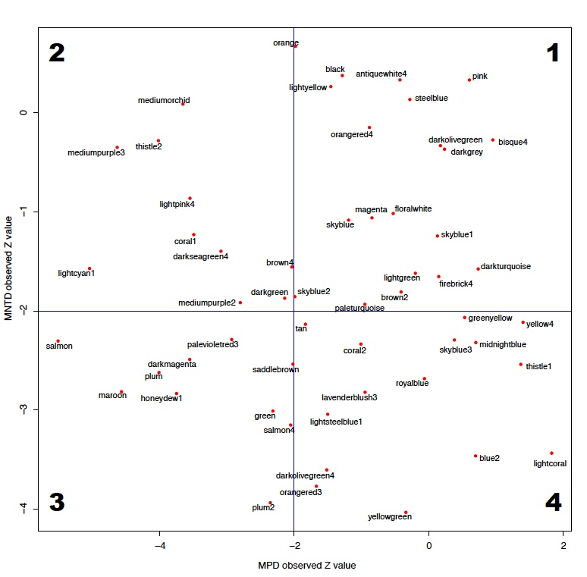
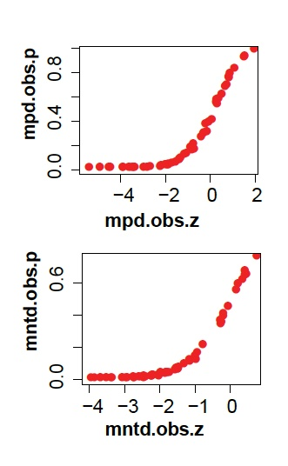
56 Modules reported both MPD and MNTD values

Slide 14
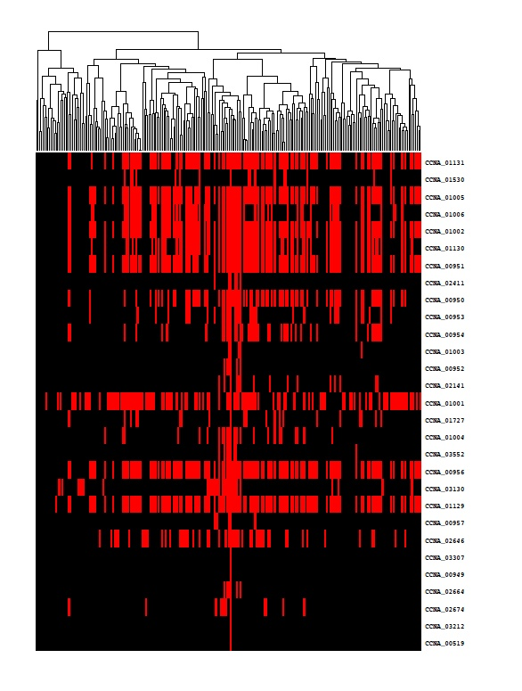
Module “salmon”
flhB;CCNA_01131 | flagellar biosynthesis protein FlhB
CCNA_01530 | flagellin
flgC;CCNA_01005 | flagellar basal-body rod protein flgC
fliE;CCNA_01006 | flagellar hook-basal body complex protein FliE
fliP;CCNA_01002 | flagellar biosyntheis protein FliP
fliR;CCNA_01130 | flagellar biosynthesis protein FliR
fliG;CCNA_00951 | flagellar motor switch protein FliG
pleA;CCNA_02411 | putative lytic transglycosylase pleA
fliF;CCNA_00950 | flagellar M-ring protein FliF
fliN;CCNA_00953 | flagellar motor switch protein FliN
flbD;CCNA_00954 | AAA-family response regulator flbD
fliO;CCNA_01003 | flagellar biosynthesis protein FliO
flbE;CCNA_00952 | flagellar assembly protein FlbE/FliH
fliL;CCNA_02141 | flagellar fliL protein
CCNA_01001 | ribokinase
CCNA_01727 | methyl-accepting chemotaxis protein
flgB;CCNA_01004 | flagellar basal-body rod protein FlgB
CCNA_03552 | conserved hypothetical protein
flhA;CCNA_00956 | flagellar biosynthesis protein FlhA
ctrA;CCNA_03130 | cell cycle response regulator ctrA
fliQ;CCNA_01129 | flagellar biosynthesis protein FliQ
CCNA_00957 | porin O precursor
CCNA_02646 | cell division protein mraZ
CCNA_03307 | hypothetical protein
CCNA_00949 | hypothetical protein
fliX;CCNA_02664 | flagellar assembly regulator fliX
CCNA_02674 | transposase
CCNA_03212 | hypothetical protein
CCNA_00519 | conserved hypothetical protein

Slide 15
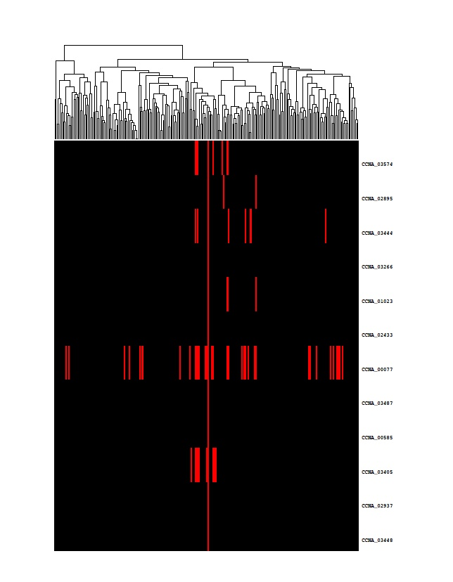
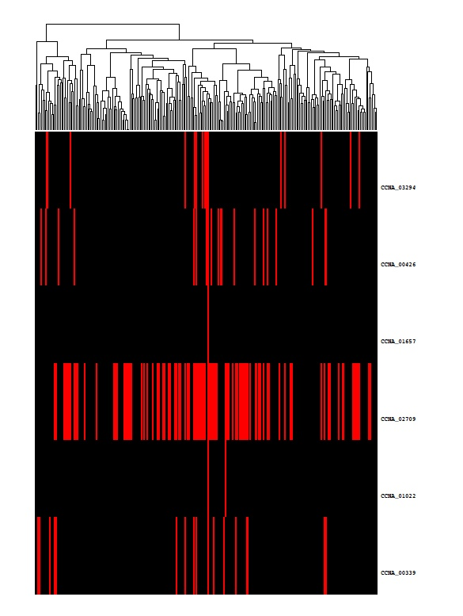
Module “plum2” and “darkolivegreen4”
More likely to be species-specific modules
Not tree-level clustering, arguably HGT

Slide 16
Conclusion 1
Like gene essentiality, expression level, network centrality and other genetic functional features, gene’s evolutionary profile and persistence are important and informative features.
Persistent genes have no low memberships, which suggests selection pressure is on the relationships between genes, rather than individual genes themselves.
Significant phylogenetic signals suggest genes are grouped into persistent modules and species-specific modules.
In bacterial, some genes are co-evolved and co-expressed providing clues of ancestral modules.
Species-specific genes make functional modules by themselves which might be related with specific phenotypes.

Slide 17
How about eukaryotic organisms?
Originated from Daifeng’s work of looking for the “gold” ortholog genes by intersecting different ortholog resources.
We used published embryonic development time course transcription profiles to examine if the orthologs are good.
We observed highly conserved genes were organized into several functional modules.
Notes:
Comparing different ortholog resources: and then examine their expression profiles are the same or not in worm and fly.

Slide 18
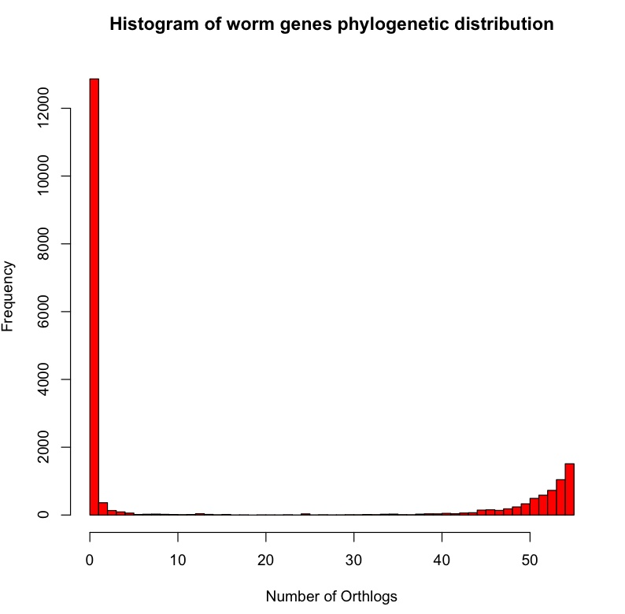
Eukaryotic genes have two distinct classes as well
Notes:
Ensembl compara

Slide 19
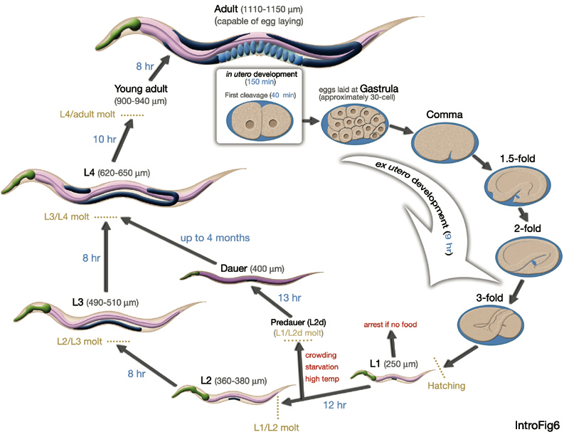
The global co-expression network
N2_EE_50-0 | 0 minutes | 12 hours
N2_EE_50-30 | 30 minutes
N2_EE_50-60 | 60 minutes
N2_EE_50-90 | 90 minutes
N2_EE_50-120 | 120 minutes
N2_EE_50-150 | 150 minutes
N2_EE_50-180 | 180 minutes
N2_EE_50-210 | 210 minutes
N2_EE_50-240 | 240 minutes
N2_EE_50-300 | 300 minutes
N2_EE_50-330 | 330 minutes
N2_EE_50-360 | 360 minutes
N2_EE_50-390 | 390 minutes
N2_EE_50-420 | 420 minutes
N2_EE_50-450 | 450 minutes
N2_EE_50-480 | 480 minutes
N2_EE_50-510 | 510 minutes
N2_EE_50-540 | 540 minutes
N2_EE_50-570 | 570 minutes
N2_EE_50-600 | 600 minutes
N2_EE_50-630 | 630 minutes
N2_EE_50-660 | 660 minutes
N2_EE_50-690 | 690 minutes
N2_EE_50-720 | 720 minutes
L1_N2_L1-1 |  | 9 hours
L2_N2_L2-4 |  | 8 hours
L3_N2_L3-1 |  | 8 hours
L4_L4b |  | 10 hours
YA_N2_Yad-1 |  | 8 hours
AdultSPE9
DauerEntryDAF2_DauerEntryDAF2-2_DauerEntryDAF2-1-1_DauerEntryDAF2-4-1
DauerDAF2_DauerDAF2-2_DauerDAF2-2-1_DauerDAF2-5-1
DauerExitDAF2-2_DauerExitDAF2-3-1_DauerExitDAF2-6-1
18

Slide 20
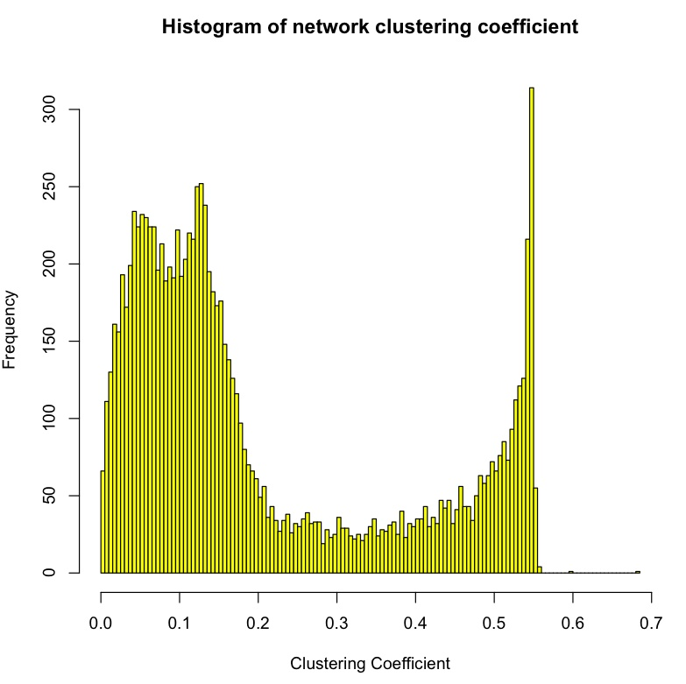
Some genes are more clustered than the others

Slide 21
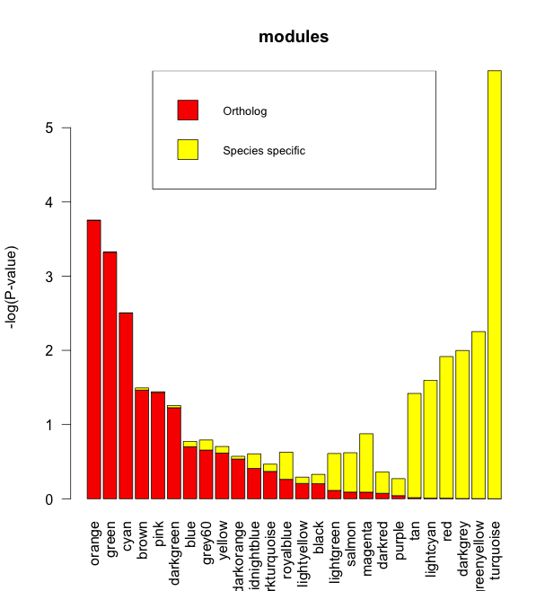
26 Modules: persistent and species-specific modules are classified using hypergeometric test:
26 Modules constructed based on ~2000 high clustering coefficient genes.
~2000 genes are classed into persistent and Species specific genes (>40 and <5, respectively)
Hypergeometric test of the two groups of genes in each module
Stacked bar plot of log transformed hyper test p-values
Notes:
KS test reports 6 modules significantly clustered.

Slide 22
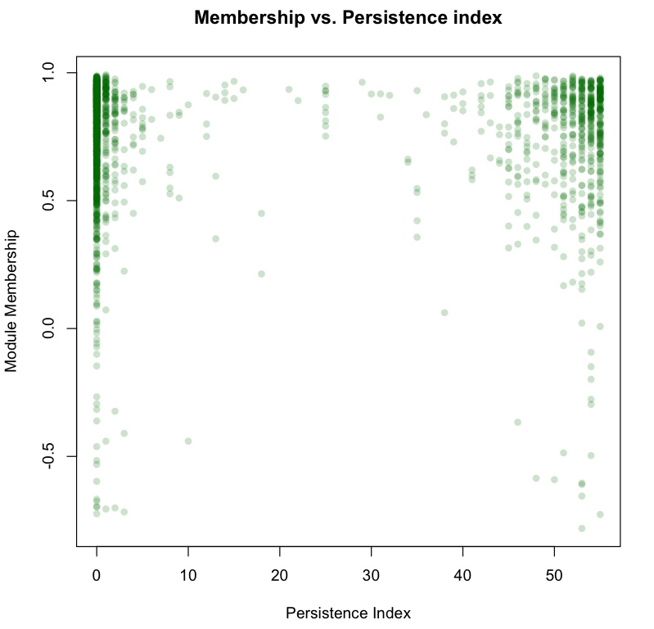
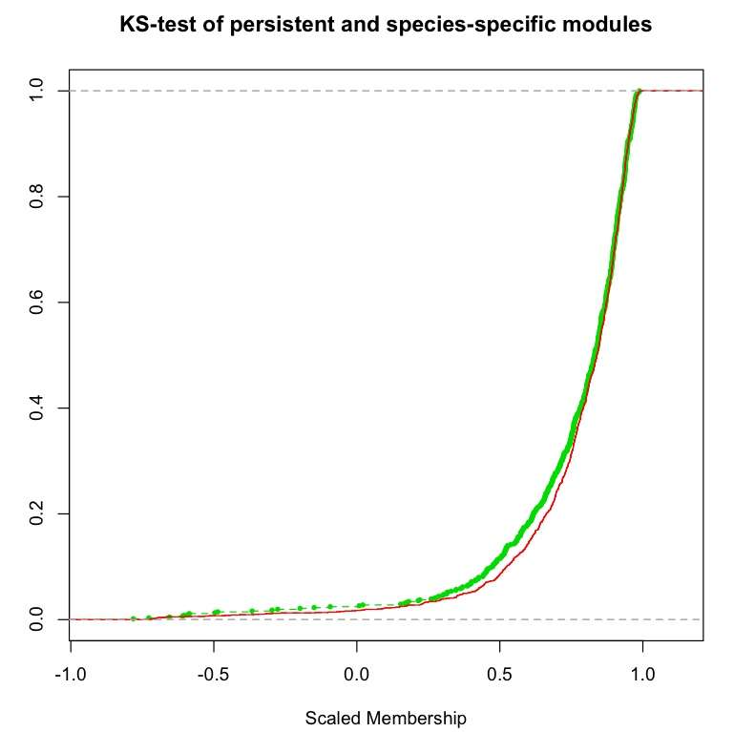
Species-specific modules have no low memberships as well.
SS gene membership
Persistent gene membership

Slide 23
The “ontogeny recapitulates phylogeny” theory
It was first observed two centuries ago that many animal embryos converge on a similar form during development, only to diverge afterwards. This temporal 'waist' in the so-called hourglass model of embryonic development is known as the 'phylotypic stage', and it is thought — controversially, given that it is based on subjective morphological comparisons — to represent an evolutionary conserved period. Now, Two transcriptomics studies give this theory strong molecular support by showing that genes active during this period are more ancient and more highly conserved in their expression.
Kalinka, A. T. et al. Gene expression divergence recapitulates the developmental hourglass model. Nature 468, 811–814 (2010)
Domazet-Lošo, T. & Tautz, D. A phylogenetically based transcriptome age index mirrors ontogenetic divergence patterns. Nature 468, 815–818 (2010)
Notes:
It was first observed two centuries ago that many animal embryos converge on a similar form during development, only to diverge afterwards.

Slide 24
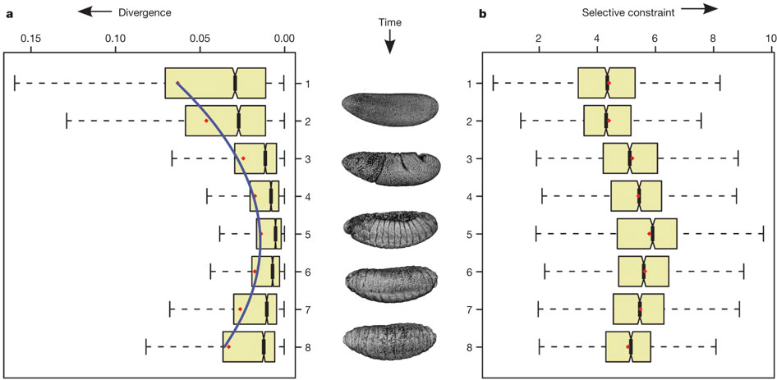
Variation in temporal gene expression across species is minimal at the phylotypic stage
Kalinka, A. T. et al. Gene expression divergence recapitulates the developmental hourglass model. Nature 468, 811–814 (2010)
Notes:
Kalinka, Varga and colleagues directly tested the hourglass model by comparing genome-wide expression profiles across embryonic development in six species of Drosophila. By generating a DNA microarray time-course for over 3,000 orthologous genes, they show that variation in temporal gene expression across species is minimal at the phylotypic stage and is greater before and after that point. Modelling suggests that this pattern is best explained by selective constraint, which seems to be strongest at the phylotypic stage. The genes whose expression follows the hourglass pattern are also most likely to be involved in core developmental processes.

Slide 25
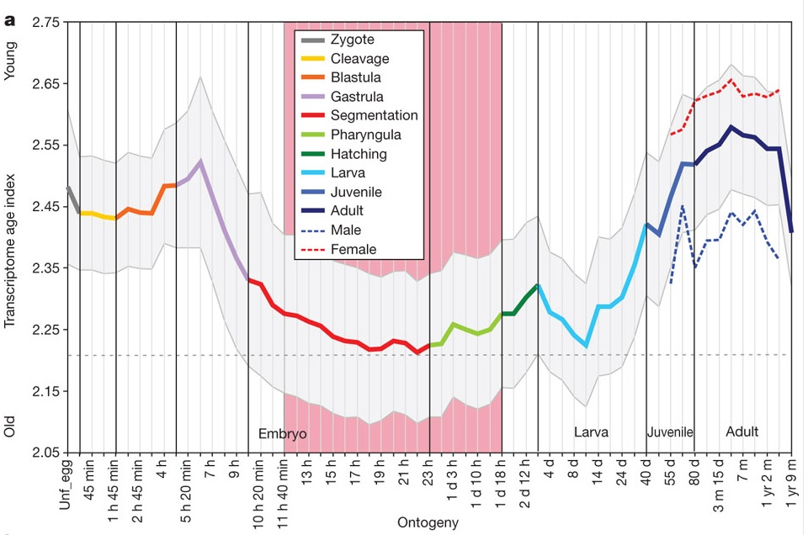
Genes expressed at the phylotypic stage belong to the “oldest and most conserved set”
Domazet-Lošo, T. & Tautz, D. A phylogenetically based transcriptome age index mirrors ontogenetic divergence patterns. Nature 468, 815–818 (2010)
Notes:
They used a previously described approach known as 'phylostratigraphy' to divide the genome into gene classes, each of which encompasses genes that have evolved at a distinct evolutionary stage (for example, a set of genes might be common to all cells, to all animals or to all chordates). By overlaying this gene classification on the developmental transcriptome of zebrafish (Danio rerio), they showed that genes that are expressed at the phylotypic stage belong to the oldest and most conserved set; by contrast, genes expressed earlier or later are more likely to belong to more newly evolved gene sets. A similar pattern was also seen in published data from Drosophila melanogaster, Anopheles gambiae and Caenorhabditis elegans.

Slide 26
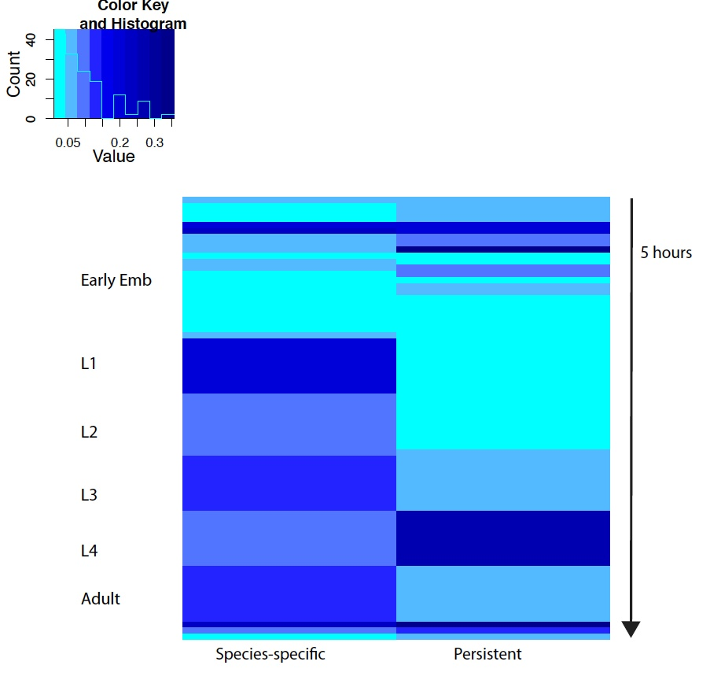
1st PC of two groups of modules

Slide 27
Conclusion 2
All conclusions from bacterial genome analyses hold
Support “ontogeny recapitulates phylogeny” theory
Species-specific modules are more active from L1 to Adult.

Slide 28
Acknowledgements
Gerstein’s lab:
Daifeng
Mark
All the lab
Jacobs-Wagner’s lab:
Jason Hocking
Manuel Campos
Paula Montero Llopis
Christine

