Slide 1
1KG Phase 1 SNPs & NA12878 Allelic SNPs
Jieming
Annotation-FIG
10th July 2012

Slide 2
1KG Phase 1 - Some numbers -
Phase 1 SNP data only
Category | # of SNPs
All SNPs | 38,248,779
Autosomal SNPs | 36,820,992
Non-mono | 11,044,591
With DAF | 10,476,726

Slide 3
1KG Phase 1 - Some numbers -
CEU population only
 | Population | Full name | # individuals | Broadpop
1 | LWK | Luhya in Webuye, Kenya | 97 | AFR
2 | YRI | Yoruba in Ibadan, Nigeria | 88 | AFR
3 | ASW | African Ancestry in Southwest US | 61 | AMR
4 | CLM | Colombian in Medellin, Colombia | 60 | AMR
5 | MXL | Mexican Ancestry in Los Angeles, California | 66 | AMR
6 | PUR | Puerto Rican in Puerto Rico | 55 | AMR
7 | CHB | Han Chinese South | 97 | ASN
8 | CHS | Southern Han Chinese | 100 | ASN
9 | JPT | Japanese in Tokyo, Japan | 89 | ASN
10 | CEU | Utah residents (CEPH) with NW European ancestry | 85 | EUR
11 | FIN | Finnish in Finland | 93 | EUR
12 | GBR | British in England and Scotland | 88 | EUR
13 | IBS | Iberian populations in Spain | 14 | EUR
14 | TSI | Toscani in Italia | 98 | EUR
 |  |  | 1092

Slide 4
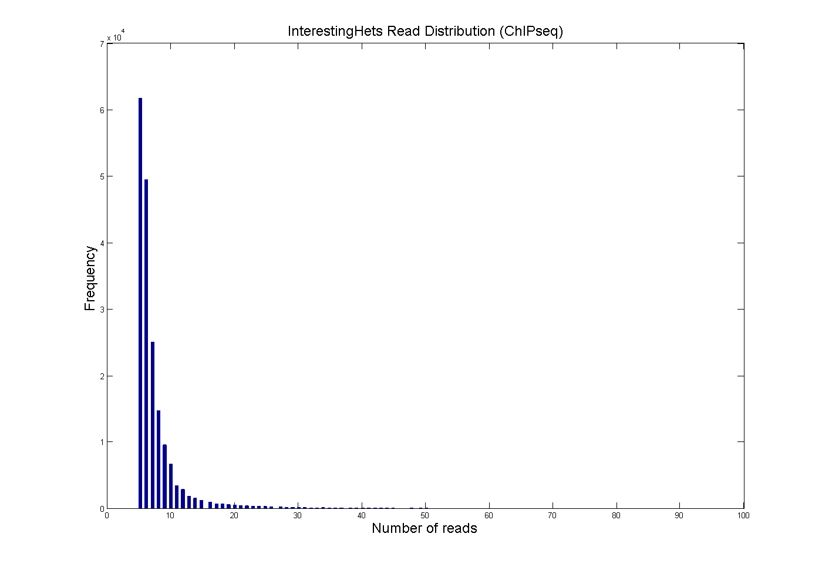
NA12878 ASB (ChIPseq)
Category | # SNPs
InterestingHets | 191,941
InterestingHets depth > 6 | 80,823
5 | 61670
6 | 49448

Slide 5
NA12878 ASB (ChIPseq)

Slide 6
NA12878 AS SNPs

Slide 7
Creating “Background”
NA12878 heterozygous SNPs genome-wide
NA12878 heterozygous SNPs in pseudogenes

Slide 8
Allele-specific SNPs in TF binding sites and associated with gene expression are under more negative selection.
List of allelic SNPs corresponding to the Phase 1 data (nonmono, CEU, with DAF) - ChIPseq (overlap:0bin) → 55,420 : 7,322 SNPs - RNAseq overlap (overlap:0bin) → 552 : 61,709 SNPs

