Slide 1
Gerstein Lab FQA Website and Posting
Gili Zilberman
Journal Club
June 27th, 2012

Slide 2
General Workflow
FAQs
Mark /
lab members
FAQtraffic@gersteinlab.org
(Declan)
Person who asked
FAQtraffic@gersteinlab.org
faq.gersteinlab.org
Formatted answer
Lab member
in-charge of
the subject

Slide 3
Quick Look
faq.gersteinlab.org

Slide 4
How to format your reply (1)
Specify the Category
Use shortcodes to describe the topic of the post.
Categories need to be predefined. If they aren’t, they will appear under “uncategorized”.
Example: [category pseudogenes, molmov]
Specify the tag as your lab initials
[tags gz]

Slide 5
How to format your reply (2)
Create an informative subject
Edit the email subject or add a shortcode in the email body: [title my post title]
Cleanup and structure
Remove all unnecessary text and symbols.
[category pseudogenes]
[tags gz]
Q:
Question goes here
A:
Your answer here

Slide 6
How to format your reply (3)
Attachments
Can be kept in the posting email and will appear in the post.
Check your post at faq.gersteinlab.org
Make sure it appears on the website, is categorized and that it’s not truncated.
You can find all your posts at
http://faqs2gersteinlab.wordpress.com/tag/gz/

Slide 7
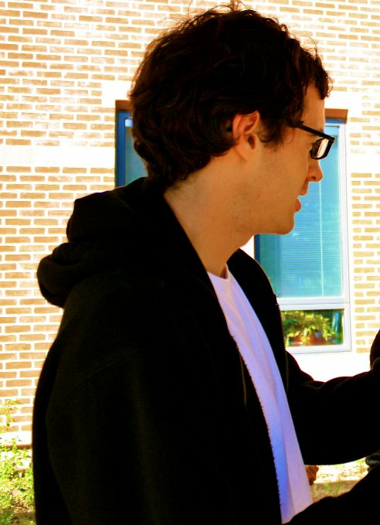
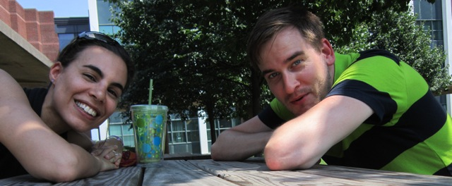
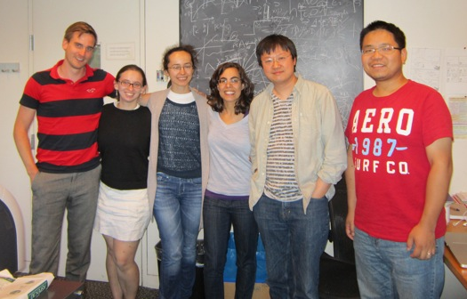
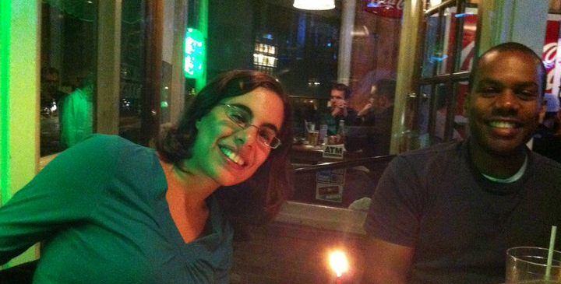
Thank you!!!

