Slide 1
Modules in a network with positive and negative edges
positive
negative

Slide 2
Aim: detecting modules across species
positive
negative
ortholog

Slide 3
Method:
Coupled Potts Model
randomly assign spins
(1,2,..,q) to the nodes
simulated
annealing for H
at most q modules

Slide 4
The R packages dependency network.
How much do you know about your favorite statistical software?
KKY

Slide 5
The R packages dependency network
R is an open software, in which people contribute their own packages to the community.
People don’t write everything from scratch. They tend to build their innovation upon on existing packages (dependence)
From a user standpoint, package A depends on package B means we need to install package B before installing package A
Dataset:
  node (package): 2450
  Edge (dependence): 5440

Slide 6



Why should we care?
Evolution of engineering /
technological systems
Design principles found in
biological systems and
technological systems

Slide 7
Why should we care?
The essence of the dependency network, “standing on the shoulders of giants”, is a simple but universal principle.
  Software design
  Advancement of scientific knowledge
  …
Mark Pagel’s book: “Wired for culture: Origins of the human social mind”
A more specific analogy between metabolic network and packages dependency network

Slide 8
Hubiness statistics
ChemometricsWithR,
Metabonomics,clustTool,
sisus, UScensus2000add
R, MASS, methods,
stats, lattice …

Slide 9
Direct versus Indirect Dependency
Direct dependency: kin(A)=2
Indirect dependency: Kin(A)=4
A

Slide 10
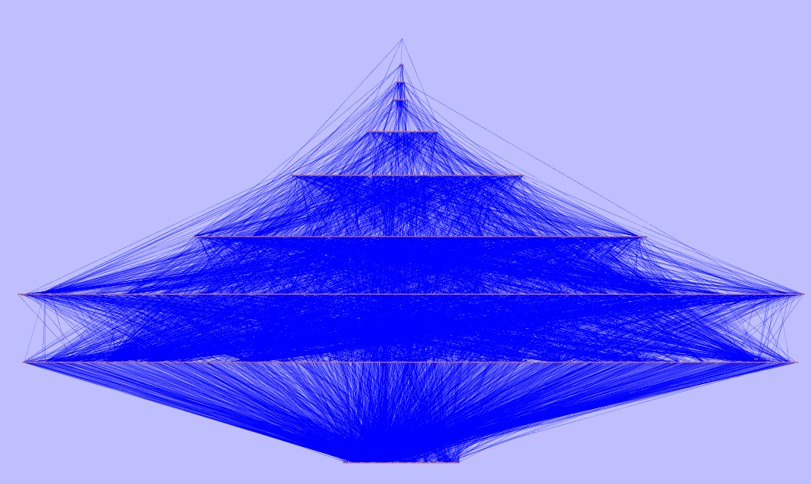
Hierarchical structure
The dependency network is a directed acyclic graph (not a single loop).
Apply a simple node-removal algorithm: 10 levels.

Slide 11
What’s the proper null model?
d=2

Slide 12
Download statistics
Statistics of 2400 packages from the CRAN mirror at UCLA
R=0.31,P<10^{-47}
R=0.28,P<10^{-36}
R=-0.13,P<10^{-8}

Slide 13
Possible continuation
More parsing:
  An updated network
  Information of packages:
    The number of versions
    Date of incorporation etc
  Track the evolution of the whole system
Interplay between download, rate of evolution and network topology
Evolution of the hierarchy:
  How does the number of layers scale with the number of nodes?
  Tetris analogy.
  What’s the meaning behind the empirical distribution of levels?

