Slide 1
Biological Networks: construction, topology and dynamics
Koon-Kiu Yan
Department of Molecular Biophysics and Biochemistry
Yale University

Slide 2
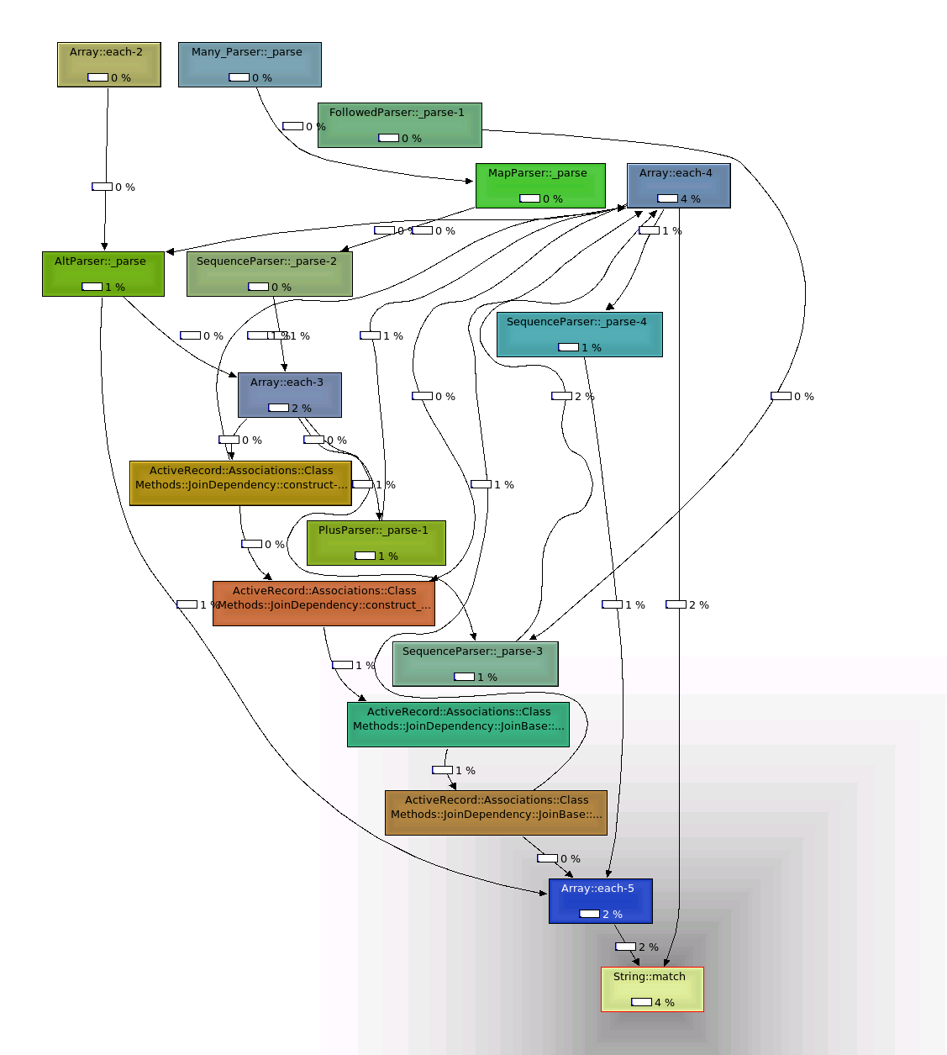
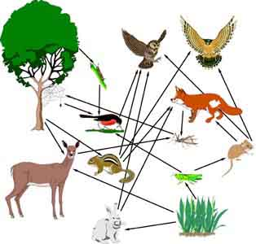
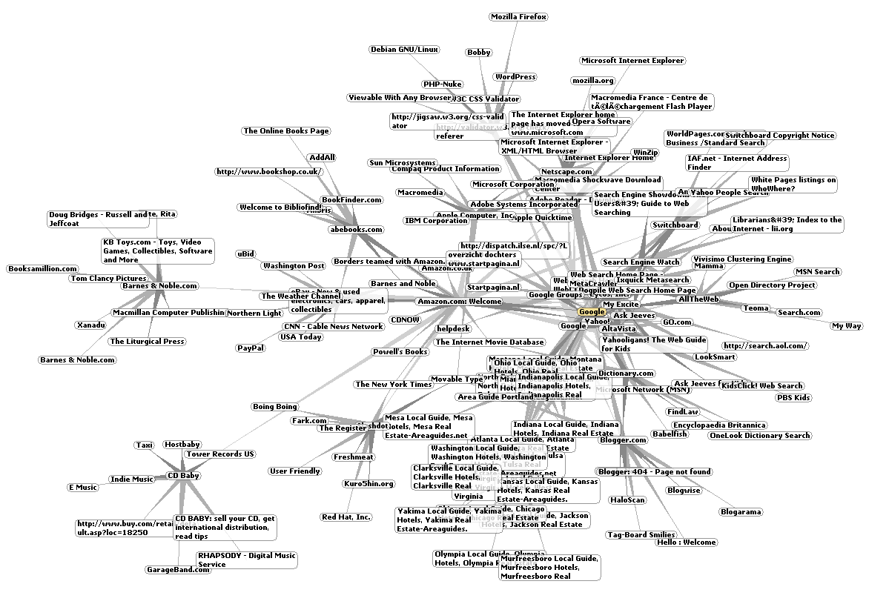
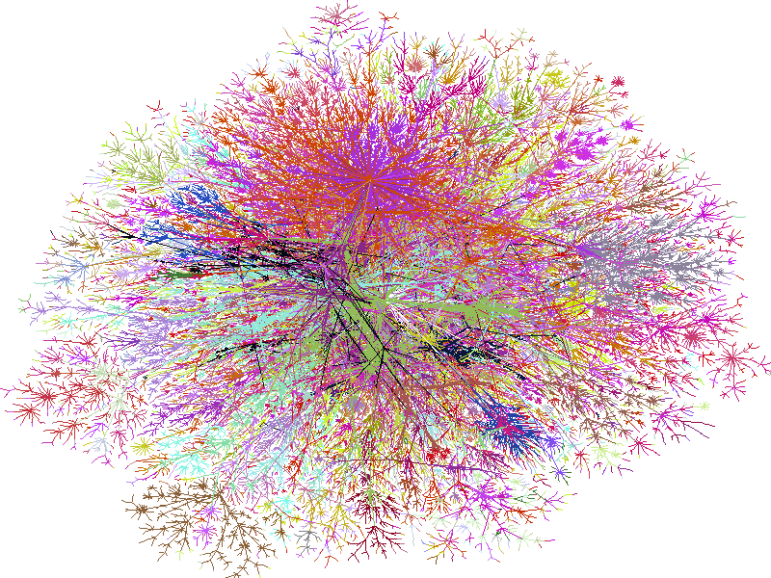
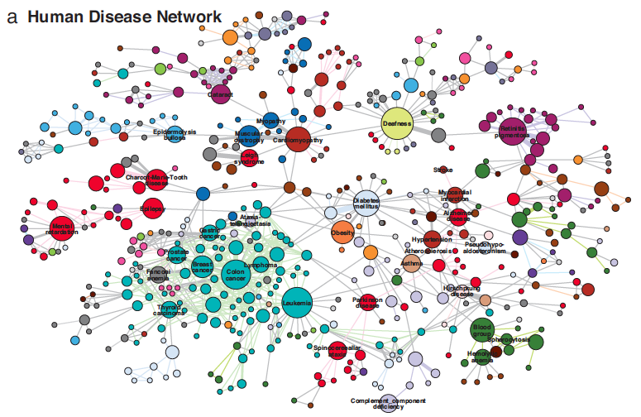
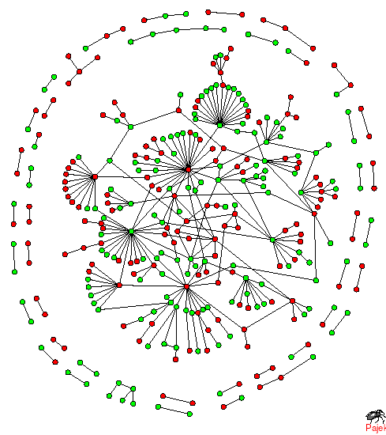

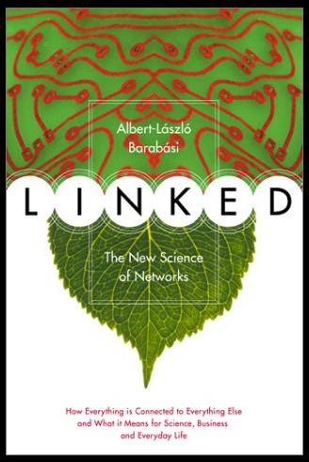
Networks as a common framework of complex interacting systems
Food Web
WWW
Software call graph
Disease
Network
Goh. et.al. 2007
Internet
Burch & Cheswick
Molecular
network
Social
Network
2
Notes:
Apart from showing u some nice pictures, the point I want to make is,

Slide 3
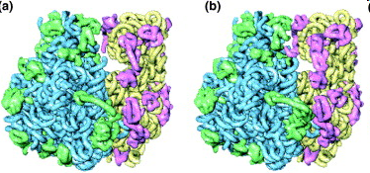
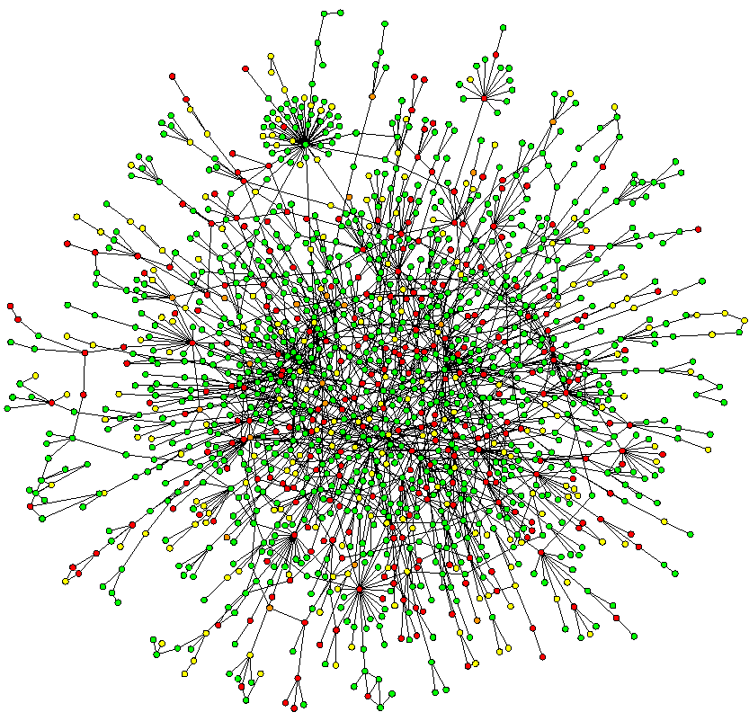
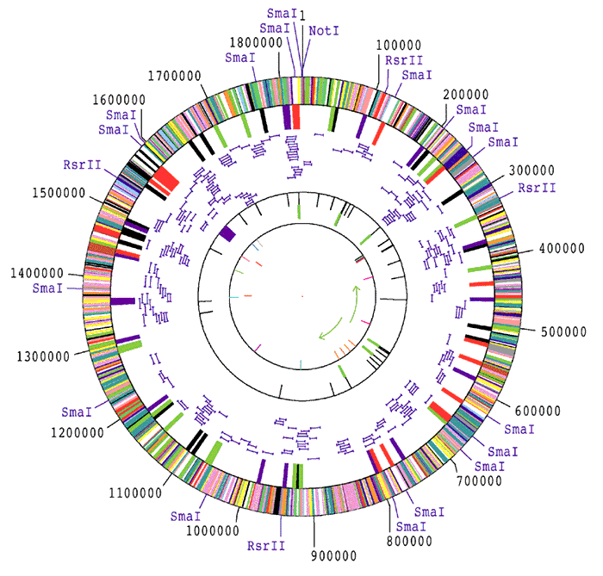
Networks occupy a midway point in terms of level of understanding
1D: Complete
Genetic Parts list
2D: Bio-molecular
Network
Wiring Diagram
3D and 4D:
Detailed structural understanding of all cellular machineries
(e.g. ribosome in different functional states)
Fleischmann et al., Science 1995
Jeong et al. Nature, 2001
Chiu et al. Trends in Cell Biol, 2006
Notes:
Appropriate ground to nourish our understanding on the big picture of complex biological systems

Slide 4
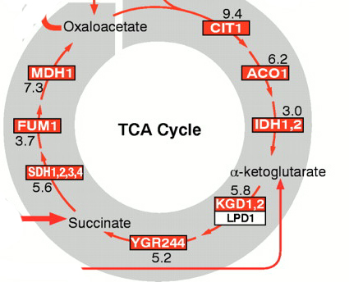
Different kinds of molecular networks and their integration
Transcription
factors
1
1
1
1
Transcription regulation
RTG1
RTG3
HAP3
HAP2
Enzymes
1
1
1
1
Metabolic pathway
CIT1
ACO1
IDH1
KGD1
Protein protein physical
interaction
Others
1
1
1
1
1
MDH1
VMA6
THS1
AAT2
PGM2
1
1
GCY1
GPH1
Post-transcriptional (e.g. miRNA)
regulation
Part of the
TCA cycle
Post-translational regulation
(e.g. phosphorylation)
4
Notes:
There are different kinds of molecular netwokrs
Though we have different kinds of netwrok, in reality, they work together

Slide 5
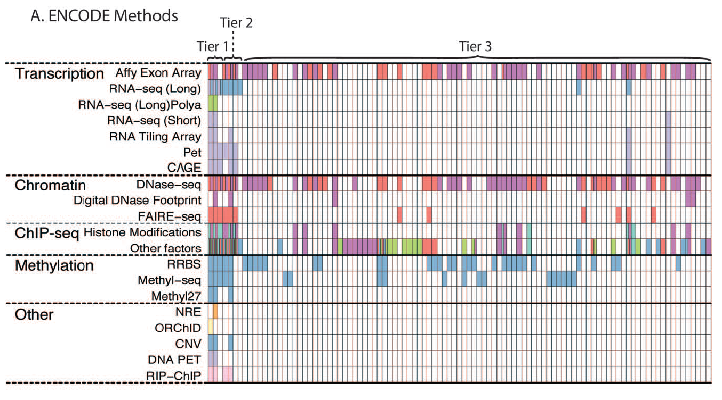

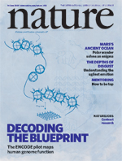
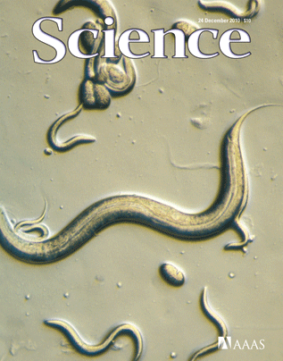

Big goal: the human wiring diagram
Adapted from:
The ENCODE consortium
PLoS Biol. 2011
Notes:
A big goal for many life sci. …presumably the most important organisms for all of us
Tier 1 and 2 have already finished, cover …
The next step is Tier 3

Slide 6
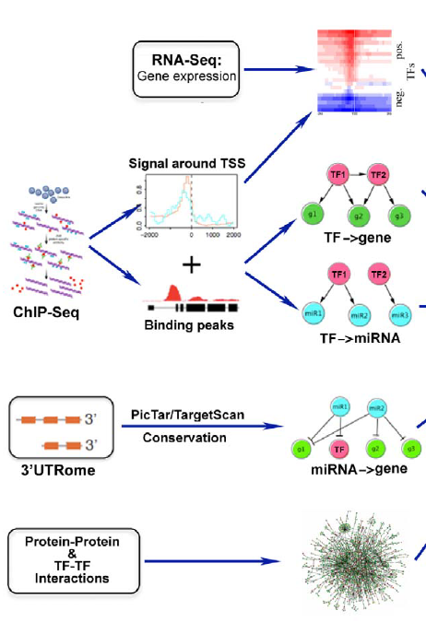
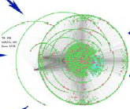
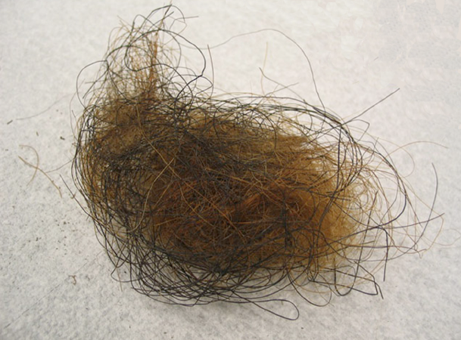
To construct the human wiring diagram: Data integration
chromatin
model
Distal
regulation
meta-network
Cheng C, Yan KK et.al. Gerstein M PLoS Comp. Biol. 2011
Gerstein M et.al. Science 2010
Gerstein M et.al. Nature (submitted)
Notes:
As I said earlier, network is a good framework to decipher the big picture. With the amount of data, there’s a great opportunity to probe the complexity of human wiring diagram. In the past two years, I have been working on the integration of some of these data, in the direction of constructing the human wiring diagram. In a nutshell,

Slide 7
How to unravel the hairball?
Studying model organisms
Mapping various “omics” data
Design principles
Bring intuition from
commonplace
systems via comparison
Looking at the underlying
dynamical processes
Notes:
How to unravel the hairball and arrive at the design principles..
There are several thought processes to think about
Comparison is actually a very powerful tool. Imagine one day, we go to a new planet and found nothing but a fossil of an alien species. The fossil is essentially the network of this organism. We shall we do? First thing, is to compare with various species we know on Earth. I want to emphasize that comparison can be cross-disciplinary, using commonplace systems, at the beginning I said networks as framework of many complex systems.
In the rest of my talk, I will show a couple of work on using these thought processes to decipher different kinds of bio. networkt

Slide 8
Networks: Organization principles from comparison with commonplace systems
Bhardwaj N, Yan KK, Gerstein M. PNAS 2010
Yan KK et.al. Gerstein M, PNAS 2010
Notes:
Structure….

Slide 9
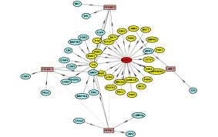
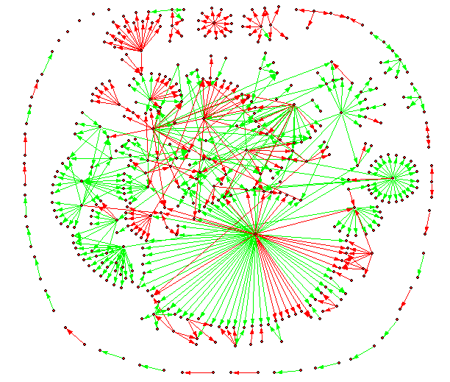
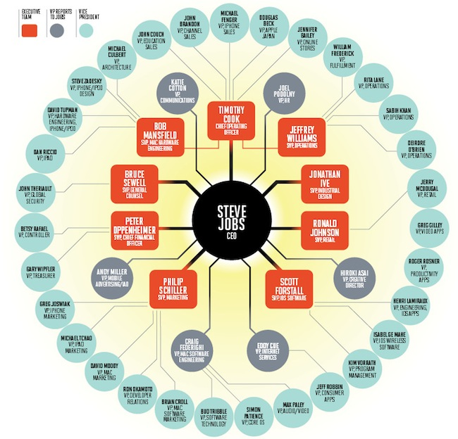
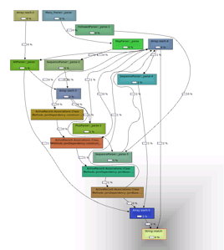
Preferred directionality in networks
9
Notes:
Many complex networks have a preferred direction.

Slide 10
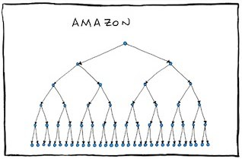
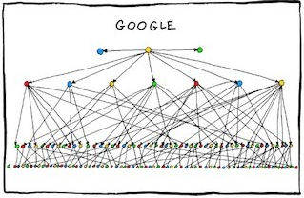
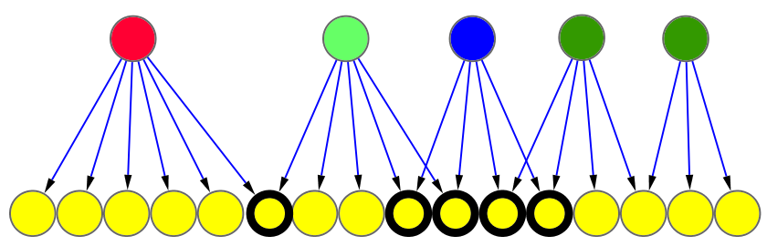
Collaboration among nodes in a hierarchical organization
http://www.bonkersworld.net/
Autonomous
Collaborative
For each regulator:
Degree of Collaboration
1/6=0.16
4/4=1
10
Notes:
The existence of a preferred direction suggests a hierarchical organization, meaning we would classify nodes into levels, at the top, middle, and bottom. However, there are different types of hierarchy. It is easier to think about from a management standpoint.
Some companies have a very strict, ordered management

Slide 11
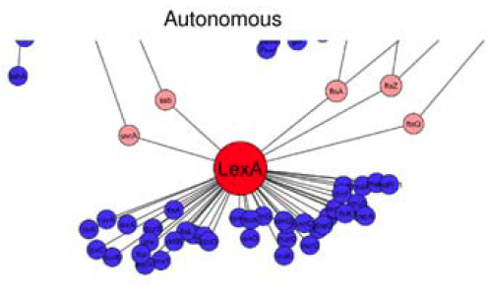
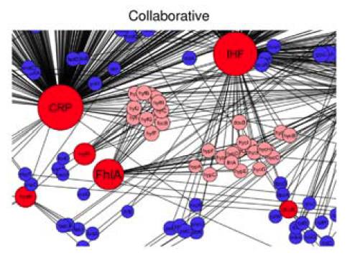
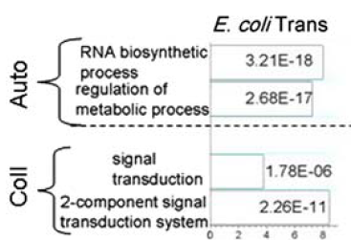
Autonomous versus Collaborative
GO enrichment for two types
of regulators
Notes:
The idea of autonomous and collaborative is clearer in this picture, network of E. coli

Slide 12
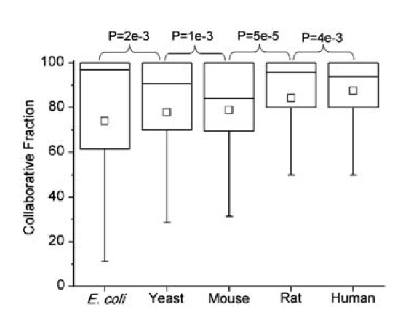
Higher species have more collaborative nodes
12
Notes:
Network of E. coli exhibits a range of degree of collaboration.

Slide 13
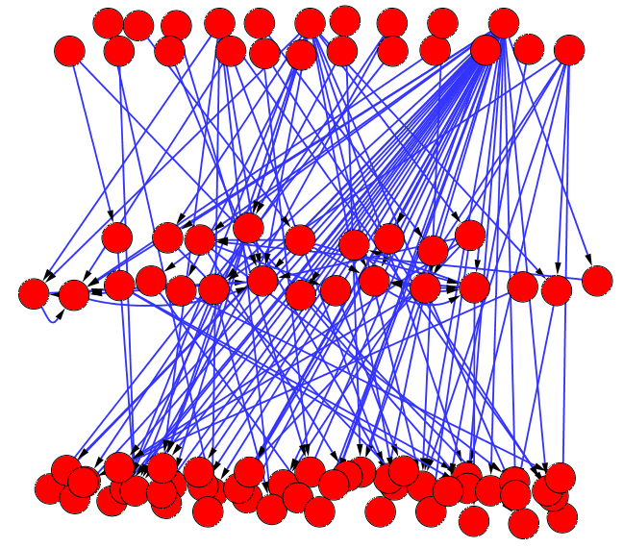
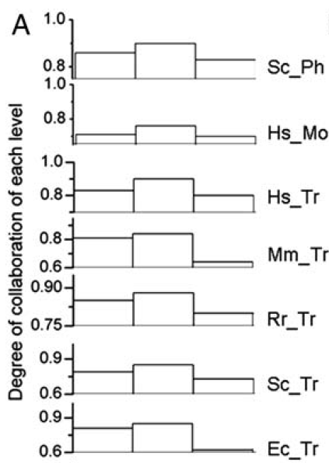
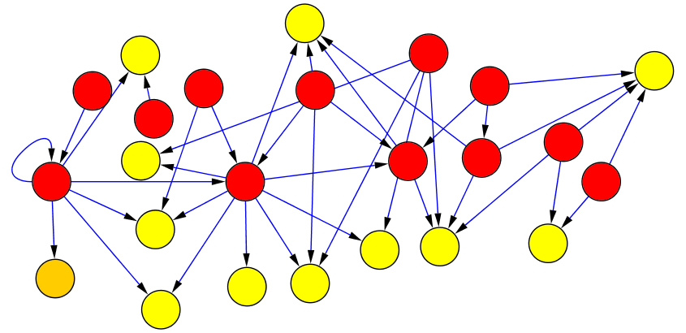
Collaborative nature of individual levels
Top: no incoming edges
Middle: regulated by other regulators
and regulate other genes
Bottom: only regulate other genes
Species | Networks
E. coli | Transcriptional regulatory
S. cerevisiae | Transcriptional regulatory Phosphorylation
H. sapien | Transcriptional regulatory Protein modification
Mus musculus | Transcriptional regulatory
Rattus rattus | Transcriptional regulatory
Top
Middle
Bottom
13
Notes:
We have defined the degree of collaboration for each regulator. And we see there’s a preferred direction in the network, in the sense we can classify nodes in layers, from top to bottom. We want to ask how’s the degree of collaboration related to the layers.
There are many ways to define the levels,

Slide 14
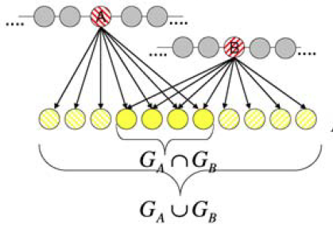

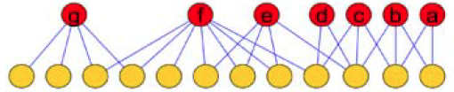
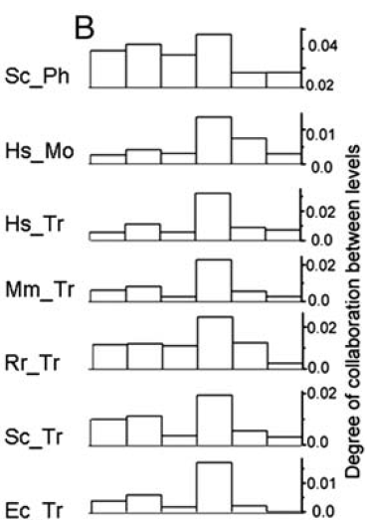
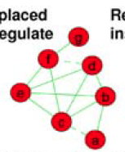
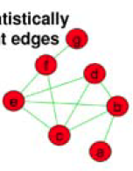
Collaborative nature between levels
Co-regulation (Partnership)
Edges placed if there
is a partnership
Statistically insignificant
edges are removed
T
T
T
M
T
B
M
M
M
B
B
B
14
Notes:
We just looked at the level of collaboration for a regulator, it’s natural to ask, to whom it collaborate with. Move to look at the collaborative nature between levels. To do so,

Slide 15
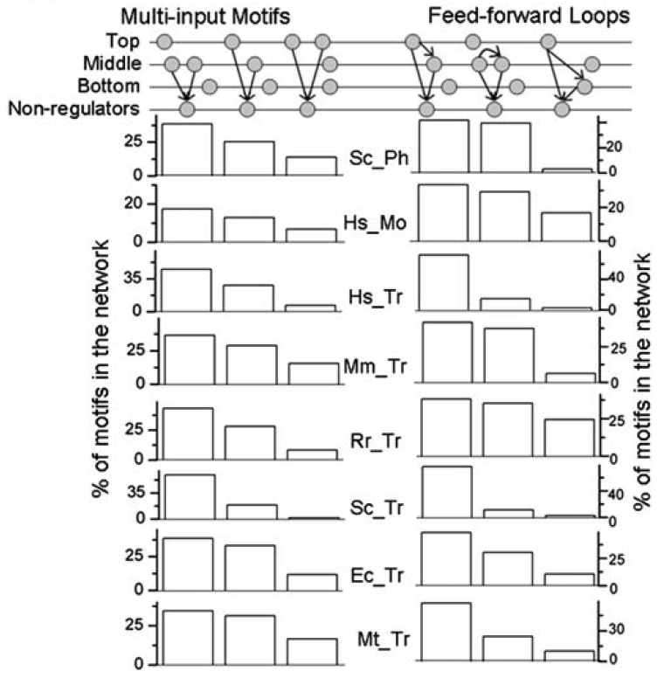
Co-regulation instantiates certain network motifs
15
Notes:
…. The observed enrichment for MM, and depletion for BB for co-regulatory pairs is consistent with the observation among network motifs.

Slide 16
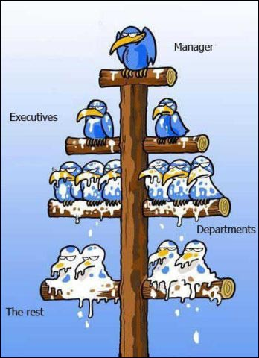
Summary/Design principles
Biological regulatory networks exhibit a hierarchical organization (chain of commands going top down) similar to corporate setting
Regulators exhibit a wide range of degree of collaboration: autonomous and collaborative
Collaborative fraction increases with organism complexity
Middle managers are the most collaborative
Middle managers interact the most in efficient corporate settings
www.gagful.com
16
Notes:
Let’s summarize on this study

Slide 17
Network evolution
Biological systems are complex adaptive systems. They change their organization / behavior in response to the success or failure of previous organization / behaviors.
From a design standpoint, technological systems / engineering devices are adaptive.
 | E. coli transcription regulatory network | Linux call graph
Nodes | Genes (TFs and targets) | Functions (subroutines)
Edges | Transcriptional regulation | Function calls
External constraints | Natural environment | Hardware architecture, customer requirements
Persistent components | Persistent genes | Persistent functions
Origin of evolutionary changes | Random mutation and natural selection | Designers’ fine tuning
17
Notes:
The last study look at network structure from an information flow standpoint. Here, we look from a different perspective, more focus on the evolution standpoint, and asking why a network is organized in such a fashion.
…..
We therefore compare a biological system to a technological system. In particular look at a software system, the Linux kernel,

Slide 18
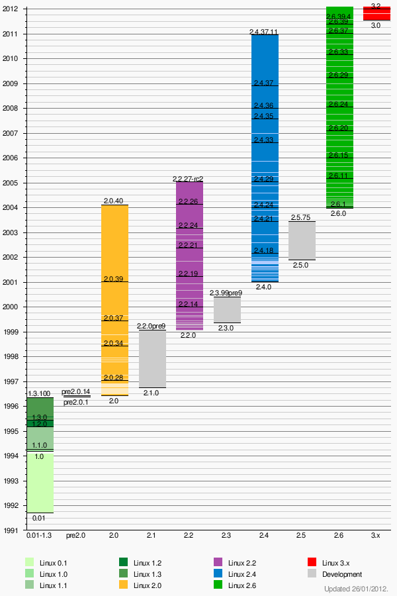
The Linux Kernel
Line of code: 6 million
We can track the evolution of
a function.
rate of evolution of a function
~ the number of times it got revised
Line of code: 4 million
From Wikipedia
From CodeViz
A subnetwork in the Linux call graph
Notes:
For those who are not really a computer geek, let me say a few sentence on the Linux kernel. I refer to kernel of the OS, not the whole distribution
Just to make it clear, I here show

Slide 19
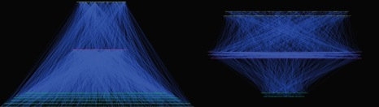
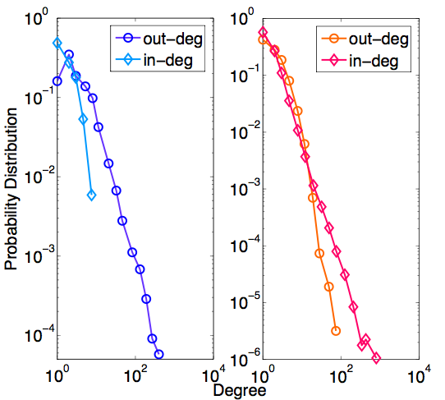
Hierarchical organization: pyramidal versus top-heavy
E. coli transcriptional regulatory network
the Linux call graph
master regulator
Middle manager
workhorse
Degree distribution
Roles of hubs
out-degree hubs
e.g. “crp”
in-degree hubs
e.g. “printk”,”_spin_lock”
19
Notes:
As before, the transcription regulatory network and the software call graph possess a preferred direction.
We therefore again construct a hierarchical organization.

Slide 20
Organization of modules and reuse
M1
M2
M3
Modules are labeled by master regulators:
TFs, high-level starting functions
Overlap(M2,M3)=
reuse=2/3
reuse=1/3
 | E. Coli TRN | Linux call graph
Average overlap | 4.3% | 80.7%
Maximum node reuse | 15.6% | 87.5%
Average node reuse | 3.5% | 8.4%
TRN:
modules overlap little,
components are
less generic
Call graph:
modules overlap,
Functions are highly
reused (generic): “printk”
20
Notes:
The idea of modules is not new to both system biologists and engineers. Essentially, a module corresponds to a certain function
A simple minded way base merely on network topology
There are many ways to define module

Slide 21
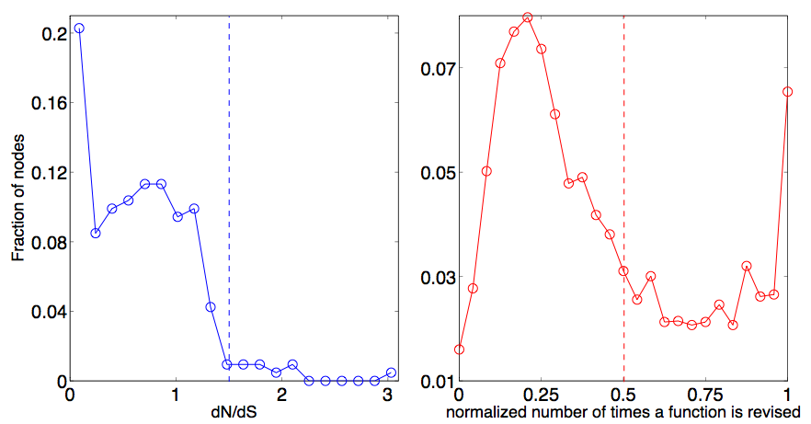
Tradeoff between reuse and robustness
reusability (cost-effective)
independent
modules
overlapping
modules
robustness
purifying
selection
adaptive evolution
purifying selection
adaptive
evolution
E. coli
Linux
Higher reuse
e.g. dnaA
e.g. strlen
srandom32
counter_set
e.g. mem_read
release_dev
swap_free
Persistent genes evolve slowly
Two classes of persistent functions
Notes:
Reuse and Overlap between modules suggest a design principle. Tradeoff between reusability and robustness
….
This comparison suggests that the reusability is not for free. The price is a constant update. When we want to use an existing component for a new function, the designer has to do some tweaking. Which is not likely to happen for nature. Cannot afford to pay for the price, natural systems are comparably more independent

Slide 22
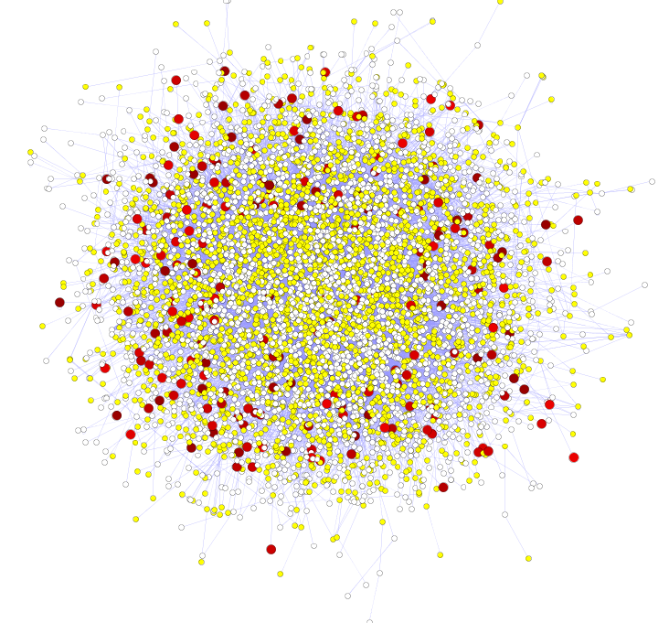
Tinkering versus Design
Hub proteins are more difficult to evolve
High likelihood of positive selection
Lower likelihood of positive selection
Not under positive selection
No data about positive selection
(Adapted from Kim et.al. and Gerstein PNAS 2007)
Notes:
We further relate the rate of evolution to network topology.
The intuition is, being related to many others, it all sort of constraint and forbid a fast evolution.

Slide 23
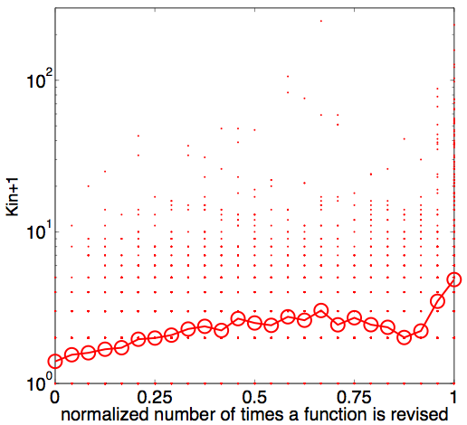
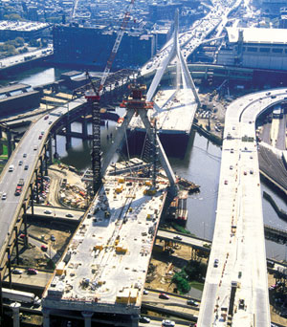
Tinkering versus Design
  Reusable components need to be constantly fine-tuned
Spearman correlation
r=0.26, P<10⁻⁷⁵
Notes:
In the case of Linux, the situation is exactly opposite. Degree is positively correlated with the rate of evolution. This is essentially how an intelligent designer works. Hubs, more useful, more central of the networks, require more fine-tune.
The situation is very similar to repair in high way systems. The bottleneck requires more upgrade and more construction. Probably, no one care about a road in the middle of nowhere.

Slide 24
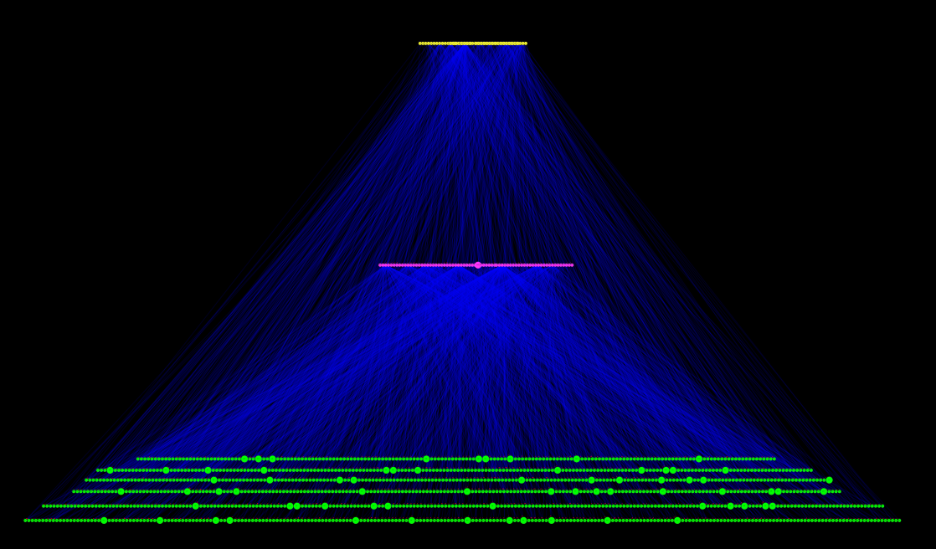
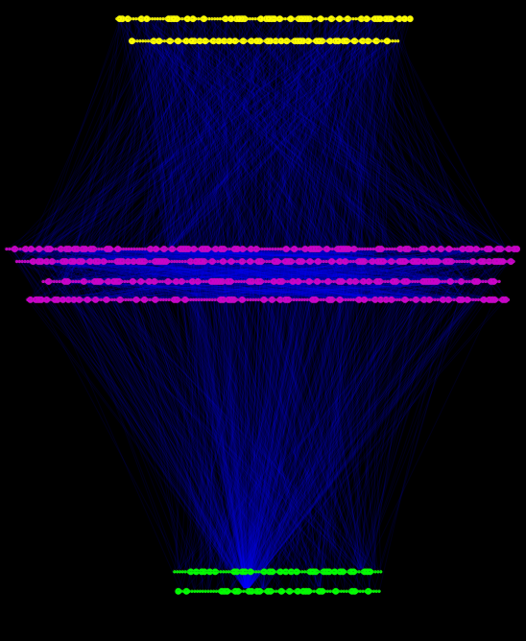
Bottom-up versus Top-down design
E. coli
Linux
Persistent genes are enriched at the bottom,
but persistent functions are enriched at the top/middle

Slide 25
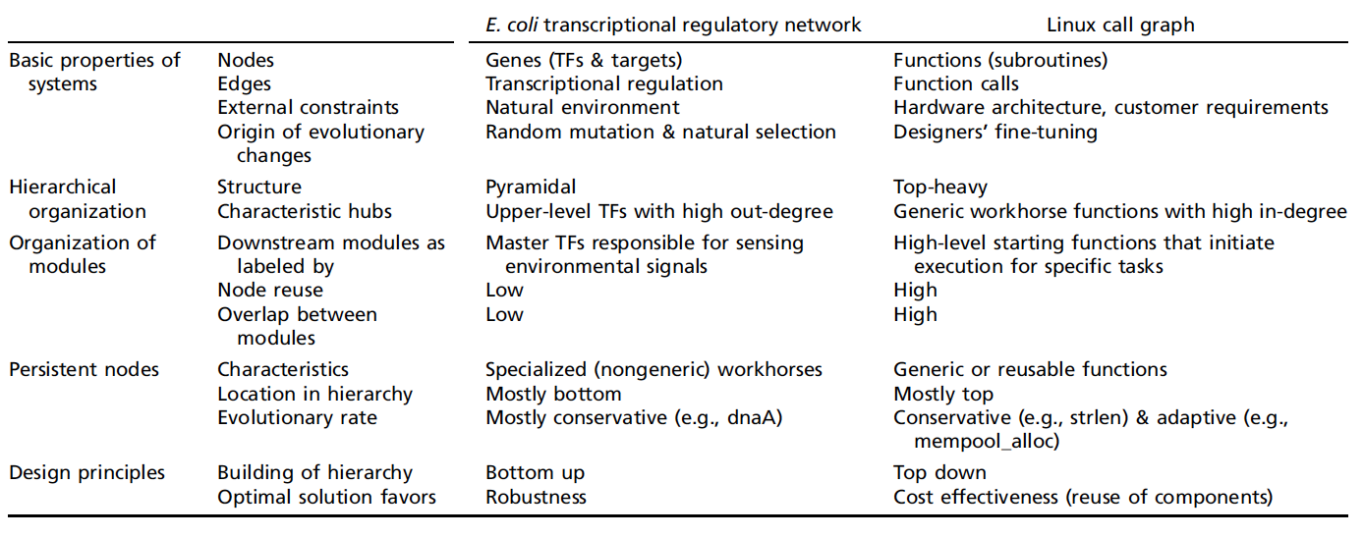
Summary and design principles
Notes:
…Summary. We compared two adaptive systems in terms of their underlying network
Different complex adaptive systems may share the same set of driving force. In many cases, these driving forces conflict with each other. For example robustness, reusability. But because of the nature of two adaptions, one by random mutation and natural selection, the other by intelligent designer, they pick their optimal solution at different ends.
, reusability still plays an important role in biology

Slide 26
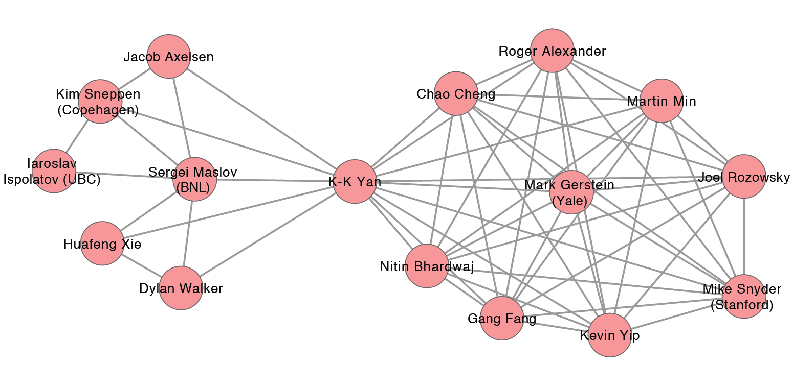
Acknowledgement
ENCODE, modENCODE consortium
Notes:
..

Slide 27
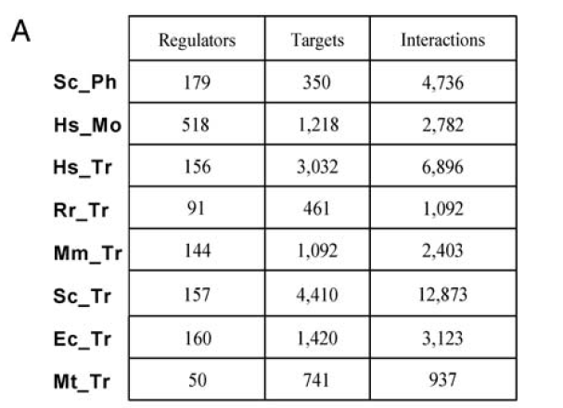
Details of regulatory networks

Slide 28

Details of hierarchy assignment

Slide 29

Bottom-up versus Top-down design
Persistent components
Top
Top
E. coli
Linux
BOT
Mid
Mid
Persistent genes are enriched at the bottom,
but persistent functions are enriched at the top/middle
Image courtesy:
Martin Krzywinski
Notes:
NOT the frac.. Not very well across…

Slide 30

Different levels have different GO categories
GO categories
for E. coli

Slide 31



















Social Hierarchy

Slide 32


Using the position in networks to describe function
Guilt by association
Finding the causal regulator
(the "Blame Game")
[NY Times, 2-Oct-05, 9-Dec-08]

Slide 33




Different kinds of Hierarchies
Well-defined levels and a clear chain of command
A military hierarchy
Without well-defined levels & with more co-regulatory partnerships
A club or a scientific
collaboration network
High degree of co-regulation and can be organized into hierarchies
A law firm
Decreases σ² of ‘stress’
Increases ‘collaboration’
[Bhardwaj et al., PNAS (2010), in press]

