Slide 2
Genome Annotation
A
G
A
C
C
C
A
C
A
C
A
C
A
C
A
A
A
G
A
A
A
A
A
A
A
A
T
A
T
A
T
A
T
A
T
A
T
A
G
G
G
G
G
G
G
G
G
G
G
G
A
G
A
G
A
A
T
G

Slide 3
Genome Annotation
A
G
A
C
C
C
A
C
A
C
A
C
A
C
A
A
A
G
A
A
A
A
A
A
A
A
T
A
T
A
T
A
T
A
T
A
T
A
G
G
G
G
G
G
G
G
G
G
G
G
A
G
A
G
A
A
T
G

Slide 4
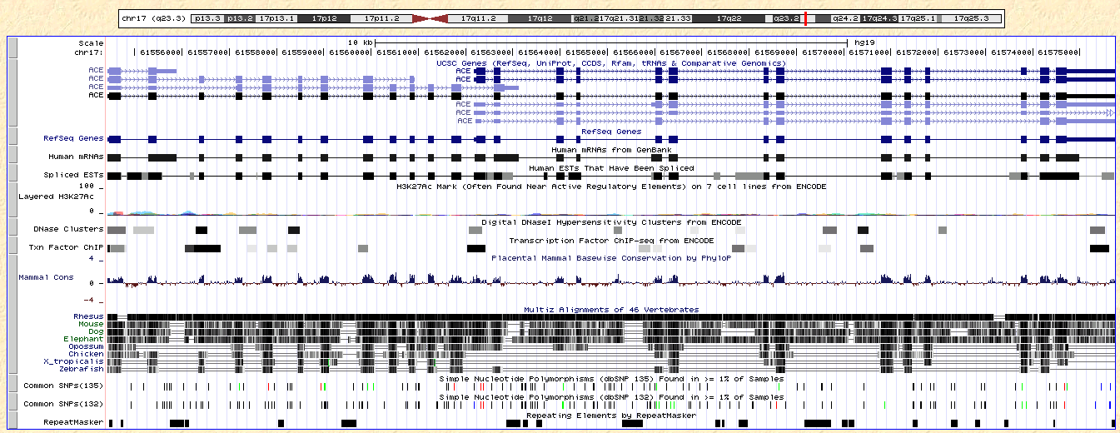
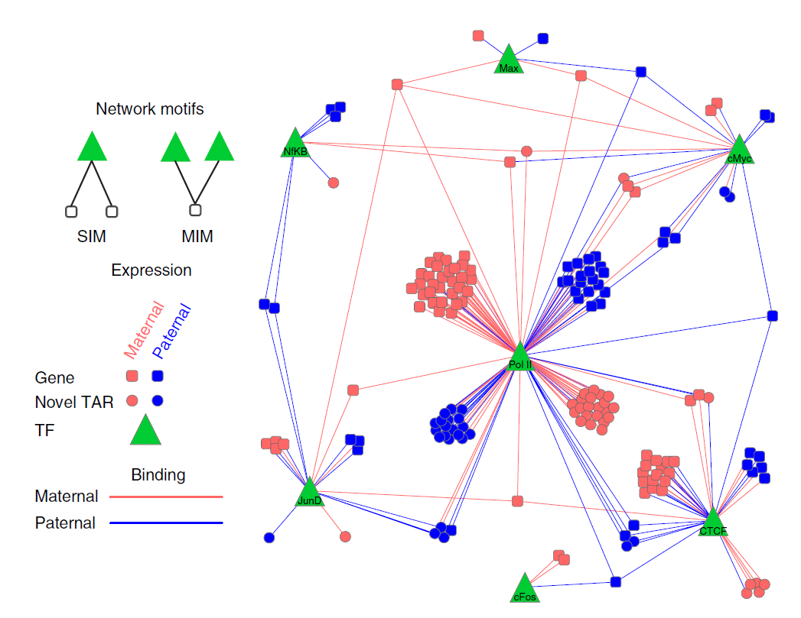
Functional Annotation of Personal Genomes
Gene
Promoter
etc.
Reference genome annotation
→ Disjointed parts
A
A
T
G
2. Personal genome annotation
Show the interactions between the disjointed parts
Show the integration of multiple layers of data from a single person

