Slide 1
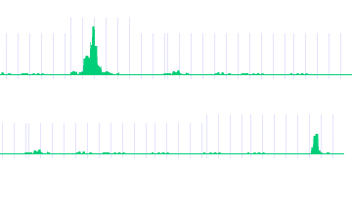
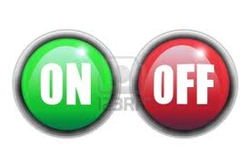
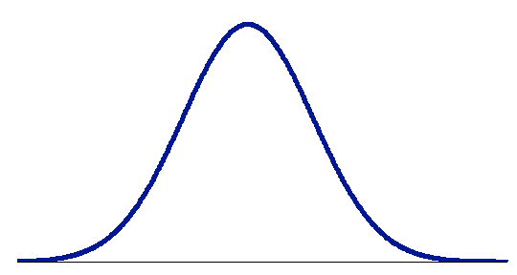
Conventional way to identify TF target genes
P53
TF binding and TF→gene regulation is NOT binary but quantitative
Gene A
P53 → A
Gene B
P53 X B
-2kb TSS 2kb
Limitations of peak-based method:
Low Medium High
- sensitive to # binding peaks
- sensitive to cut-off value (1, 2 or 5 kb of TSS?)
-- no significance estimation
Regulatory score

Slide 2
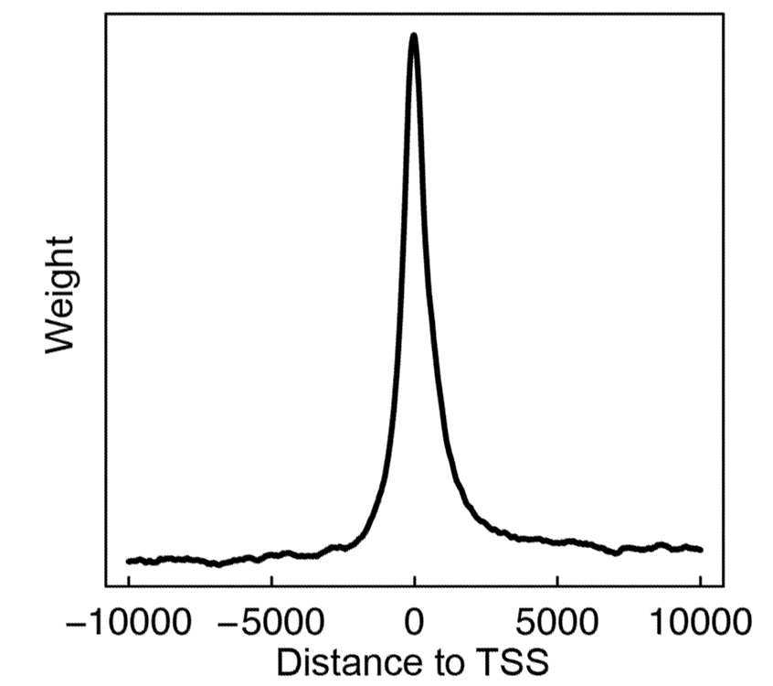
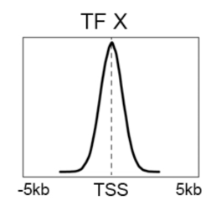
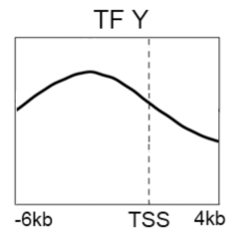
Target Identification with a Probabilistic model (TIP)
-10000 0 10000
S_{i}(g): the signal of a TF at nucleotide i of gene g
Binding signal: S_{i}(g)
Avg. profile: w_{i}
-- TF binding signal at different position contribute differently
Distance from TSS
binding preference of TFs
P-value & FDR
Calculate regulatory score and p-value for all genes
Avg binding signal across all genes
Cheng et al. 2011, Bioinformatics

Slide 3
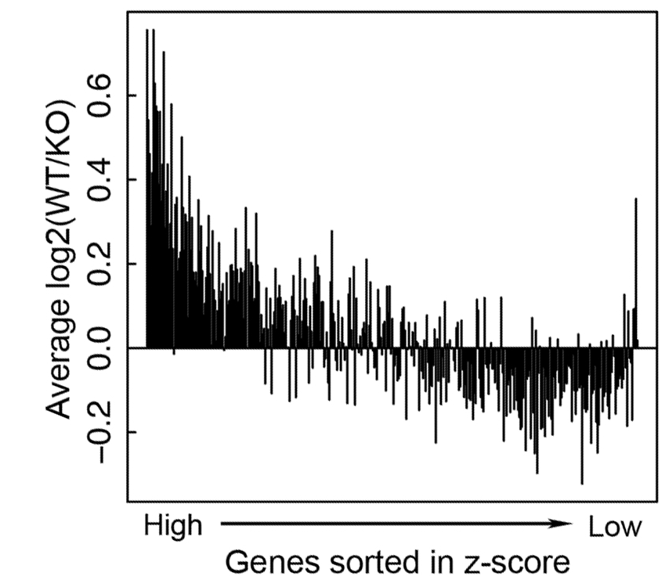
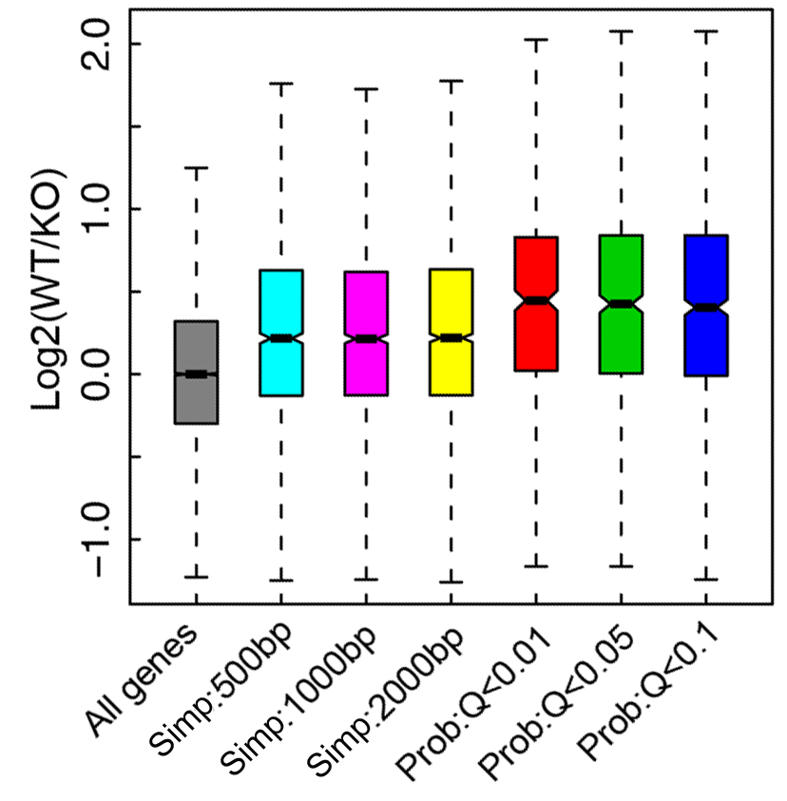
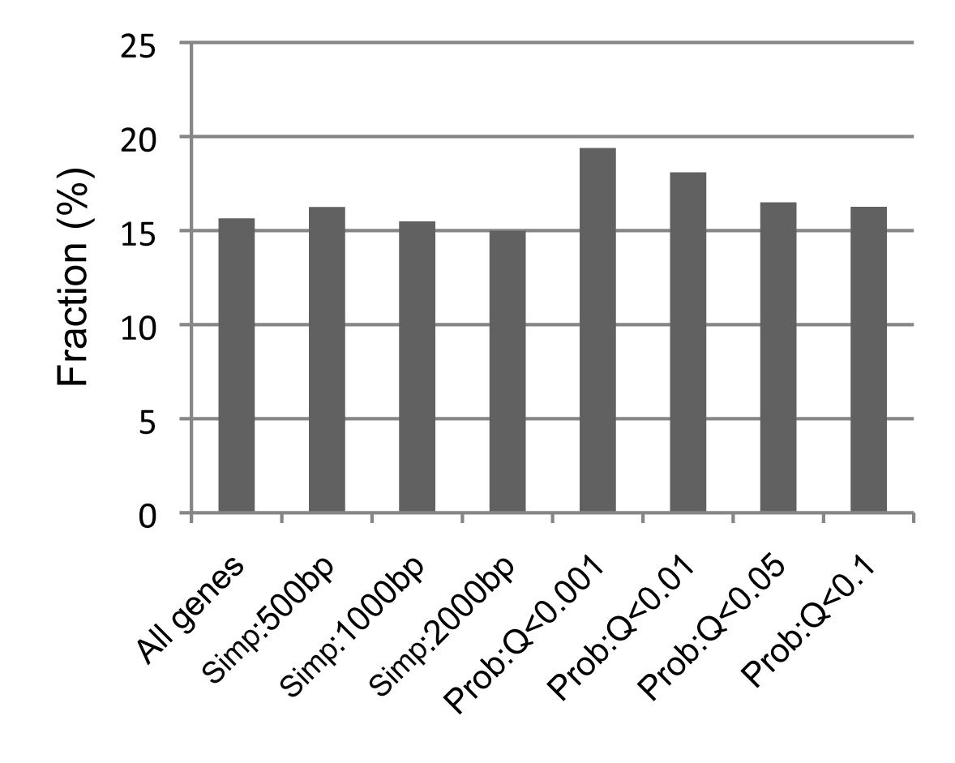
Example 1: STAT4 targets identified by TIP are more down-regulated in STAT4 KO
Peak
TIP
Data
ChIP-seq data:
Stat4 binding in Th1 cell
Gene expression:
STAT4KO + WT mice
Wei et al., 2010
Target
Non-target
TIP
STAT4 binding motif are more enriched in targets identified by TIP
Peak
STAT4 motif

