Slide 1
Improving the distinction between real and null deletion junctions in the 1000 Genome Project data
Gili Zilberman
April 25th 2012
Gerstein Lab – Annotation Meeting

Slide 2
Introduction
Currently - identify deletions by mapping reads to real (previously studied) junction seq., identify non junction reads by mapping them to null junction seq.
Goal - Improve the distinction between the real and null junction reads based on the distribution of mismatches.

Slide 3
Assumptions & Hypothesis
Sequencing errors tend to increase towards the 3’ end (as the position index increases).
Hypothesis - the mismatches in the reads mapped to real cluster in the higher indices, while those in the reads mapped to null cluster in the lower indices.

Slide 4
Data
Two data sets:
38,669 reads mapped to null junction sequences,
1,959,176 reads mapped to real junction sequences.
0, 1, 2 or 3 mismatches.
Real junction sequences – known based on previous studies.
Reads mapped to the real seq.→ junction seq.
Null junction sequences - “fake”.
Reads mapped to the null seq. → erroneous, resulting from sequencing errors.

Slide 5
The Analysis
Compile the set of mismatch positions in both data sets:
REAL: R11, R21, R22, R31, R32, R33
NULL: N11, N21, N22, N31, N32, N33
Look at the mismatch positions distribution in the 6 matching pairs:
R11-N11, R21-N21, R22-N22, R31-N31 …

Slide 6
Mismatch Distribution Example R22-N22

Slide 7
Real vs. Null mismatch distributions
1 mismatch 2 mismatches 3 mismatches
1st 2nd 3rd

Slide 8
Look at the normalized distribution
Absolute Normalized

Slide 9
So Far…
The histograms suggest that the real and null distribution pairs do not originate from the same underlying distributions.
To formalize this, I apply the Two Sample Kolmogorov-Smirnov test.

Slide 10
Kolmogorov‐Smirnov Test (1)
A nonparametric test for the equality of continuous, one-dimensional probability distributions.
Used to compare whether two samples originate from the same distribution
Step 1 - For n independent and identically distributed observations (=mm positions) X_{i}, the empirical distribution function F_{n} is:
Where equals 1 if X_{i} ≤ x and 0 otherwise.
Notes:
Fn counts the number of observations that have a value <= x.
Normalized by the number of observations.

Slide 11
Kolmogorov‐Smirnov Test (2)
Step 2- compute
Since the distributions are finite, the supremum is simply a max.
Step 3- for a given α > 0 calculate K_{α}:
Where:
Step 4- reject the null hypothesis at level α if

Slide 12
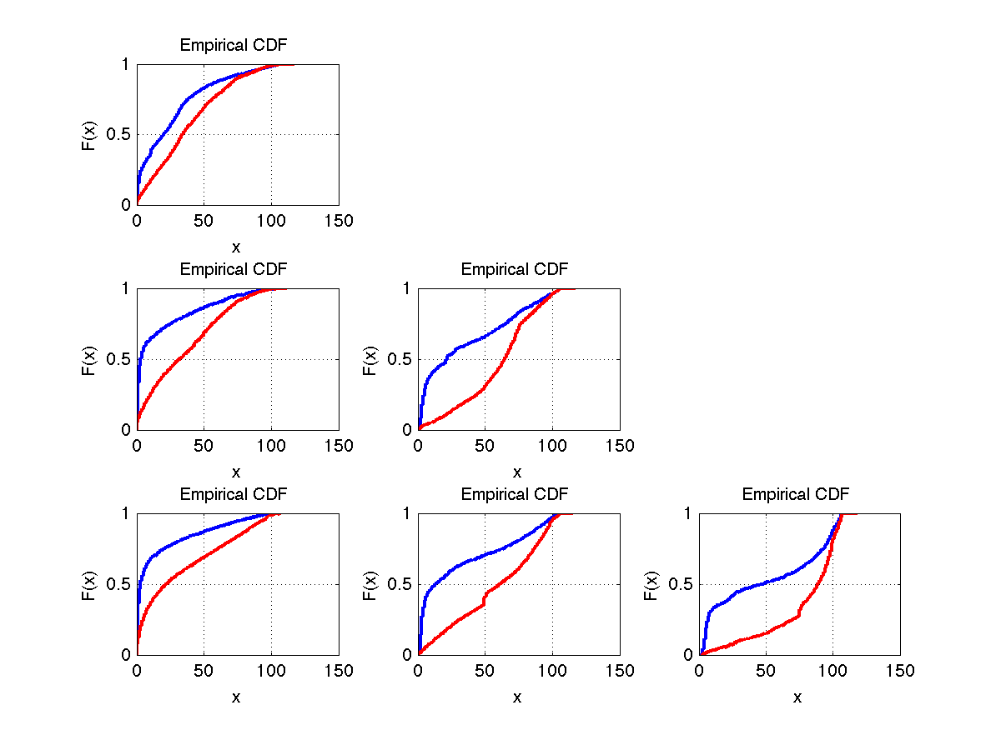
Absolute Normalized
Cumulative Distribution Function

Slide 13
Kolmogorov‐Smirnov Test Results (Absolute)
The test statistic k is the maximum difference between the curves.

Slide 14
Summary
There is a correlation between the mismatch position distribution and the likelihood of a read being a real/null seq.
Next –
Find a relative position that can be used as a threshold.
Look at the multivariate distribution of the mismatch positions.

Slide 15
Acknowledgments
Alexej Abyzov

