Slide 1
Patterns of Genomic Variants Reveal Selection Pressure in Non-Coding Elements
Xinmeng Jasmine Mu
Gerstein Lab Group Meeting
April 17, 2012

Slide 2
Introduction & Background
Genomic variant patterns can be measures for selection pressure:
Polymorphism - the level of intra-species genomic variants within a species.
Divergence - the level of inter-species genomic differences.
Allele frequency of genomic variants.
Pattern rel. to neutral sequences | Negative selection (selective constraint; purifying sel.) | Positive selection (adaptive selection)
Polymorphism | ⬇ | ⬇
Divergence | ⬇ | ⬆
Derived allele frequency (DAF) | ⬇ | ⬆
Pol. vs. Div. ratio (McDonald-Kreitman test) | ⬆ | ⬇

Slide 3
Introduction & Background
In human, it is estimated:
1.5% of the genome is coding
5% of the genome is under natural selection
positive selection in human is rare
selection dominated by negative selection
Previous studies on selection pressure using genomic variant patterns within human populations:
Limited to targeted local regions
Biased sampling of genomic variants, e.g. using genotyping arrays
Focused on SNPs; indel and SVs not abundant

Slide 4
Introduction & Background
Genomic variants
The 1000 Genomes Project low coverage pilot
Whole genome sequencing; 60 CEU, 59 YRI, 60 CHBJPT individuals.
A full spectrum of genomic variants, including SNPs, indels, and SVs.
Genomic annotations
ENCODE project
Genes (CDS, introns and UTRs), TF-binding sites, ncRNAs, pseudogenes.
Notes:
- The latter two types have not previously been well studied of functional significance.
- Improved SV detection in terms of number, size-range and breakpoint-precision.

Slide 5
Introduction & Background
Existing Methods for detecting positive selection
Long-Range Haplotype (LRH) test:
Integrated Haplotype Score (iHS) test
Cross Population Extended Haplotype Homozygosity (XP-EHH)
Composite of multiple signals (CMS):
iHS, XP-EHH, F_{st,} ΔDAF, and ΔiHH
etc...
Some traditional tests for natural selection
Tajima’s D
HKA
Fu and Li’s D, D*, F, or F*
Fay and Wu’s H
McDonald-Kreitman test
1000 Genomes dataset deviates from standard coalescence model!

Slide 6
Introduction & Background
Genomic variant patterns can be measures for selection pressure:
Polymorphism - the level of intra-species genomic variants within a species.
Divergence - the level of inter-species genomic differences.
Allele frequency of genomic variants.
Pattern rel. to neutral sequences | Negative selection (selective constraint; purifying sel.) | Positive selection (adaptive selection)
Polymorphism | ⬇ | ⬇
Divergence | ⬇ | ⬆
Derived allele frequency (DAF) | ⬇ | ⬆
Pol. vs. Div. ratio (McDonald-Kreitman test) | ⬆ | ⬇
2

Slide 8
Selection pressure in relation to secondary structure of ncRNAs.
Higher selection pressure for more ubiquitous regulatory binding sites.
Selection in relation to regulatory network.

Slide 9
Selection pressure in relation to secondary structure of ncRNAs.
Higher selection pressure for more ubiquitous regulatory binding sites.
Selection in relation to regulatory network.

Slide 10
Diverse functions of ncRNAs
micro-RNA (miRNA) - regulation of transcription.
small nuclear RNA (snRNA) - RNA splicing.
transfer RNA (tRNA) & ribosomal (rRNA) - translation.
small nucleolar RNA (snoRNA) - chemical modification of other RNA molecules.
long non-coding RNA (lncRNA) – many, e.g. transcription, epigenetic
(ENCODE annotated the above ncRNAs)
Piwi-interacting RNA (piRNA), and others.
Notes:
- The latter two types have not previously been well studied of functional significance.
- Improved SV detection in terms of number, size-range and breakpoint-precision.

Slide 11
miRNA secondary structure
Anatomy of a pri-miRNA:

Slide 12
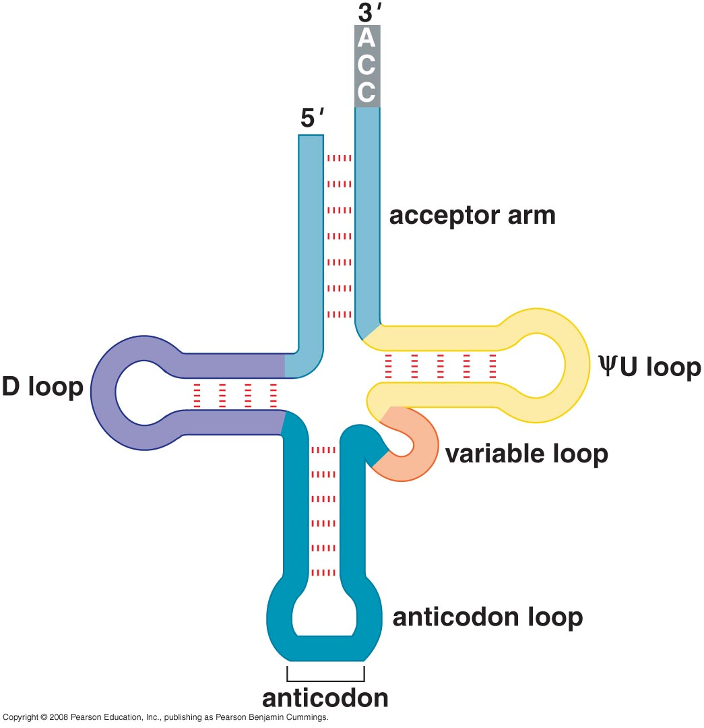
tRNA secondary structure

Slide 13
Mutations vs. stability of RNA secondary structure

Slide 14
ΔΔG of secondary structure of miRNAs reversely correlates with DAF of SNPs
miRNA
Control (flanks)
P-val = 0.05
P-val = 0.75
SNPs under more selection pressure are more disruptive to miRNA secondary structures!
Same is true for tRNAs, but not for rRNA, snoRNA, and snRNA.

Slide 15
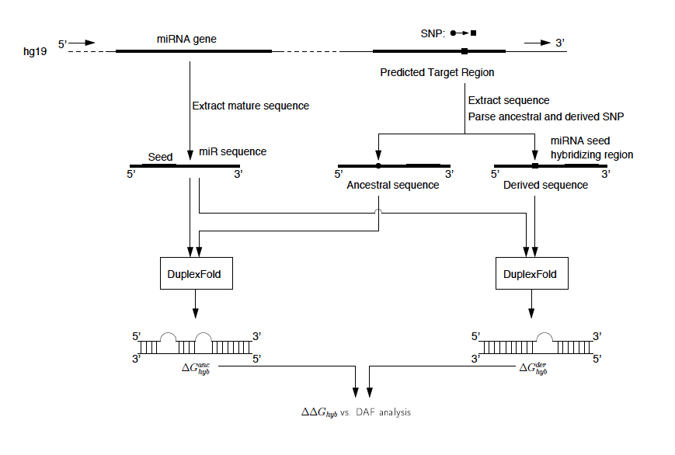
Mutations vs. stability of the binding duplex of miRNA and its binding target
For miRNA binding: ρ=-0.0893, and p-value=3.6E-3
For control set: ρ= 0.0138, and p-value=6.8E-1
SNPs under more selection pressure are more disruptive to
the binding duplex of miRNA and its binding target!

Slide 16
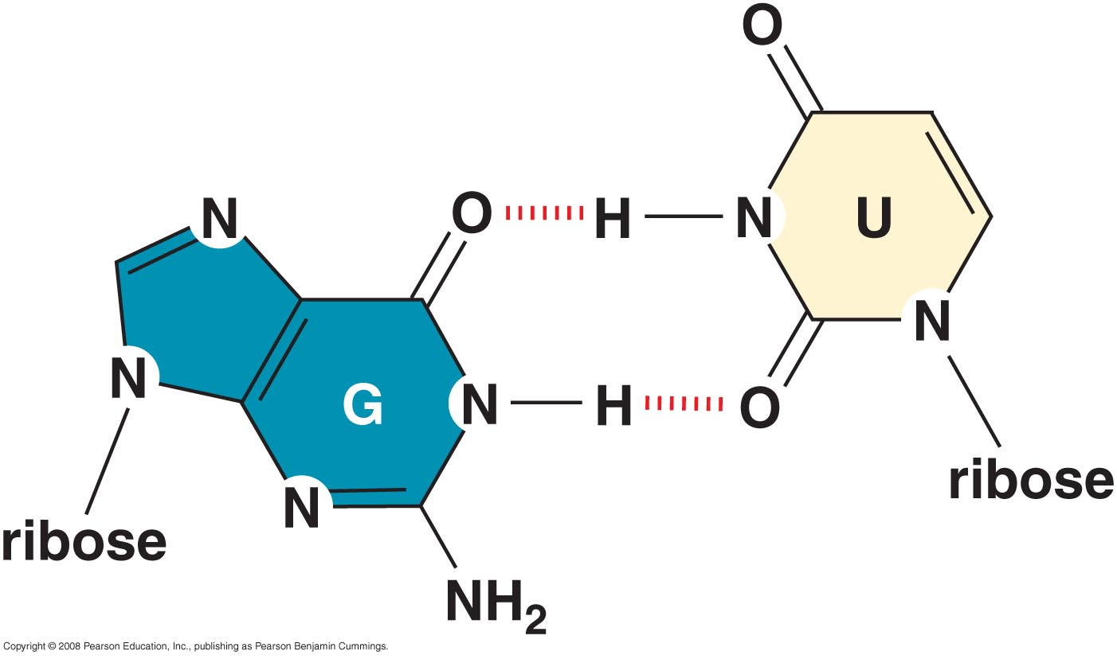
G=U wobble pair in RNAs
Besides Watson-Crick base-pairs (A=U, C=G), RNA molecules can form additional base pairs.
The most common is G=U wobble pair.
Therefore, A=U➔G=U, or G=C ➔ G=U, retains pairing, which we term ‘synonymous mutations’.
We define mutations that change secondary structures of RNAs as ‘non-synonymous mutations’.
There are many other types of other pairings in RNA molecules, including:
A-C⁺ wobble pairs
U-U pairs
G-A pairs (usually only at the ends of duplexes
G=U
4
3
2
A=U
2
Pyle Lecture

Slide 17
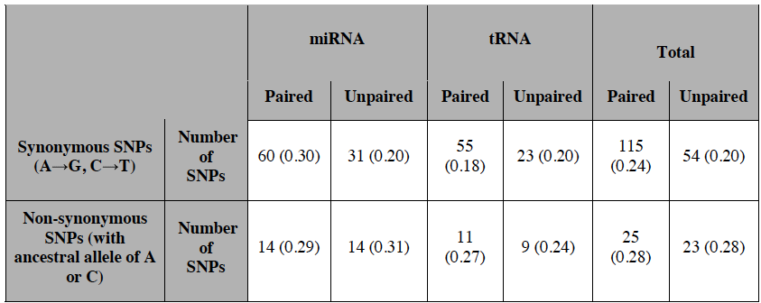
Enrichment of synonymous mutations
in miRNA and tRNAs
parenthesis indicates average DAF

Slide 18
Summary
In RNA secondary structures:
Stem regions are under more selection pressure in miRNA & tRNA than loops.
SNPs under more selective pressure tend to be more disruptive to secondary structures of miRNA & tRNA
SNPs under more selective pressure tend to be more disruptive to the binding duplex between miRNA and its binding target.
Synonymous mutations are enriched in miRNA & tRNA relative to non-synonymous mutations.
Notes:
- The latter two types have not previously been well studied of functional significance.
- Improved SV detection in terms of number, size-range and breakpoint-precision.

Slide 19
Future Directions
1. Develop a tool for predicting impact of mutation to function of ncRNAs
Predictors:
Structural region that mutation falls in, i.e. stem/loop
DAF
Interspecies conservation of the mutation locus
synonymous vs. nonsynymous
ΔΔG
Training/test set
Allele-specific expression of RNAs
eQTL SNPs
GWAS SNPs
RNA expression from RNAseq
2. Further investigation into snRNA, snoRNA, rRNA, and lncRNA, intron, and UTRs.
3. Use 1000 Genomes Phase I data.
Notes:
- The latter two types have not previously been well studied of functional significance.
- Improved SV detection in terms of number, size-range and breakpoint-precision.

Slide 20
Selection pressure in relation to secondary structure of ncRNAs.
Higher selection pressure for more ubiquitous regulatory binding sites.
Selection in relation to regulatory network.

Slide 21
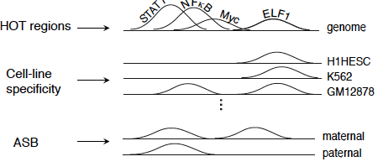
Ubiquitous vs. condition specific binding sites

Slide 22
Ubiquitous binding sites tend to be more selective constraints
HOT: High Occupancy of TF

Slide 23
TF-binding HOT regions
HOT: High Occupancy of TF

Slide 24
Cell-line specific TF-binding sites

Slide 25
Allele-specific sites are under less selective constraints

Slide 26
Allele-specific sites are under less selective constraints (cont.)
ASB | Low DAF (<0.05) | Medium DAF (0.05-0.5) | High DAF (>0.5)
Allelic score (median ± MAD) | 0.99947±0.00053 | 0.99973±0.00027 | 0.99982±0.00018
Number of SNPs | 143 | 782 | 398
ASE | Low DAF (<0.05) | Medium DAF (0.05-0.5) | High DAF (>0.5)
Allelic score (median ± MAD) | 0.62±0.34 | 0.70±0.34 | 0.74±0.31
Number of SNPs | 56 | 393 | 177
ASB: Allele-Specific Binding
ASE: Allele-Specific Expression

Slide 27
Summary
TF-binding HOT regions are under more selection pressure than other TF-binding sites.
Constitutive TF-binding sites across cell lines are under more selection pressure than cell-line specific TF-binding sites.
Allele-specific sites are under more selective constraints.
Ubiquitous regulatory binding sites tend to be under more selection pressure.
In parallel with prior discoveries for coding regions, i.e. housekeeping genes tend to be under more selective constraints.
Notes:
- The latter two types have not previously been well studied of functional significance.
- Improved SV detection in terms of number, size-range and breakpoint-precision.

Slide 28
Future Directions
Ubiquitous vs. tissue-specific binding
DNase I hypersensitive sites data across multiple tissues
Intersect with TF-binding peak data to predict TF-binding sites across tissues
Characterize SNPs within DNase I sites
Compare variant patterns in ubiquitous vs. tissue-specific binding sites
Functional analysis of regulatory binding sites in various tissues
Characterize SNPs within DNase I sites across tissues
Tissue differentiation, e.g. embryonic stem cells
Skin vs. internal tissue
Brain, cadiovascular, etc
Allele SNPs within TF-binding motifs
Use 1000 Genomes Phase I data
Notes:
- The latter two types have not previously been well studied of functional significance.
- Improved SV detection in terms of number, size-range and breakpoint-precision.

Slide 29
Selection pressure in relation to secondary structure of ncRNAs.
Higher selection pressure for more ubiquitous regulatory binding sites.
Selection in relation to regulatory network.

Slide 30
Co-selection pressure between modules of the regulatory network

Slide 31
Co-selection pressure between modules of the regulatory network

Slide 32
TFs that have more target genes to regulate tend to use more specific versions of binding motifs
Target
gene
TF
Information content of TF-binding motifs
Binding
reaction
Number of target genes for each TF
ρ=-0.31, P-value=0.015

Slide 33
Summary
The regulatory modules are under co-selection pressure within both TF regulatory network, and miRNA regulatory network.
TFs that play a more central role in the regulatory network tend to use binding motifs that have higher information content.
Notes:
- The latter two types have not previously been well studied of functional significance.
- Improved SV detection in terms of number, size-range and breakpoint-precision.

Slide 34
Future Directions
Develop a tool for predicting impact of mutations to the function of TF-binding motifs
* Predictors
Motif information content within human
Interspecies conservation
Impact of mutations to structural interaction between TF protein & TF-binding motif
DAF
F_{ST}
* Training/test data
Allele-specific binding
RNAseq expression data of genes across population
eQTL SNPs
GWAS SNPs
Use 1000 Genomes Phase I data.
Notes:
- The latter two types have not previously been well studied of functional significance.
- Improved SV detection in terms of number, size-range and breakpoint-precision.

Slide 35
Acknowledgements
Arif Harmanci
Jieming Chen
Joel Rozowsky
Robert Bjornson
Chao Cheng
Ekta Khurana
Suganthi Bal
Alexej Abyzov
Mark Gerstein
Annotation Group
ENCODE-nets Group
Entire Gerstein Lab!

