Slide 1
Condition-specificity and Allele-specificity
Jieming
Genome Annotation
10th April 2012

Slide 2
Data
Condition-specificity (13 cell-lines)
→ human Ensembl regulatory build (v11)
Peak calls from DNAseI and histone modification experiments
hg19
Allele-specificity (167,328 SNPs on NA12878)
ChIPseq/AlleleSeq on NA12878
A list of SNPs that Joel et. al. deemed to be significantly allele-specific
hg19
Non-allele-specific heterozygous SNPs (1,491,310 SNPs on NA12878))
→ non-monomorphic CEU autosomal SNPs from 1KG
→ hg19

Slide 3
Q: Are allele-specific SNPs more condition-specific (than non-AS SNPs)?
 | CS | Non-CS
AS SNPs | a | b
Non AS SNPs | c | d
Setup: Fisher’s exact test
→ AS SNPs and non-AS SNPs
→ CS vs non-CS
1) within DNaseI HS sites and histone binding regions
2) within only DNaseI HS sites
3) within only histone binding regions
For each 13 cell-lines, and also the unique sum of all the SNPs
All tests show significant results (p < 2.2e-16)

Slide 4
Cell-line | OR (DNaseI only) | OR (histone)
CD4 | 6.97331 | 2.09609
GM06990 | 10.3024 | 1.50077
GM12878 | 11.9915 | 1.57883
H1ESC | 2.98168 | 1.40765
Hela | 2.78817 | 1.3064
HepG2 | 3.54527 | 1.32282
HMEC | 2.69839 | 1.36056
HSMM | 2.01446 | 1.35848
HUVEC | 2.82508 | 1.29181
IMR90 | 2.44173 | 1.32804
K562 | 3.40083 | 1.37234
NH-A | 2.12326 | 1.33495
NHEK | 2.79017 | 1.36591
TOTAL unique | 2.29348 | 1.39366
Notes:
CD4 most enriched but T cells more variability& diversity (heterozygosity)

Slide 5
RegulatoryFeatures_GM06990.gff (not in 1KG) | Lymphoblastoid from a CEPH indiv (WBC – lymphocyte/leucocyte precursor; blood)
RegulatoryFeatures_GM12878.gff | Lymphoblastoid from a CEPH indiv (WBC - lymphocyte/leucocyte precursor; blood)
RegulatoryFeatures_CD4.gff | T cell line (WBC)
RegulatoryFeatures_HSMM.gff | Human skeletal muscle myoblast
RegulatoryFeatures_IMR90.gff | Human fibroblast (connective tissue, synthesizes ECM and collagen)
RegulatoryFeatures_NH-A.gff | Normal Human astrocyte cells (provide physical and homeostatic support and protection for neurons)
RegulatoryFeatures_HeLa-S3.gff | Immortalized cervical cancer adenocarcinoma (epithelium of glandular tissue) cell line; contain human papilloma virus
RegulatoryFeatures_HMEC.gff | Human mammary epithelial cells
RegulatoryFeatures_NHEK.gff | Normal human epidermal keratinocytes
H1ESC | Human Embryonic Stem cells
RegulatoryFeatures_HUVEC.gff | Human umbilical vein endothelial cells
RegulatoryFeatures_K562.gff | Immortalized myelogenous Leukemia cell line, erythroleukemia type
HepG2 | Human hepatocellular liver carcinoma cell line; Hepatocytes
YF-120306
Notes:
foreach gene in the cell line, 0 indicates close chromatin; 1 DNase data; 2 DNase + any histone modification

Slide 6
Cell-line | OR (DNaseI only) | OR (histone)
GM12878 | 11.99149 | 1.578827 | 2
GM06990 | 10.3024 | 1.500769 | 3
CD4 | 6.973306 | 2.096092 | 1
HepG2 | 3.545265 | 1.32282 | 12
K562 | 3.400832 | 1.372337 | 6
H1ESC | 2.981677 | 1.407648 | 4
HUVEC | 2.825078 | 1.291807 | 14
NHEK | 2.790166 | 1.365909 | 7
Hela | 2.788171 | 1.306401 | 13
HMEC | 2.698392 | 1.360558 | 8
IMR90 | 2.441734 | 1.328044 | 11
TOTAL unique | 2.293483 | 1.393656 | 5
NH-A | 2.123264 | 1.334954 | 10
HSMM | 2.014458 | 1.358477 | 9
Notes:
CD4 most enriched but T cells more variability& diversity (heterozygosity)

Slide 7
Summary
Allele-specific SNPs seem to be more condition-specific
Especially in DNaseI HS sites
Less so in histone modifications

Slide 8
Spearman’s correlation
Allele-specificity (AS) score
= 1 – p-value of Binomial test
Use full list of heterozygous NA12878 SNPs found in ChIPseq peaks
Condition-specificity (CS) score
= 1 – proportion of cell-lines SNP is found in * 13/12
Use SNPs in full list found in the peaks of cell-lines
250,173 SNPs
rho = 0.01773063, p-value < 2.2e-16
Dubious use of Binomial p-value as allelic score…

Slide 9
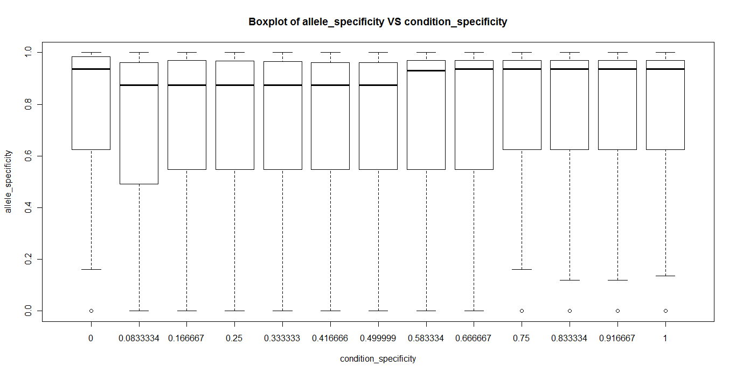
AS-CS Boxplots

Slide 10
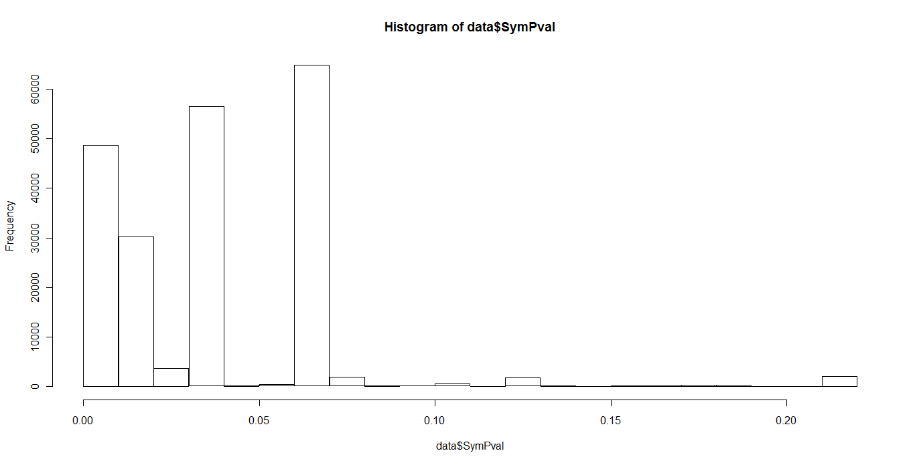
Histogram showing a range of p-values
- disability of Binomial p-value as AS score

