Slide 1
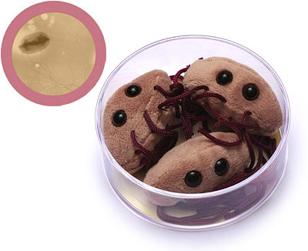
How noisy is E. coli?
Koon-Kiu Yan
Group Meeting
March 2012

Slide 2
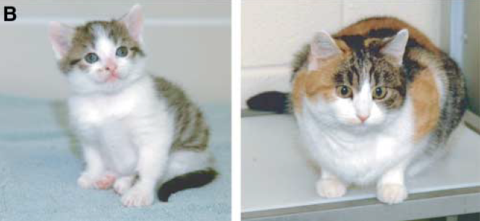
Why noise?
Raser and O’Shea Science 2005
Notes:
Left: CC, is the first cloned cat,
Right: genetic mother is rainbow.
Identical genome but diff. in appearance
Q: why the same genome-type, diff. in phenotype?
Epigenetic nature.
Should not discard: Stochastic origin of biological processes….
meaning, all bio. processes, governed by law of phy or chem, molecules, and stochastic..

Slide 3
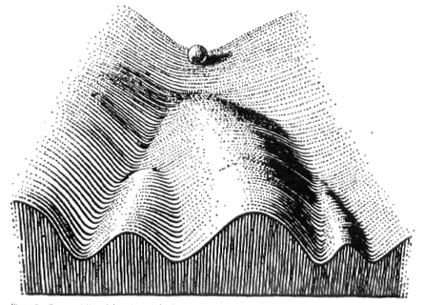
Why noise?
stochasticity versus canalisation (robustness)
Notes:
Stochasticity and canalisation are 2 faces of a coin.
Robustness, despite variation, we arrive at the same phenotype.
Metaphor, by Waddington, channel…
Noise is an important source of variation…
To understand noise, help us to understand robustness

Slide 4
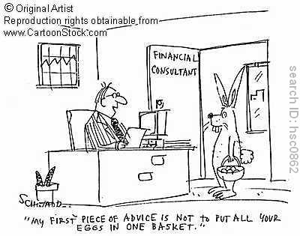
Why noise?
Notes:
Noise is not always bad to life
Noisy enable us to survive.
Bugs living in Fluctuating environment., if its phenotype is always stable…
Strategy of survival is, noise, keep changing….No matter what happen outside, a fraction of bugs can survive
In finance, bet hedgng…

Slide 5
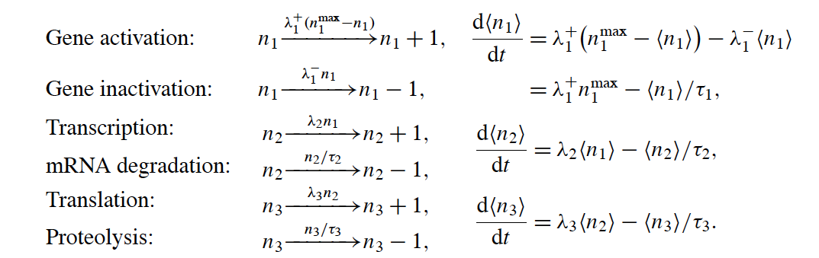
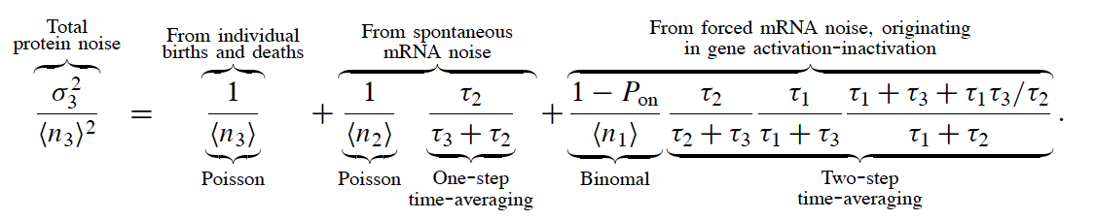
Biophysical approach to noise
Paulsson Phy. of Life 2005
Notes:
N1 is the copy of active genes
N2 s the copy of mRNA
N3 is the number of protein…
Inc or dec by 1 with certain rate…
ODE
Noise…,can be decomposed…, 1st: birth and death of protein, 2nd, burst, mRNA,-> protein, 3rd: activation/ not
Drawback: small systems ok, rate const are diff. to obtain…

Slide 6
Genetic approach to noise
Understand from a system-wide standpoint why certain genes are more noisy or quiet in term of protein expression
To integrate noise information with various genomic features
  Location in the genome
  Essentiality
  Position in various molecular networks
  ….
How noise is being controlled or exploited?

Slide 7
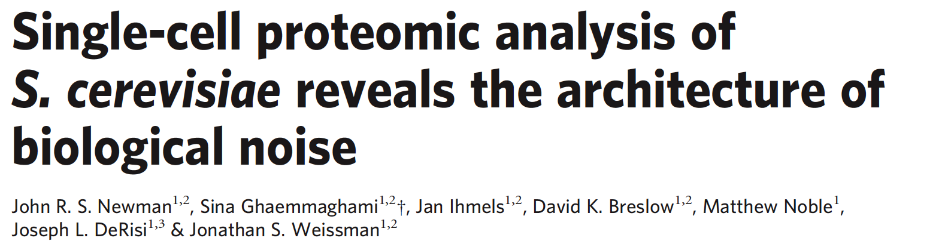
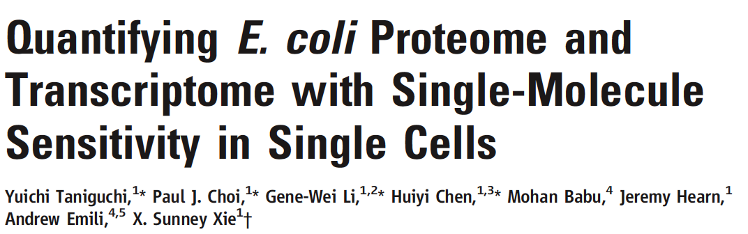
Genome-wide measurement of protein abundance in single-cell level
2500 proteins
Nature 2006
Science 2010
1018 proteins, 137 mRNAs
Notes:
Simultaneous measurement of proteins and mRNA
E. coli, not merely a different organism, but technical difference: low copy number. Give the number
Single-molecule sensitivity

Slide 8
Scaling of noise against abundance
Notes:
For each protein, they measure the dist in a population of cell, therefore, mean and std…

Slide 9
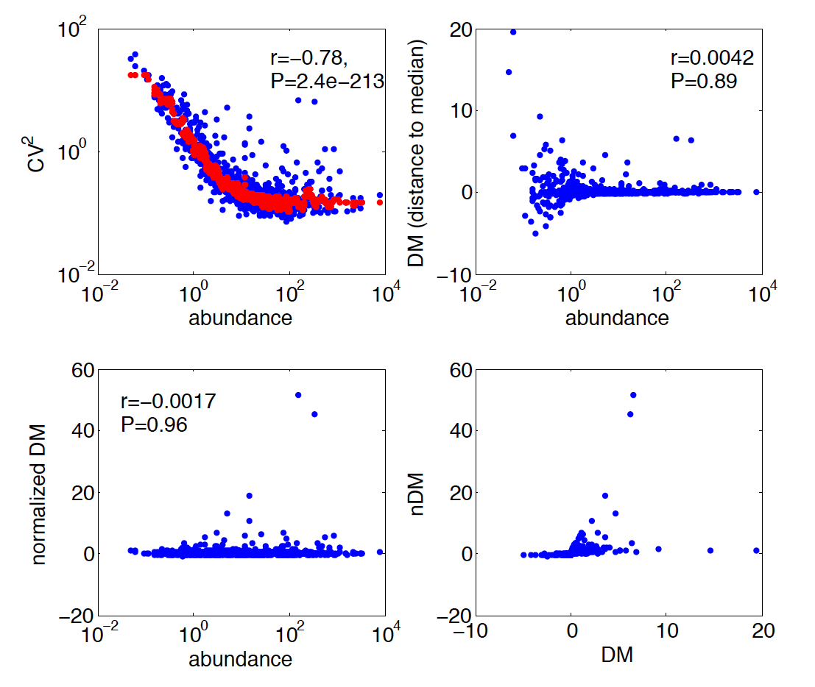
Various noise metrics

Slide 10
quiet
noisy
DM, nDM

Slide 11
Noise level is under selection

Slide 12
Noise level is under selection
P=0.027

Slide 13
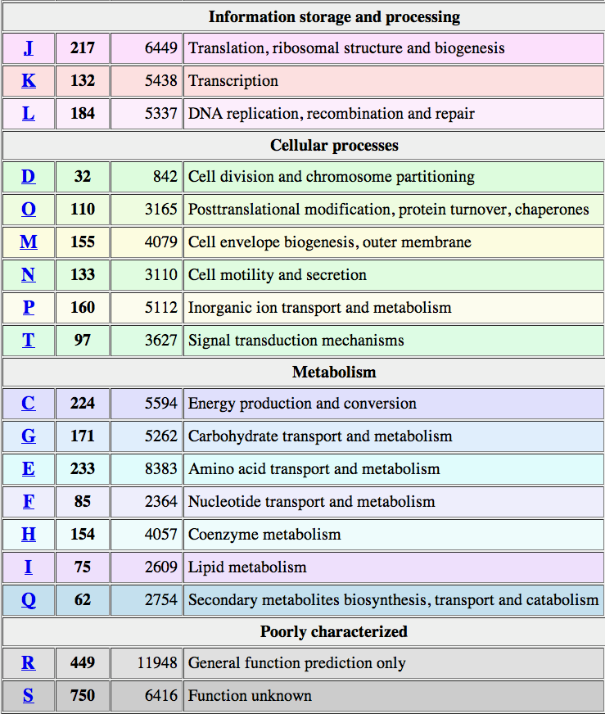
Noise versus functional annotation
*
*
*
*

Slide 14
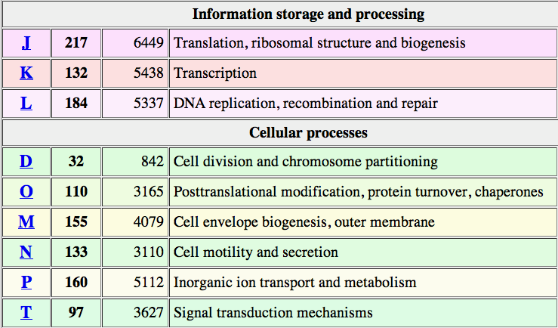
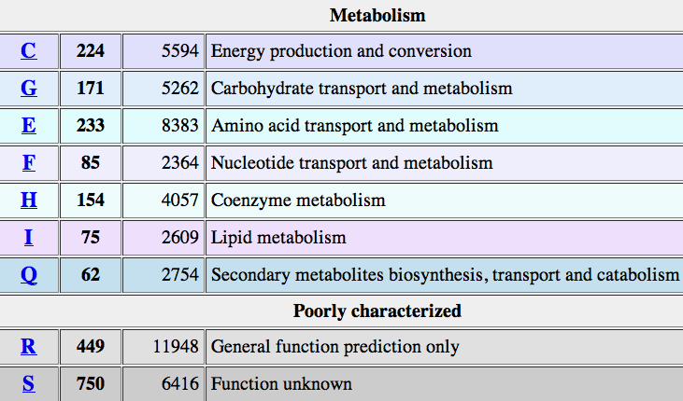
Noise versus functional annotation

Slide 15
Noise level with respect to
PPI organization
Hu et.al
PLoS Biol. 2009

Slide 16
Proteins forming complexes are less noisy
Stoichiometric effects matter

Slide 17
Noise level with respect to transcription regulation
Noise propagates via cascade of transcription regulation, Pedraza and van Oudenaarden Science 2005
Transcription factors are less noisy
Auto-regulation is a mechanism to repress noise
Level of hierarchy? Kin? Kout?
42 TFs with noise level in the dataset

Slide 18
Red: noisy
Green: quiet
Square: sigma factor
Circle: both activator and repressor

Slide 19
Noise level of TFs
Non-auto
regulators
Auto
regulators

Slide 20
Noise level of Targets

Slide 21
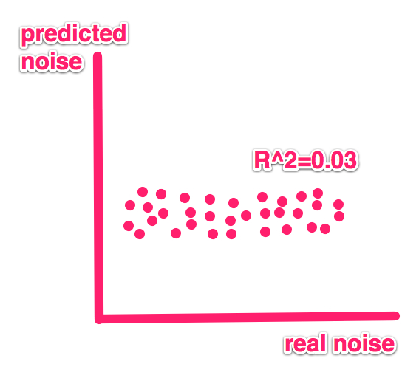
To predict noise using TFs
Binding Pattern
 | TF1 | TF2 | … | TFn | noise
Gene 1 | 0 | 1 |  | 0 | ?
Gene 2 | 0 | 0 |  | 1 | ?
Gene m | 1 | 1 |  | 0 | ?

Slide 22
In Comparison with Yeast
Yeast | E. coli
TFs are less noisy compared to targets | Kind of true for COG analysis
Noise level of targets correlate with the number TF regulators | Not really
Binding pattern could predict pretty well the noise level (AUC=0.69) | Not really
Zhang et.al.
PNAS 2010
Why?
  Statistics?
  Chromatin remodeling factors in yeast play an important role in predicting the noise level?

Slide 23
Noise level versus Essentiality

Slide 24
Noise level versus responsive genome
Knockout experiments were performed in 324 conditions (Nichols et.al. Cell 2010)
Responsive versus non-responsive genes
Conditional essentiality
42 out of 1018 genes are conditional essential
The trend is significantly different from essential genes (P=0.003)
Noisy guys are enriched with conditional essential genes

Slide 25
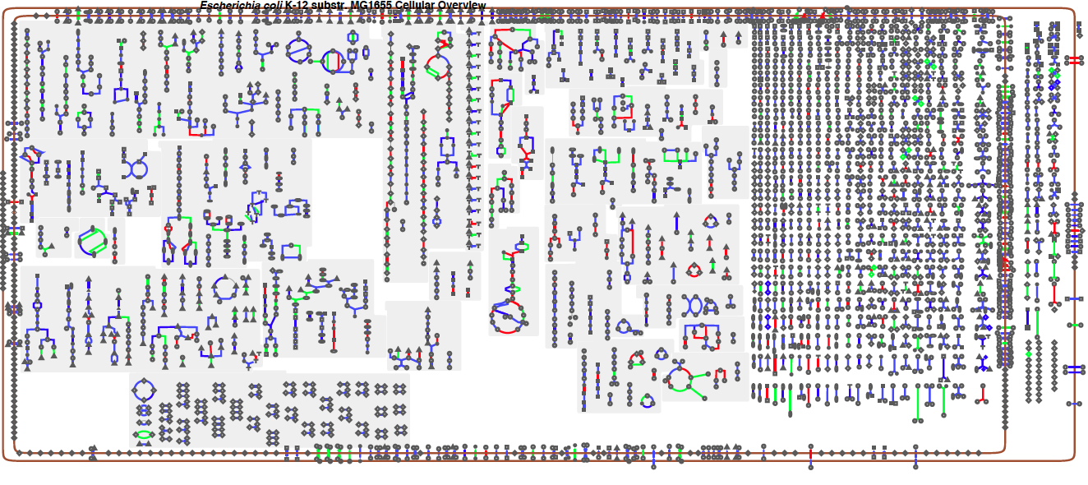
Noise level with respect to pathway organization
anabolic
catabolic
red: noisy, green: quiet

Slide 26
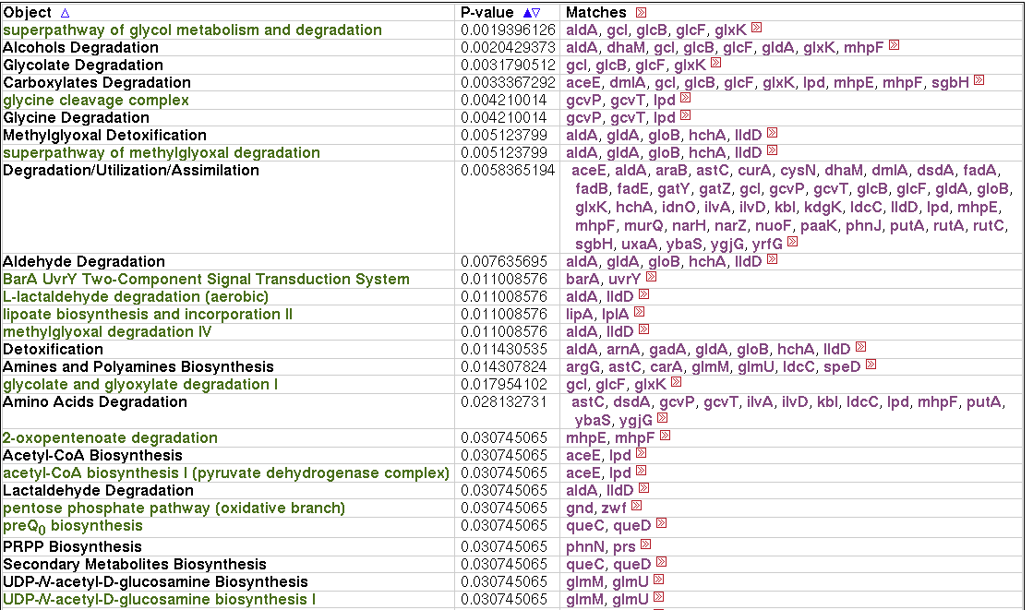
Pathway enrichment/depletion
Noisy genes

Slide 27
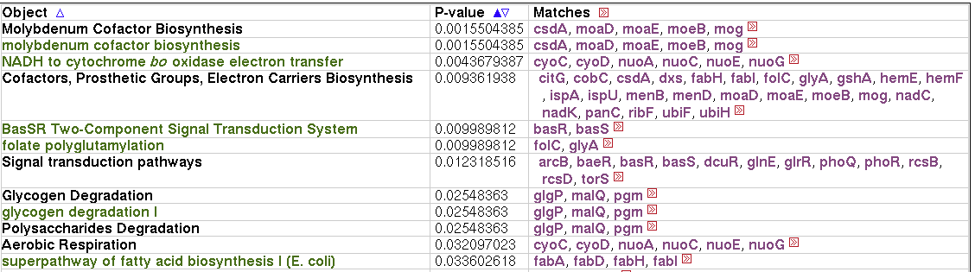
Pathway enrichment/depletion
Quiet genes

Slide 28
Pathways integration
Pathways are organized in an integrative fashion as they share certain common enzymes
An integrative picture allows the definitions of many more network parameters, and their relationship with noise
  Upstream
  Metabolic core
  Downstream
  Reuse of enzymes etc

Slide 29
Noise level with respect to genome organization
Quiet genes (noisy genes) are slightly biased toward the + (-) strand. But not that significant. Most likely a result of the bias of essential genes
Noise level with respect to proximity
Operon as a mechanism to enable protein abundances fluctuate in a coherent manner. Require further measurement of correlated noise

Slide 30
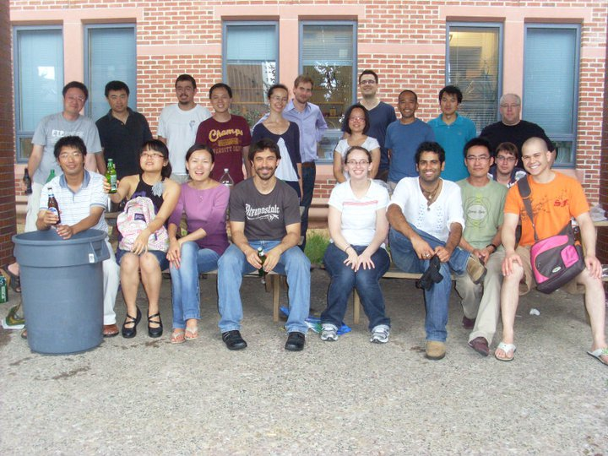

Acknowledgement

