Slide 1
Diffusion of Tweets
Nets 3-15-12
RR

Slide 2
A meme “an idea, behavior or style that spreads from person to person within a culture”
Hypothesis: A tweet that is retweeted is similar to how a cell divides, reproduces and evolves.
A tweet is like a meme/gene.
Can we compare how a tweet spreads to how a tweet evolves?
How can we do this?

Slide 3
Memetics: Theory of mental content based on an analogy with Darwinian evolution, popularized by Richard Dawkins book The Selfish Gene
Uses evolutionary model approaches to information transfer
Some people think it is “pseudoscientific dogma” and dangerous to think about it
There is more history to this idea than I realized.

Slide 4
Still I’m going to try to work with pseudoscience
Originally I downloaded the most recent tweets using the Twitter API and was trying to parse the tweets using Perl and regular expressions
Also was trying to create a network of how tweets spread just from tweets and retweets
More interested in studying how the tweet is evolving…

Slide 5
Truthy
Very pretty piece of software, not as intuitive as one would think
They are not making a network of all the individual tweets, but the general who is tweeting with a particular #hashtag or @mention and anyone who has retweeted any of the tweets they have ever made
Also counting how many retweets one user has made as opposed to how many times it has been retweeted
I’m more interested in a singular tweet as opposed to one word or hashtag
Only works for political based tweets
Some of the tweets in the network don’t seem to make it into the network they created. I wrote to the developers, but haven’t heard back
But I can definitely utilize some of their data and continuing to study the evolving tweet, possible ways to calculate similarities?

Slide 6
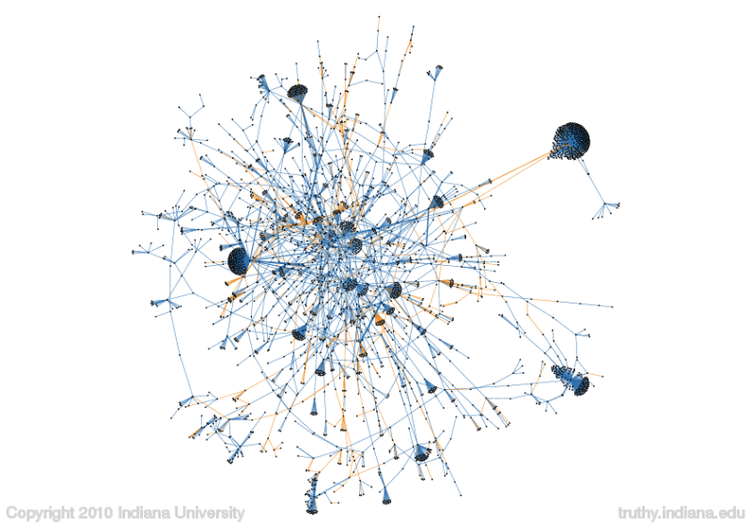
#obama diffusion network

Slide 7
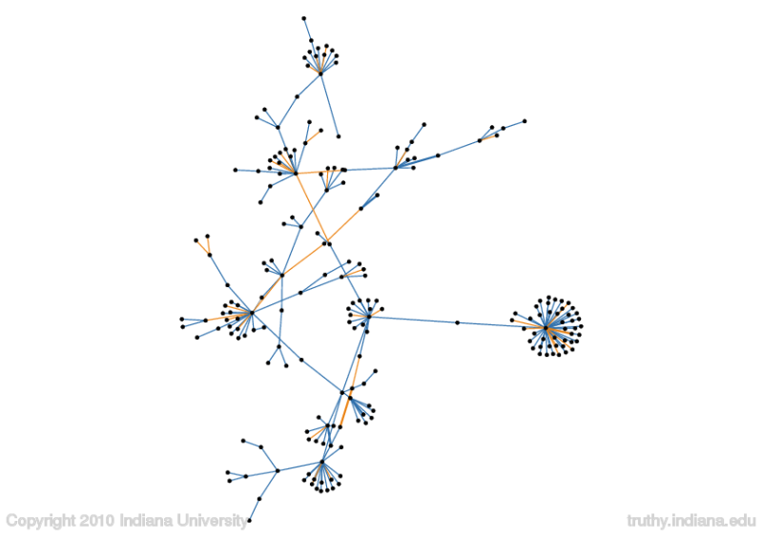
#patriots diffusion network

Slide 8
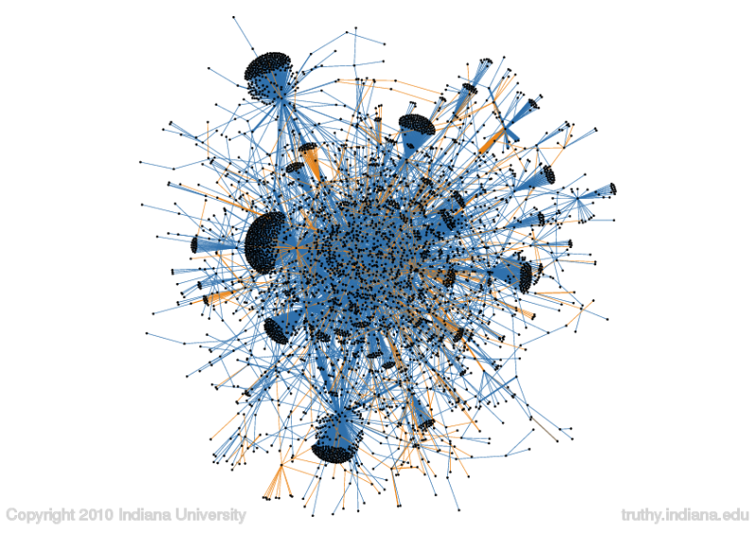
#ows (occupy wall street) diffusion network

Slide 9
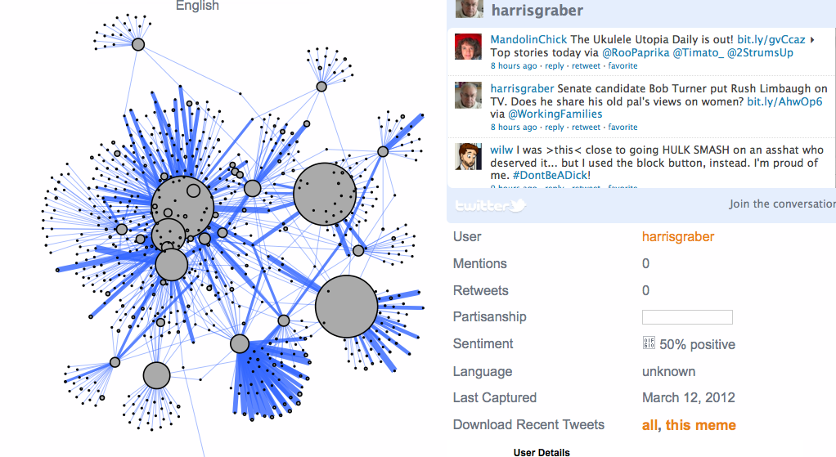
Interactive Network of #ows

Slide 10
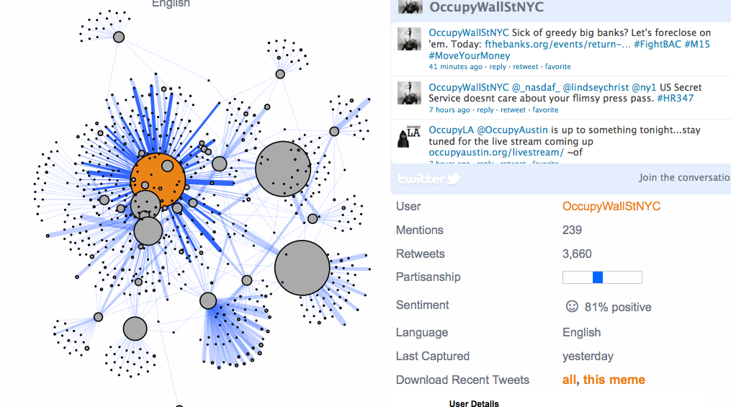
Interaction network of #ows

Slide 11
Datasets using Truthy API
Datasets are large, but RTs for single tweets dataset are smaller
Starts with 190,517 tweets with #ows
Top retweeted is @OccupyWallStNYC with 3,600 retweets containing the term #ows
Downloaded 500 of the 3,600 tweets at once found an average of 22 retweets of a particular tweets, with a level of 2
The data sets are not as large as I thought they were, using the twitter API, may go back to that

Slide 12
Datasets using my API
Searched for #DNA, found 1,906 tweets in past 3 minutes
Top retweeted was @aplusk with 631 retweets
Out of the 631, there were 281 retweets of the unique original tweet, also with a level of 2
There is some discrepancy between our two APIs.
Truthy cleans up the data of noisy tweets or ones that don’t pertain to politics

Slide 13
With the 281 retweets we can make more interesting trees, then with the 12 retweets, still a little hard to figure out the levels and parsing
Contacted Truthy to see if they could possibly help me network part.
Otherwise I am going to continue on developing the memetics of twitter and seeing there are any interesting trees
Now that I understand the data compares to each other, it is giving better ideas of how things interact

