Slide 1
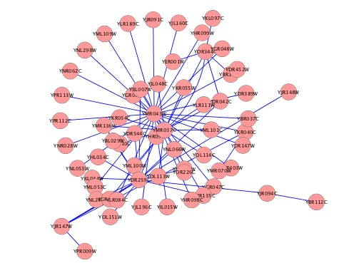
Target
EncodeNet Reg Net
TSS
5Kb
DNase1 || Histone modification
Target
Ensembl Gene
Cell line specific Ensembl Features

Slide 2
13 Cell Lines

Slide 5
Cell line specific genes
CD4: "CD300C" "CD5" "LRRC31"

