Slide 1
Preliminary results for highly confident ortholog genes between worm, fly and human
Daifeng Wang, Gang Fang, Roger Alexander, Mark Gerstein
Gerstein lab, Yale University
Mar 9 2012

Slide 2
Outline
Gene expression time-course data
worm, fly and human in ENCODE and modENCODE
Ortholog genes
highly confident among worm, fly and human
expression levels, exons, TFs
Preliminary clustering and network analysis

Slide 3
Gene expression data across stages
Worm
Integrative Analysis of the Caenorhabditis elegans Genome by the modENCODE Project
Figure S12: WS190 Transcript expression levels of all worm transcripts at 7 developmental stages
Fly
The developmental transcriptome of Drosophila melanogaster
Table S18. FPKM Levels for modENCODE transcripts from short poly(A)+ RNA-Seq, 30 stages
Human (working on…)
ENCODE RNA Dashboard
Cell lines: GM12878 and K562, Tier 1, whole cell, long Poly A+
Select values for the longest one if a gene maps multiple transcripts

Slide 4
Inparanoid
Kellis
Worm-Fly
3519 pairs
Fly-Human
3437 pairs
Worm-Fly
3192 pairs
Fly-Human
3237 pairs
1962
triplets
1952
triplets
Worm-Human
2686 pairs
Worm-Human
2624 pairs
1952
triplets
1021 triplets
(52%)
1962
triplets
* one-to-one pairs only
Notes:
(4-5 slides) More about 1021 genes
housekeep vs. human total worm total (CV?)
TFs GO term
1 exon vs. multi exon -> ensembl
Expression levels -> CV, mean distrubition, PCs
If possible, cluster inparanoid and kellis seperately, see which one connects more orth genes
(3-4 slides) jessica li

Slide 5
Histograms of expression max/min ratios

Slide 6
All gene expressions and 1st PCs across stages

Slide 7
Histograms of exons per transcript

Slide 8
GO terms on transcription
GOID | TERM | Number in worm | Number in fly
GO:0003899 | DNA-directed RNA polymerase activity | 14 | 16
GO:0003723 | RNA binding | 37 | 89
GO:0048037 | cofactor binding | 24 | 29
GO:0001076 | RNA polymerase II transcription factor binding transcription factor activity | 5 | 8
GO:0001104 | RNA polymerase II transcription cofactor activity | 5 | 7
GO:0000988 | protein binding transcription factor activity | 7 | 13
GO:0000989 | transcription factor binding transcription factor activity | 5 | 13
GO:0003712 | transcription cofactor activity | 5 | 12
GO:0008134 | transcription factor binding | 2 | 7
GO:0043565 | sequence-specific DNA binding | 5 | 7
GO:0001071 | nucleic acid binding transcription factor activity | 3 | 8
GO:0003700 | sequence-specific DNA binding transcription factor activity | 3 | 8
From http://go.princeton.edu/cgi-bin/GOTermFinder

Slide 9
Ortholog worm gene,
gw1,gw2,…,gwN
Stage, Sw1,Sw2,…,Swp
Ortholog fly gene,
gf1,gf2,…,gfN
Stage, Sf1,Sf2,…,Sfq
Worm
Fly
Cluster fly genes
(PCA,K-means, HC, WGCNA…)
…
Cluster
f1
Cluster
f2
…
Cluster
fl
Cluster
w1
Cluster
w2
Cluster
wk
Highly conserved
ortholog
gene pairs
Cluster
wi
Cluster
fj
Calculate ortholog overlap between worm’s & fly’s clusters
Compare highly conserved ortholog genes between worm and fly
co-expression network positions (e.g., centralities)
principal components across stages

Slide 10
Clusters enriched by conserved ortholog genes
Weighted Gene Co-expression Network Analysis (WGCNA)
http://www.genetics.ucla.edu/labs/horvath/CoexpressionNetwork/
Clustering via gene expression variability and network position
Worm cluster
Log(P-value by hypergeometric test)
Fly cluster

Slide 11
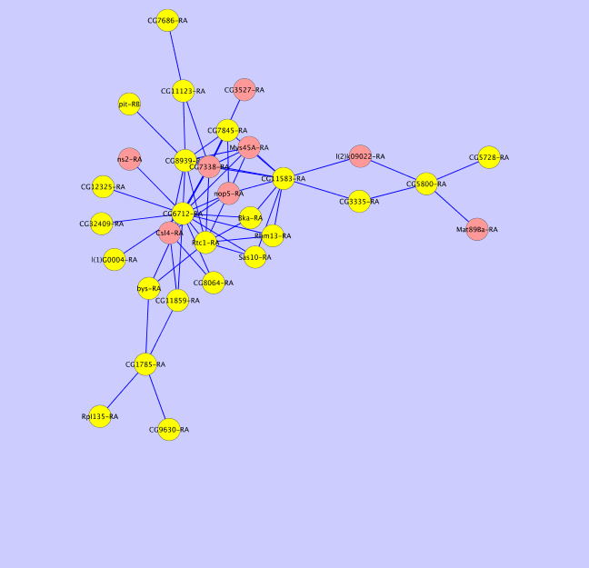
Ortholog genes are hub genes in GCN
Ortholog genes
Sequence conservation (ortholog genes) highly correlates with factors (hub genes) that regulate gene expression
Fly cluster blue
Worm cluster yellow
Notes:
Seq. conservation percentage vs. hub connections
Network alignment

Slide 12
Comparison of centralities
Corr = 0.45
Eigenvector centrality
the eigenvector of adjacency matrix with the largest eigenvalue
measurement of the influence of a node in a weighted network
similar with Google Pagerank
Notes:
What Datasets fly worm human tier 1

Slide 13
Working on…
Human data
Non-coding RNA

