Slide 1
Sample View of Existing Dataset
575 → 431

Slide 2
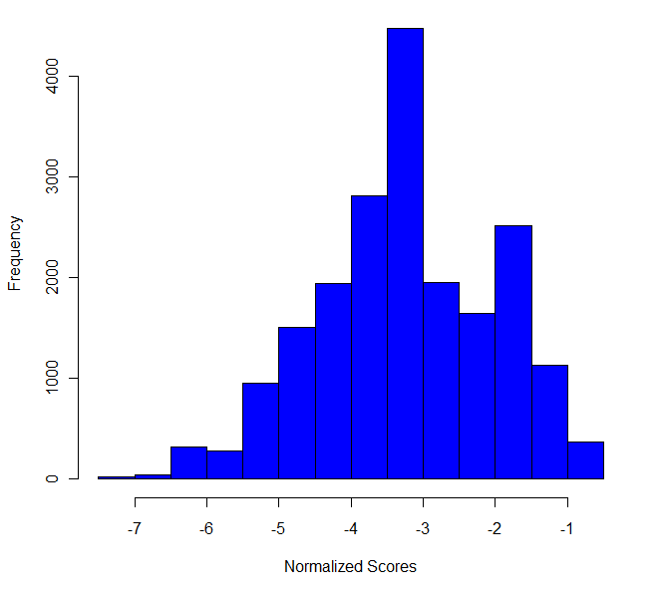
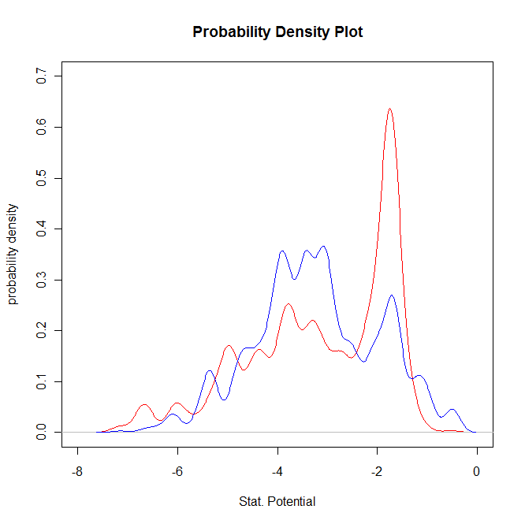
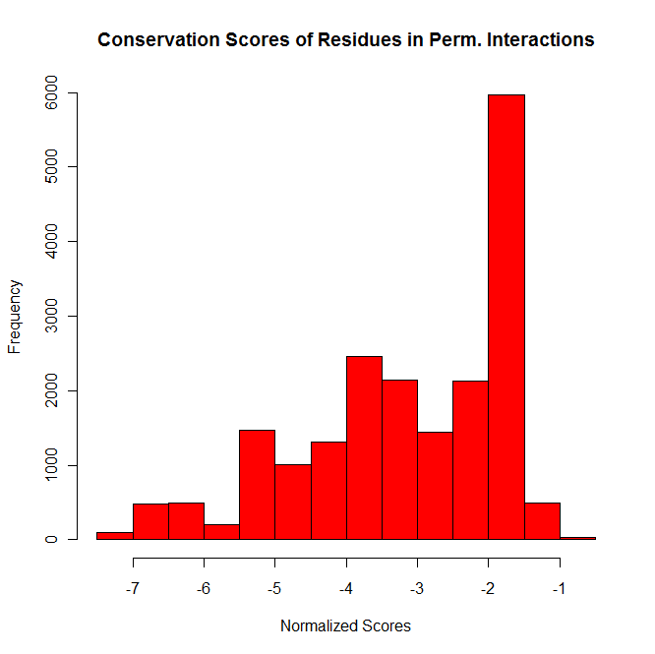
Prev. shown for randomly selected elements of Net
Transient
Trans mean: -3.230
Perm mean: -3.143
Permanent

Slide 3
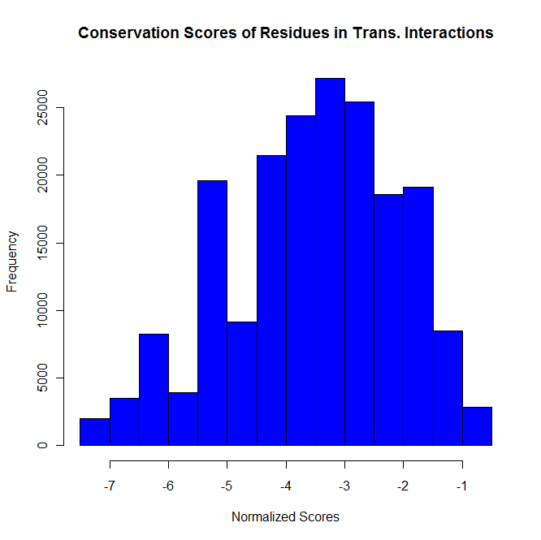
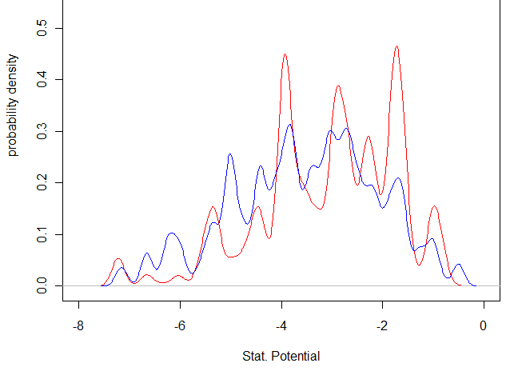
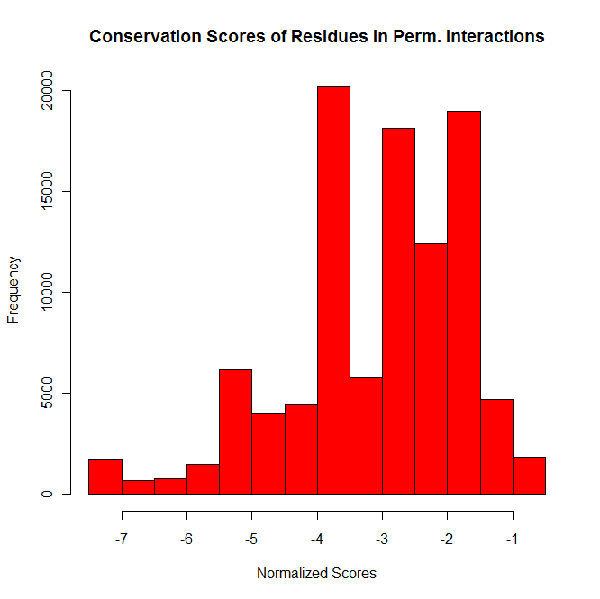
More Global Probability
Density Distributions
Trans mean: -3.523
Perm mean: -3.110
*NOTE: formatting excludes some interactions w/structures (est: ~5%)

Slide 4
Fut. Steps
comparison with null models
explore other potentials
prot. cores
resolve file format issues within DynaSIN
within DynaSIN, relate to flexibility?

