Slide 1
K562
GM12878
H1
Hela

Slide 2
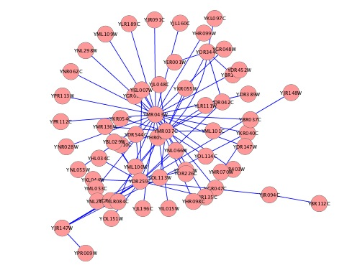
Regulator
Target
EncodeNet Reg Net
TSS
5Kb
Regulator Binding
Target
Ensembl Gene
Feature
Cell line specific Ensembl Features
Overlapping different cell lines on to Reg Net
Condition-Specific Network
Cell line specific regulation pairs

Slide 3
Cell Lines | # TF binding || Dnase Data
CD4 | 10
GM06990 | 2
GM12878 | 34
H1ESC | 7
HUVEC | 9
Hela | 29
HepG2 | 20
IMR90 | 1
K562 | 30
NHEK | 6
Net | Edge
EncodeNet | 26070
GM12878 | 10229
K562 | 12025
Hela | 5550

