Slide 1
Promoter regulation
Distal regulation
Protein-protein interaction
STAT1
Post-transcriptional regulation by miRNAs
+
+
STAT3
+
RUNX1
Target genes
TFs
ncRNAs
miRNAs
6 pairs of toggle switches
A.
3-node
motifs
868 | 490 | 729 | 26 | 0 | 0 | 8 | 64 | 6 | 6 | 2 | 16 | 122
Frequency
N
*
*
*
*
*
*
*
B.
C.
112346 | 17406 | 43273 | 3464 | 1313 | 8135
(miR-128)
(miR-101)
*
*
*
*
*
*
N=456 *
(TAL1)
(SP1)
N=7745 *
(FOS)
(RUNX)
(ABHD8)

Slide 2
D.
-
+
±
?
N=90
N=42194
-
+
±
?
N=28*
N=15700*
relative portion
number of ncRNA targets

Slide 3
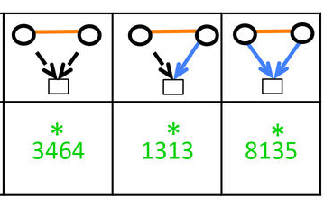
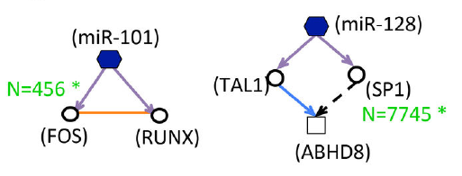
Promoter regulation
Target genes
TFs
Distal regulation
Protein-protein interaction
ncRNAs
miRNAs
Post-transcriptional regulation by miRNAs
motif template
enriched motif, frequency,
fold enrichment and examples
Either: mutual regulation,
one direction regulation or
empty
6
2
16
122
either with or without
a P-P interaction
exhaustive enumeration
and
enrichment analysis
Either: distal regulation or
promoter regulation
Either: P-P interaction, or
connection via various
mediators
either: auto-regulation or no regulation
15700

