Slide 1
SignalSNPs
Jieming
Netz
1st March 2012

Slide 2
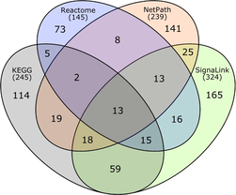
SignaLink
8 major signal transduction pathways (for C. elegans, Drosophila and human)
EGF/MAPK, INS/IGF, Insulin/IGF, TGF-ß, Wingless/WNT, Hedgehog, JAK/STAT, Notch, and Nhr (Nuclear hormone receptor)
Ensembl protein IDs
Korcsmaros et. al. (2010)
Notes:
Comparing the four signaling pathways (EGF/MAPK, Notch, TGF, and WNT) curated in all four databases: Reactome, NetPath, KEGG, and SignaLink. Each section of the diagram shows the number of proteins in that set. The total number of proteins in the four pathways of each database is shown below the name of the database. For this figure only proteins listed in UniProt/Swiss-Prot were used (no TrEMBL proteins). Background image from R. Millard
Interactions are verified physical interactions and are directed

Slide 3
Issues
Analyses on original network
Exclusion of nodes with 0 degree

Slide 4
Original network (without 0 degrees)
Decided to use network without nodes of 0 degrees
Notes:
Doesn’t affect network stats and it’s an entire pathway
Skew corelation analyses/relationship

Slide 5
Correlations
Entire network
Selection (particularly non-synonymous SNPs) VS degree centrality → in-degree → out-degree → total degree (edge count)
MPP
Multi-pathway proteins/genes (MPP/MPG) VS non-multi-pathway proteins/genes → VS in-, out-, total-degree → VS selection → Disease-related genes
Further explore tripartite relationship in MPP: selection-degree-disease-relatedness

Slide 6
Selection VS degree
Metrics for selection: → in SNPs (~1000) : AF, DAF - NS (44%), S (55%) SNPs - no significant results → in genes: dN/dS, SNP density - NS, S SNP density
Degree → in-degree → out-degree → total degree

Slide 7
Gene-level analyses
Category | # of genes |  | Spearman rho | P value
dN/dS (by gene) | 339 | Degree (All) | -0.105525 | 0.05259
 |  | Degree (in) | -0.1397374 | 0.01011
 |  | Degree (out) | 0.01825966 | 0.738
SNP density (NS SNPs by gene) | 219 | Degree (All) | -0.2042935 | 0.002381
 |  | Degree (in) | -0.1545487 | 0.02215
 |  | Degree (out) | -0.1570541 | 0.02005
SNP density (S SNPs by gene) | 257 | Degree (All) | -0.08529432 | 0.1728
 |  | Degree (in) | -0.002168202 | 0.9724
 |  | Degree (out) | -0.1553967 | 0.01262

Slide 9
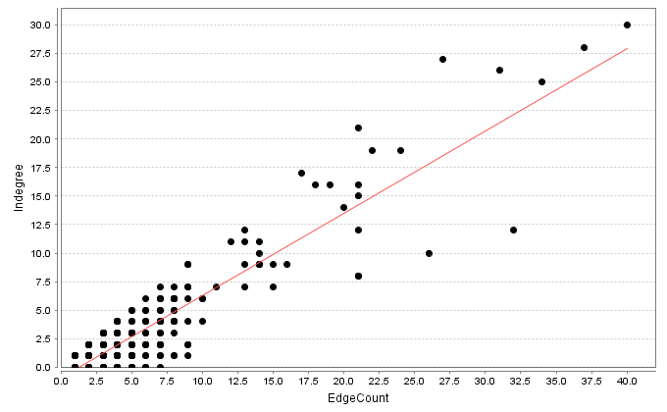
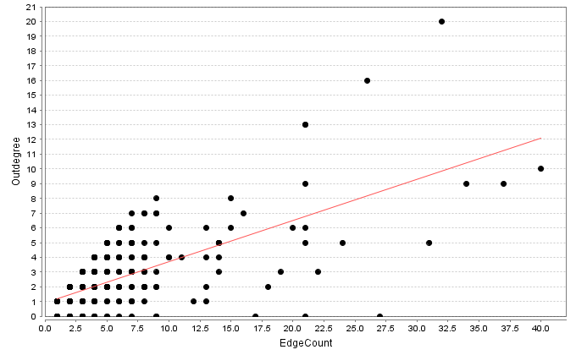
Degrees

Slide 10
Degree relationship between upstream and downstream and the implication in specificity??

Slide 11
MPP vs nonMPP
Crosstalks between 2 or more pathways: multi-pathway protein (MPP)
SNPs VS no SNPs → no significance
# NS SNPs vs # S SNPs in MPP vs non-MPP → significant depletion of NS SNPs in MPP → OR=0.49, p=0.0002224
# disease-related genes VS # non-disease-related genes (relatedness from HGNC db) → no significance → but Signalink paper shows significance (they got their list of disease related genes from specific literature), will do further check.

Slide 12
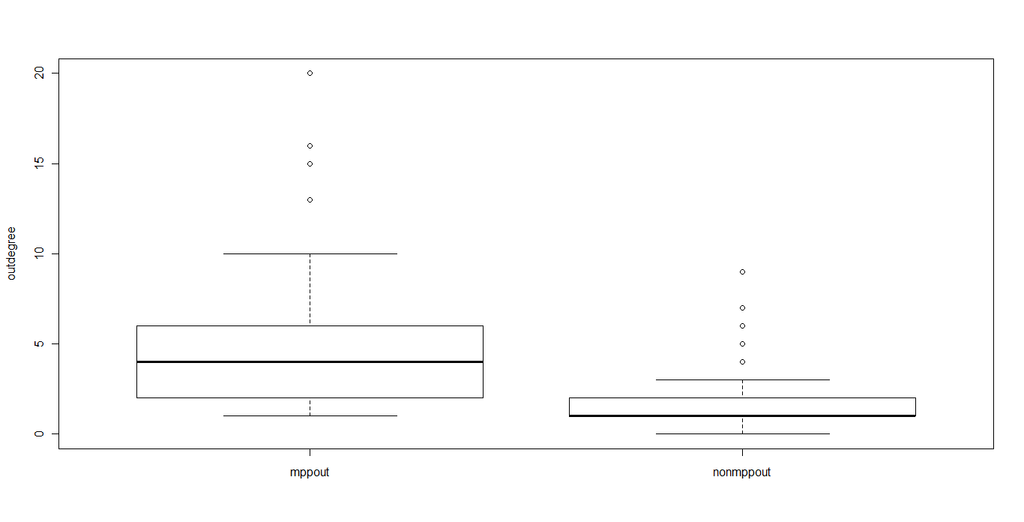
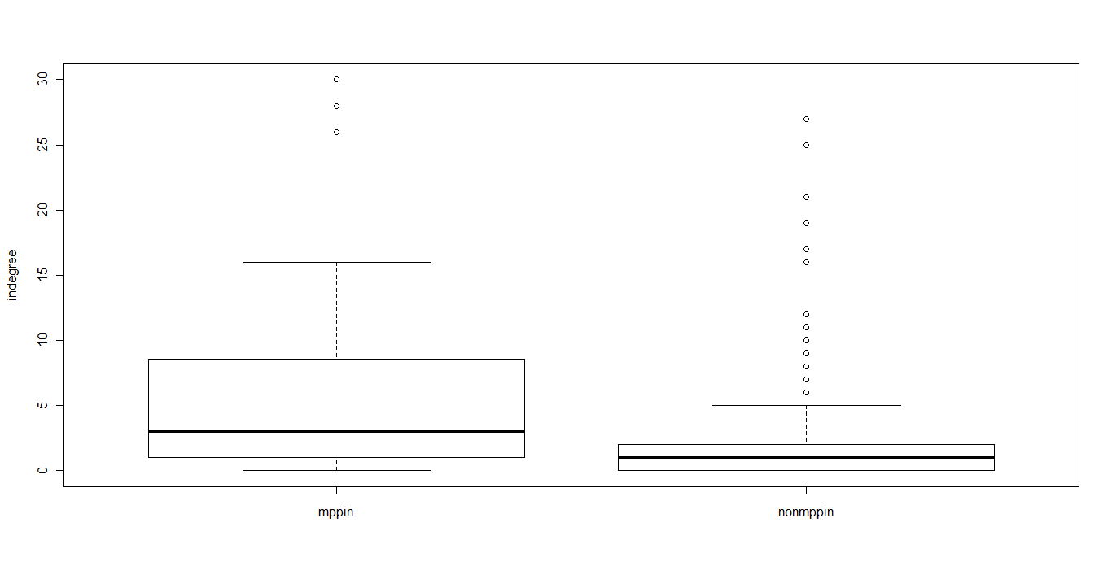
MPP vs nonMPP
Degrees → whether MPP have different degree distribution from nonMPP → KS test: p<0.0001, MWW test: p<0.0001
MPPin
nonMPPin
MPPout
nonMPPout

Slide 16
Possible Further Analyses?
Investigate graph theory parameters and their relevance in the context of signaling pathways and relationship with selection and disease-relatedness: → betweenness centrality → closeness centrality → eigenvector centrality → shortest path
Edges: Activation and inhibitory → wrt disease-relatedness

