Slide 1
Allele-specific peaks
 | Number | %
None | 4993 | 56.65%
SNP only | 2647 | 30.04%
Indel only | 457 | 5.19%
SV only | 100 | 1.13%
SNP & Indel | 610 | 6.92%
Indel & SV | 1 | 0.01%
SNP & SV | 5 | 0.06%
SNP, Indel & SV | 0 | 0.00%
Total | 8813 | 100%

Slide 2
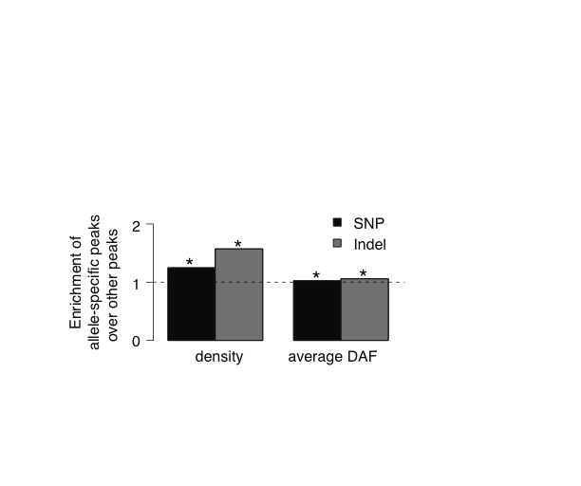
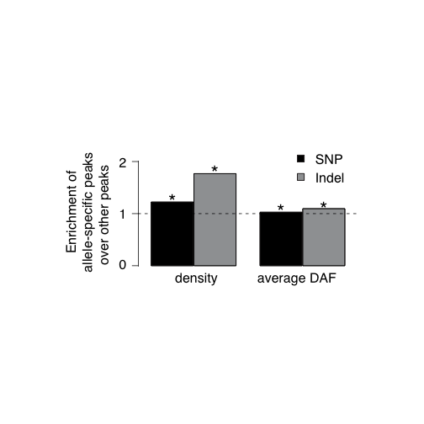
All peaks
Peaks that overlap with heterozygous variants

Slide 3
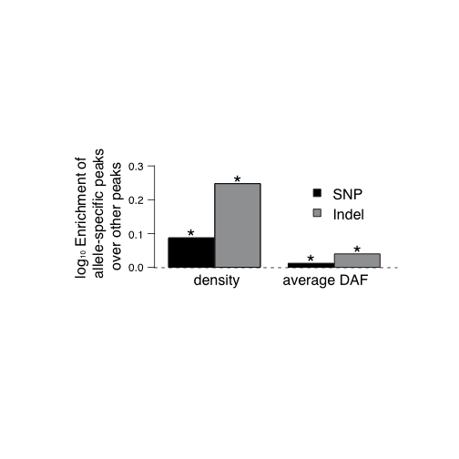
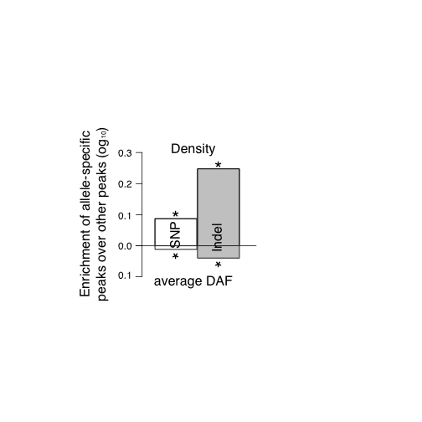
Peaks that overlap with heterozygous variants

