Slide 1
Group Meeting
YF
3-2-2012

Slide 2
Outline
NetSNPs (EK & YF)
Cell cycle genes prediction (CC & YF)

Slide 3
Major purpose & Data
Correlate human variations with Networks
1000 genomes phase I data
HGMD disease causing data
HGMD disease associated data
GWAS data

Slide 4
Variants Data
 | # Number | # Corresponding Genes
Non-synonymous SNPs | 282793 | 19510
HGMD disease causing (missense) | 44453 | 2117
HGMD disease associated (missense) | 1492 | 974
GWAS data (missense) | 148 | 138
Network Data
 | # Interaction | # Corresponding Genes
Physical interaction | 48393 | 11224
Regulatory Network | 6896 | Top: 58;Middle: 52;Bottom: 27;Targets: 2972
Genetic interaction | 498 | 534
Phosphorylation network | 28638 | 2392
Metabolic Enzyme interaction | 13667 | 1035
Structural interaction network

Slide 5
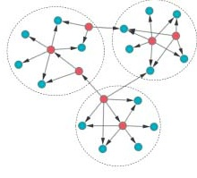
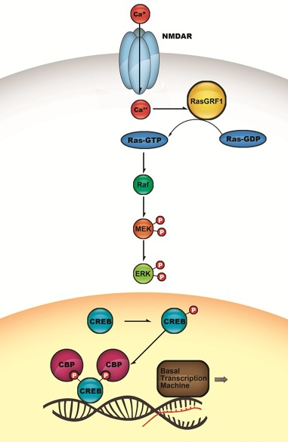
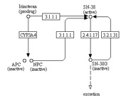
Network types
Regulatory network
Phosphorylation network
Metabolic Enzyme network

Slide 6
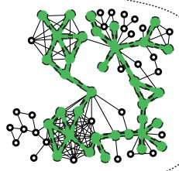
Structural Interaction Network
From SIN, derived from Pfam.
Hypothesis: Proteins with larger amount of interacting surface area are under more constrain.
Interacting surface area
For now, just calculate number of surface interacting residues.
Because of limited data, only 400 genes are calculated.

Slide 7
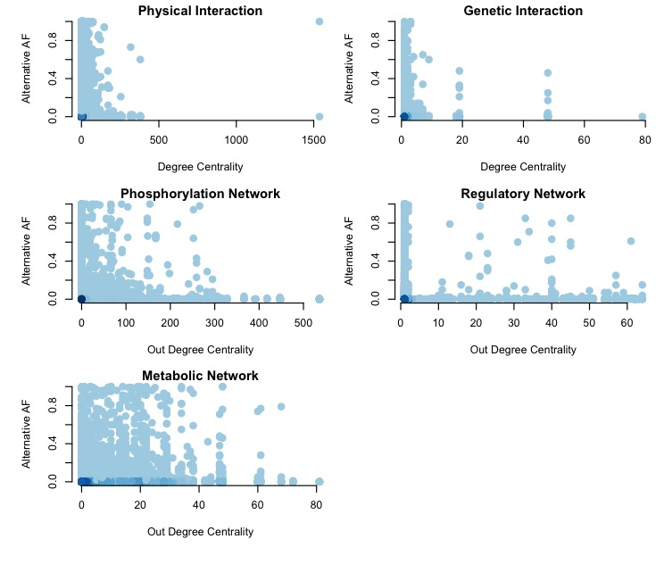
Phase I: Alternative AF & Network
*
*
*
*
*

Slide 8
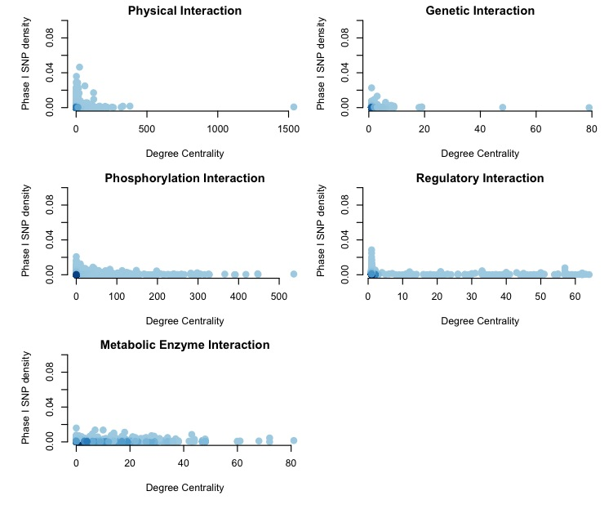
Phase I: SNP density Vs. Network
*
*

Slide 9
Disease Gene Vs. Network
Disease genes are more central.
Genes associated with similar diseases, more often to high likelihood of physical interactions

Slide 10
Comparison (Physical Interaction)
*
*
1425
686
9190
69
Notes:
HGMD genes are more clustered in the inner part of physical interaction network.

Slide 11
Comparison (Genetic Interaction)
*

Slide 12
Comparison (Phosphorylation Network)
Notes:
Out degree means how many genes that gene could phosphorylate. There is no different in Out degree distribution. That shows most of the mutations happen on the bottom of the phosphorylation network. In degree means how many genes can phosphorylate this gene. HGMD genes are in genes that could be phosphorylated by less genes. Also not significant. Genes with direct effect in regulating transcriptional activity.

Slide 13
Comparison (Regulatory Network)
*
*
*
Notes:
Most mutations occur at the bottom level of regulatory network. Mutations in genes regulated by more genes are more likely be disease causing. These genes are under delicate regulation, that are more important.

Slide 14
Comparison (Metabolic Network)

Slide 15
Singlish Vs. Multiple Hubs
 | Singlish Hubs (848) | Multiple interfaces Hubs (236)
Phase I (19510) | 797 | 226
HGMD (2117) | 158 | 75
HGMD associated (974) | 98 | 38
*
HGMD genes tend to be hubs. (p < 2e-16)
Pilot genes no preference for singlish and multiple hubs.
HGMD genes are more likely to be multiple interfaces hubs (p = 0.0009)
HGMD associate genes are not significantly enriched in multiple interface hubs. (p=0.12)
Compared to HGMD, HGMD associated genes are more in singlish hubs (p = 0.03), but not in multiple hubs. (p =0.7 )
Notes:
Number of interacting interfaces.

Slide 16
Structure Interaction Net
Notes:
This doesn’t work.

Slide 17
Overlap Networks
PPI
PPI
Phos
1147
703
8059
PPI
PPI
435
55
1344
29
16
155
7
1032
107
666
Reg
Meta

Slide 18
Overlapping genes between physical, regulatory and phosphorylation networks
*
Overlap genes have significantly higher out-degree centrality in regulatory network & phosphorylation network.
Generally, overlapping genes are more central in Physical interaction network, and also function in upper level in phosphorylation & regulatory networks.

Slide 19
Summary
Allele frequency is negative correlated with degree of centrality in physical, genetic, regulatory, phosphorylation and metabolic networks.
For physical & genetic interaction networks, disease mutation tends to occur in genes with higher degree.
In phosphorylation network, disease mutations are more in genes with less in-degree. (genes could be phosphorylated by few interacting partners).
But in the regulatory networks, disease mutations are more in gene with larger in-degree. (Genes regulated by more transcription factors).

Slide 20
Using regulatory features to predict Cell Cycle regulated genes (CC genes) in yeast
CC & YF

Slide 21
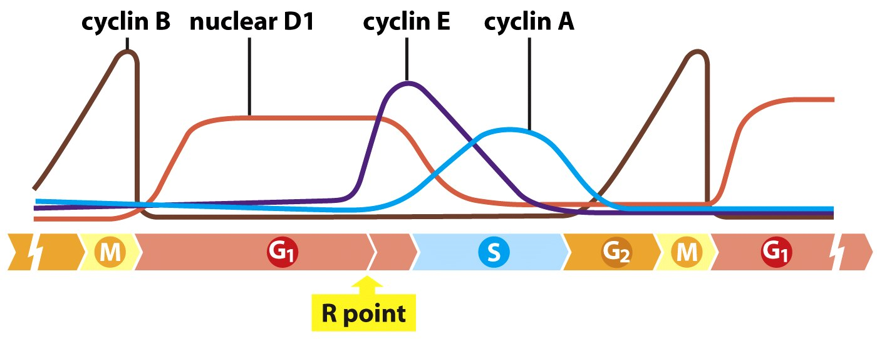
Background
Cell cycle is a process leading to cell proliferation. It is under delicate regulation control, such as gene expression, protein activation, localization and degradation.
Disruption of cell cycle may cause cancer.
Many yeast genes have been identified as periodic genes.
Notes:
Different cell cycle stages need different gene function. Gene expression, activity need to be regulated in a stage specific manner. We could imagine that genes that are required as certain stage, would express in this stage to fulfill its function.
Periodic genes are genes expressed at a certain stage of cell cycle and repressed at other stages. First identified periodic genes are cyclins. Cyclins were originally named because their concentration varies in a cyclical fashion during the cell cycle.
Identifying these genes would help us to better understand cell cycle mechanism.

Slide 22
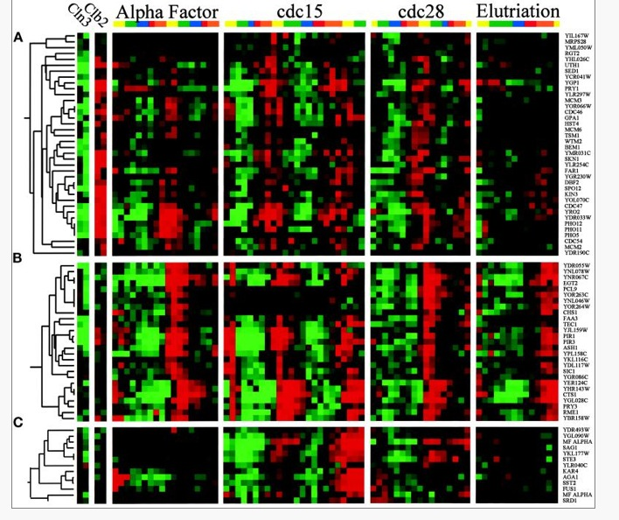
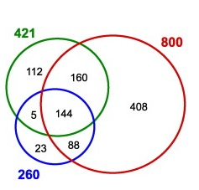
Approaches to identify CC genes
Microarray data.
Problems with microarray experiments:
  Inconsistency
  Method noise (experiment condition; synchronization method)
  Difficulty to identify lower expressed genes.
Spellman et al. 1998

Slide 23
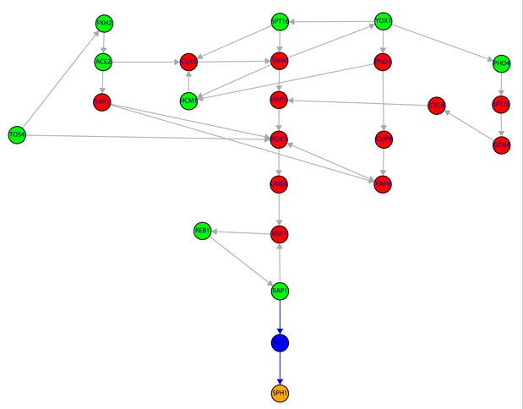
Approaches to identify CC genes(cont.)
Computational methods
  Causal interaction (Frank et al. 2009)
  E-MAP & DNA microarray (Want et al. 2011)
  Protein features (de Lichtenberg et al. 2003)

Slide 24
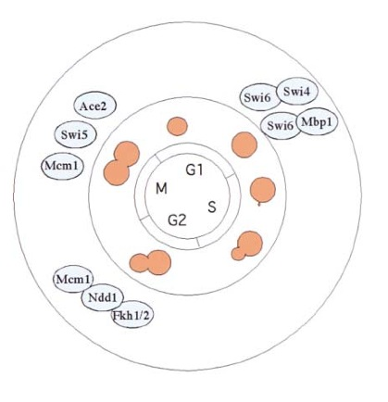
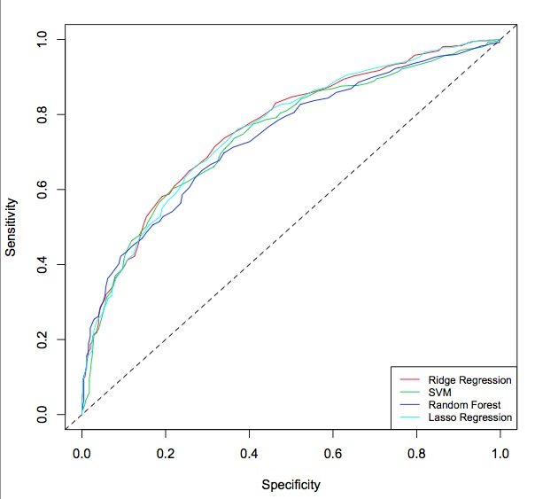
Our approach (regulatory features)
Data: 203 TF binding and motif profiles of promoter region (-1kb ~ +1kb TSS)
Method: Ridge Regression, 10 fold validation
Training data: 599 positive; 454 negative
Notes:
We combine TF and motif data together. Complementary effect of the two. Motif indicates potential binding. TF is condition specific.

Slide 25
Result : part I
TF + motif outperforms TF or motif only method
AUC:0.82
-- CC

Slide 26
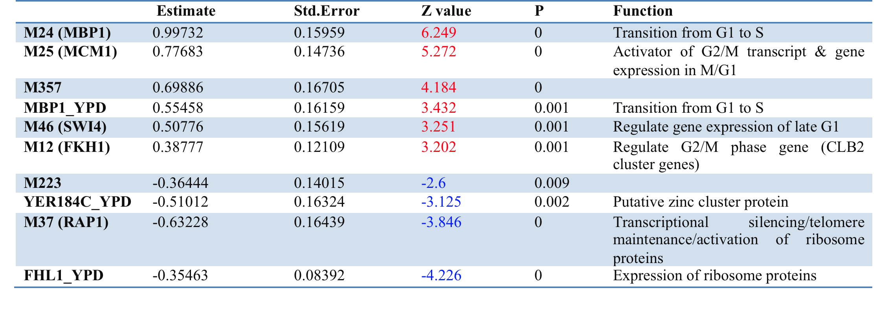
Prediction Function

Slide 27
Prediction Results
5168 genes, 211 genes above the threshold of 0.8, corresponding to 37.7% sensitivity and 5.5% false positive rate, were classified as cell cycle regulated genes.
24 out of 211 has been verified as cell cycle regulated genes in at least one experiments in Cyclebase.org.
The expression level of the other 187 genes is lower than that of validated cell cycle regulated genes (p value 0.04948, Wilcoxon rank sum test)
DAVID: top GOs: cell walls, DNA condensing, cell cycle.
SGD: 51 has unknown function and others are involved in several different biological processes such as lipid metabolic process, response to chemical stimulus, mitotic cell cycle, cytoskeleton organization.

Slide 28
Result : part 2 (phase specific prediction)
G1 (219)
S(157)
G2 (101)
M (99)

Slide 29
Cell cycle phase specific prediction
Training: phase specific genes Vs. other phase specific genes
G1: 0.825
S: 0.811
G2: 0.788
M: 0.859

Slide 30
TF or Motif | Function | G1 | S | G2 | M
SWI5 | M/G1, G1 | + |  | -
ACE2 | M/G1 |  | -
MBP1 | Late G1 | + |  | -
M24 | MBP1, late G1 | + |  | - | -
M46 | SWI4, late G1 |  | + | - | -
NDD1 | G2/M | - |  | +
FKH2 | G2/M | - |  | +
M12 | FKH1, G2/M |  | + |  | -
M25 | MCM1, G2/M, M/G1 |  | - |  | +
DOT6 | Telomeric gene silencing and filamentation | -

Slide 31
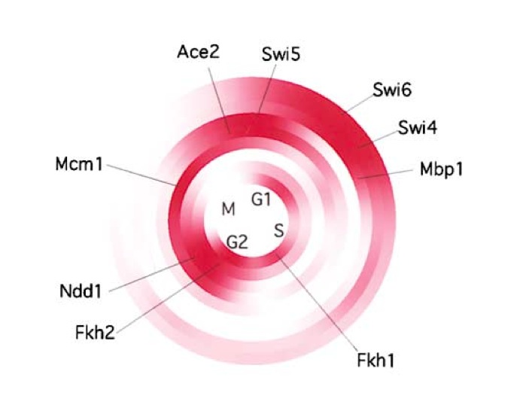
G1
S
G2
M
Serial Regulation of Transcriptional Regulators in the Yeast Cell Cycle

Slide 32
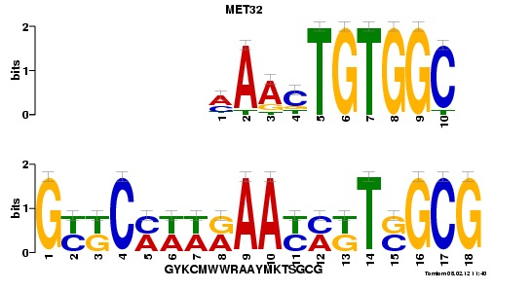
S phase specific transcription factor
SWI4; FKH1; M95
TOMTOM (P=0.003) : MET32
“These results suggest that the combination of both a higher expression level and higher cell cycle inhibitory activity of Met32 as compared with Met31 makes Met32 the primary mediator of the Met30-controlled cell cycle checkpoint.”
-- Su et al. JBC, 2008
Notes:
A Dominant Suppressor Mutation of the met30 Cell Cycle Defect Suggests Regulation of the Saccharomyces cerevisiae Met4-Cbf1 Transcription Complex by Met32*

Slide 33
Cell cycle phase specific prediction
Cut-off 0.5;
211
M(12)
Other(123)
G1(53)
S(14)
G2(9)

Slide 34
*
Relative binding values of 9 transcription factors
*
*
*
*
*
*
*
*
S (13)
G1 (38)
M (12)
G2 (9)

Slide 35
Gene function
G1 phase genes (38)
Most of them are involved in metabolic process and amino acid transportation
S phase genes (13)
Mitotic cell cycle; rRNA processing; chromosome segregation; organelle fission …
G2 phase genes (9)
Biological process unknown; lipid metabolic; protein complex biogenesis;
sporulation; ion transport
M phase genes (12)
Conjugation; cytokinesis; cell wall organization; cytoskeleton organization….

Slide 36
Examples: Gene Prediction (G1 phase)
CDC8 , prediction score 0.803.
Function : thymidylate and uridylate kinase and essential for mitotic and
meiotic DNA replication
CDC8 gene has been validated as periodically expressed gene in yeast cell
cycle before, but not in Cyclebase

Slide 37
Examples: Gene Prediction (S phase)
ERS1.
Function : Membrane protein involved in molecular transportaiton

Slide 38
Examples: Gene Prediction (G2 phase)
EKI1.
Function : ethanolamine kinase, primarily responsible for
phosphatidylethanolamine synthesis via the CDP-ethanolamine
pathway

Slide 39
Examples: Gene Prediction (M phase)
CLA4 , prediction score 0.898.
Function : Serine/threonine protein kinase required for cytokinesis
Promoter region of binding (from other source): Mcm1; SWI4, SWI6

Slide 40
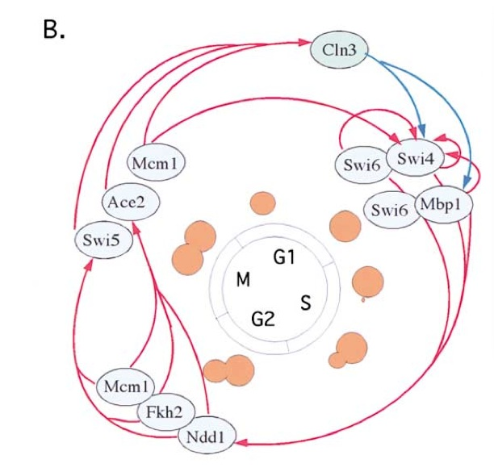
Serial Regulation of cell cycle
Serial Regulation of Transcriptional Regulators in the Yeast Cell Cycle

Slide 41
NDD1
FKH1
FKH2
MBP1
SWI5
SWI4
G1
S
G2
M
SWI5
MBP1
SWI4
FKH1
M95
FKH2
NDD1
MCM1

Slide 42
Map onto regulatory network

Slide 43
Summary
We proposed a new computational method to predict cell cycle regulated gene based on their regulatory features.
We have predicted 211 potential cell cycle regulated genes. About 25% of them are not assigned explicit function, thus our prediction provides insight into their function.
Among them, 12 to be G1, 9 S, 13 G2, and 38 M genes have clear prediction in particular phase.
Cell cycle regulation is a complex process. Our model suggests only small proportion of transcription factors could explain majority part of periodic expression in cell cycle.

Slide 44


