Slide 1
Towards gold set of breakpoints
Alexej Abyzov

Slide 2
How breakpoints are derived
GenomeStrip
CNVnator
BreakDancer
EMBLdelly
Pindel
PilotAssembly
Merging to 113,649 calls
Extended set
of b-points: 55,957
Stringent set
of b-points: 36,237
TIGRA assembly
SAV FDR: 45% SAV FDR: 35%
Contig alignment with AGE
Merging breakpoints
Contig alignment with CROSSMATCH

Slide 3
Additional analyzis
Use stringent set of b-points (total of 36,237)
Map unaligned reads (flag 0x4) to breakpoint junctions (low quality end is trimmed up to q15 a la BWA)
Select junctions with mapped reads from at least 2 individuals
Changing min_d = min(d1,d2)
d1 d2

Slide 4
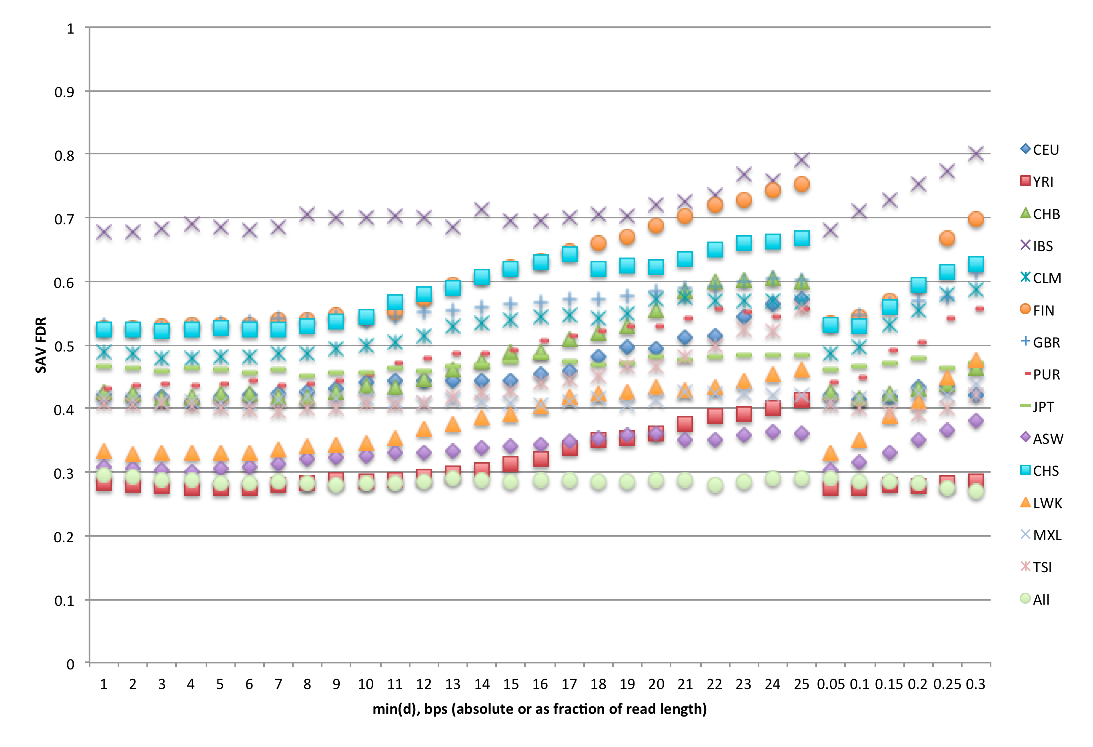
Correspondence with SAV FDR

Slide 5
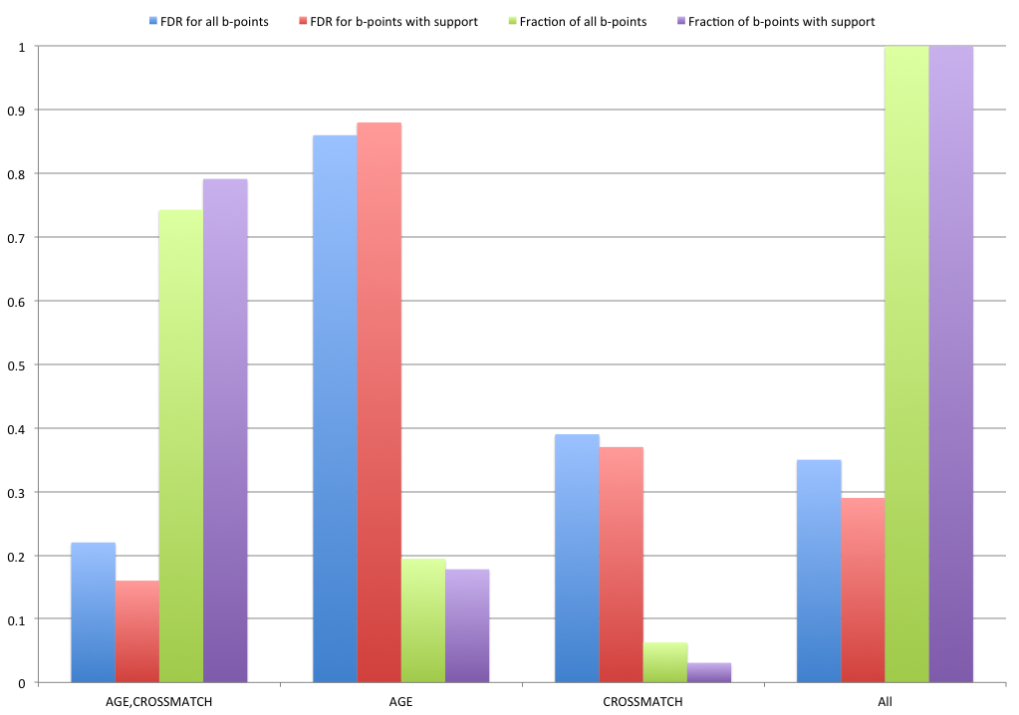
By aligner

Slide 6
Estimated FDR of breakpoints
Real junction
Read mapping is
evidence for the deletion
deletion
Null junction
Read mapping is background
From preliminary analysis FDR is < 10%

Slide 7
So…
Discordance between SAV and breakpoint evidence still persist
Point for future analysis
Here the goal is to select a gold set (by any measure) b-points
Use b-points found by both AGE and CROSSMATCH
Apply further filtering: 2 out of 6 + GenomeStrip

Slide 8
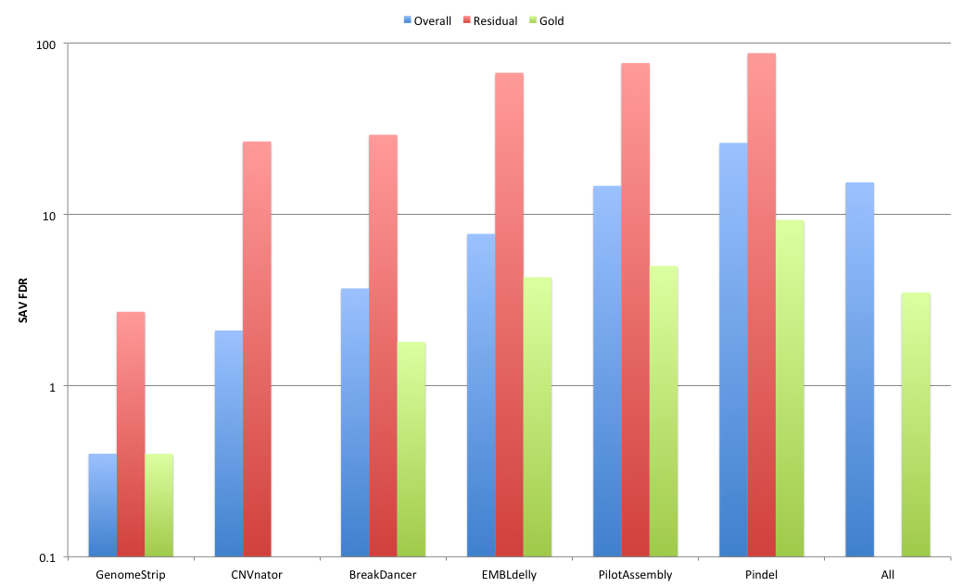
FDR by caller

Slide 9
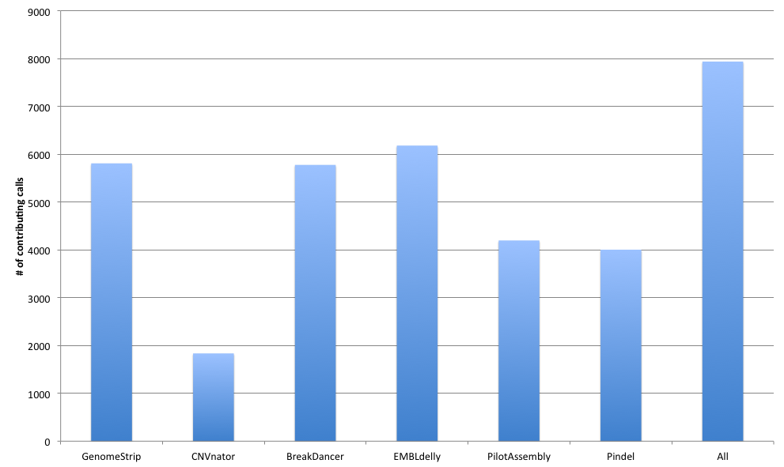
Gold set of b-points

Slide 10
Further things to do
Perform the same analysis with extended set of b-points (total of 55,957)
Analyze discordance between SAV and breakpoint evidence

