Slide 1
NetSNPs: SNPs on Human Signaling Pathways
JC
Netz
21st Feb 2012

Slide 2
KEGG pathways & 1KG CEU SNPs
 | # human pathways | # unique human genes in CEU 1KG that are found in the pathways | # NS genes | # S genes
metabolism | 85 | 1088 | 813 | 862
geneticInfo | 21 | 669 | 440 | 546
signaling | 16 | 1069 | 759 | 883
cellularProcesses | 14 | 878 | 636 | 725
Systems | 45 | 1560 | 1194 | 1218
Diseases | 46 | 910 | 632 | 747
Drug Dment | 0 | 0 | 0 | 0
 | 227 | 6174 | 4474 | 4981
total # unique human genes = 4093 => genes in multiple pathways
# NS+S genes = 9455 => genes can also be both NS and S

Slide 3
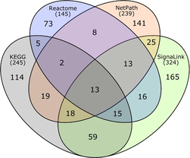
SignaLink
8 major signal transduction pathways (for C. elegans, Drosophila and human)
EGF/MAPK, INS/IGF, Insulin/IGF, TGF-ß, Wingless/WNT, Hedgehog, JAK/STAT, Notch, and Nhr (Nuclear hormone receptor)
Ensembl protein IDs
Korcsmaros et. al. (2010)
Notes:
Comparing the four signaling pathways (EGF/MAPK, Notch, TGF, and WNT) curated in all four databases: Reactome, NetPath, KEGG, and SignaLink. Each section of the diagram shows the number of proteins in that set. The total number of proteins in the four pathways of each database is shown below the name of the database. For this figure only proteins listed in UniProt/Swiss-Prot were used (no TrEMBL proteins). Background image from R. Millard
Interactions are verified physical interactions and are directed

Slide 4
SignaLink
Proteins from these pathways are excluded
Nuclear import/export system, chromatin remodelling and ubiquitin system
Interactions between TFs are omitted.
Stop at the first TF of a pathway

Slide 5
SignaLink

Slide 6
Allele freq (AF) vs degree
Based on 504 SNPs
 |  |  | Spearman correlation (rho) | P-value
AF (by SNP) | totaldeg | 504 (snps) | 0.04273682 | 0.3383
 | indeg |  | 0.1695953 | 0.0001304
 | outdeg |  | -0.03818772 | 0.3923

Slide 7
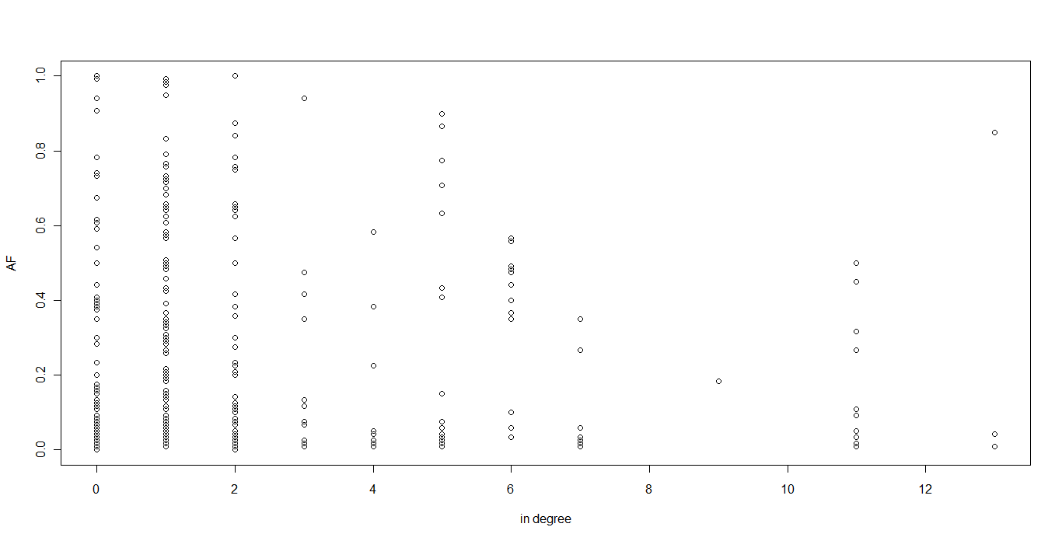
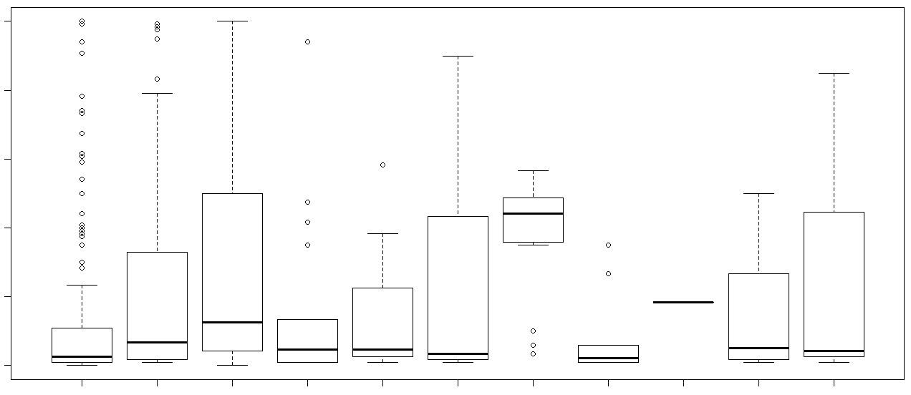
Allele freq (AF) vs indegree

Slide 8
Allele freq (AF) vs degree

Slide 9
dN/dS
 |  |  | Spearman correlation (rho) | P-value
dN/dS (by gene) | SNP density | 197 | 0.03115661 | 0.6638
 | Degree (All) | 256 | -0.09782584 | 0.1185
 | Degree (in) | 256 | -0.09623375 | 0.1246
 | Degree (out) | 256 | -0.01055498 | 0.8665

Slide 10
Thoughts
NHR seems to be fragmented. Might be better to remove and try again?

Slide 11
References
SignaLink http://signalink.org/

