Slide 1
Plant Networks
Darryl Reeves
Nets Meeting
02/21/2012

Slide 2
Co-expression Network Construction with WGCNA (Kbase)

Slide 3
Data
7,311 experiments (Affymetrix Arabidopsis ATH1 Genome Array)
22,591 genes
Raw data normalized using RMA method

Slide 4
Adjacency -> TOM dissimilarity
Adjacency matrix A = a_{ij} = |cor(x_{i},x_{j})|^{β}
    i - gene i
    j - gene j
    x_{i} - expression level of gene i
    x_{j} - expression level of gene j
β chosen based on how network fits scale-free topology
Topological Overlap Matrix (TOM)
  Reflects relative interconnectedness of two nodes
  Converted to TOM Dissimiliarity Measure for clustering

Slide 5
Soft Thresholding Power
Test a number of different values
  Generate range of powers to plot
  Test each soft thresholding power
  Pick power based on plot
  R² of log(p(k)) and log(k) used to determine how well network satisfies scale-free topology
      p(k) - frequency distribution of node (gene) connectivity
      k – node connectivity
  R² > 0.8 considered a good fit given trade-off between maximizing scale free topology and maintaining connectivity

Slide 6
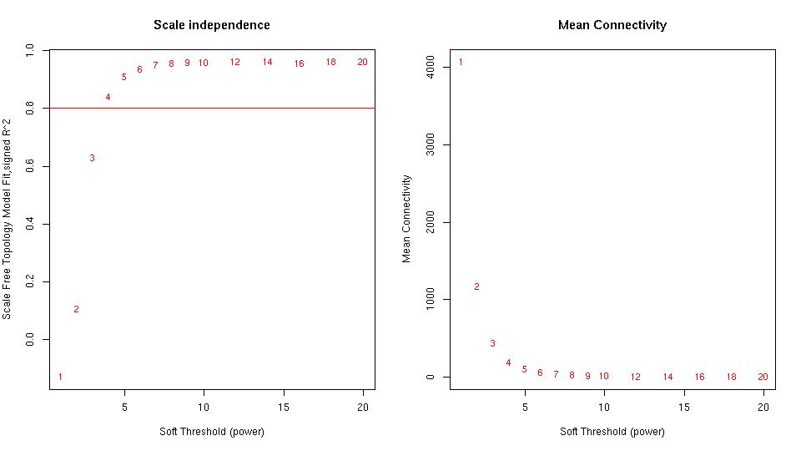
Soft Thresholding Power

Slide 7
Clustering

Slide 8
Next Steps
Determine appropriate parameters for module detection
Utilize computational resources to broadly test parameter choice (in parallel) for two tree cutting methods
  Dynamic tree cut
  Dynamic hybrid tree cut
Enrichment analysis using GO and KEGG
Automated merge and comparison of results for choosing appropriate parameters

Slide 9
Module Detection Workflow
Co-expression Network
Cluster
Cut tree (multiple params)
Calculate Eigengenes
Cluster Eigengenes
Merge Eigengene Clusters
KEGG Annotation
GO Annotation

Slide 10
Arabidopsis Network Evolution

Slide 11
Data
Data Type | Source | Size
A. Thaliana
PPI | TAIR/BIOGRID | 8,993 interactions
Pathways | AraCyc | 4,996 pathway enzymes
Transcription Regulation | AGRIS - AtRegNet | 11,365 TF-gene interactions

Slide 12
Ortholog node differences
 | PPI Network Nodes | TF Regulatory Network Nodes | Metabolic Network Nodes
Arabidopsis thaliana | 1324 | 8161 | 4433
Missing in A. lyrata | 82 | 893* | 198
*3 TFs missing

Slide 13
PPI Network

Slide 14
PPI Network

Slide 15
TF Regulatory Network

Slide 16
TF Regulator Network

Slide 17
Metabolic Pathway Network

