Slide 1
ENCODENET update

Slide 2
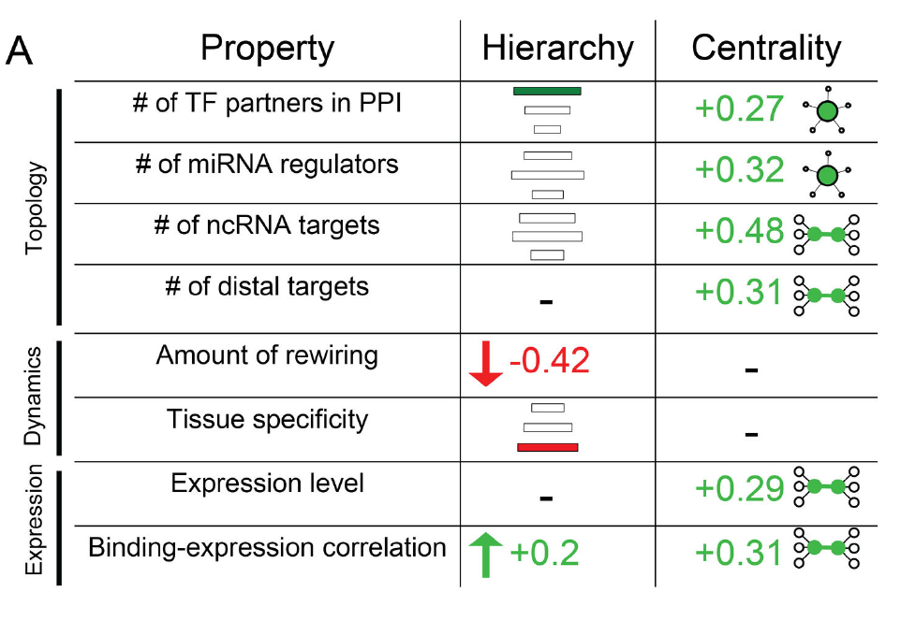
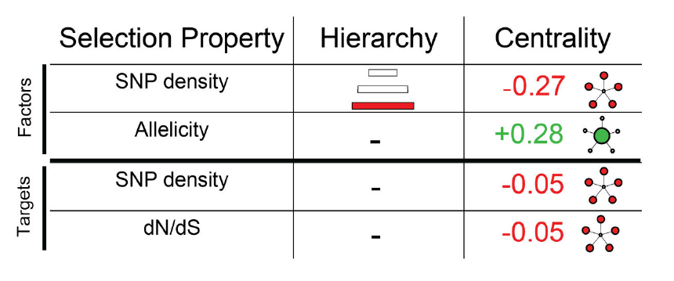
Robustness
Significant correlation between h and the TF feature

Slide 3
Robustness with respect to scaling

Slide 4
Correlation between h and h_reduced

Slide 5
Num. of miRNA regulators

Slide 6
maximum Spearman Correlation
of TF binding with expression

Slide 7
num. ncRNA targets

Slide 8
snpdensity

Slide 9
Amount of rewire

Slide 10
Robustness with respect to false positive

Slide 11
Num. of miRNA regulators

Slide 12
Amount of rewire

Slide 14
Compare with random network

Slide 17
CC_stat=(Down + horizontal)
/(up + horizontal)

Slide 18
TFSS only

Slide 19
TFSS only
Notes:
Some data are removed, they are corr. to sig….

Slide 20
 | P value (All) | P value (TFSS only)
Maximum Spearman Correlation of Tf binding with expression | 0.0468 | 0.6426
num. of mirna interaction | 0.0022 | 0.0006
snpdensity | 0.0106 | 0.1629
num. ncRNA targets | 0.0411 | 0.0001
Amount of rewiring | 0.0178 | 0.6036
AlleleSeq.KS.D | 0.0526 | 0.0893

