Slide 1
Gerstein Lab Group Meeting
JC
2nd Feb 2012

Slide 2
Contents
Gerstein Lab
ncVarII: Allele-specific effects in the non-coding region
Peeking into 23andMe
Regan Lab
PPI: probing relationship between interface area and binding
3TPR consensus sequence in informing protein engineering design
Methanogen Methanoregula Boonei

Slide 3
ncVarII
Mu XJ, Harmanci A et. al. (under review)
Notes:
Investigate selection patterns in non-coding regions →

Slide 4
ncVarII – main findings
SNPs with higher selection pressure tend to be more destabilizing to secondary structures of ncRNAs.
More binding reactions lead to stronger selection pressure, as observed in TFBSes, cell-line specific binding, allele-specific effects and regulatory networks.

Slide 5
ncVarII – ASB & ASE Data Sources for GM12878
 | ASB | ASE
Technology | ChIPseq | RNAseq
Results of | 63 TFs (including CTCF, NFkB, Pol2, Pol3…) | Long polyA- Short RNAs
Heterozygous SNPs from | 1KG pilot CEU | 1KG pilot CEU
Annotation |  | GENCODE v7
Notes:
ChIpseq- TFBS
Data sources ChIP
RNAseq – RNA fractions = long polyA- (exclude coding mrNA) and short RNA (coding regions shorter usually, but long RNA for longer gene regions; they fractionate from gel expts different sizes)
(refer to http://genome.crg.es/encode_RNA_dashboard/)

Slide 6
ncVarII – ASB & ASE
Allele-specific binding (ASB) events
Allele-specific expression (ASE) events
AlleleSeq (Rozowsky J et. al. 2011) → a pipeline for determining sites showing allele-specific behavior → using diploid genome of NA12878, phased into maternal and paternal variants at heterozygous sites → ASE/ASB events reported by means of p-value from binomial test and then corrected for multiple hypothesis testing

Slide 7
ncVarII – ASB/ASE VS selection
ASB/ASE → allelic score = 1 – p - high allelic score, high AS effect
Selection → Derived Allele Frequency (DAF) of SNPs from pilot 1KG CEU - low DAF, high selective constraint
2 issues: 1) SNPs unique to the personal genome with no DAF available → assign DAF=0 → non-continuous 2) bias – larger allelic scores are associated with larger read depths, which also in turn correlate with more selection
Notes:
Results from a single individual, SNP AF not found in SNPs unique to that individual

Slide 8
ncVarII – ASB/ASE VS selection
Genomic regions | Total number of SNPs | Number (& fraction) of SNPs
 |  | Low DAF (<0.05) | Medium DAF (0.05-0.50) | High DAF (>0.50)
All GM12878 | 1,588,421 | 141,507 (8.91%) | 958,981 (60.37%) | 487,933 (30.72%)
pseudogenes | 11,996 | 1,058 (8.82%) | 7190 (59.94%) | 3748 (31.244%)
TFBSes | 343,237 | 30,938 (9.01%) | 206,900 (60.28%) | 105,399 (30.71%)
ncRNAs | 626 | 56 (8.95%) | 393 (62.78%) | 177 (28.27%)
Mu XJ, Harmanci A et. al. (under review)

Slide 9
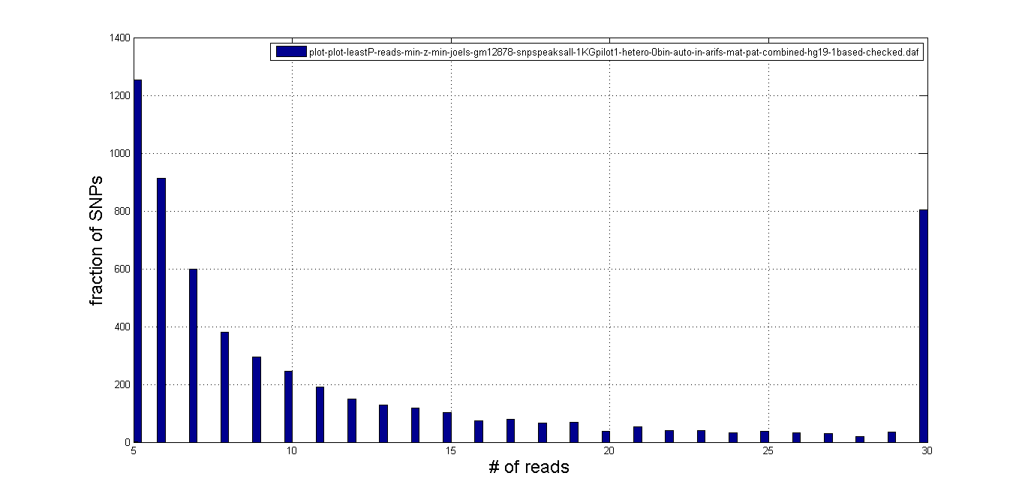
P-values in ASB
Issue: bias – larger allelic scores are associated with larger read depths, which also in turn correlate with more selection
‘Sliding window’ test, size 1000
Window 5, size 15 (depths 5-20)
Window 6 (depths 6-21)
Window 7
Window 8
Number of SNPs
Total number of SNPs in each window
Notes:
Larger read depths/peak signals assoc with higher selection

Slide 10
P-values in ASB
Low read depths – noisy High read depths – insufficient SNPs
So we want a window size, such that we minimize bias + have enough statistics.
Mu XJ, Harmanci A et. al. (under review)
In each window,
Count SNPs in 3 categories and calculate median:
LOW: DAF <0.05
MED: 0.05<DAF<0.5
HIGH: 0.5>DAF
Trend of medians in these 3 categories
Notes:
Minimize effects of bias and simultaneously have enough stats

Slide 11
P-values in ASB
Trend of median allelic scores for SNPs from low to high DAFs | Number of windows with this trend
Increasing trend | 462
Decreasing trend | 0
Other (Ambiguous trend or insufficient number of SNPs) | 3027
Total | 3489
Mu XJ, Harmanci A et. al. (under review)
Notes:
Even if the bias exists wil be an opposite trend, it odesnt seem to be affecting the results

Slide 12
ncVarII – ASB/ASE VS selection
ASB (only window 70) | Low DAF (<0.05) | Medium DAF (0.05-0.5) | High DAF (>0.5)
Allelic score (median±MAD) | 0.99947±0.00053 | 0.99973±0.00027 | 0.99982±0.00018
Number of SNPs | 143 | 782 | 398
ASE | Low DAF (<0.05) | Medium DAF (0.05-0.5) | High DAF (>0.5)
Allelic score (median±MAD) | 0.622±0.341 | 0.702±0.342 | 0.737±0.310
Number of SNPs | 56 | 393 | 177
DAF of SNPs increases, less selective constraint
Median of SNP allelic score increases, more AS effect
Main conclusion: Sites with allele-specific effects are under relaxed selective constraints.
Mu XJ, Harmanci A et. al. (under review)

Slide 13
23andMe
With Lynn and Jasmine
~ 1million SNPs per genome
Illumina OmniExpress customized microarray
Ancestry Traits Drug response Disease risks
Provides your raw data
Notes:
With raw data take your analysis beyond 23andMe analysis
Particular in ancestry

Slide 14
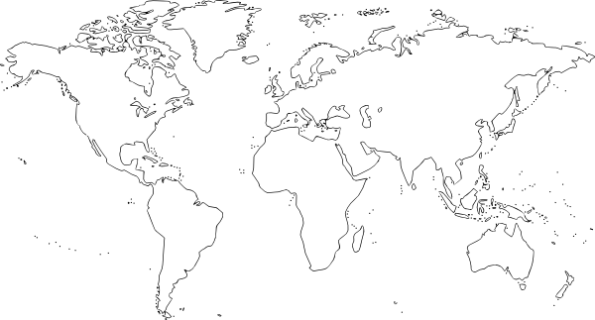
Beyond 23andMe – Ancestry
Population panels:
HAPMAP (Intl HapMap Consortium 2003)
HGDP (Li JZ et. al. 2008)
PASNP (HUGO PASNP Consortium 2009)
SGVP (Teo YY et. al. 2009)
Middle East
Inset: http://www.clker.com/clipart-9213.html

Slide 15
Beyond 23andMe – Ancestry
Chen J et. al. (2009)

Slide 16
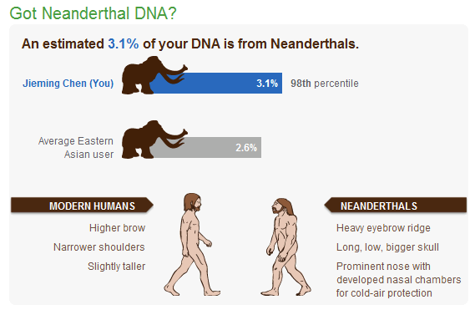
Ancestry Neanderthal

Slide 17
Beyond 23andMe – Ancestry
Projects/software from the public cyberspace
Dienekes Pontikos - EURO-DNA-CALC Dienekes Anthropology Blog http://dienekes.blogspot.com/2008/06/euro-dna-calc-11-released.html
Dodecad Project http://dodecad.blogspot.com
Eurogenes http://eurogenes.blogspot.com/
Tools used widely by the scientific community
EIGENSTRAT (Price et. al. 2006) http://genepath.med.harvard.edu/~reich/EIGENSTRAT.htm
STRUCTURE (Pritchard et. al. 2000) http://pritch.bsd.uchicago.edu/structure.html
ADMIXTURE (Alexander et. al. 2009) http://www.genetics.ucla.edu/software/admixture/

Slide 18
Additional Links
SNPedia http://snpedia.com/index.php/SNPedia
Promethease http://snpedia.com/index.php/Promethease
A comprehensive list of tools to probe 23andMe data. http://www.23andyou.com/3rdparty
23andMe blog http://spittoon.23andme.com/
SNP-tip – Firefox browser Add-on http://www.wired.com/wiredscience/2011/01/new-firefox-plugin-for-23andme-customers/

Slide 19
Currently
With Ekta and Yao
NetSNPs – signaling pathways

Slide 20
Regan Lab
PPI: contact surface area VS binding energy relationship
3TPR consensus
Methanogen Methanoregula Boonei

Slide 21
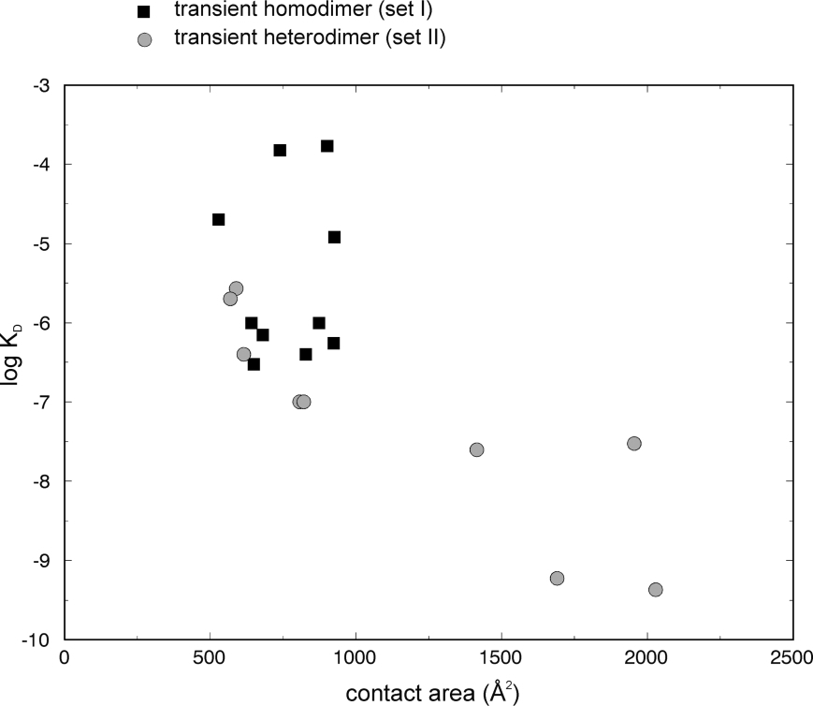
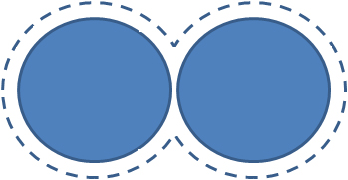
PPI: Protein-protein interactions
Nooren & Thornton, J. Mol. Biol. (2003).

Slide 22
Data sources
Structures → PDB → PISA, 3Dcomplex.org, ProtCID → hetero-/homodimers, BU vs ASU
Contact surface area → NACCESS
Kd values → PDBbind + manual curation
Notes:
Classification and annotation of dimers in PISA, 3Dcomplex.org to complement PDB; ProtCID tries to use homology and conservation guess interface possibility – can be used to infer BU and ASU

Slide 23
Structures: PDB
PDB, 5th July 2011
filter | # | %
total # structures | 74297
keyword 'complex' | 28698 | 38.6
Proteins only (without DNA or RNA) | 25237 | 34.0
>2 protein entities | 7822 | 10.5
Non-homologs (<100% sequence identity) | 2665 | 3.6
X-ray <3A and NMR only | 2427 | 3.3
2 chains only | 1112 | 1.5
Kd values (PDBbind) | 263 | 0.35
Manual Curation | ? | ?
Notes:
Classification and annotation of dimers in PISA, 3Dcomplex.org to complement PDB; ProtCID tries to use homology and conservation guess interface possibility – can be used to infer BU and ASU

Slide 24
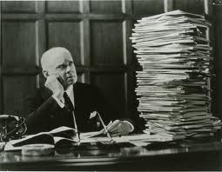
Manual Curation
Other ligand at interface?
Kd corresponds to structure?
Dimerization function and localization
Peptide?
Terminal or internal peptide?
Mutagenesis results with Kd?
Or with related structures and Kd?
Fragments/proteins mutated? E.g. engineered proteins
Any modified residues? E.g. pY
Hetero-/homodimer?
Method in Kd determination
% standard variation in Kd
Biological unit? E.g. dimer or oligomer.
Interface area
Domains, e.g. SH3, SH2, TPR…

Slide 25
Preliminary results
underrepresentation of larger proteins
all are heterodimers
prominent domains involved → how do they help in the PPI? → hotspots?
most are fragments of the entire proteins → comparability of affinity of the peptides and actual full-sized proteins
Notes:
1E96
1180 CSA
-12.8
Done 90 structures

Slide 26
PPI: Protein-protein interactions

Slide 27
Complementing the data
More homodimers, larger proteins (Jones and Thornton, 1996; LoConte et al., 1999)
Biological Assembly (BA) vs ASymmetric Unit (ASU)
PISA (Krissinel & Henrick 2006)
3Dcomplex.org (Levy, Teichmann et. al. 2006)
ProtCID (Xu & Dunbrack 2011)
Notes:
Classification and annotation of dimers in PISA, 3Dcomplex.org to complement PDB; ProtCID tries to use homology and conservation guess interface possibility – can be used to infer BU and ASU

Slide 28
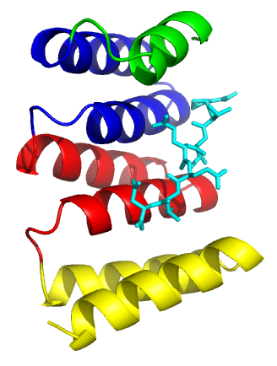
3TPR consensus to inform protein design
With Nicholas Sawyer (Regan Lab)
TPR = tetratricopeptide repeat protein
Each TPR repeat is 34 amino acid
Mediates a wide range of protein-protein interactions
Highly modular, useful in protein design
1ELW (TPR1), Hsp70 + PTIEEVD

Slide 29
Contact Map of TPR1
Threshold: 5 Angstroms
Main et. al. (2003)
Notes:
Green lines = start of helices
Red lines = end of helices

Slide 30
1TPR
Who | When | Data | Sequence
Sikorski et. al. | 1990 | 47 TPR sequences from 5 proteins across 2 different species of yeast | W4, L7, G8, Y11, A20, F24, A27, P32
Andrea & Regan | 2003 | 3418 TPR sequences on more than 107 proteins; Pfam database | W4, G8, Y11,G15, Y17,A20, Y24, A27, P32
using a ratio between percentage of occurrence of an amino acid i, for a position j, against all other positions in the sequence; termed “global propensity”

Slide 31
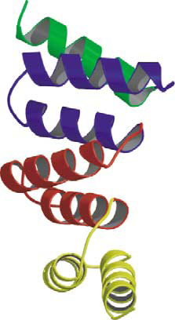
1TPR
Main et. al. (2003)
CTPR1, CTPR2, CTPR3
CTPR390
Tmod
Hydrogels, antibody replacements, fluorescent assays…
Notes:
based on consensus sequence constructed from seven 3TPR proteins

Slide 32
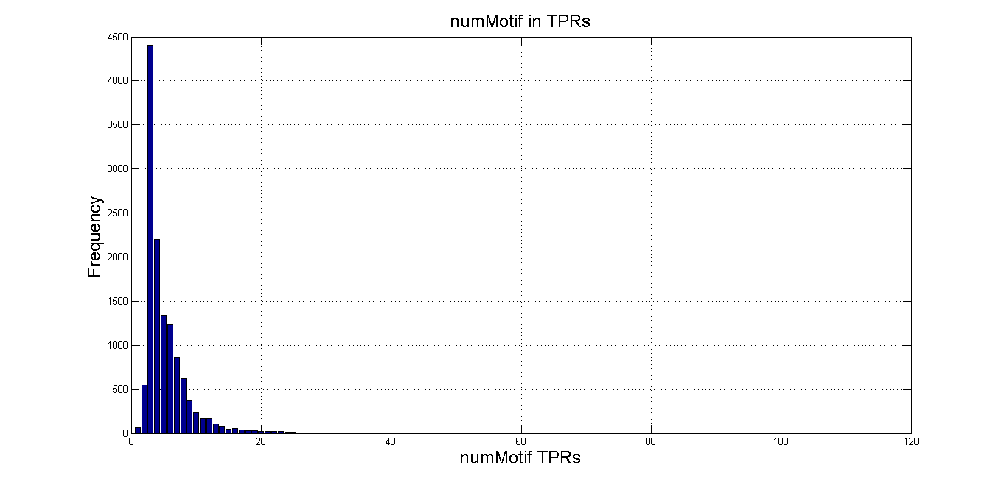
3TPR consensus
Why 3?
Data source: SMART database (Schultz et. al. 1998)
Structural signature?
Functional signature?
Notes:
Smart 7 database distribution; 34aa post-filter, removed by TPR

Slide 33
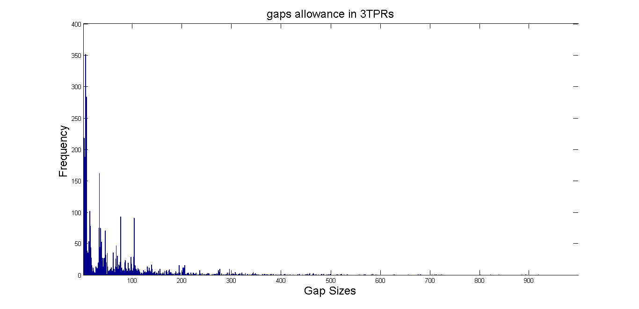
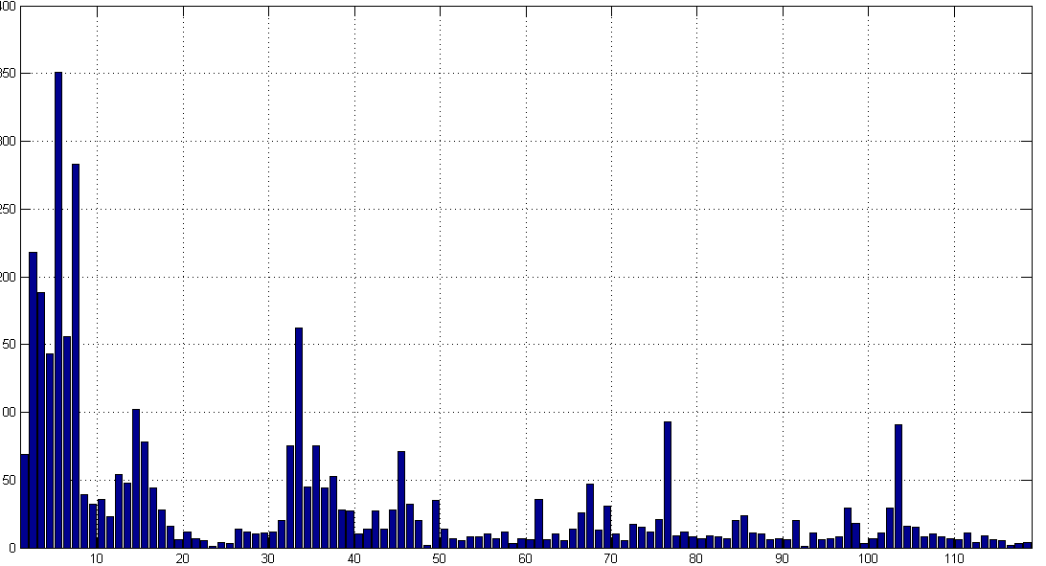
3TPR consensus
34aa
Gap issue
Use of global propensity
TPR1
TPR2
TPR3
TPR1
TPR2
TPR3
TPR1
TPR2
TPR3

Slide 34
3TPR consensus
1TPR-new vs 1TPR-old
3TPR vs 1TPR → redefinition of structural signature of 3TPR specifically? → functional signature?

Slide 35
3TPR consensus Functional signature
Functional signature → based on Magliery et. al. hypervariable sites → positions 2,5,9,12,13,33,34 on each repeat

Slide 36
3TPR consensus Functional signature
Hypothesis is that each class of TPRs correspond to a subset of the “functional residue space”.
Can be detected when the site differs from consensus
1,2,4 – bind X
3,4,5 – bind Y…
Example: Dicarboxylate clamp residues in TPRs that bind to Hsp90 (MEEVD) and Hsp70 (PTIEEVD)
5KTPR1, 9NTPR1, 6NTPR2, 2KTPR3
1
2
3
4
5
Notes:
Its wide range of functions results from the ability of HSP90 to chaperone several client proteins that play a central pathogenic role in human diseases including cancer, neurodegenerative diseases and viral infection.
Proteosome analysis revealed that Hsp90 is differentially expressed between ewing’s sarcoma cell lines, sensitive and resistant to specific IGF1R/KIT inhibitors.

Slide 37
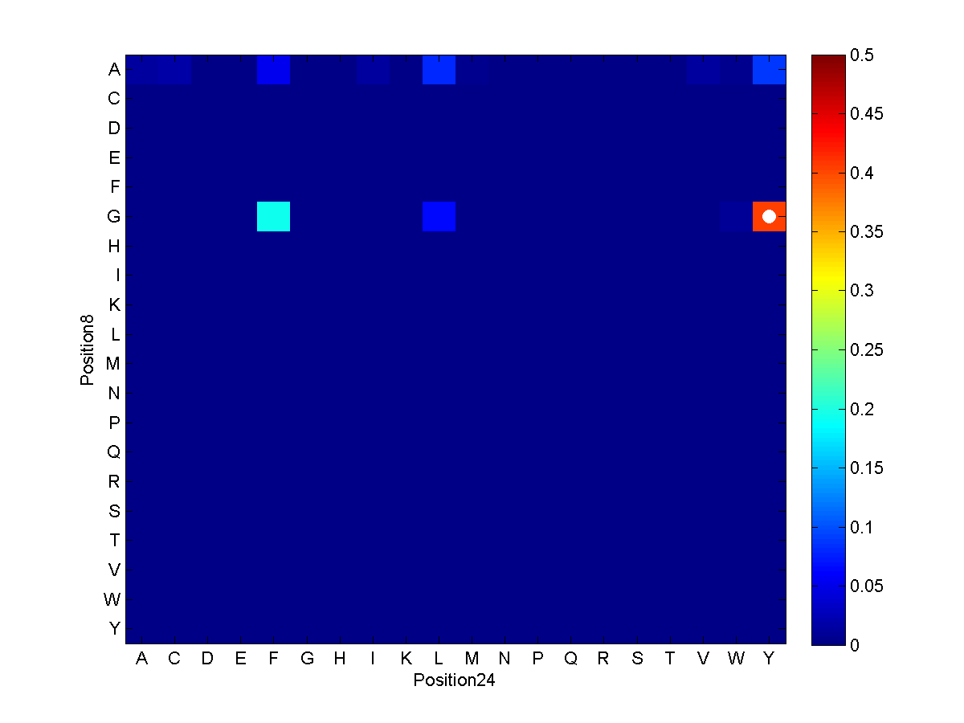
3TPR Covariation
Covarying residues
→helical packing
- inter-helical interactions
- inter-/intra-repeat interactions
“Engineering maps” – informs when there is a need for alternative pairing (from consensus)
Courtesy of Nicholas Sawyer

Slide 39
Methanogen: Candidatus Methanoregula Boonei
With Robert Collin (Regan Lab)
First TPR position starts at 6, gap at 1604-1637 (34aa) and then ends at 4051 (protein ends at 4079 – 28aa tail)
118 34aa TPR, mostly in tandem.

Slide 40
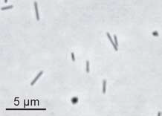
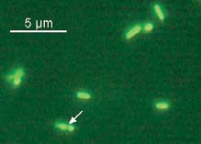
Methanogen: Candidatus Methanoregula Boonei
Archaea > Euryarchaeota > Methanmicrobia > .. > Methanoregula
Complete genome sequenced by DOE, available on UCSC
Obligate anaerobe, strain 6A8, acidiphilic (pH~5), H₂/CO₂-using in methanogenesis, dimorphic (mainly rod, ~0.3-by-3 um; coccoid, 0.3-0.8um diameter)
Slow-growing: doubling time = 2 days
Braeuer SL et. al. (2006) Nature.
Notes:
http://archaea.ucsc.edu/cgi-bin/hgGateway?db=methBoon1

Slide 41
Methanogen: Candidatus Methanoregula Boonei
pPROEX HTa plasmid
Still at stage of PCR: single PCRs gave no products
To do: Double PCR

Slide 42
Acknowledgements
Gerstein Lab
Jasmine (XJM)
Arif (AH)
Joel (JR)
Robert (Bjornson)
Ekta (EK)
Yao (YF)
Lynn (Williams)
Mark (MG)
Regan Lab
Nicholas (Sawyer)
Robert (Collin)
Lynne (Regan)

Slide 43
Thank you!

