Slide 1
Mapping reads to deletion junctions
Alexej Abyzov
February 8

Slide 2
Selection criteria
Mapped reads from at least 2 individuals
At least one individual has 2 mapped reads
Changing Min D = min(d1,d2)
d1 d2

Slide 3
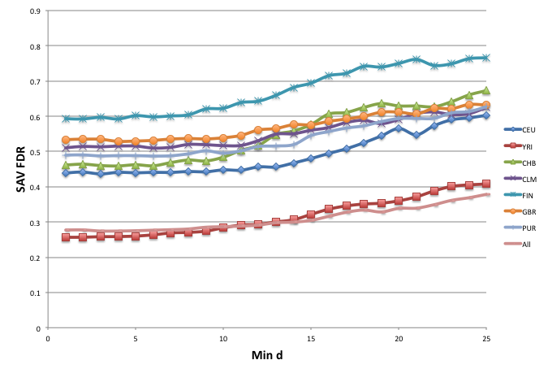
Increasing stringency

Slide 4
41 CNVs for additional analysis
Using read mapping from CEU, YRI, CHB
Min D = 25
Length > 10 kb
SAV p-value > 0.5 (used for FDR calculation)

Slide 5
“difficult” loci
IGH
HLA
chr14:106217114-106244208
chr14:106712931-107011412
chr14:106791703-106816435
chr14:106798247-106822961
chr6:29067775-29140500
chr6:32514280-32540578

Slide 6
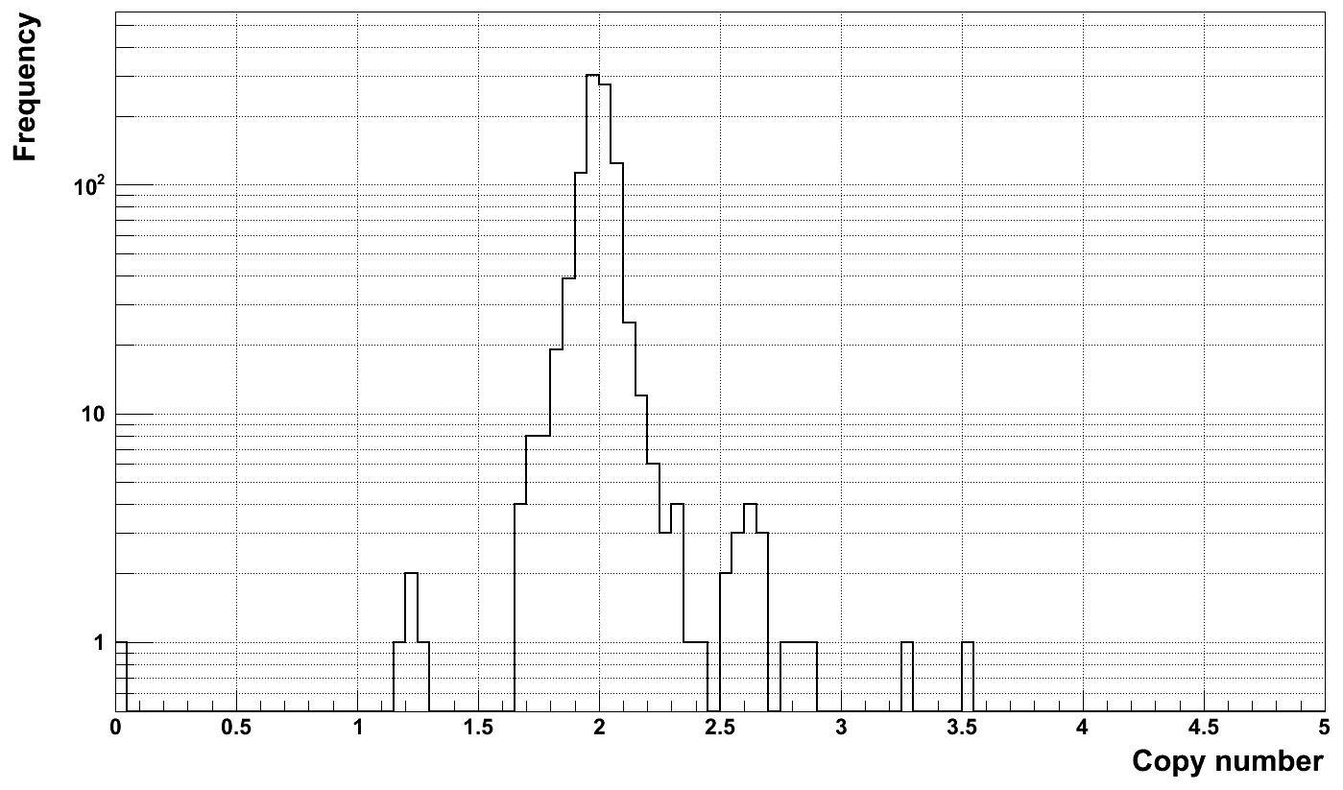
Multi-allelic locus, chr7:76144769-76648120

Slide 7
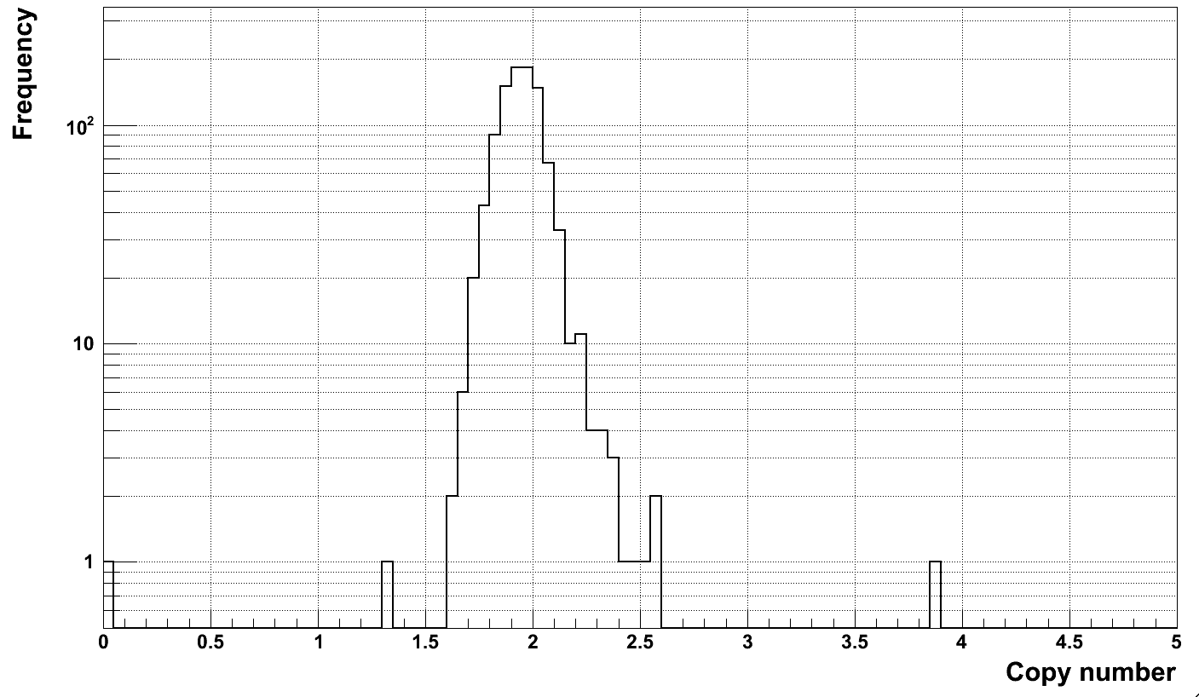
Multi-allelic locus, chr7:129157177-129204216

Slide 8
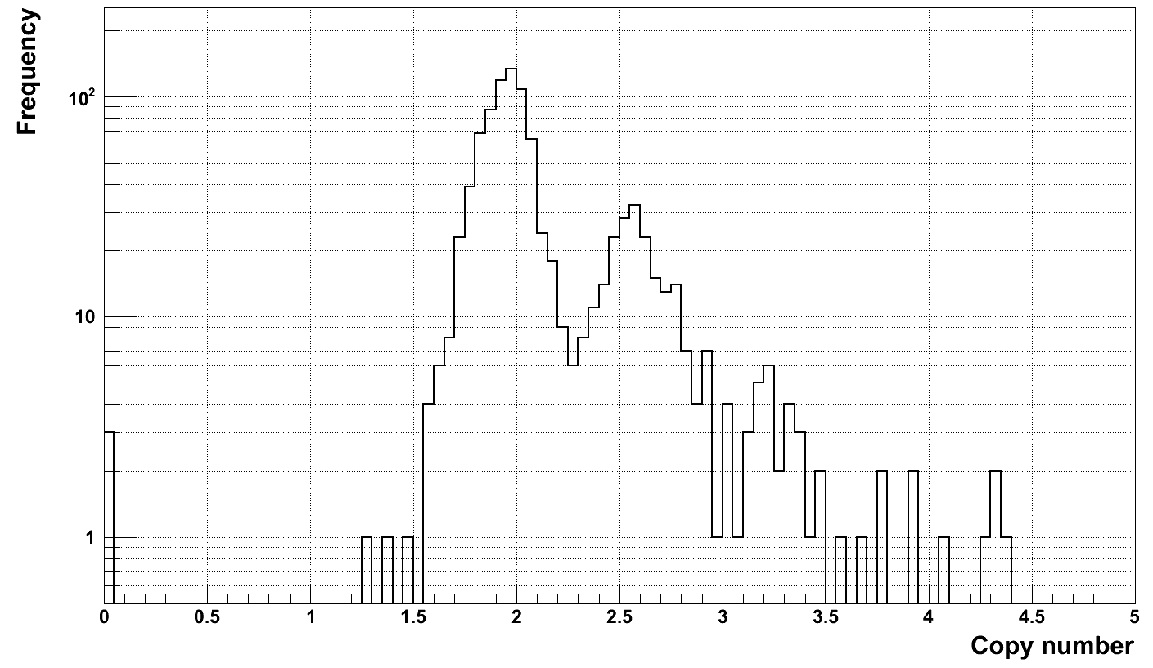
Multi-allelic locus, chr22:42912847-42974711

Slide 9
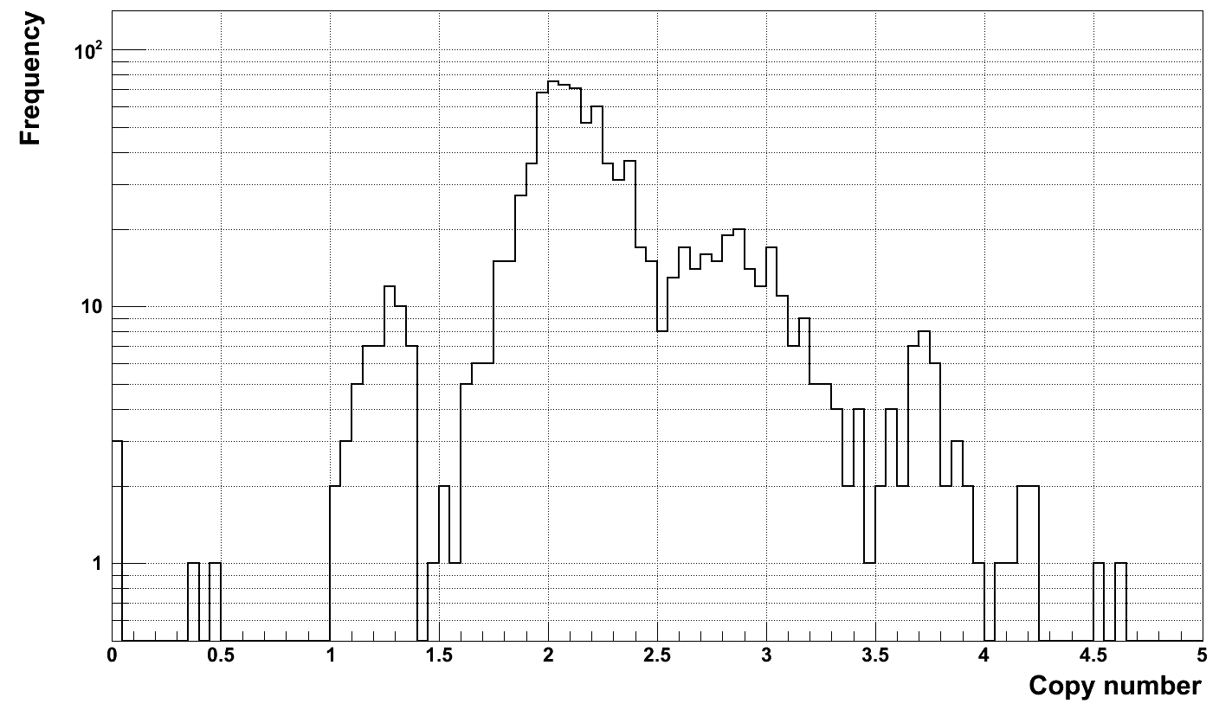
Multi-allelic locus, chr22:42519215-42531374

Slide 10
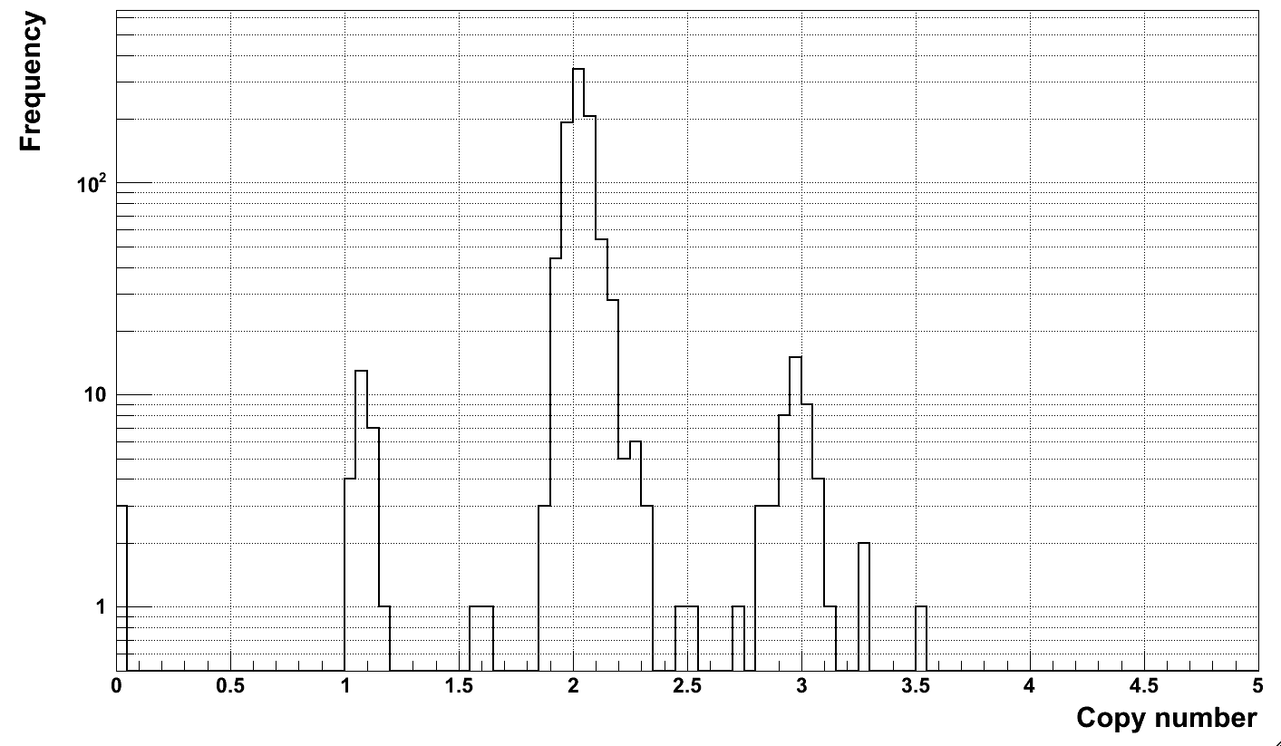
Multi-allelic locus, chr22:25667082-25923197

Slide 11
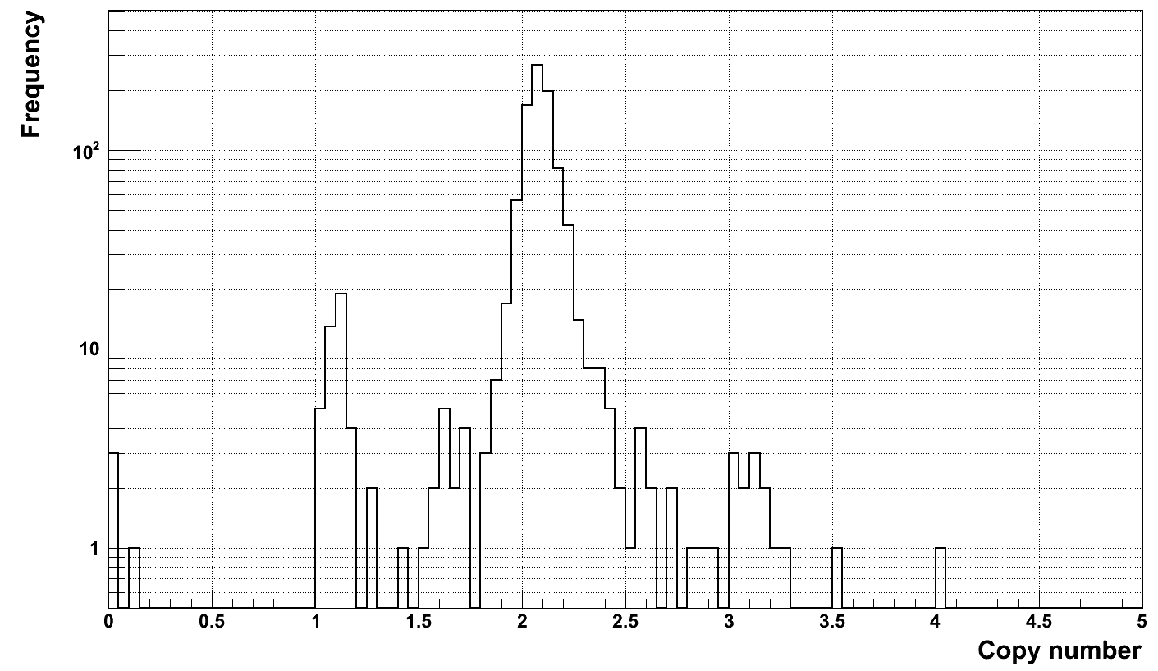
Multi-allelic locus, chr19:43453291-43544159

Slide 12
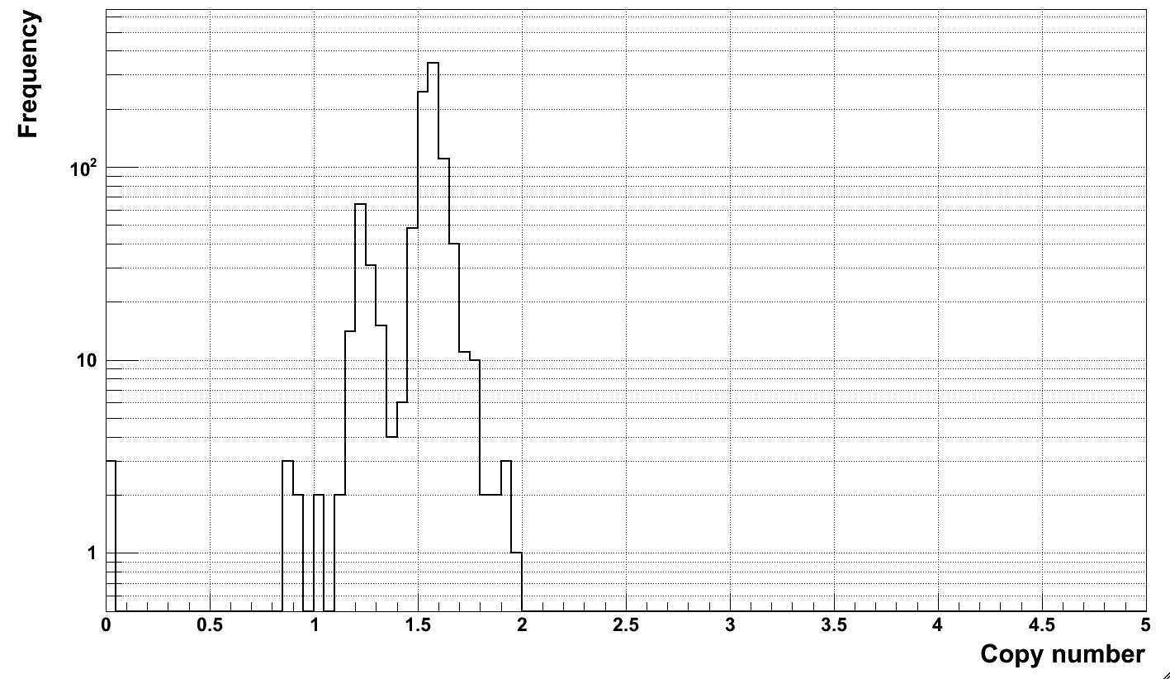
Multi-allelic locus?chr19:20447616-20802363

Slide 13
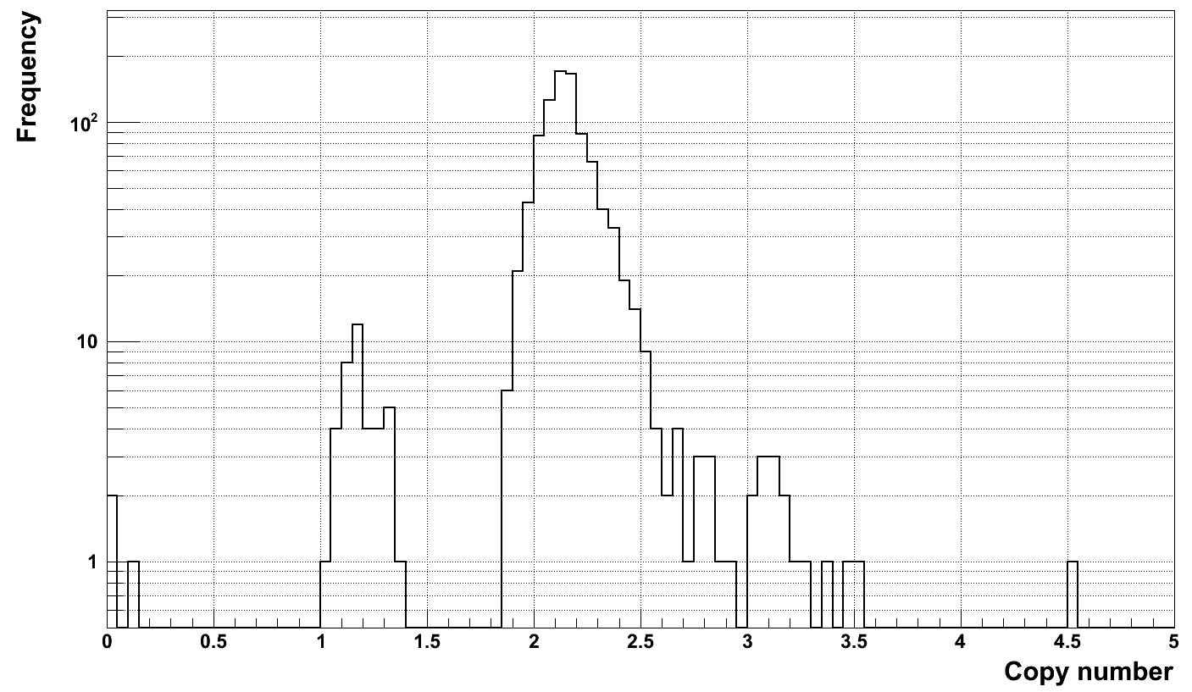
Multi-allelic locus, chr14:21371110-21399280

Slide 14
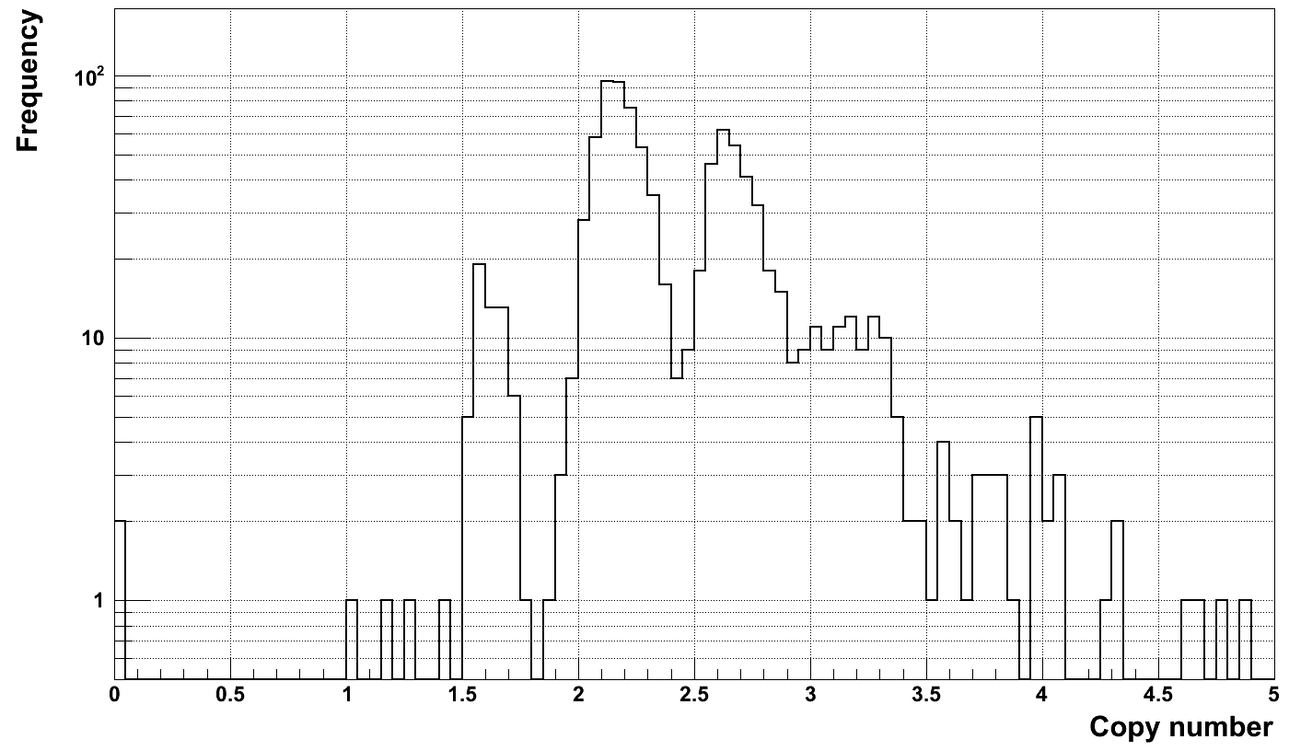
Multi-allelic locus, chr11:18941996-18986417

Slide 15
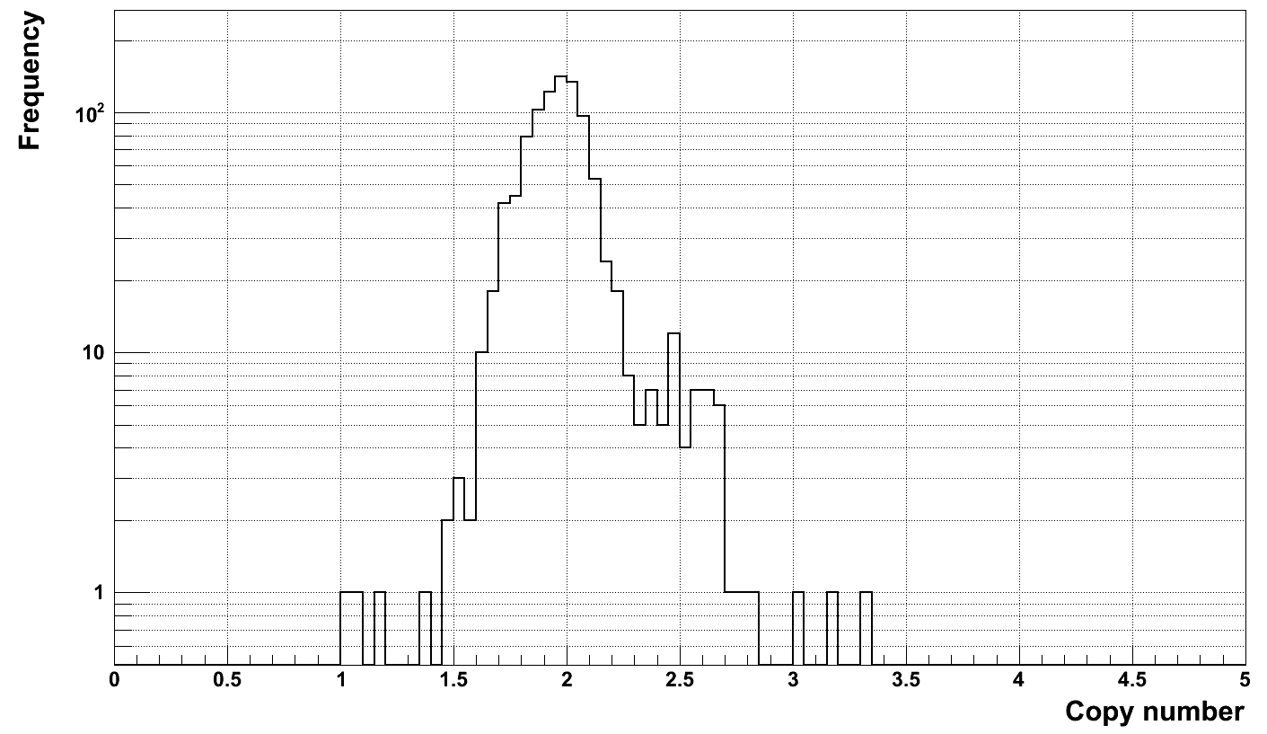
Multi-allelic locus, chr1:16356745-16378499

Slide 16
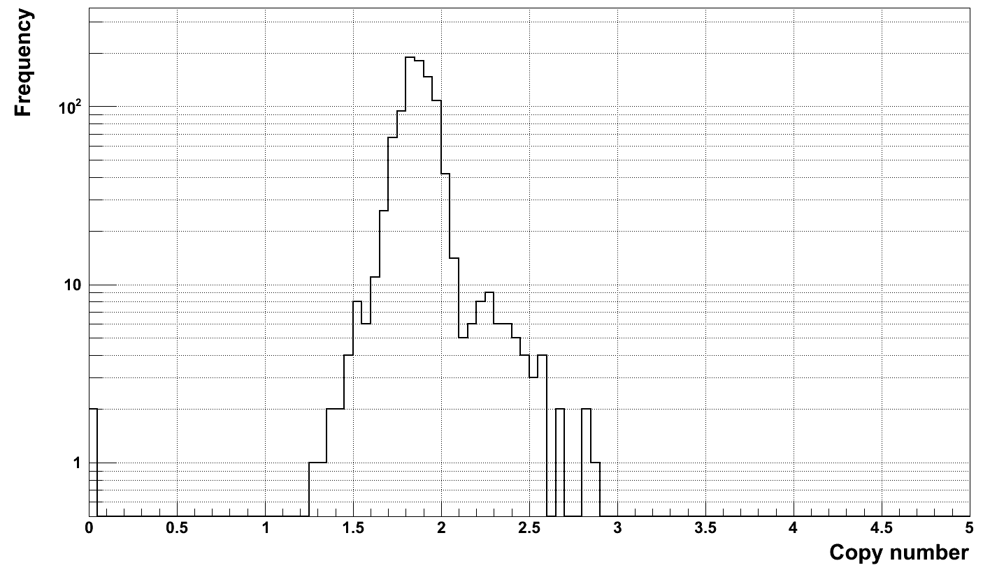
Multi-allelic locus, chr12:7942706-8045976

Slide 17
Summary
6 are in “difficult” loci
At least 11 are multi-allelic
Probably >41% (=17/41) of SAV FDR can be explained/filtered
Another explanation – proximal duplication

Slide 18
Mapping to putative junction of tandem duplication
11 CNV have support (compared to 9000-15000 for deletions)
May this is not working

