Slide 1
Highly confident ortholog gene triplets among worm, fly and human
Daifeng Wang, Roger Alexander, Gang Fang
Gerstein lab
Feb 7 2012

Slide 2
Inparanoid
Kellis
Worm-Fly
3519 pairs
Fly-Human
3437 pairs
Worm-Fly
3192 pairs
Fly-Human
3237 pairs
1962
triplets
1952
triplets
Worm-Human
2686 pairs
Worm-Human
2624 pairs
1952
triplets
1021 triplets
(52%)
1962
triplets
* one-to-one pairs only

Slide 3
Cluster genes from triplets
Weighted correlation network analysis or Weighted Gene Co-expression Network Analysis (WGCNA)
R package, http://www.genetics.ucla.edu/labs/horvath/CoexpressionNetwork/
Cluster genes into steady, robust modules
Functional organization of the transcriptome in human brain, Nature Neurosci. 2008 November; 11(11): 1271–1282
Compare gene co-expression modules across six brain regions using WGCNA

Slide 4
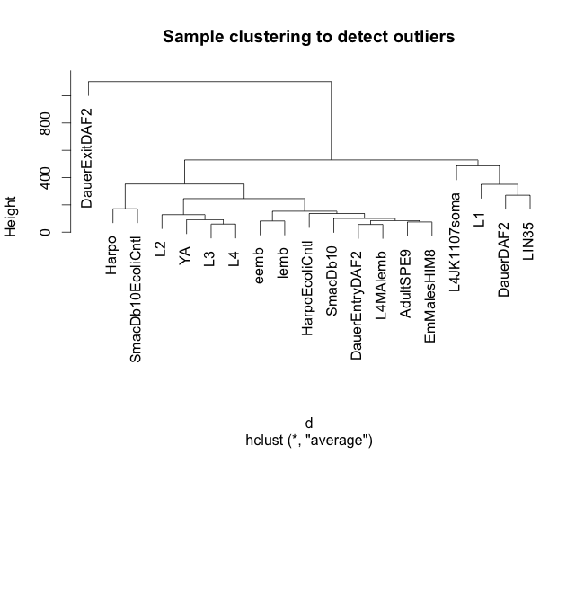
Cluster worm ortholog genes from overlapped triplets using WGCNA
data from Integrative Analysis of the Caenorhabditis elegans Genome by the modENCODE Project, 2010
remove DauerExitDAF2
power = 16
min. module size = 50
height cutoff = 0.99

Slide 5
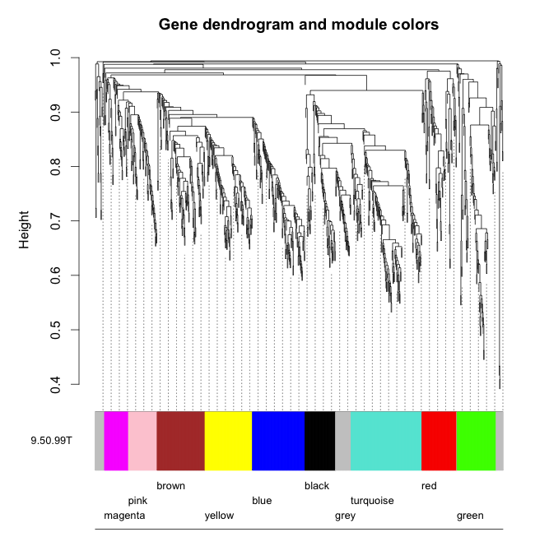
Cluster fly ortholog genes from overlapped triplets using WGCNA
data from The developmental transcriptome of Drosophila melanogaster, 2010
power = 16
min. module size = 50
height cutoff = 0.99

