Slide 1
Cell Cycle Prediction
YF, CC

Slide 2
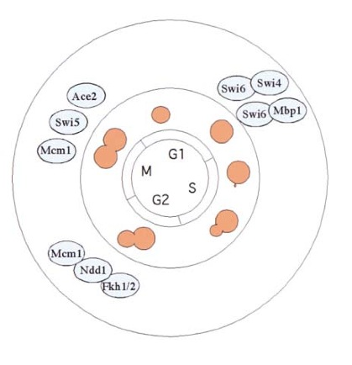
Yeast Cell Cycle

Slide 3
Aim: Predict cell cycle regulated genes based on TF and motif data.
203 TF binding & 666 motif scores around TSS (-1000 kb to + 1000 kb)
Ridge Regression
Training : 599 (positive) Vs. 454 (negative); 10 fold validation
AUC:0.82
-- CC

Slide 4
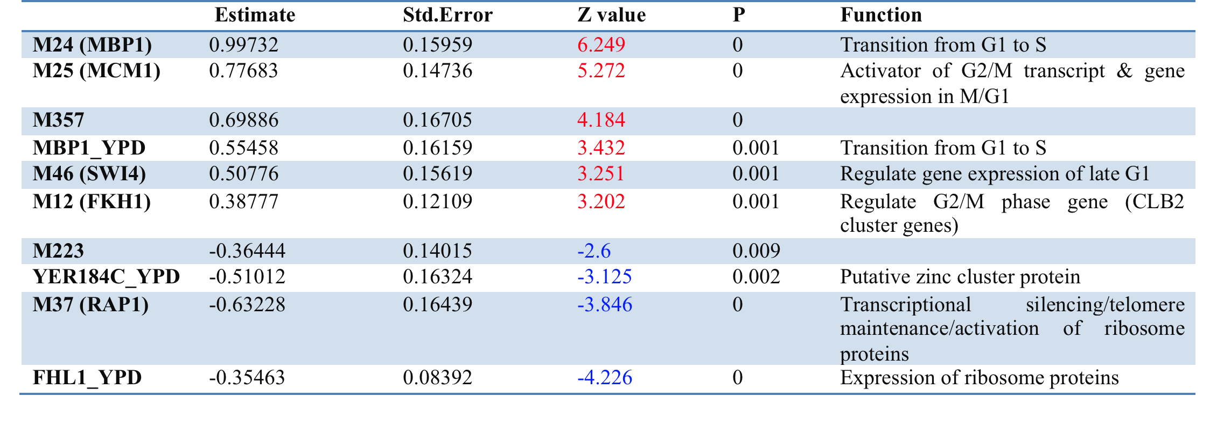
Prediction Function

Slide 5
Prediction Result
5168 genes, 211 genes above the threshold of 0.8, corresponding to 37.7% sensitivity and 5.5% false positive rate, were classified as cell cycle regulated genes.
24 out of 211 has been verified as cell cycle regulated genes in at least one experiments in Cyclebase.org.
The expression level of the other 187 genes is lower than that of validated cell cycle regulated genes (p value 0.04948, Wilcoxon rank sum test)
DAVID: top GOs: cell walls, DNA condensing, cell cycle.
SGD: 51 has unknown function and others are involved in several different biological processes such as lipid metabolic process, response to chemical stimulus, mitotic cell cycle, cytoskeleton organization.

Slide 6
Cell cycle phase specific prediction
Data: Cyclebase
G1 (219)
S(157)
G2 (101)
M (99)

Slide 7
Cell cycle phase specific prediction
Training: phase specific genes Vs. other phase specific genes
G1: 0.825
S: 0.811
G2: 0.788
M: 0.859

Slide 8
TF or Motif | Function | G1 | S | G2 | M
SWI5 | M/G1, G1 | + |  | -
ACE2 | M/G1 |  | -
MBP1 | Late G1 | + |  | -
M24 | MBP1, late G1 | + |  | - | -
M46 | SWI4, late G1 |  | + | - | -
NDD1 | G2/M | - |  | +
FKH2 | G2/M | - |  | +
M12 | FKH11, G2/M |  | + |  | -
M25 | MCM1, G2/M, M/G1 |  | - |  | +
DOT6 | Telomeric gene silencing and filamentation | -

Slide 9
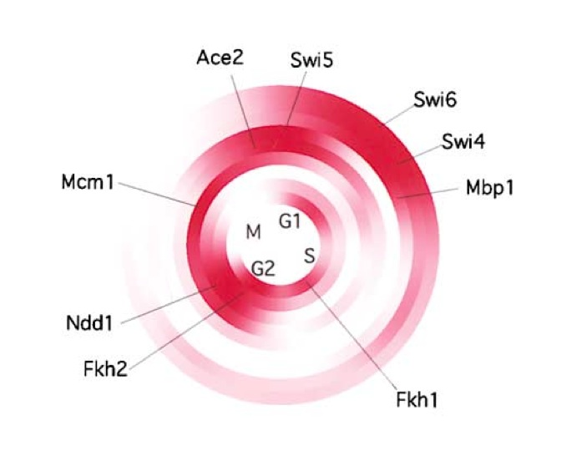
G1
S
G2
M
Serial Regulation of Transcriptional Regulators in the Yeast Cell Cycle

Slide 10
Phase prediction
Cut-off 0.5;
G1: 53
S:14
G2:9
M:12
123

Slide 11
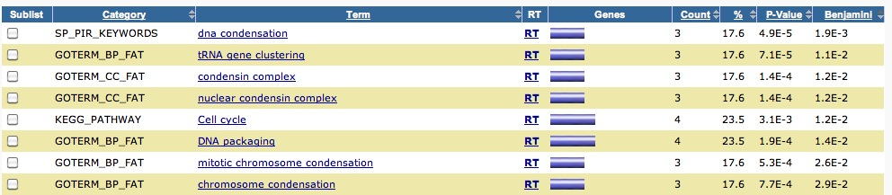
GO enrichment
S phase genes (14)
G2 phase genes (9)
M phase genes (12)
G1 phase genes (53)

Slide 12
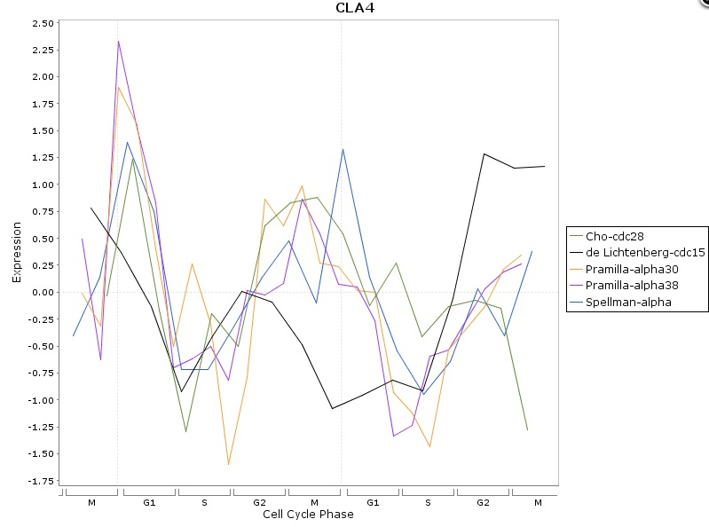
Gene Function
M phase gene.
CLA4 , prediction score 0.898.
Function : Serine/threonine protein kinase required for cytokinesis
Promoter region of binding (from other source): Mcm1; SWI4, SWI6(p < 0.001)

Slide 13
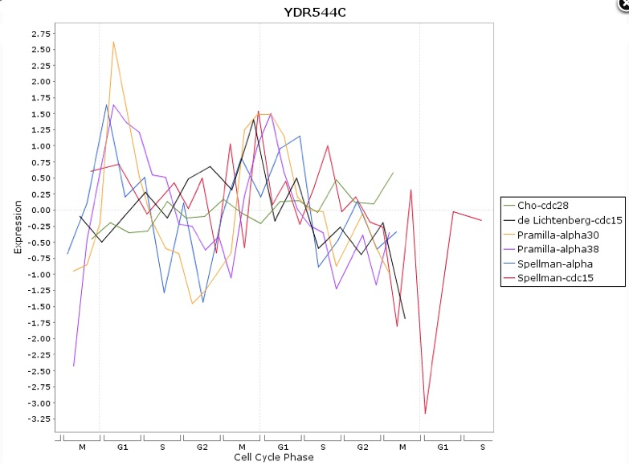
Gene Function
G1 phase gene.
YDR544C , prediction score 0.99.
Function :Protein of unknown function
Promoter region of binding (from other source): SWI5, SWI4 (p < 0.001)

Slide 14
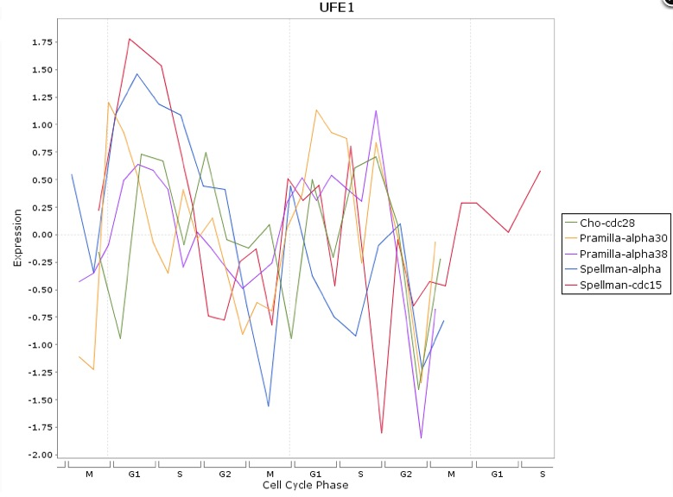
Gene Function
G1 phase gene.
UFE1 , prediction score 0.945.
Function :Syntaxin homolog (t-SNARE) of the endoplasmic reticulum
required for targeting of vesicles to the ER
Promoter region of binding (from other source): MBP1(p < 0.001)

Slide 15
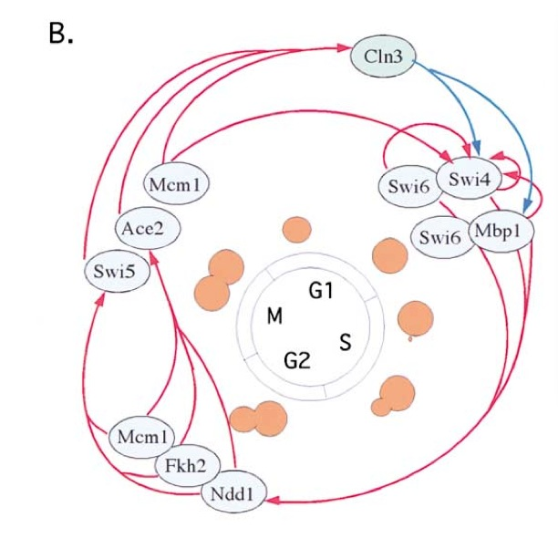
Serial Regulation of Cell Cycle
Serial Regulation of Transcriptional Regulators in the Yeast Cell Cycle

Slide 16
FKH2
SWI6
MBP1
SWI5
SWI4
MCM1 (not periodical)
NDD1
FKH1
CLB2
CLN3
ACE2
G1
S
G2
M
SWI5
MBP1
SWI4
FKH1
FKH2
NDD1
MCM1
YHP1
YOX1

Slide 18
Strategy 2:
Training: phase specific genes Vs. others (non-cell cycle regulated genes & other phase specific genes)
G1: 0.866
S: 0.848
G2: 0.749
M: 0.829

Slide 19
TF or Motif | Function | G1 | S | G2 | M
SWI5 | M/G1, G1 | +
ACE2 | M/G1 |  | -
MBP1 | Late G1 | +
M24 | MBP1, late G1 | + |  | - | -
M46 | SWI4, late G1 |  | + |  | -
NDD1 | G2/M | - |  | +
FKH2 | G2/M | - |  | +
M12 | FKH1, G2/M |  | + | +
M25 | MCM1, G2/M, M/G1 |  | - |  | +
DOT6 |  | -
YPR196W |  |  | -
RAP1 |  |  | -
M34 | PAC |  | -
FKH1 | G2/M |  | +
FHL1 | Ribosome Protein regulation | -

