Slide 1
Scalable web applications and cloud computing
David Z. Chen
January 24, 2012

Slide 2
Overview
Developing web applications
Amazon Web Services
Cloud computing

Slide 3
Web Development
Web application – application accessed over the Internet using a web browser
Think: application
Web service – application programming interfaces (API) accessed over the Internet
Think: software library

Slide 4
Static Web Page
2. Apache retrieves requested page
1. Browser makes HTTP request to server
Linux server
Apache
Index.html
3. Apache replies with requested page
4. Browser refreshes with requested page

Slide 5
Dynamic Web Application
2. Apache invokes server-side executable or interpreter to run script
1. Browser makes HTTP request to server
Linux server
Apache
PHP
Index.php
3. Apache replies with HTML generated by server-side code
4. Browser refreshes with requested page

Slide 6
Dynamic Web Application
We want web applications to be interactive
Don’t want to be doing page refreshes all the time
We want to update parts of the page but still be able to use other parts of the page

Slide 7
Asynchronous JavaScript and XML (AJAX)
Use JavaScript, a scripting language that runs in the browser, to make asynchronous HTTP requests to the web server
Update page with new data from server
$.get(params)
RESTful API on Server
results

Slide 8
Representational State Transfer (REST)
Web applications can be very complex
Offload work to other servers for scalability
Task-specific
Storage/database
Mobile or desktop clients
Solution: web services accessed by remote procedure calls
How to do the procedure calls: HTTP requests

Slide 9
Representational State Transfer (REST)
Actions performed by making HTTP requests using various HTTP methods
GET: List objects/retrieve objects
POST: Create object
PUT: Modify/replace object
DELETE: Delete object
Used to interact with web services like AWS
Often abstracted by libraries

Slide 10
Languages and Frameworks
Server-side logic
Client-side presentation (UI)
PHP
Zend Framework
Kohana
CodeIgniter
Ruby
Ruby on Rails
Python
Pylons
Pyramid
Java EE
ASP .NET
Roll your own
JavaScript
jQuery
MooTools
Prototype
CSS
Twitter Bootstrap

Slide 11
Overview
Developing web applications
Amazon Web Services
Cloud computing

Slide 12
Amazon Web Services
Collection of services for building cloud and distributed computing applications
Provides infrastructure
AWS libraries available in many programming languages

Slide 13
Elastic Compute Cloud (EC2)
Provide private servers in form of virtual machines (instances)
Install your own libraries and applications
Root access to your instances
Storage:
Elastic Block Storage (usually mounted as disk
Simple Storage Service

Slide 14
Simple Storage Service (S3)
Online persistent storage
Store arbitrary objects (files) up to 5 TB in size, each with up to 3 KB of metadata
Organize objects into buckets
“Folders” within buckets
Access through RESTful interface

Slide 15
Other services
Elastic Load Balancing
Auto-Scaling
Elastic MapReduce

Slide 16
Overview
Developing web applications
Amazon Web Services
Cloud computing

Slide 17
Cloud Computing
Software as a service
Provided without end-user knowledge of where service is hosted physically
Using web and networking technologies to provide scalable, robust, ubiquitous applications

Slide 18
Examples
Facebook, Google+
Photo hosting
Messaging (very broad term)
Picasa, Flickr
Photo hosting
Twitter
Messaging

Slide 19
Variant Annotation Tool
Web server/EC2 Instance
Local disk
CLI VAT Executables
I/O layer
S3 support disabled
VAT web application
Input data bucket
Output data bucket
S3 support enabled
Public HTML
Public API

Slide 20
VAT: Master/slave architecture
Input data buckets
Output data buckets
Worker 1
Worker 2
…
Worker n
Master
User

Slide 21
MapReduce
Originally developed by Google
Inspired by map and reduce from functional programming
Hadoop – Open source Java implementation
Amazon provides Elastic MapReduce to easily run Hadoop MapReduce applications
Can also run Hadoop on EC2 instances

Slide 22
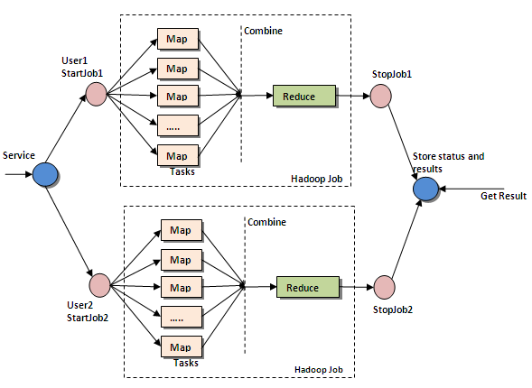
MapReduce

Slide 23
Thanks
Prof. Mark Gerstein
Alexej Abyzov
Lukas, Suganthi
Gerstein Lab

